Slide 1

Avent – 2026
Agenda
1.Welcome and thanks
2. Avent
3. Soothers
4. Natural bottles
5. Anti Colic bottles
6. Breast milk storage
7. Breast pumps
8. Questions

Slide 2




Avent
Avent Product Training
2026

Slide 3
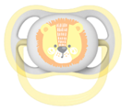

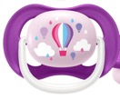


Soother
Range.
Easy to find in
the dark.
Ultra Air
Ultra Air Collection
Ultra Air Night-time
For baby’s skin to breathe.
Bright & colourful designs.
A light, breathable soother for (baby’s) dry skin.
A light, breathable soother for (baby’s) dry skin.
A light, breathable soother with glow in the dark handle for night-time.

Slide 4

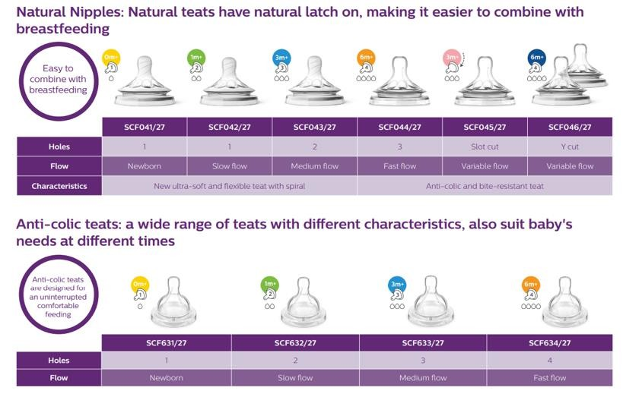

Slide 5


Our Natural Range
has the following benefits.
Breastfeeding
friendly.
Natural latch on
Wide teat range
Advanced Anti-colic valve
Ergonomic shape
Mix and match
Simple to use and clean
BPA free

Slide 6
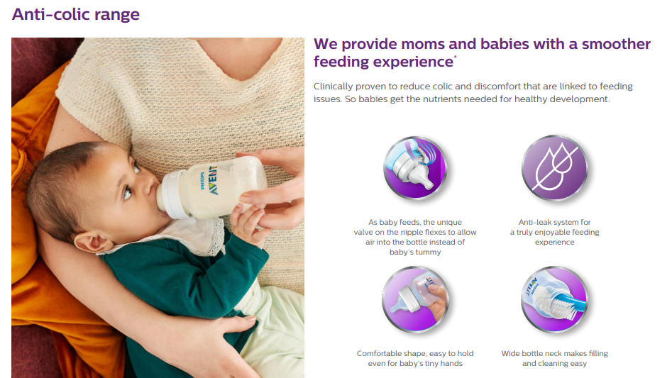
Anti-colic Range.
We provide moms and babies with a smoother feeding experience.
Clinically proven to reduce colic and discomfort that are linked to feeding issues, so babies get the nutrients needed for healthy development.
As baby feeds, the unique valve on the nipple flexes to allow air into the bottle instead of baby’s tummy.
Comfortable shape, easy to hold even for baby’s tiny hands.
Anti-leak system for a truly enjoyable feeding experience.
Wide bottle neck makes filling and cleaning easy.

Slide 7

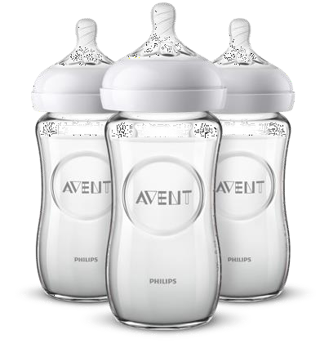


Natural Glass Bottles
are made of pharmaceutical grade glass.
Premium quality borosilicate glass.
Heat and thermal shock resistant.
They can be safely stored in the fridge, warmed, and are suitable for sterilisation.
© Koninklijke Philips N.V.

Slide 8

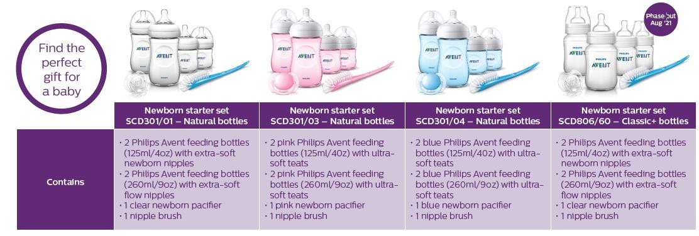

Slide 9
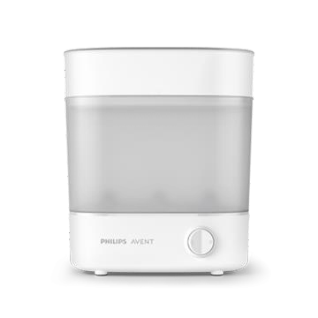
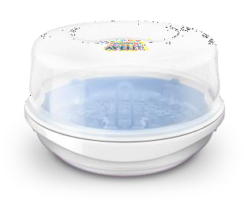
Steam
Sterilisers.
 | Microwave Steam Steriliser (SCF281/03) | Advanced Bottle Steriliser (SCF291/00 SCF291/01)
Adjustable Size | - | ✔️
Compact | ✔️ | ✔️
Automatically Turns Off | - | ✔️
Sterilising Cycle Time | Sterilises in 2 minutes. | Sterilises in 10 minutes.
Capacity | 4 Philips Avent Bottles. | 6 Philips Avent Bottles.
© Koninklijke Philips N.V.

Slide 10

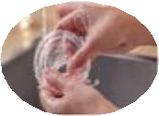
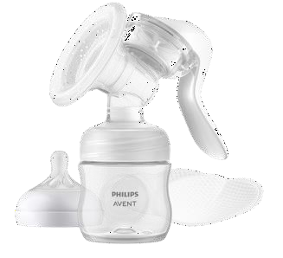
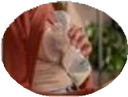





Express & Feed.
Easy to Clean & Set Up.
To feed using your expressed milk, simply attach the soft nipple to the bottle container. To store your milk for feeding later, close the bottle using the sealing disc.
Because there are only a few parts, our new pump is easy to set up and clean.
Natural Motion Technology.
Portable & Easy to Use.
The innovative silicone flange - inspired by baby’s unique suckling action - stimulates the nipple to help start your milk flow, fast. For comfortable and effective expression.
The breast pump is small and lightweight, which means it is easy to store and transport, making pumping on-the-go simple and discreet.
Sit Comfortably.
Suction & Flow Control.
Relax and sit comfortably while you express - thanks to our design that lets you sit upright, rather than having to lean forward.
Feel free to adjust the pumping rhythm and suction to suit your needs, comfort and milk flow.
Manual
Breast Pump.
Adapts to Your Nipples.
Fast Milk Release.
One size fits all. Because we all come in different shapes and sizes, the silicone cushion gently flexes and adapts to fit your unique anatomy. Fits 99.98% of all nipple sizes* (up to 30mm)
A unique, portable manual breast pump – ideal For mothers who need to gently release their milk while away from home, or before breastfeeding..
© Koninklijke Philips N.V.

Slide 11
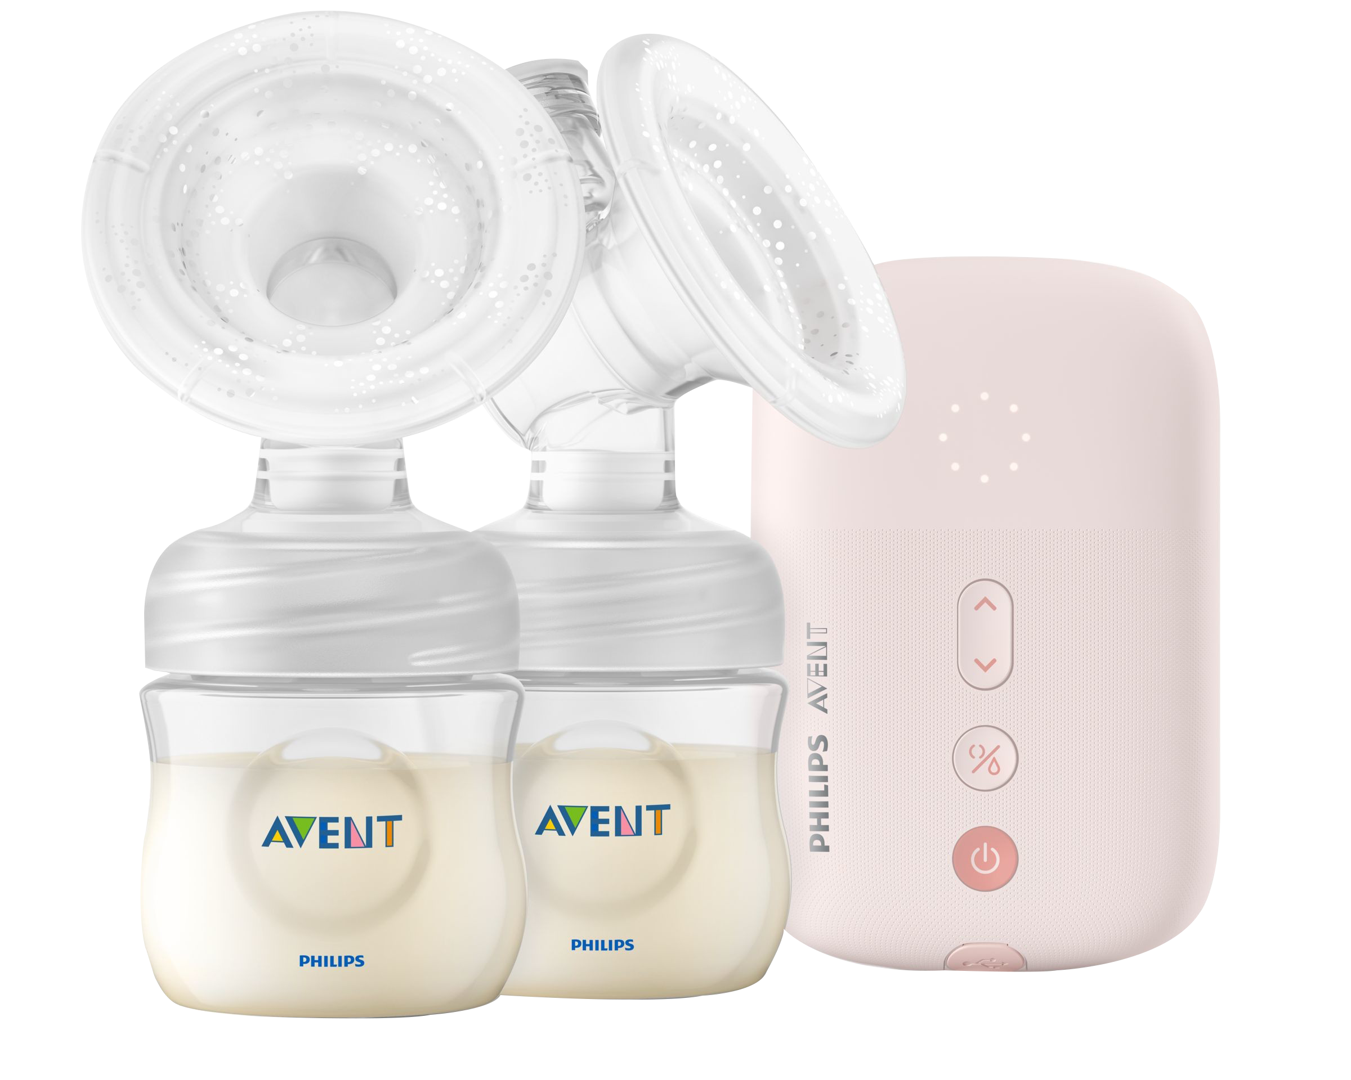
NEW
  Basic Electric
  Breast Pump.
 | Daisy SCF323/11 | Eureka SCF395/11
Design | Motor Unit Size: 10 x 9 x 5 cm Weight: 185g Total | Motor Unit Size: 14.5 x 9.5 x 4.5cm Weight: 370g Total
User Interface | Front Panel Keyboard and LED Indicators | Front Panel Keyboard and LED Indicators
Vacuum Performance | 4 Stimulation Modes and 4 Expression Modes | Suction Cycle Settings: 8 Stimulation Modes and 16 Expression Modes
 | Min: 210 Mb Max: 298 Mb | Min: 60 Mb Max: 360 Mb
 | Classic Expression Kit without Tactile Stimulation | Cushion with Tactile Stimulation for a Higher MER (time between start and the moment the milk actually flows)
Energy Source | Power Adapter (not included) Compatible with USB battery bank (not included) | Power Adapter (included)
Notes:
Eureka is the best in class for performance, while Daisy is easier to use on-the-go.

Slide 12
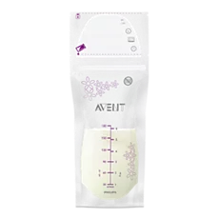
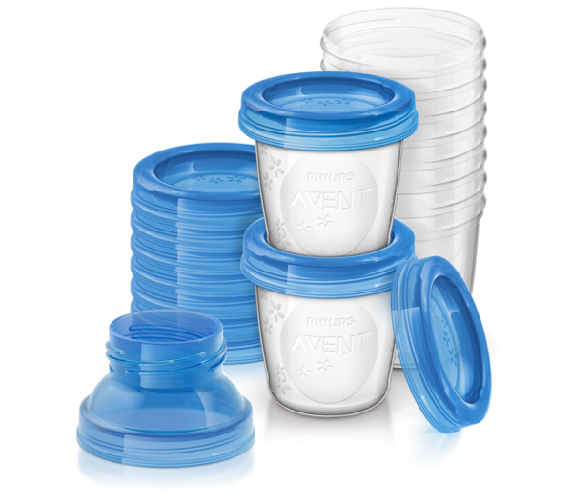
  Storage and
  Feeding.
 | Breast Milk Storage Bags (SCF603/25) | Breast Milk Storage Set (SCF618/10)
Description | Provide safe and secure storage for your breast milk. | Store breast milk securely with leakproof lids.
 | They can be stored in the fridge or freezer and are presterilised for immediate use. | Sterilise and reuse the storage cup with the Philips Avent pump or teats — one system, many options.
Size | 180ml | 180ml
Quantity | 25 bags | 10 (reusable)
Lids | - | 10
Extras | - | 2 Breast pump adapters (compatible with Natural and Classic nipples).
Notes:
Eureka is the best in class for performance, while Daisy is easier to use on-the-go.

Slide 13
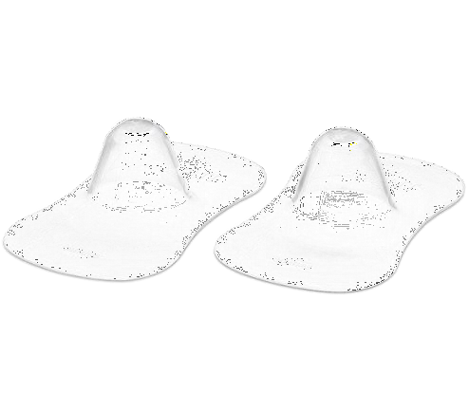
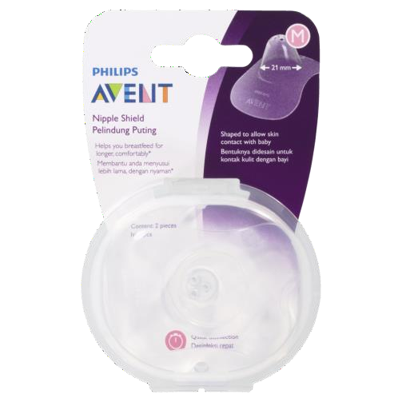
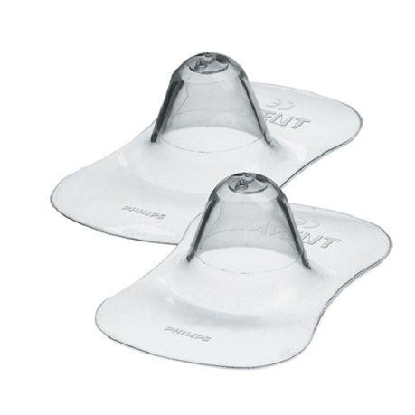
Nipple
Protectors.
SCF154/03 (Medium)
Helps you breastfeed for longer
with sore nipples.
Protects sore nipples during breastfeeding.
Easy latch-on for your baby.
Made with odourless, tase-free, ultra-fine silicone.
Shape to allow skin contact with baby.
© Koninklijke Philips N.V.

Slide 14
Questions?

