Slide 1

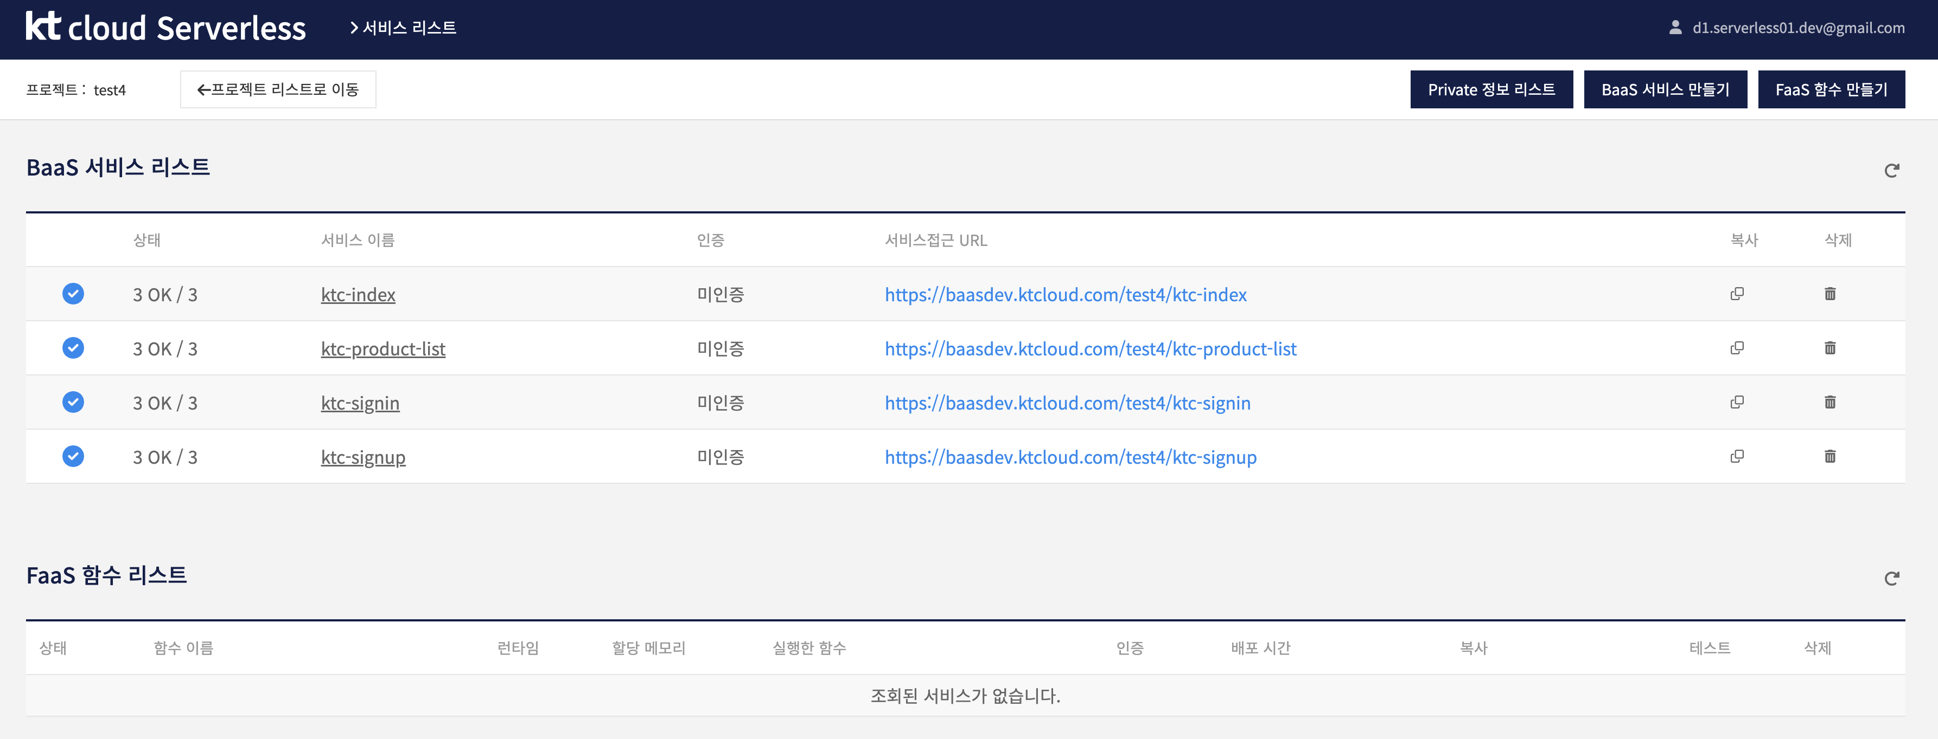
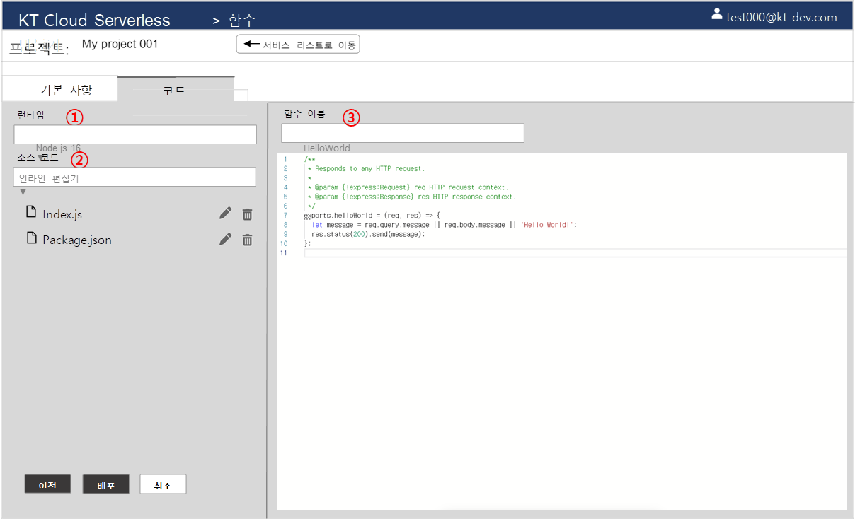
① Access to the BaaS URL
(e.g., ‘https://bassdev.ktcloud.com/test4/ktc-signin’)
② Pull the container image from registry
③ Run the image as a container on Serverless
④ Manage services by using FaaS console
(e.g., edit container image)
⑤ Run the existing container image with the FaaS revision
⬄ Replace existing container image
⑥ Terminate the container when the user finish using it
①
Dockerfile
CMD
requirements.txt
(Flask, Jinja, …)
②
Flask Application
@app.route(“/signin”)
/templates
(html, …)
/static
(css, js, …)
Docker Registry
New!
ktc-index
ID001
…
ktc-signin
ID002
ktc-signin
ID1023
⑤
ktc-signup
ID003
…
ktc-search
ID004
③
Terminated
Container
⑥
‘ktc-signin’
Container
④
edit-signin
replace(“KTCloud”, “kt cloud”)
Serverless

Slide 2
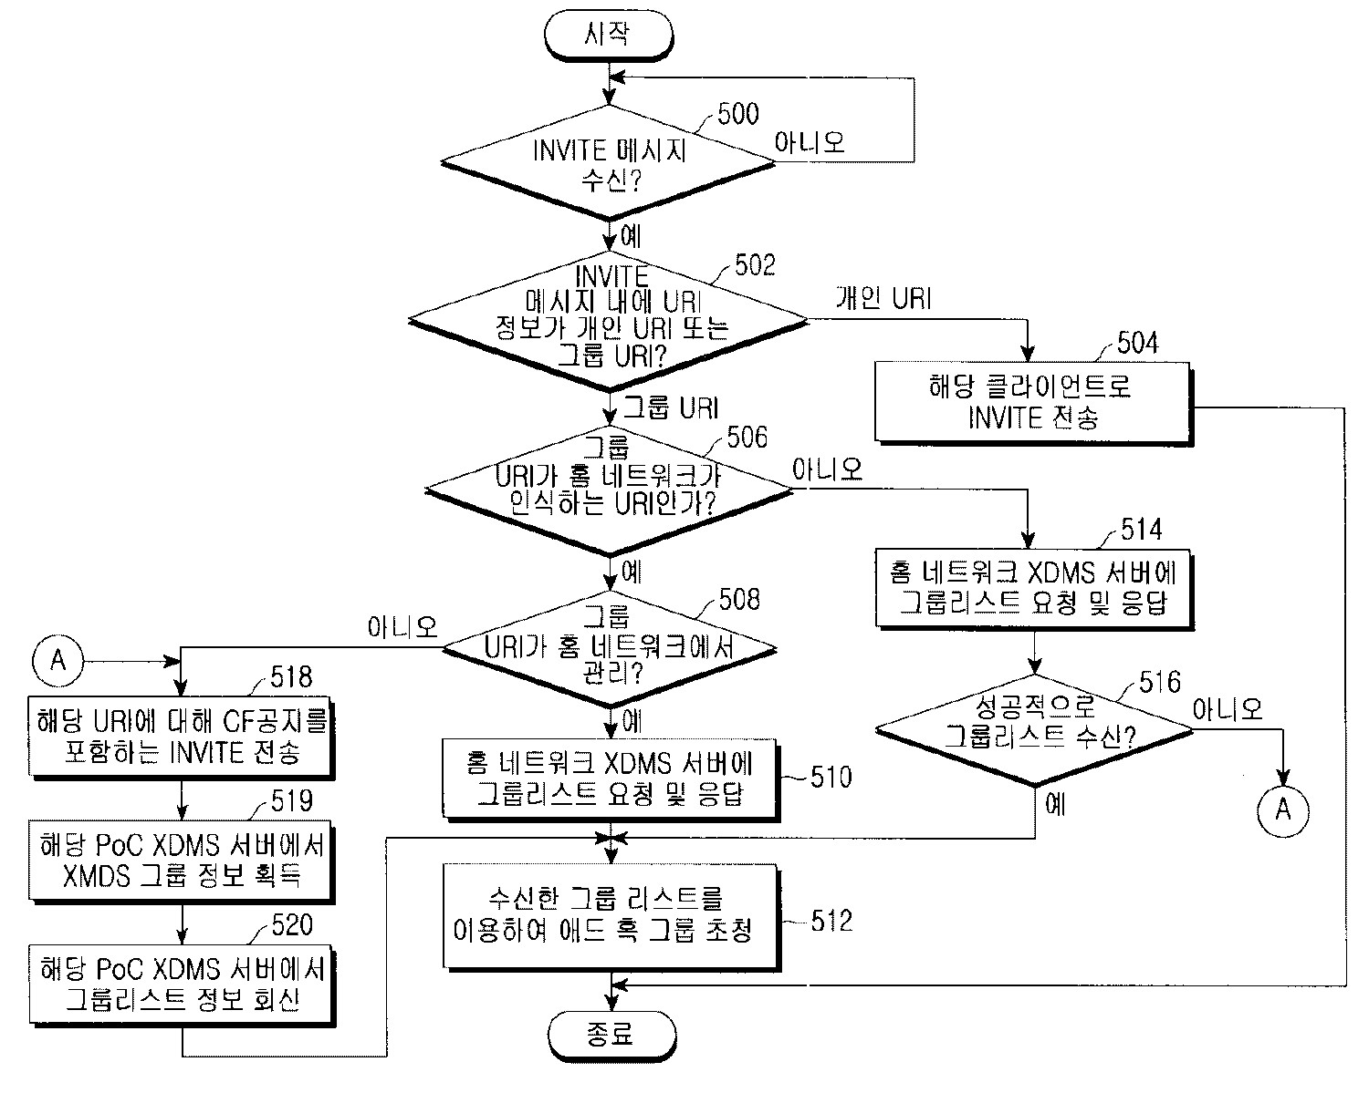
PoC Architecture
순서도 형태로 구성 필요?

