Slide 1
Challenge 5
Satellite/Aerial Image Retrieval
Arun | AXXXXXX
Himanshu | AXXXXXX
Shivani | AXXXXXX
Suraj | AXXXXXX

Slide 2
Aim:
To write a program using Bing maps tile system to automatically download aerial imagery (maximum resolution available) given a lat/lon bounding box.

Slide 3
Understanding of the problem:
The input given is the latitude and longitude values of two points using which the image involving these values, with the highest zoom level possible, is obtained.

Slide 4
Code Overview
Since, we have the two input values i.e. the lat and long values, we calculate the maximum zoom level that can be attained for all the images and then this zoom level is fixed.
Now, level by level we zoom out from this maximum zoom level image and get the final image at zoom level 0.
In order to do so we take reference from Bing Map Tile systems.

Slide 5
Code Overview:
Now using reference from Bing Tile Map systems,
we calculate the tileX and tileY values for which, we take into consideration the lat, long values and the maximum zoom level.
Now, using the starting and ending tile tuples we get the list of all intermediate tileX and tileY values.
Using the tileX and tileY values with the zoom level information, the quad key is calculated.
Finally, the maptiles are downloaded using these quad key values.
Then, all the maptiles are stitched together to get the final output image.

Slide 6
How to Run?
Python
map_tile.py
-- latitude1 12.34
-- longitude1 45.78
-- latitude2 56.78
--longitude2 89.10
-- release/debug
Arguments are optional and defaults values can be used for demonstration

Slide 7
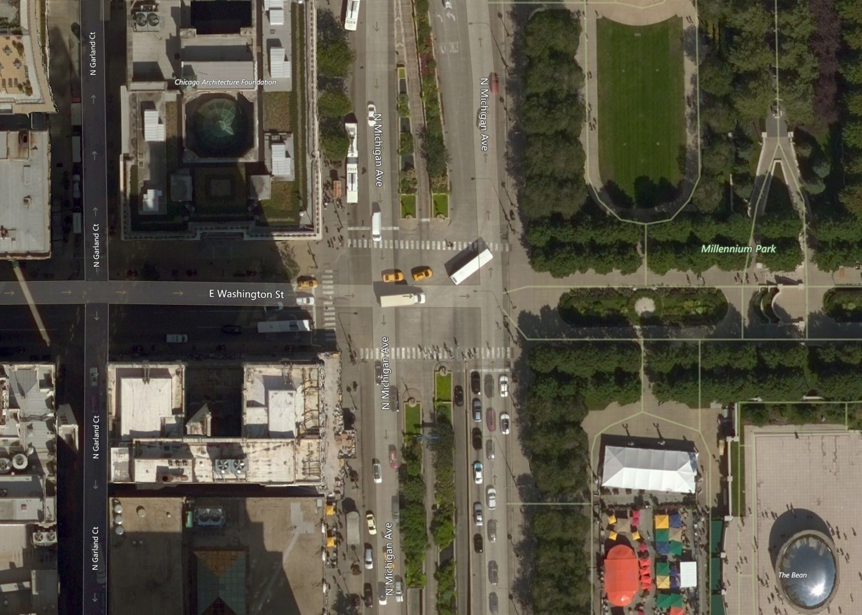
Result:

Slide 8
Thank You!

