Slide 1
LINEAR ALGEBRA
DSIA-SYD-FT-201907: BFW GROUP

Slide 2
VECTOR
Present: badar

Slide 3
VECTOR
Text
Definition | • It is a quantity having direction as well as magnitude, especially as determining the position of one point in space relative to another
Example | displacement, velocity, acceleration, force.

Slide 4
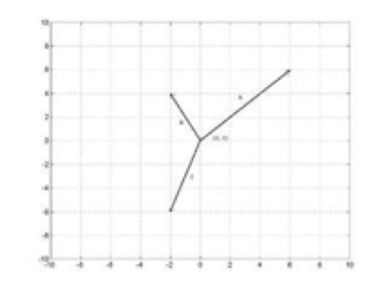
VECTOR
Text

Slide 5
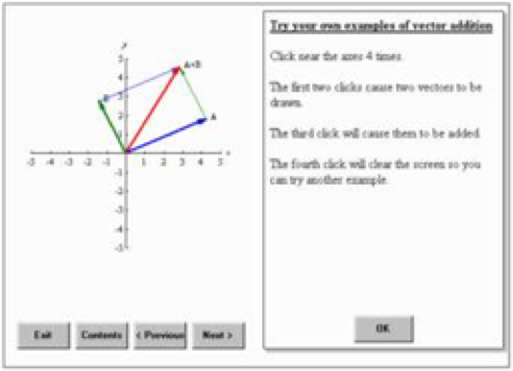
VECTOR
Text

Slide 6
VECTOR
Text

Slide 7
VECTOR
Text

Slide 8
VECTOR
Text

Slide 9
CROSS & INNER GROUP
Present: FRANK

Slide 10
CROSS & INNER PRODUCT
LINEAR ALGEBRA

Slide 11
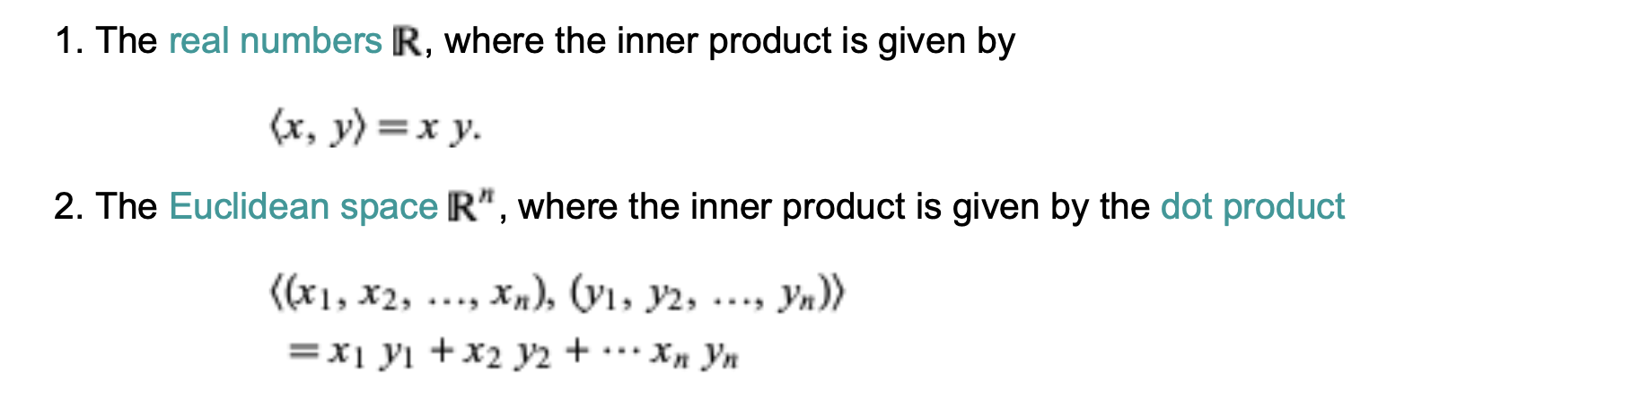

Slide 12
CROSS & INNER PRODUCT
Text

Slide 13
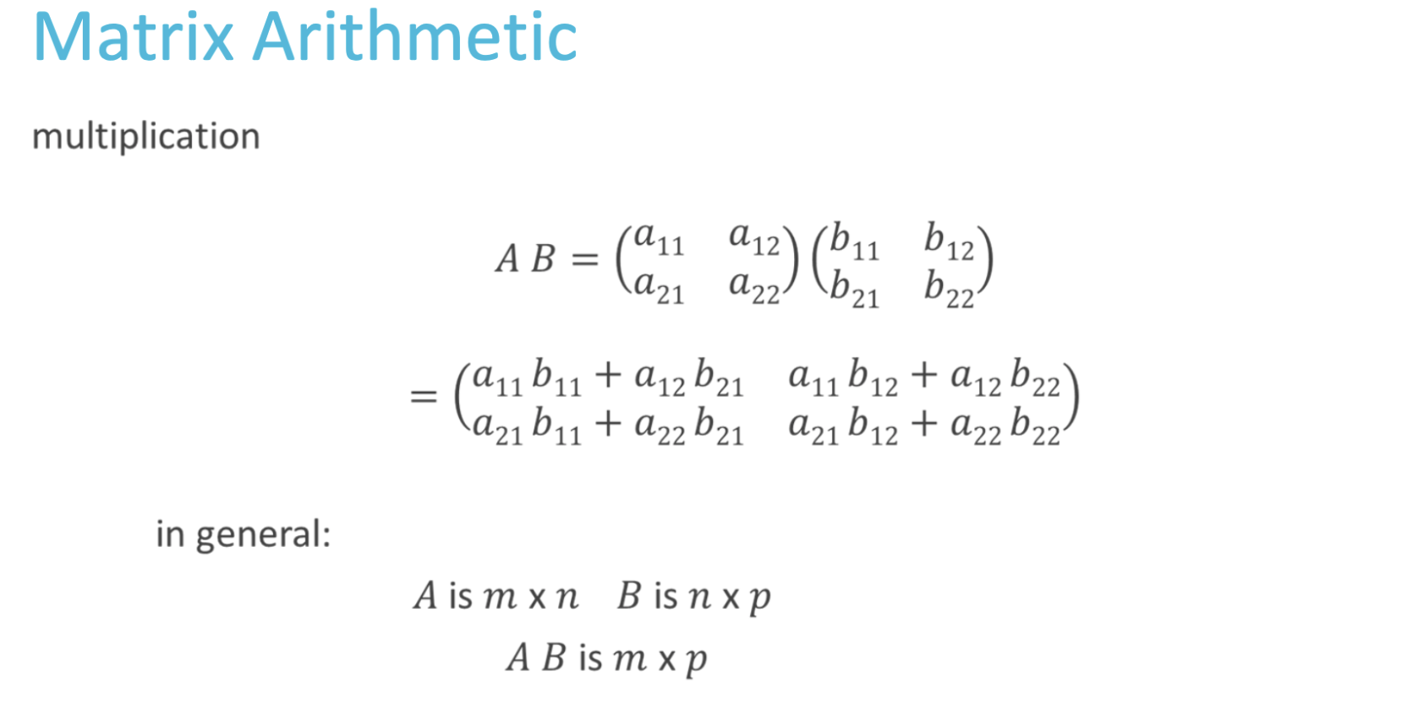
Text
Type a quote here.
Joe Bloggs

Slide 14
CROSS & INNER PRODUCT
Text

Slide 15
CROSS & INNER PRODUCT
LINEAR ALGEBRA

Slide 16
MATRIX
Present: WEINA

Slide 17
MATRIX
LINEAR ALGEBRA
MATRIX
Definition | A two-dimensional dataset and geometrically represents a transformation of two or more vectors.
Contribution to Data Science | Set of observations for multiple entities Transforming a dataset from one representation to another Using for data mapping in project Providing insight from different angle by changing weighing on hidden data layer
Type of Functions | Matrix Equality Matrix Addition and Subtraction Multiplications Transposition | Finding values of x and y in data range such as A=B Presupposition: Same Dimension (Real: Sales $ Report) Scalar Multiplication, Matrix Multiplication (statistical Real: Product Matrix - Row Vector=Price, Column Vector=Quantity Transpose, Visualising Transposition

Slide 18
Matrix (cont’d)
Linear algebra
 | BEAUTY & COMPLEXITY | MATH & STATISTICS | PYTHON - JUPYTER - SPYDER - CODING
i) | Addition |  | np.add(A,B)
ii) | Multiplication |  | np.multiply(A,B)
iii) | Determinant | 2x2 3x3 | np.det(A)
 |  | 3x3
iv) | Transpose A^{T} |  | np.transposed.append([row[:,i]])
v) | Inverse A⁻¹ |  | np.def reverse(A::-1)
vi) | Define n x n Identify ln |  | np.def(Aln:)

Slide 19
DISCLAIMER
Text
DSIA-SYD-FT-201907 learning module material
python.org
<<Matrix Algebra and Applications>>

