Slide 1
DATA TOOLS LEARNED
DSIA-SYD-FT-201907
BFW GROUP: BADAR, FRANK, WEINA FRIDAY 12 JULY 2019

Slide 2
INTRODUCTION
DATA-PROCESSING WITH…
SQL
NOSQL
BIG DATA

Slide 3
TOPIC: SQL PRESENT BY: BADAR
DEFINITION
Structure
Query
Language
,,,,,it means, domain specific, and designed for managing data held in relational databases
HISTORY
Pioneer (Raymond boyce) introduced 1974 to the world started interacting with databases

Slide 4
TOPIC: SQL PRESENT BY: BADAR
INDUSTRY STANDARDS
Industry- accepted standards are the American national Standard Insititute (ANSI) and ISO international Standard Organisation which is affiliated with the international electrotechnical commission (IEC) since 1986-87.
Both ANSI and ISO/IEC have accepted SQL as the standard language for relational database.
CODE: ISO/IEC 9075.

Slide 5
TOPIC: SQL PRESENT BY: BADAR
DATABASE ENGINES ARE:
IBM DB2 VERSION 9 AND ABOVE
MY SQL VERSION5
POSTGRES VER 9
ORACLE VERSION9
SQL SERVER VERSION 2012

Slide 6
TOPIC: SQL PRESENT BY: BADAR
STRENGTH | OPTIMZATION OF RESULT IN DIFFERENT WAYS (INDEX,PARALLEL PROC, STORAGE MANAGEMENT USES IN COMPANY FOR CRM SYSTEMS DRIVE DEEPER RELATIONSHIP WITH CRM COMMERCIAL SUPPORT TO DEFINED SLA’S ADVANCE FEATURE AGAINST OPEN SOURCE SYSTEMS AVAILABILTY OF TOOLS FEATURE STABILITY BEATING NOSQL (JOINS)
WEAKNESS | ONLY IN TABULAR FORMS SQL TABLES UNORDERED SETS
OPPORTUNITY | TALKING THROUGH
THREAT | No sql was developed secretly (hadoop, cassandra, mongodb) Internet web sourced(1989)
SELLING POINT of SQL

Slide 7
TOPIC: SQL PRESENT BY: BADAR
SYNTAX/LANGUAGE STATEMENT
USES STATEMENT TO MAKE ROWS OR COLUMN
SQL INTERFACES
AMAZON RDS, GOOGLE,CLOUD SQL,AZURE DB FOR POSTGRESQL, MY SQL SQLITE
SQL INTERFACES WITH HADOOP, SPARK, KAFKA

Slide 8
SQL=>NoSQL
LESS IS MORE
NoSQL=NON-SQL
=Not only SQL
1960s

Slide 9
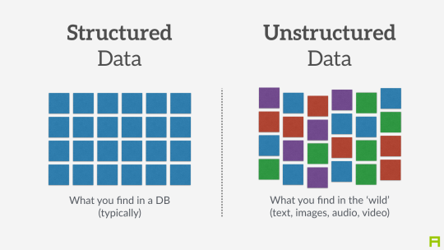
TOPIC: SQL PRESENT BY: FRANK
SQL vs NoSQL <=> Structured Data vs UnStructured Data

Slide 10

TOPIC: NOSQL PRESENT BY: FRANK
SQL

Slide 11
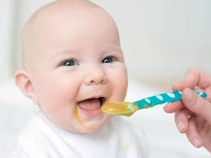
TOPIC: BIG DATA PRESENT BY: FRANK
NoSQL=
A healthy baby
“look ! I can digest anythin
G !”

Slide 12
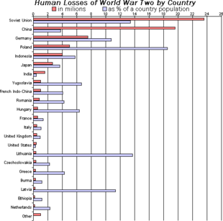
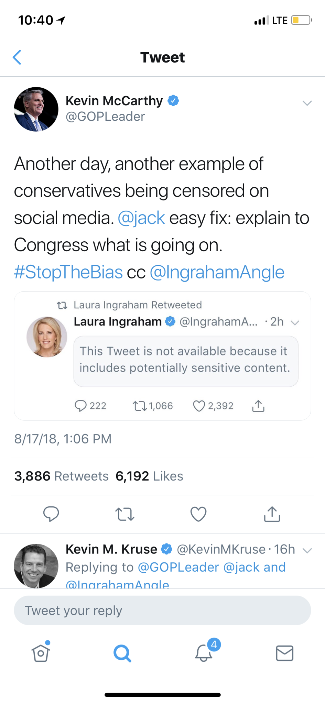
TWITTER : CONTINGENT PROPERTIES OF DATA
Example:
Storage of Twitter information:

Slide 13
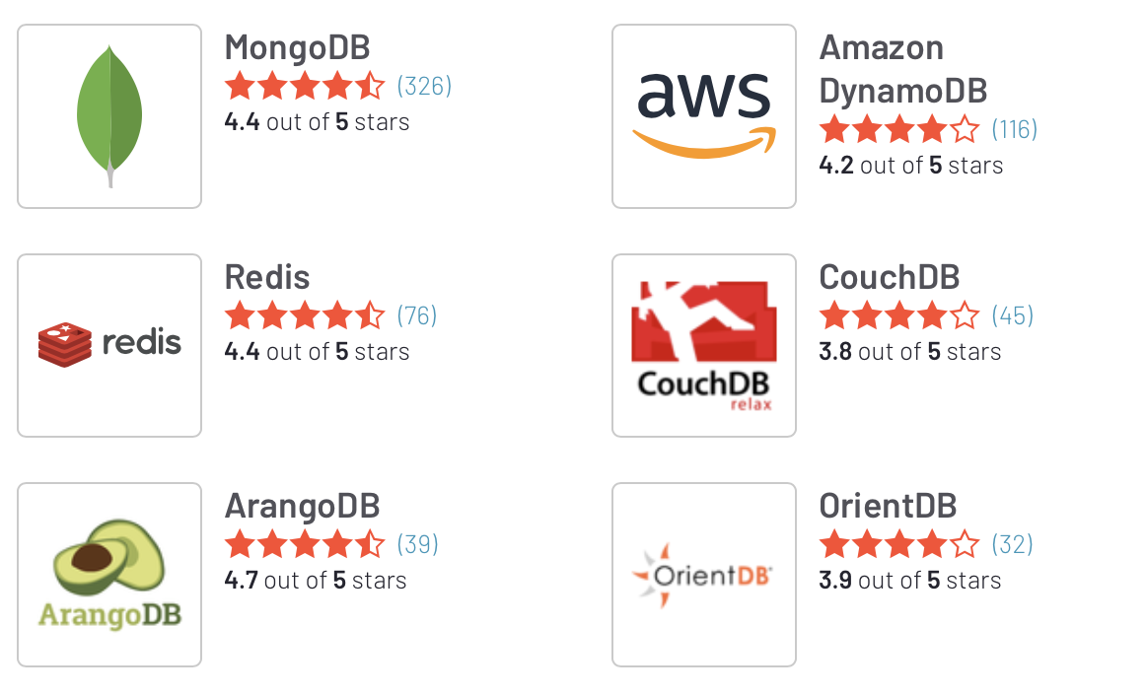
GEAR IN THE TOOLBOX

Slide 14
Development on Data Processing
NoSQL observes and works on the fact that in real life context, variables and data might have uncertain sizes
In terms of modelling, we call it the development from
Deterministic model vs Congtingent model
It is a further development, one step further

Slide 15
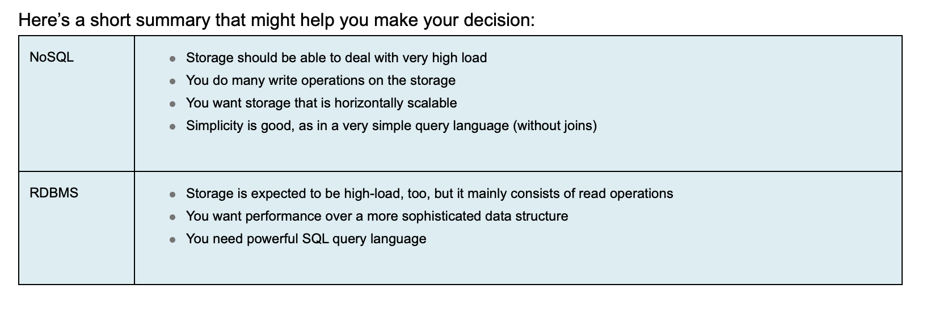
WHEN TO CHOOSE WHOM-A STORAGE PERSPECTIVE

Slide 16
DATA SCIENTIST PHILOSOPY
UNDERSTAND YOUR DATA’S FEATURE AND CHOOSE THE RIGHT TOOL FROM YOUR TOOLBOX
BUILD UP STRONG QUERY SKILL
BUILD UP BIG TOOLBOX

Slide 17
TOPIC: BIG DATA PRESENT BY: WEINA
DEFINITION
Size
Transaction volume
Processing speed - Velocity
Usage channel

Slide 18
TOPIC: BIG DATA PRESENT BY: WEINA
INDUSTRY STANDARDS

Slide 19
TOPIC: BIG DATA PRESENT BY: WEINA
ADVANTAGE OF USING DATA SCIENCE TO HANDLE BIG DATA
Fast transferring data
Fast processing for data analytics
Interactive
Language-integrated cluster
Lower cost to store
Future way of living i.e. Internet-of-Thing
A handy tool for Data Scientist -
Streaming Mode
Graph Processing
Machine Learning

Slide 20
TOPIC: BIG DATA PRESENT BY: WEINA
CURRENT DATA TOOL | CAPABILITIES
Apache Spark - Resilient Distributed Dataset (RDD) - Directed Acyclic Graph (DAG) | Functional programming via using Python Fundamental data searching via API Incorporate with NoSQL Incorporate with messaging platforms i.e. Apache Kafka and Amazon Kinesis

Slide 21
TOPIC: BIG DATA PRESENT BY: WEINA
COMPARISON
Big Data Usage
Industry, Energy Resource vs FinTech
Big Data Type
Structured vs Unstructured

Slide 22
CONCLUSION
Involve comprehensive math & algorithms
SQL system
Price prediction

Slide 23
DISCLAIMER: DSIA-SYD-FT-201907-BFW-GROUP
DSIA-Data Science & AI Program Materials 2019
Coindesk.com/US SEC Seeks Big Data Tool for Major Blockchains/Author: Yogita Khatri/ 04022019
Ig.com/Cryptocurrencies-Bitcoin ($1)-chart

