Slide 1

Payroll Management System
Under The Supervision of
Mr. Ram Bhupal M.Tech(Ph.D)
Assistant Professor
Amar Gopi-21BQ1A12C3
Asish-21BQ1A1285
Akhil-21BQ1A1295
Rajesh-21BQ1A12B4
Nishoke-21BQ1A1293
Presented By
Rajeev Chowdary – 21BQ1A12D2
Leela Krishnamurthy – 21BQ1A12D4
Vishwanath – 21BQ1A12C8
Sujith Paul – 21BQ1A12I0
Himavanth-21BQ1A12H2
Prashanth-21BQ1A12D6
Narendra-21BQ1A12F9 Pavan Sai-22BQ5A1218
yonesh-22BQ5A1221
Department of Information Technology
Vasireddy Venkatadri Institute of Technology
Peda kakani Mandal, Namburu, Guntur-522508

Slide 2
INDEX
ABSTRACT
INTRODUCTION
MODULES
SYSTEM REQUIREMENTS
USE CASE DIAGRAM
CLASS DIAGRAM
EXECUTION SCREENSHOTS

Slide 3
ABSTRACT
“Employee Database And Payroll Management System” is designed to make the existing manual system automatic with the help of computerised equipment and full-edged computer software, fulfilling their requirements, so that their valuable data and information can be stored for a longer period with easy access and manipulation of the same. The required software is easily available and easy to work with. This web application can maintain and view computerised records without getting redundant entries. The project describes how to manage user data for good performance and provide better services for the client.

Slide 4
INTRODUCTION
The proposed project “Employee Database and Payroll Management System” has been developed to overcome the problems faced in the practicing of manual system. This software is built to eliminate and in some cases reduce the hardships faced by the existing system. Moreover this system is designed for particular need of the company to carry out its operations in a smooth and effective manner. This web application is reduced as much as possible to avoid errors while entering data. It also provides error message while entering invalid data. It is user-friendly as no formal knowledge is required to use the system. Human resource challenges are faced by every organization which has to be overcome by the organization. Every organization has different employee and payroll management needs. Therefore I have design exclusive Employee and payroll Management System that are adapted to the organization’s Managerial Requirements.

Slide 5
MODULES
MODULE-1: Design web page
MODULE-2: Creating a database
MODULE-3: Database Connection
MODULE-4: Managing admin

Slide 6
Design web page
we design our website which contains of home page, login page and contact us. In home page it consists of basic information regarding our website, contact us consists of manager contact details and login page has two major options one is admin login and another one is user login. In admin login page it contains following fields as options add employee, change password , employee report and logout . In employee login page it contains leave apply , leave report, generate pay slip , change password and logout.

Slide 7
SYSTEM REQUIREMENTS
Hardware Requirements
2gb ram , 256 gb internal storage , minimum i3 or eqvivalent processor
Software requirements :
visual studio
XAMPP SERVER(MySQL)

Slide 8
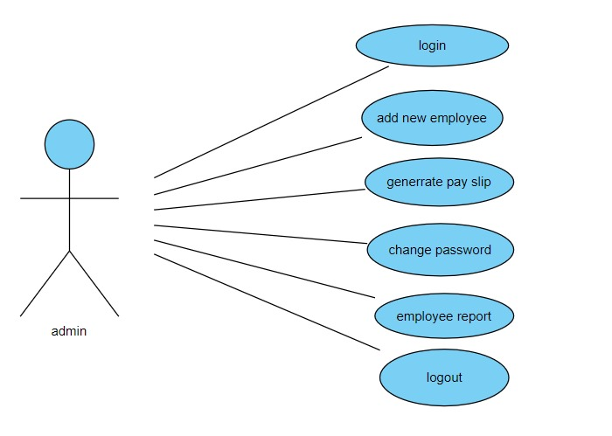
Use case diagram

Slide 9
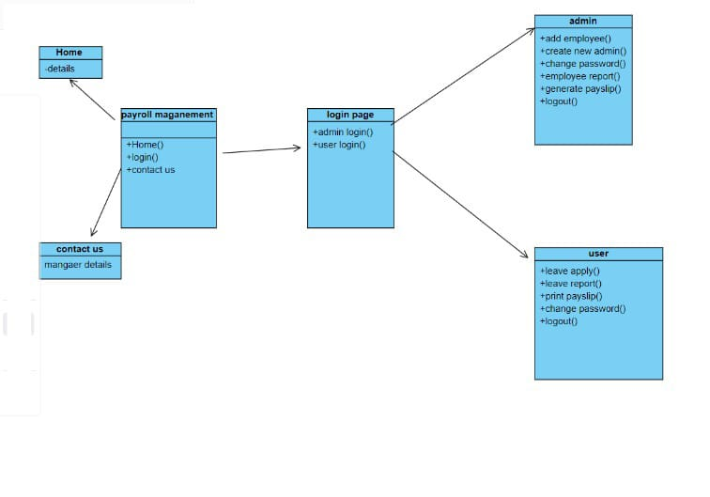
Class diagram

Slide 10
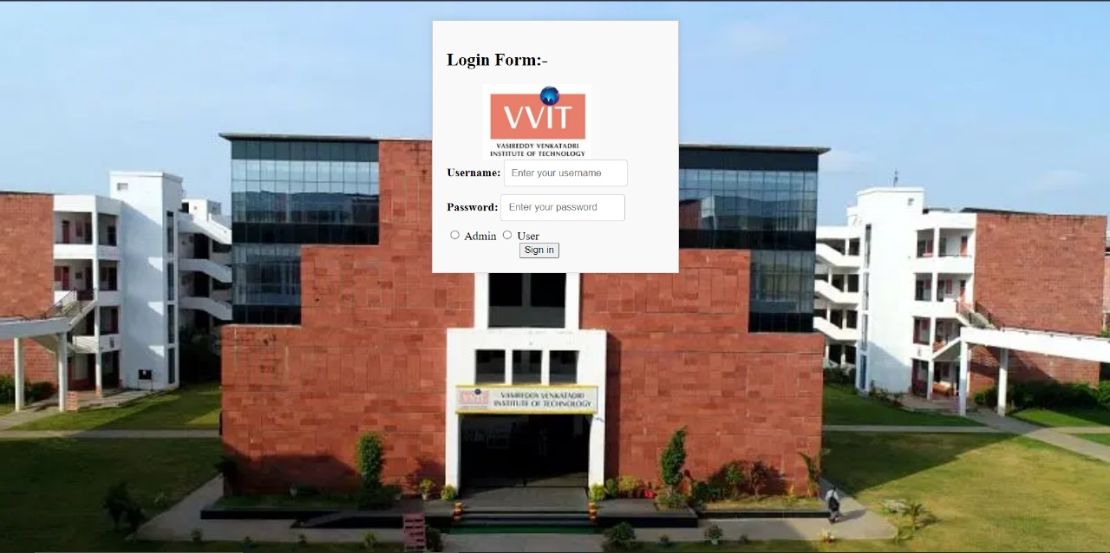

Slide 11
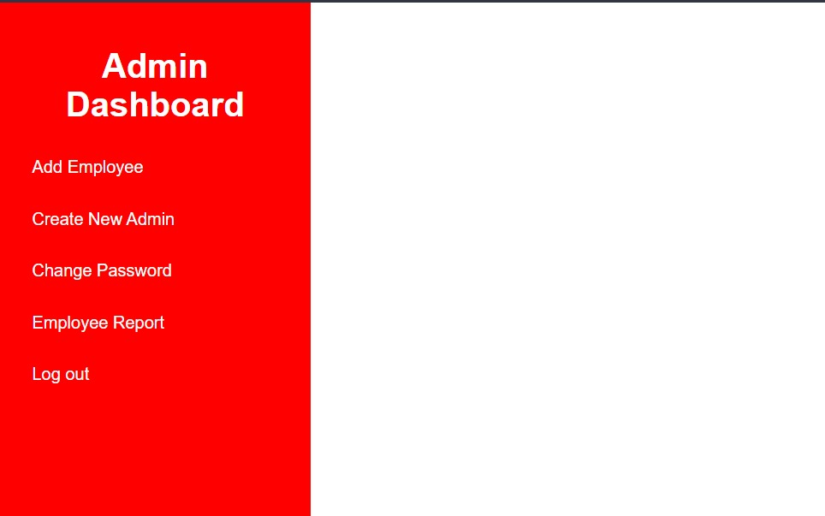

Slide 12
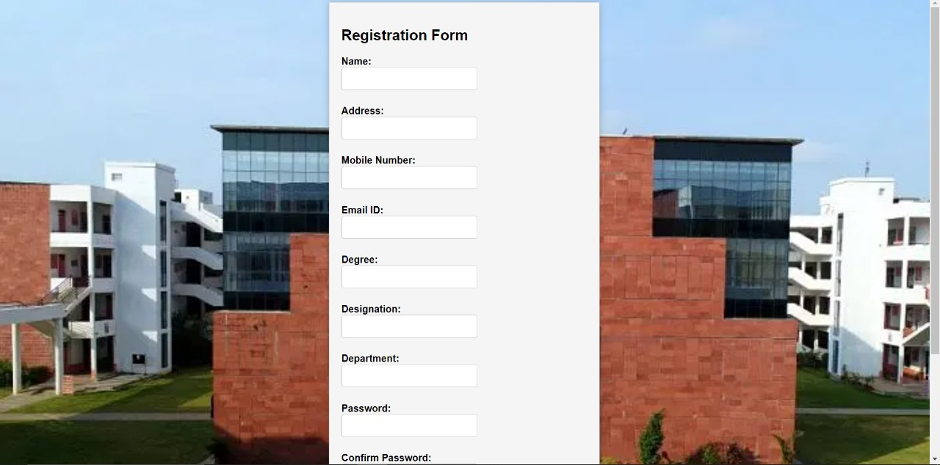

Slide 13
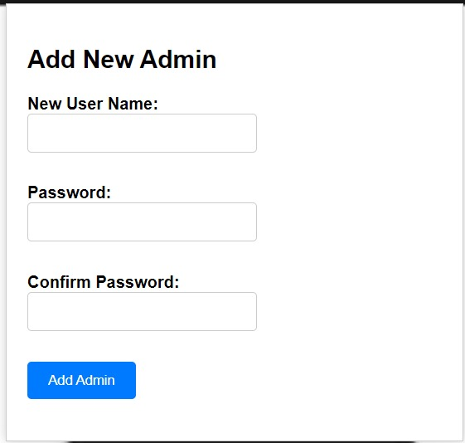

Slide 14
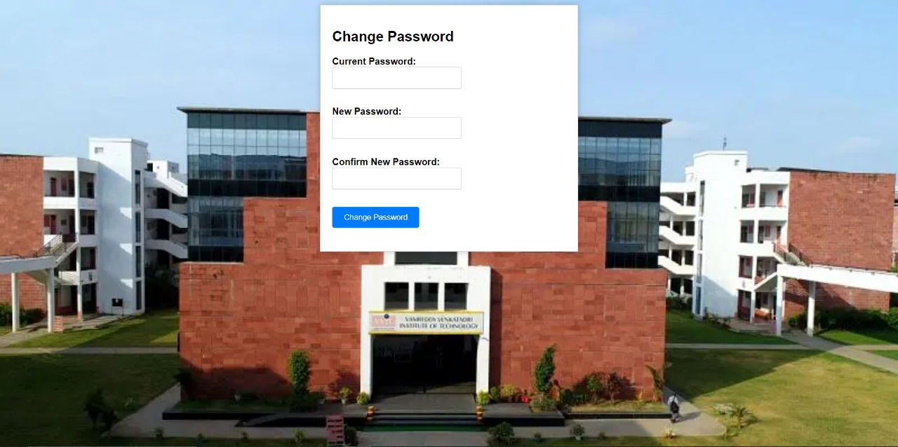

Slide 15
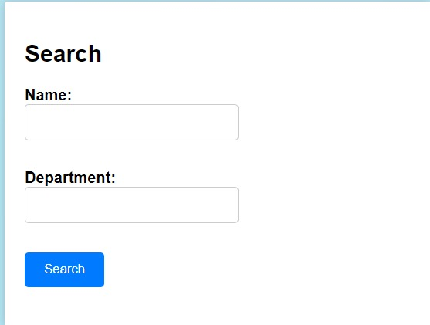

Slide 16
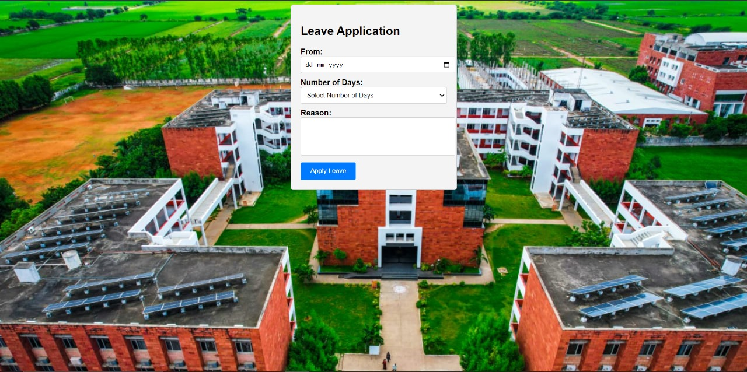

Slide 17
Thank You…! & Any Questions…!

