Slide 1
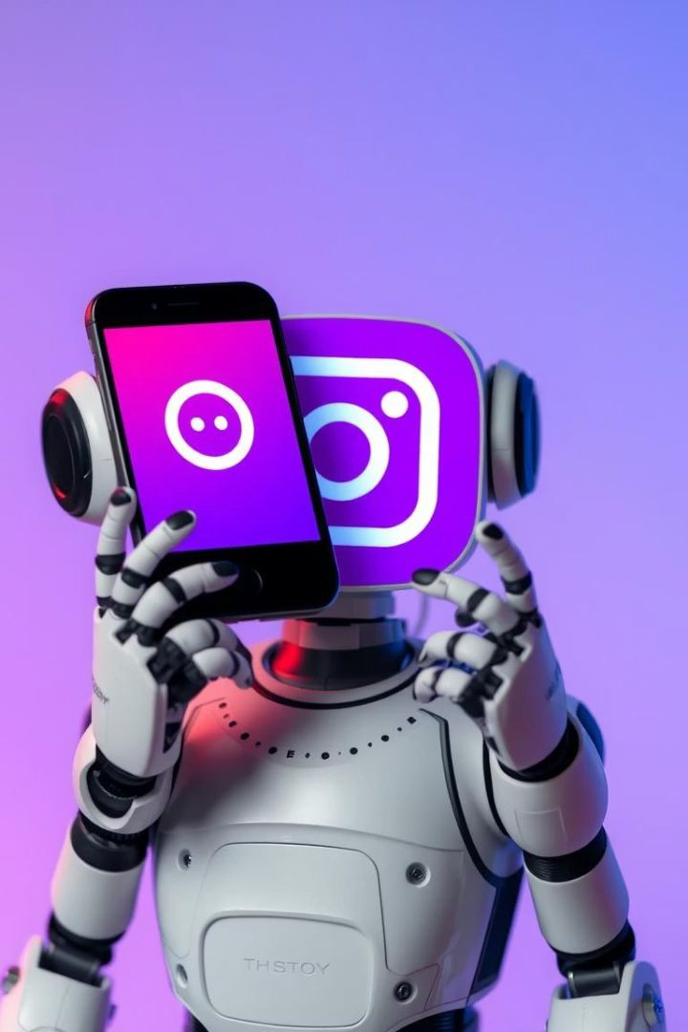

An Automated Social-Media Bot
Empowering Your Instagram Presence Through Smart Automation
Team Members' Names Dinesh Karthik - AP23110011557 Leela Srikanth - AP23110011622 Venkatesh M  AP23110011626 Karuna Kiran - AP23110011631

Slide 2
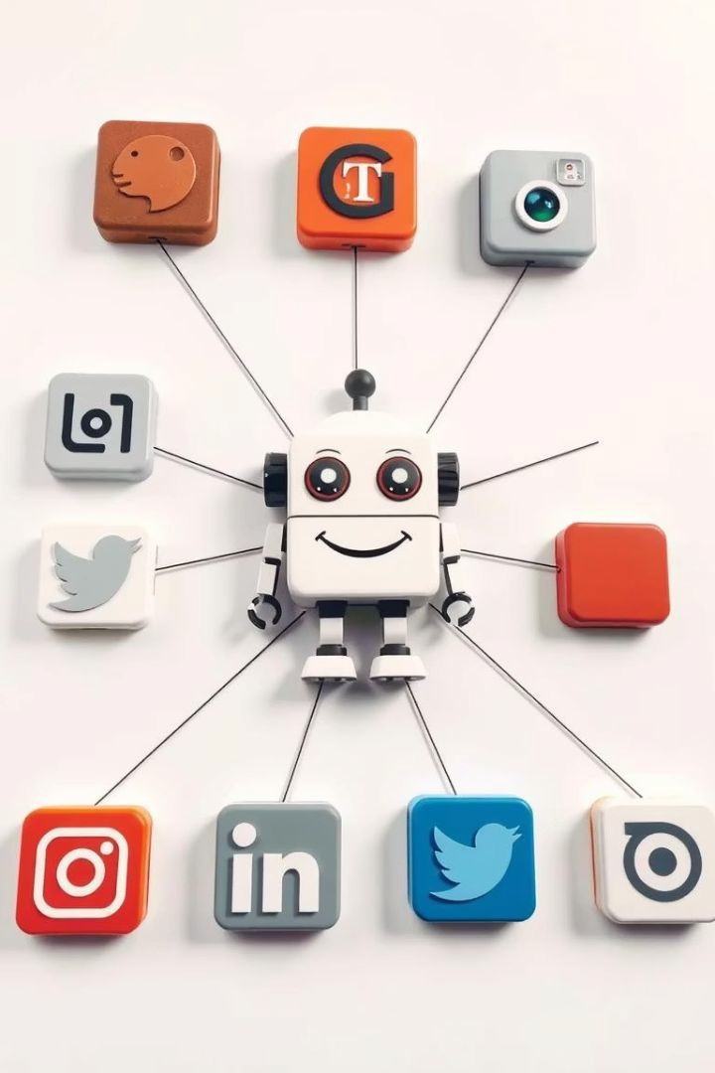

Hello, Automation!
What's the Buzz About Bots?
Imagine a tireless assistant for your social media managing tasks automatically.
It saves time and energy by taking repetitive tasks off your plate.
Bots handle posting, liking, commenting, and gathering insights
effectively.

Slide 3


Our Mission: Automation Station!
Level Up Your Social Game
Build a smart system for automatic Instagram interaction handling.
Reduce endless scrolling and manual repetitive actions with our
bot.
Harness Python, Selenium browser automation, and Requests for smooth communication.

Slide 4
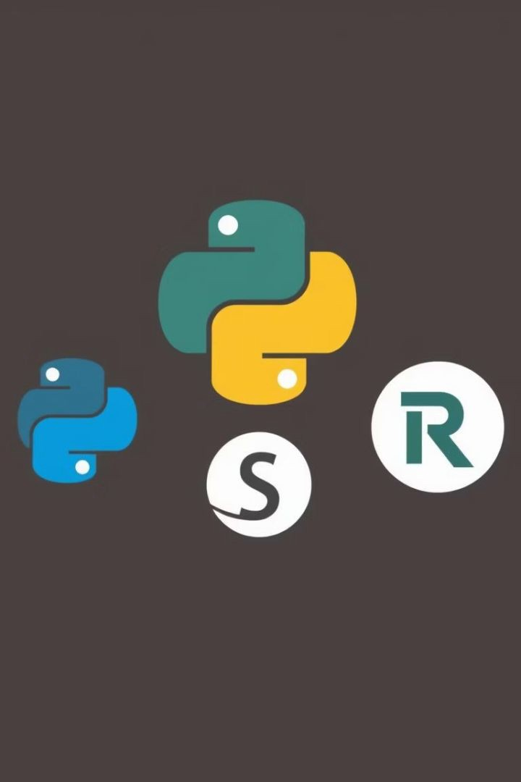

Our Awesome Arsenal!
Python
Versatile and friendly language powering the bot's brain.
Selenium
Automates browser actions like clicks, typing, and navigation perfectly.
Requests
Facilitates smooth sending and receiving of data from Instagram servers.
ChromeDriver
Controls Chrome browser seamlessly to interact with Instagram.
.

Slide 5


Unleashing the Bot's Superpowers
Smart Login
Automatically and reliably logs into your Instagram account.
Content Broadcaster
Posts photos with captions to keep your feed fresh and engaging.
Interactive Buddy
Likes and comments on posts automatically to boost engagement.

Slide 6

How the Automation Engine Works
User Input
Tell the bot your tasks like scheduling posts or liking content.
Bot Initialization
Bot sets up tools including web driver to prepare for tasks.
Login
Securely logs into your Instagram account to start automation.
Perform Actions
Posts, likes, and comments are executed as instructed.
Logout/Exit
Closes browser smoothly once all tasks are complete.

Slide 7

A Peek Inside the Bot's Brain
Login Automation
Handles Instagram login via Selenium clicks and form entries.
Post Photo
Uploads images with captions to Instagram through automated navigation.
Like & Comment
Finds recent posts, likes them, and leaves preset comments.

Slide 8
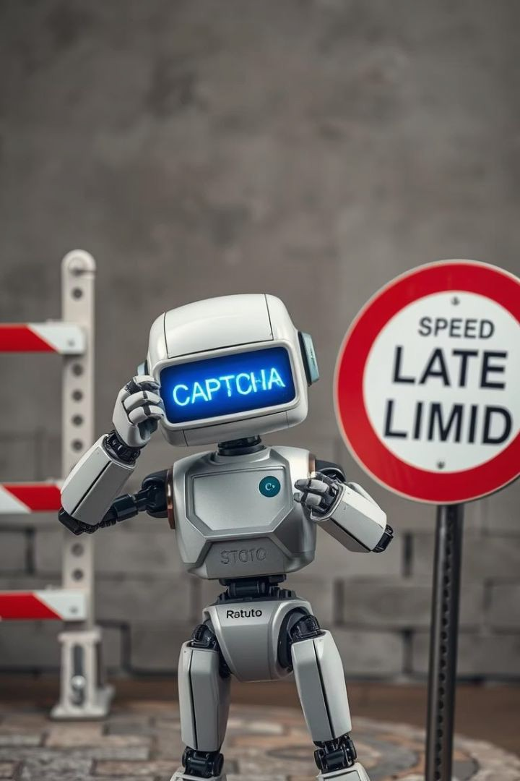

The Bot's Battles: Challenges Faced
CAPTCHA Conundrums
"Prove you're not a robot" often blocks automation routines.
Bot Detection Blues
Instagram's advanced systems detect and restrict bot actions.
Rate Limiting Roadblocks
Excessive actions can trigger temporary usage restrictions.
Dynamic Content Dilemmas
Content loading on scroll demands smart handling techniques.

Slide 9

Witness the Automation Magic!
Successful Login
Bot smoothly signs in to a test Instagram account.
Photo Posting
Image and caption appear on the Instagram feed automatically.
Liking Posts
Bot identifies and likes selected posts in
real-time.
Commenting
Leaves friendly comments on recent posts to increase engagement.

Slide 10

The Future is Automated and Bright!
Smart Talk
Integrate NLP for human-like understanding and replies.
Timing is Everything
Develop advanced scheduling for perfectly timed posts.
Platform Power
Expand bot capabilities to Twitter, Facebook, and more.
Feeling the Vibe
Use AI sentiment analysis to gauge emotions in comments.

