Slide 1
Git

Slide 3
Git
Local Repository
Working Directory and Staging Area or Index
Blobs
Trees
Commits
Branches
Tags
Clone
Pull
Push
HEAD
Revision
URL

Slide 4
Install
Ubuntu:
sudo apt-get install git-core
Centos:
yum -y install git-core
git config --global user.name “My Name“
git config --global user.email “my email"
Color High Lighting:
git config --global color.ui true
git config --global color.status auto
git config --global color.branch auto
Set Default editor:
git config --global core.editor vim

Slide 5
Install
Select default merge tool:
git config --global merge.tool vimdiff
View saved settings:
git config --list

Slide 6
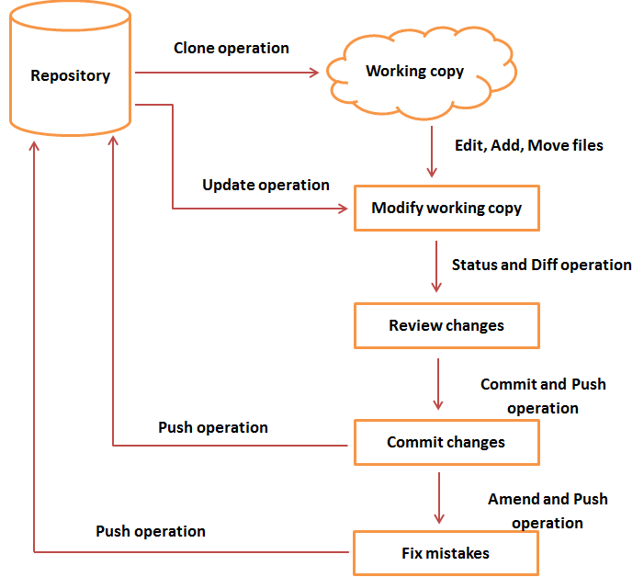
Work Flow

Slide 7
Create New User:
groupadd dev
useradd -G dev -d /home/gituser -m -s /bin/bash gituser
passwd gituser
Create new repository:
mkdir project.git
cd project.git/
git --bare init
RSA Key generation (tom and jerry):
ssh-keygen
ssh-copy-id -i ~/.ssh/id_rsa.pub gituser@git.server.com
Push Changes to the Repository

Slide 8
Push Changes to repository
mkdir tom_repo
cd tom_repo
git init
echo 'TODO: Add contents for README' > README
git status -s
git add .
git status –s
git config --global user.email "tom@example.com"
git config --global user.name "tom"
git commit -m 'Initial commit'
git log
git remote add origin gituser@localhost:project.git
git push origin master

Slide 9
Clone
git clone gituser@git.server.com:project.git

Slide 10
Perform Changes
git status -s
git add string.c
git status -s
git commit -m 'comment'
git log
Review changes:
git show
git diff

Slide 11
Perform Changes
commit changes to staging repo:
git status -s
git add string.c
git status -s
git commit --amend -m 'Changed return type of my_strlen to size_t'
git log
Push to remote:
git show
git push origin master

Slide 12
What was done so far?
Installed Git server, created a linux user “gituser”, created a git server repository
Created 2 developer machines (actually 2 users in same machine) tom and jerry, then established key authentication with gituser
Tom created a repository and made commits, he added the origin as remote server machine and pushed his codes to the remote git repository
Jerry did a clone to get the code on his machine, then he made some changes to the files, and commited the changes.
Jerry and tom use git diff, git log, git show commands to identify the changes in git and the history.

Slide 13
Update
git pull

Slide 14
stash
git stash
git stash list
git stash pop

Slide 15
Move, Rename, Delete
git mv README README.OLD
Git rm test.txt

Slide 16
Fix mistakes
git checkout
git reset (https://git-scm.com/docs/git-reset) : Assignment
git reset --hard 2daa81487c613486af0aba2781c0f6a90e356caf

Slide 17
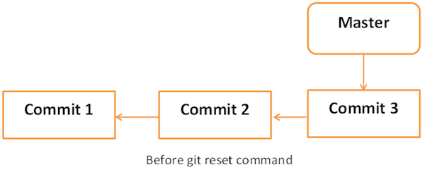
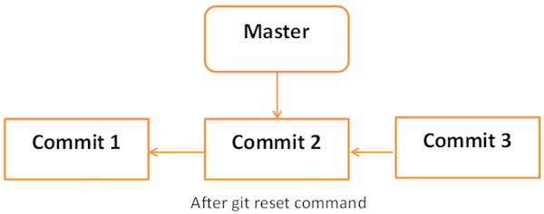

Slide 18
Tag
git tag Release1.0
git tag
git push origin tag Release1.0
List tags:
git tag -l
Delete tag:
git tag -d Release1.0

Slide 19
patch
git format-patch -1
Apply patch:
git apply 0001-Added-my_strcat-function.patch

Slide 20
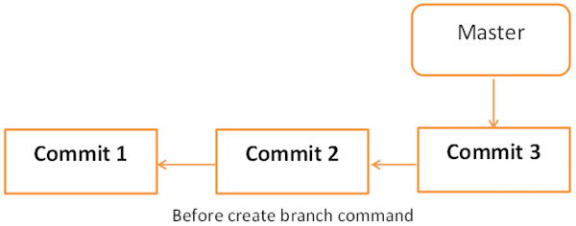
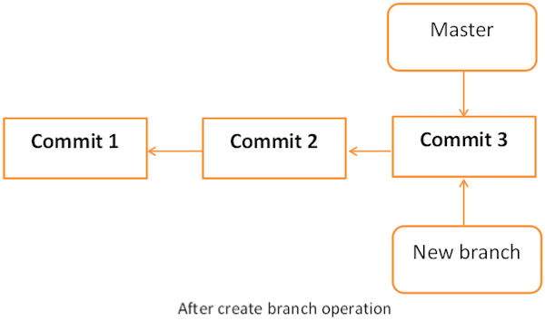
Git Branch

Slide 22
Branch
git branch new_branch
Git checkout new_branch
git log origin/new_branch / git log new_branch
git merge new_branch –m “comment”

Slide 23
Handling Conflicts
(Assignment)
http://www.tutorialspoint.com/git/git_managing_branches.htm
As a new user (tom), Create a branch
Edit a file in the branch
As a different user (jerry), edit same file, same line in “master” branch
Both tom and jerry Commit and push changes
Jerry now want to pull the code from new branch and merge with master

Slide 24
Review
Create a git server project under “gituser” linux user.
Create user tom (client) and configure RSA key based authentication.
Verify the key authentication
Initialize a repository in tom’s machine
Write some codes, do an initial commit to git
Add a remote repository
Push tom’s code to remote repository
Create another user jerry (client) and clone the “remote repository” to jerry’s laptop
Tom and jerry working together on the project.

Slide 25
Assignment:
Install Apache2
Install PHP
Install MySQL
Install PHP module for apache
Install mysql module for php
Download wordpress.

