Slide 1
KAIROS
CNC_01
DEGRADING
CNC_02
CRITICAL
timing makes the difference
Adaptive Predictive Maintenance
with machine-specific baselines,
fleet context, and LLM-assisted actioning
Bearing wear developing
Thermal runaway risk
PUMP_03
WARNING
CONV_04
SENTINEL
Cavitation burst pattern
Reference healthy machine

Slide 2
WHY THIS PROBLEM MATTERS
Factories bleed money at both extremes.
TOO EARLY
TOO LATE
JUST RIGHT
Preventive
(schedule-based)
Good parts replaced.
Production interrupted.
Budget wasted.
Reactive
(after failure)
Hard breakdown.
Unplanned downtime.
Costly emergency repair.
Predictive
(data-driven)
Catch drift early.
Schedule at optimal time.
Maximize uptime.
$47B
in annual industrial downtime losses globally

Slide 3
WHAT MAKES THIS HARD
Four compounding challenges no threshold can handle.
Slow Degradation
Phase Changes
Bearings wear over weeks.
Thresholds miss gradual drift.
Startup and steady state behave differently.
Same metric, different normal.
Shared Environment
Simultaneous Failures
Heat, sunlight, and HVAC affect all machines.
Not every spike is a fault.
Two machines can degrade at once.
Who goes first?

Slide 4
CORE ARCHITECTURE
A pipeline where statistics lead and the LLM finalizes action.
SENSOR STREAMS
ADAPTIVE BASELINE
ANOMALY DETECTION
FLEET CORRELATION
RUL ESTIMATION
LLM REASONING
QUEUE & ACTION
temp · vibration
rpm · current
per-machine
rolling normal
rolling windows
MAD · z-score
env vs machine
fault isolation
Theil-Sen slope
health stage
evidence packet
not raw streams
ticket · schedule
shutdown
Statistical math does the heavy lifting · LLM only sees compressed evidence packets

Slide 5
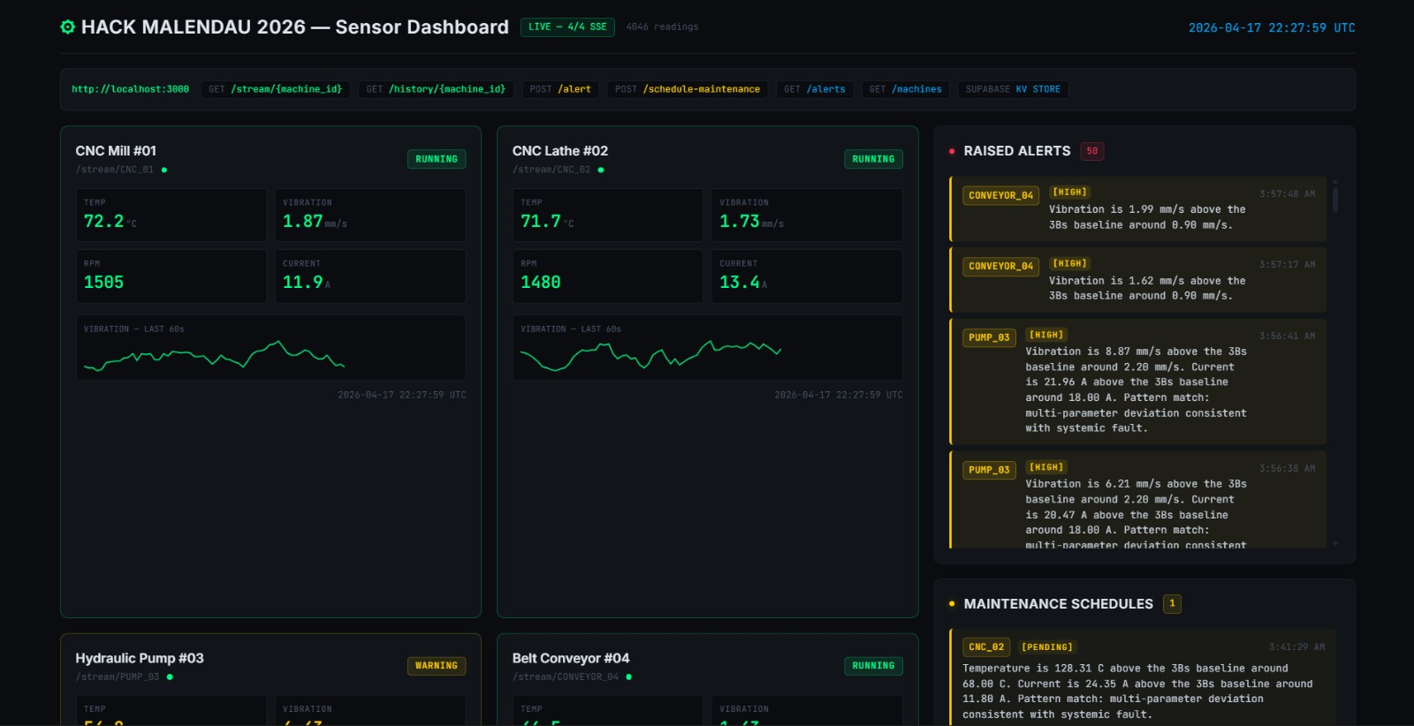
LIVE MONITORING DASHBOARD
Single-screen machine health, alerts, and operating state.
Exact dashboard screenshot provided by the user.

Slide 6
ROLLING WINDOWS & STATISTICAL CORE
Every second of data informs every decision.
20s FAST GATE
30s CONFIRMATION
60s FLEET CORRELATION
600s DEGRADATION WINDOW
15min TIME-OF-DAY BUCKET
Immediate spike detection
Verify anomaly persistence
Cross-machine event check
Theil-Sen trend slope
Historical phase baseline
MATH CORE
median + MAD · direction z-score · persistence %
Theil-Sen slope · compound rules · machine weights

Slide 7
FLEET-WIDE CORRELATION
Not every anomaly is a machine fault.
SCENARIO: 14:30 HRS
Temperature rises on 3 of 4 machines
simultaneously.
CNC_01
CNC_02
+4.2°C
AMBIENT
+3.9°C
AMBIENT
PUMP_03
CONV_04
+4.0°C
AMBIENT
+3.8°C
SENTINEL
Fleet Event Detected: likely sunlight, HVAC, or plant load shift
FLEET EVENT RULE
OUTCOME
Same-sign |z| >= 2.5 on the same metric across at least 3 of 4 machines for 3 consecutive seconds within a 60-second context window.
Flag plant-wide environmental events, suppress false machine alerts, and avoid unnecessary maintenance tickets.

Slide 8
REMAINING USEFUL LIFE
Don't just detect, estimate how much time is left.
RUL OUTPUTS
remaining_life_minutes
~87 min
rul_confidence
0.82
health_stage
DEGRADING
operating_phase
HIGH_LOAD
RUL = min((limit - current) / Theil-Sen slope)
across all sensors trending toward failure
Why it matters
Why it works
Maintenance can be scheduled before the fault becomes a shutdown.
Trend slope beats raw thresholding when degradation is slow and phase-aware.

Slide 9
WHY THE LLM IS IN THE LOOP
Math detects. The LLM explains and decides.
MATHEMATICS
LLM REASONING
- Detects anomalies via z-score
- Confirms persistence windows
- Estimates RUL via slope
- Scores priority pre-rank
- Flags fleet vs machine faults
COMPRESSED
PACKET
- Explains likely root cause
- Adds time-of-day context
- Ranks machine priority
- Decides maintenance action
- Sets shutdown flag if needed
Short,
structured
input only
Token-efficient: the LLM never sees raw per-second sensor streams.

Slide 10
MULTI-MACHINE FAILURE QUEUE
When multiple machines fail, triage first and act calmly.
#1
CNC_02
CRITICAL
RUL: 12 min
Thermal runaway: temperature spike plus sustained current
#2
CNC_01
HIGH
RUL: 87 min
Bearing wear: vibration, temperature, and current rise
#3
PUMP_03
MODERATE
RUL: 3.2 hrs
Cavitation risk: vibration burst with RPM drop
#4
CONV_04
HEALTHY
RUL: —
Sentinel reference: no action required
Priority = f(risk score, RUL urgency, persistence, hard fault, fleet/machine flag)

Slide 11
MAINTENANCE SCHEDULING & SHUTDOWN
From anomaly to action, automatically.
Anomaly Event
Priority Queue
Top Ticket
Maintenance Row
Machine OFF
industrial_alert_events
->
pre-score + LLM rank
->
highest priority raised
->
industrial_maintenance_schedule
->
power state -> SHUTDOWN
RUNNING
QUEUED FOR SHUTDOWN
SHUTDOWN
Normal operation
Maintenance imminent
Machine powered off

Slide 12
DASHBOARD CONCEPT
Full visibility into status, risk, RUL, queue, and power state.
What the dashboard shows
- Live machine state and telemetry
- Raised alerts with severity context
- Maintenance schedule and queue status
Why it matters
- Operators can spot critical machines quickly
- The queue aligns alerts with action
Key outcomes
- Faster triage
- Explainable maintenance decisions
- Cleaner handoff from detection to shutdown

Slide 13
WHY THIS STANDS OUT
Disciplined. Explainable. Operationally complete.
ASPECT
TYPICAL APPROACH
KAIROS
Anomaly Detection
Fixed thresholds
✓ MAD + z-score + persistence
Baseline
Global static limit
✓ Per-machine adaptive rolling
Environment Handling
Misattributed as faults
✓ Fleet correlation layer
LLM Usage
Raw stream -> token waste
✓ Compressed evidence packet only
RUL
Absent or simple countdown
✓ Theil-Sen slope + health stages
Action
Alert only
✓ Queue -> Ticket -> Schedule -> Off

Slide 14
KAIROS
"From raw telemetry to explainable maintenance action."
Statistics detect · Baselines normalize · Fleet context localizes · LLM explains and decides · Automation executes
CNC_01
CNC_02
timing makes the difference
PUMP_03
CONV_04

Slide 15
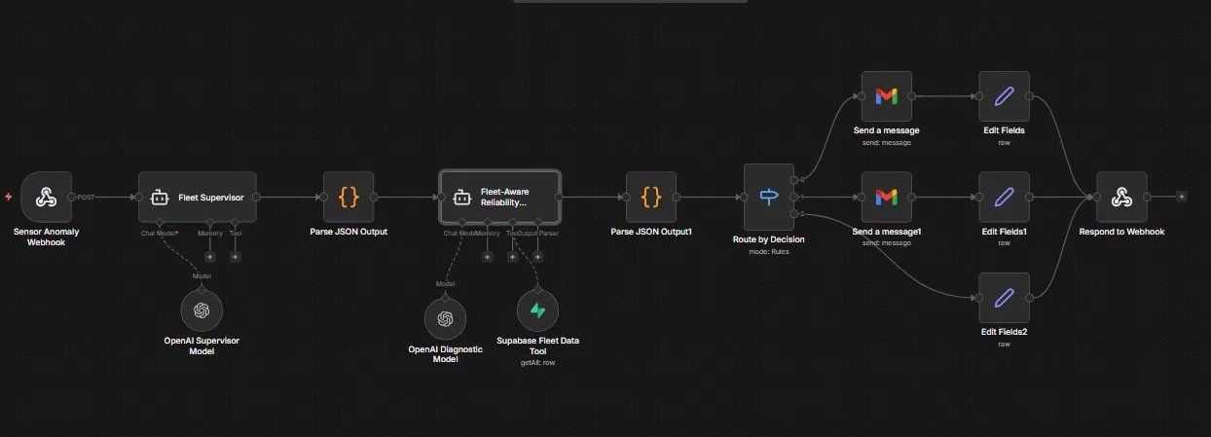
AGENTIC PIPELINE
Fleet-aware sensor-to-action orchestration built in n8n.
Anomaly detected -> Supervisor triage -> Diagnostic reasoning -> Priority routing -> Gmail alert -> Webhook response
01 - Ingest & Supervise
Webhook receives the sensor anomaly. Fleet Supervisor triages with fleet memory context.
02 - Diagnose & Enrich
Fleet-aware agent queries Supabase. OpenAI reasons on root cause and severity.
03 - Route & Alert
Rules-based router dispatches Gmail alerts by severity tier and confirms by webhook.

