Slide 1
CODE CONVERTER
Verilog · Nexys 4 FPGA · 7-Segment Display
Binary → Decimal | Binary → Hex | Binary → Gray | Binary → BCD
Clock Divider | Anode Control | 7-Segment Drive
Presented by:
V.Arya Satya Sai [12308032_16]
T.Leela Krishna [12316522_39]
O.Vinil Kumar [12311402_ 24]

Slide 2
Binary → Decimal
Mode: 2'b00
Binary to Decimal
How It Works
• 4-bit binary input (0–15)
• Outputs: tens digit + units digit
• 0–9 → tens=0, units=0–9
• 10–15 → tens=1, units=0–5
• Displayed on 2 seven-segment digits
Truth Table
Binary | Decimal | Tens | Units
0000 | 0 | 0 | 0
0001 | 1 | 0 | 1
0101 | 5 | 0 | 5
1001 | 9 | 0 | 9
1010 | 10 | 1 | 0
1100 | 12 | 1 | 2
1111 | 15 | 1 | 5
module bin_to_decimal(
input [3:0] bin,
output reg [3:0] tens,
output reg [3:0] units
);
always @(*) begin
case(bin)
4'd0: begin tens=0; units=0; end
4'd9: begin tens=0; units=9; end
4'd10: begin tens=1; units=0; end
4'd15: begin tens=1; units=5; end
// ... all 16 cases
default: begin tens=0; units=0; end
endcase
end
endmodule
Verilog Code

Slide 3
Binary → Hexadecimal
Mode: 2'b01
How It Works
Binary to Hexadecimal
• 4-bit binary maps directly to 1 hex digit
• 0–9 → digits '0'–'9'
• 10–15 → letters 'A'–'F'
• Displayed on the 1st seven-segment digit
• Each hex digit = 4 binary bits
Truth Table
Binary | Decimal | Hex Output
0000 | 0 | 0
0101 | 5 | 5
1001 | 9 | 9
1010 | 10 | A
1011 | 11 | B
1100 | 12 | C
1101 | 13 | D
1110 | 14 | E
1111 | 15 | F
module bin_to_hex(
input [3:0] bin,
output reg [3:0] hex
);
always @(*) begin
case(bin)
4'b0000: hex = 4'h0;
4'b0001: hex = 4'h1;
// ... 2–9 same ...
4'b1010: hex = 4'hA;
4'b1011: hex = 4'hB;
4'b1100: hex = 4'hC;
4'b1101: hex = 4'hD;
4'b1110: hex = 4'hE;
4'b1111: hex = 4'hF;
default: hex = 4'h0;
endcase
end
endmodule
Verilog Code

Slide 4
Binary → Gray Code
Mode: 2'b10
Binary to Gray code
How It Works
• Only ONE bit changes between consecutive values
• MSB of Gray = MSB of Binary
• Other bits: Gray[i] = Bin[i+1] XOR Bin[i]
• 4 bits displayed on 4 seven-segment digits
• Useful in rotary encoders, error reduction
Truth Table
Binary | Decimal | Gray Code
0000 | 0 | 0000
0001 | 1 | 0001
0010 | 2 | 0011
0011 | 3 | 0010
0100 | 4 | 0110
0101 | 5 | 0111
0110 | 6 | 0101
0111 | 7 | 0100
1000 | 8 | 1100
1001 | 9 | 1101
1010 | 10 | 1111
1111 | 15 | 1000
module bin_to_gray(
input [3:0] bin, output reg [3:0] gray );
always @(*) begin
case(bin)
4'b0000: gray = 4'b0000;
4'b0001: gray = 4'b0001;
4'b0010: gray = 4'b0011;
4'b0011: gray = 4'b0010;
4'b0100: gray = 4'b0110;
4'b0101: gray = 4'b0111;
4'b0110: gray = 4'b0101;
4'b0111: gray = 4'b0100;
4'b1000: gray = 4'b1100;
// ... up to 4'b1111
default: gray = 4'b0000;
endcase
end
endmodule
Verilog Code

Slide 5
Binary → BCD
Mode: 2'b11
Binary to BCD
How It Works
• BCD = Binary Coded Decimal
• Each decimal digit stored as 4 bits
• 8-bit output: [7:4] = tens, [3:0] = units
• All 8 bits displayed on 8 seven-segment digits
• e.g. 12 → 0001_0010 (1 and 2 in BCD)
Truth Table
Binary | Dec | BCD [7:4] | BCD [3:0]
0000 | 0 | 0000 | 0000
0101 | 5 | 0000 | 0101
1001 | 9 | 0000 | 1001
1010 | 10 | 0001 | 0000
1011 | 11 | 0001 | 0001
1100 | 12 | 0001 | 0010
1111 | 15 | 0001 | 0101
module bin_to_bcd(
input [3:0] bin, output reg [7:0] bcd );
always @(*) begin
case(bin)
4'd0: bcd = 8'b0000_0000;
4'd5: bcd = 8'b0000_0101;
4'd9: bcd = 8'b0000_1001;
4'd10: bcd = 8'b0001_0000;
4'd11: bcd = 8'b0001_0001;
4'd12: bcd = 8'b0001_0010;
4'd13: bcd = 8'b0001_0011;
4'd14: bcd = 8'b0001_0100;
4'd15: bcd = 8'b0001_0101;
default: bcd = 8'b0000_0000;
endcase
end
endmodule
Verilog Code

Slide 6
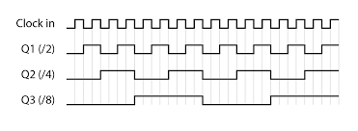
Clock Divider
Slows down the FPGA clock
Clock Divider
Why Do We Need It?
• Nexys 4 board runs at 100 MHz
• Too fast for human eye / 7-seg refresh
• We divide using a 32-bit counter
• Output = count[3] → divides by 2⁴ = 16
• Slowed clock feeds the refresh counter
count[3] picks the 4th bit → output toggles every 8 clocks = 16× slower
module clockdivider(clk, nclk);
input clk;
output reg nclk;
reg [31:0] count = 0;
always @(posedge clk)
begin
count = count + 1;
nclk = count[3]; // bit[3] = divided clock
end
endmodule
// Refresh Counter (fed by nclk)
module refresh_counter(
input clk, output reg [2:0] rc = 3'b000 );
always @(posedge clk)
begin
rc = rc + 1; // cycles 0..7
end
endmodule

Slide 7
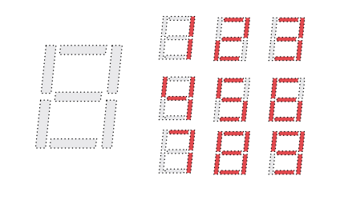
Cathode control
7 cathode wires (CA–CG) are shared by all 8 seven-segment displays.
Active LOW: 0 turns a segment ON, 1 turns it OFF.
Value depends on the digit (0–9, A–F) to be shown on the currently selected display.
Changes with each refresh (rc[2:0] selects which display is active).
module seg7_cathode(input [3:0] in,output reg [6:0] cathode);always @(*) begin case(in)
4'h0: cathode = 7'b1000000; // 0
4'h1: cathode = 7'b1111001; // 1
4'h2: cathode = 7'b0100100; // 2
4'h3: cathode = 7'b0110000; // 3
4'h4: cathode = 7'b0011001; // 4
4'h5: cathode = 7'b0010010; // 5
4'h6: cathode = 7'b0000010; // 6
4'h7: cathode = 7'b1111000; // 7
4'h8: cathode = 7'b0000000; // 8
4'h9: cathode = 7'b0010000; // 9
4'hA: cathode = 7'b0001000; // A
4'hB: cathode = 7'b0000011; // b
4'hC: cathode = 7'b1000110; // C
4'hD: cathode = 7'b0100001; // d
4'hE: cathode = 7'b0000110; // E
4'hF: cathode = 7'b0001110; // F
default: cathode = 7'b1111111; // OFF endcase
end
endmodule

Slide 8
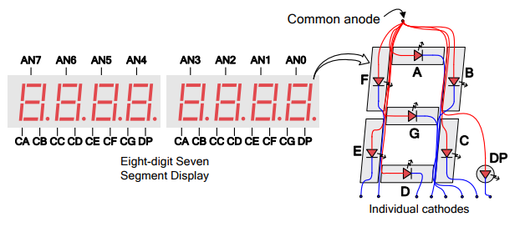
Anode Control
Multiplexed 7-Segment Drive
Anode Control
What Is Anode Control?
• Nexys 4 has 8 seven-segment displays
• All share the same cathode bus (7 wires)
• Each display is individually selected via its anode
• Active LOW: 0 = ON, 1 = OFF
• rc [2:0] input selects one display at a time
• Refreshed fast enough so it looks steady to the eye
module anode_control(in, anode);
input [2:0] in;
output reg [7:0] anode;
always @(*) begin
case(in)
3'b000: anode = 8'b11111110; // Digit 0 ON
3'b001: anode = 8'b11111101; // Digit 1 ON
3'b010: anode = 8'b11111011; // Digit 2 ON
3'b011: anode = 8'b11110111; // Digit 3 ON
3'b100: anode = 8'b11101111; // Digit 4 ON
3'b101: anode = 8'b11011111; // Digit 5 ON
3'b110: anode = 8'b10111111; // Digit 6 ON
3'b111: anode = 8'b01111111; // Digit 7 ON
default: anode = 8'b11111111; // All OFF
endcase
end
endmodule

Slide 9
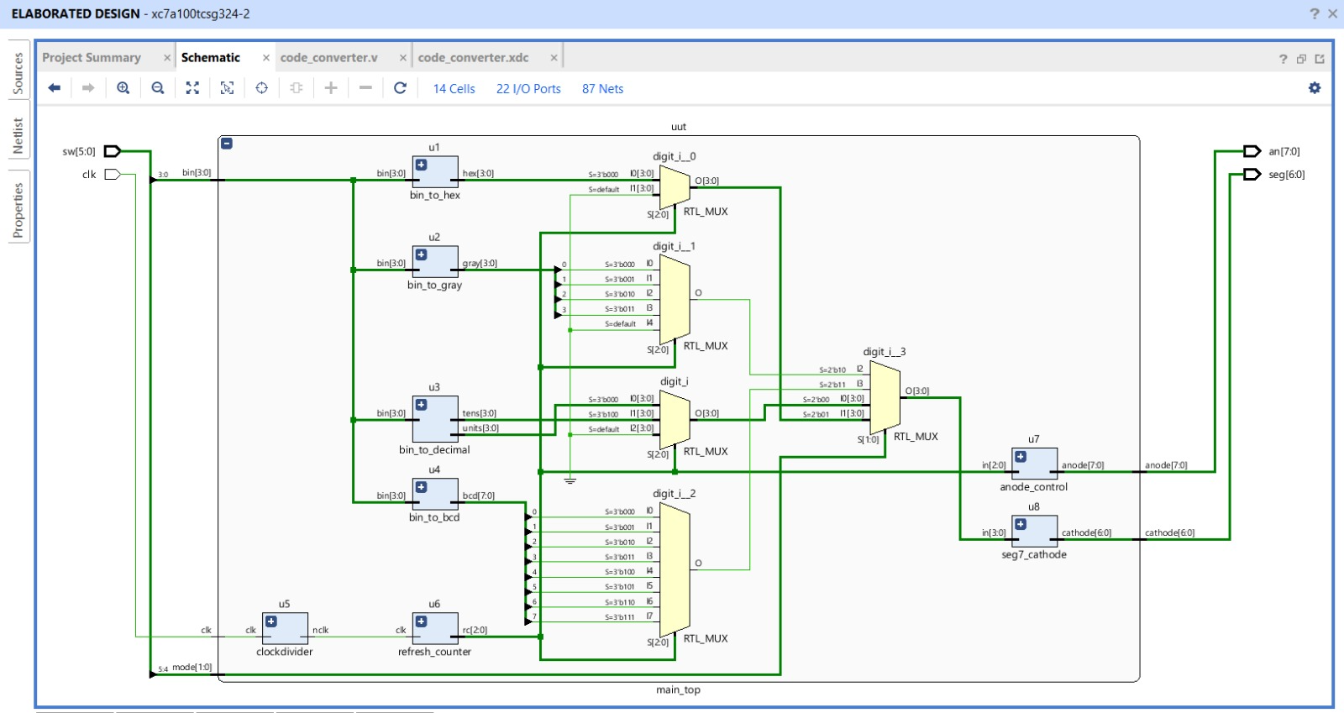
Elaborated Design — RTL Schematic
Vivado · xc7a100tcsg324-2
Data Flow:
sw[3:0]→bin • sw[5:4]→mode • clk→clockdivider→refresh→anode • digit→seg7_cathode→seg
Top-Level Modules
Instance | Module
u1 | bin_to_hex
u2 | bin_to_gray
u3 | bin_to_decimal
u4 | bin_to_bcd
u5 | clockdivider
u6 | refresh_counter
u7 | anode_control
u8 | seg7_cathode

Slide 10
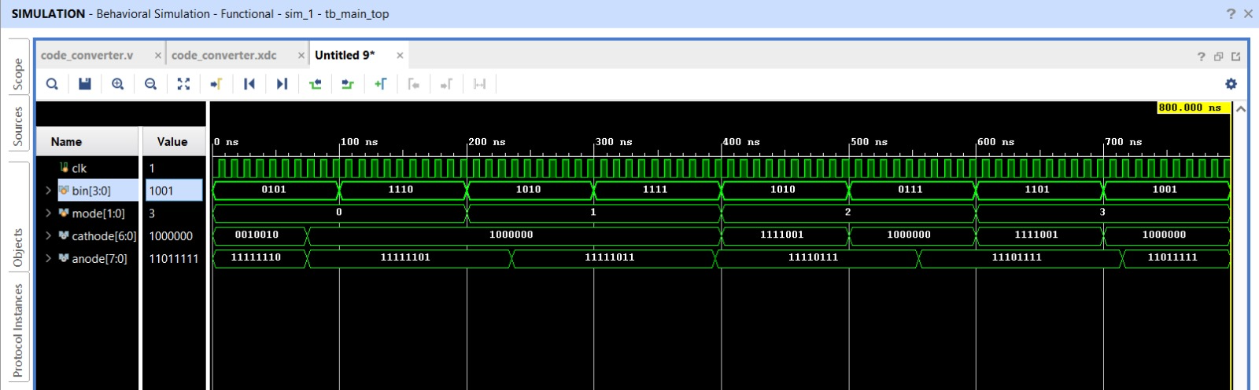
Simulation Waveform
Behavioral Simulation — Vivado
What the Waveform Shows
Signal | Observed Value | Meaning
clk | Continuous toggle | 100 MHz system clock running
bin[3:0] | 0101→1110→1010→… | Input binary values changing over time
mode[1:0] | 0 → 1 → 2 → 3 | Mode switches through all 4 conversion modes
cathode[6:0] | 0010010→1000000… | 7-segment pattern for current digit being driven
anode[7:0] | 11111110→11111101… | Multiplexer cycles through displays (active LOW)

Slide 11
Summary
Binary → Decimal
Binary → BCD
Tens & units on 2 displays (Mode 00)
8-bit BCD on 8 displays (Mode 11)
Data Flow
Binary → Hex
Clock Divider
Single hex digit on display (Mode 01)
Slows 100 MHz for refresh counter
Binary → Gray
Anode Control
4-bit Gray on 4 displays (Mode 10)
Active-LOW mux for 8 displays

