Slide 1
Title
OTP Verification System

Slide 2
Object
To develop a secure and user-friendly 6-digits OTP (One-Time Password) Verification System to validate user identity during an authentication process.
Requirements:
Implement a function to generate a 6-digit OTP randomly.
Develop a function to simulate sending the OTP to the user's email address.
Create a function to prompt the user to enter the OTP received in their email.
Implement a function to verify if the entered OTP matches the generated OTP.
Ensure proper error handling and user-friendly prompts throughout the system.
Allow the user to retry OTP entry in case of incorrect input.

Slide 3
Tools
PyCharm Community Edition
Email
PPT

Slide 4
Methodology
OTP Generation :- Length, Validity, uniqueness
Email Sending:- Send mail by using SMTP
User Verification:- Attempts (5)

Slide 5
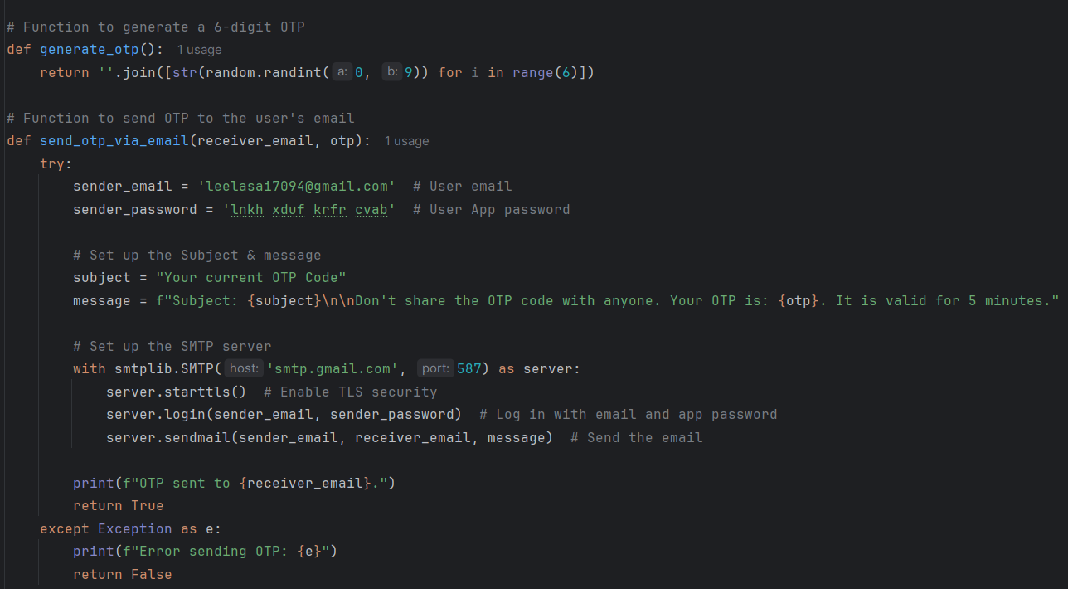
Step1: Generate OTP & Access Email

Slide 6
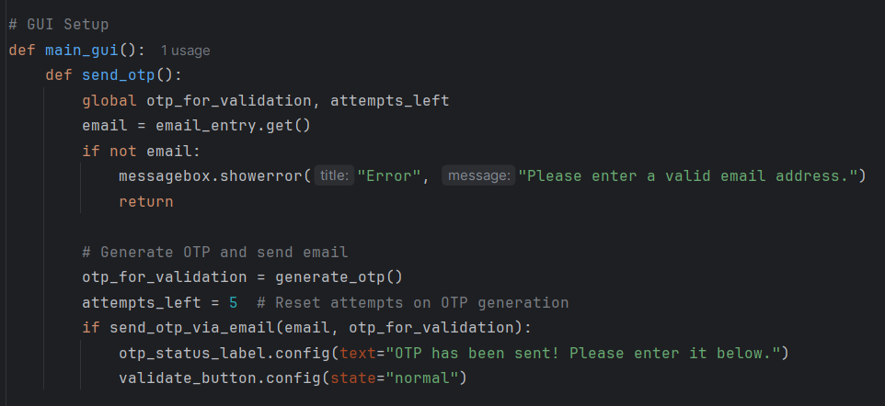
Step2: Graphical User Interface (GUI)

Slide 7
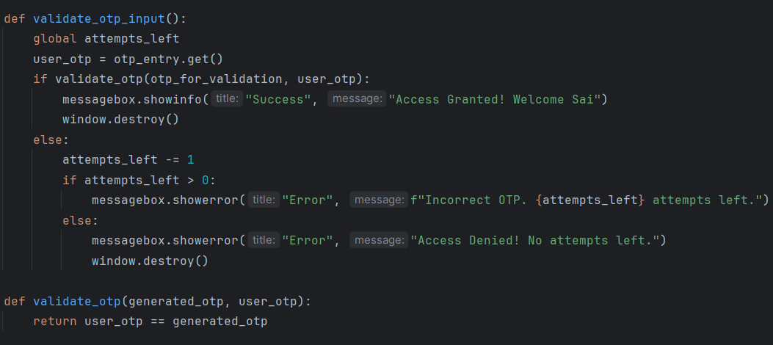
Step3: OTP Verification & Attempts

Slide 8
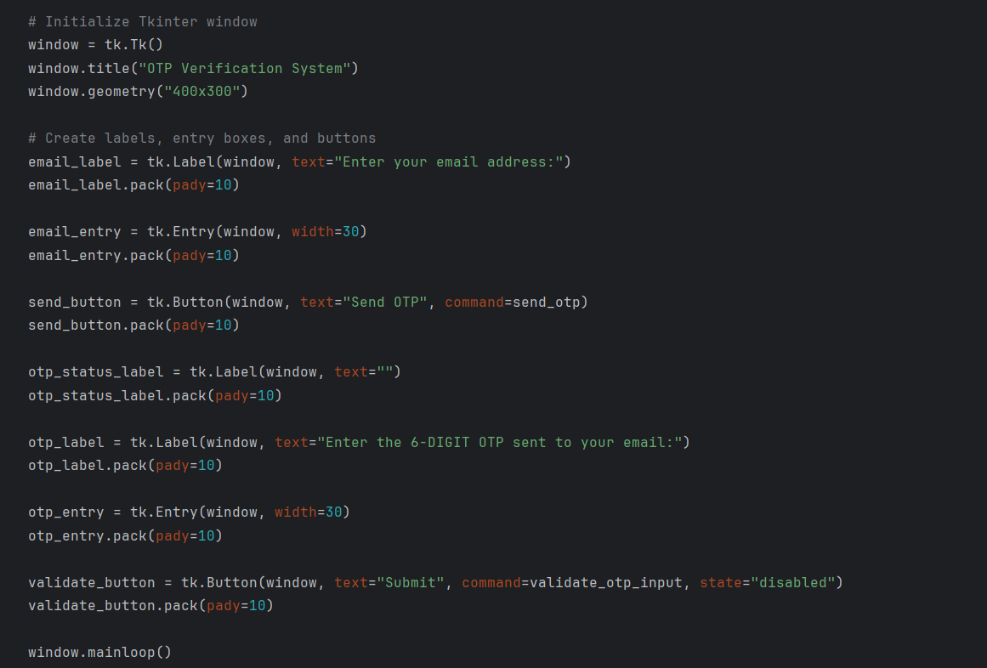
Step4: Create Labels, Buttons in Tkinter Window

Slide 9
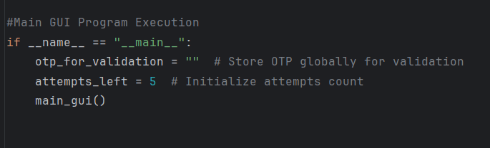
Step5: Main GUI Program Execution

Slide 10
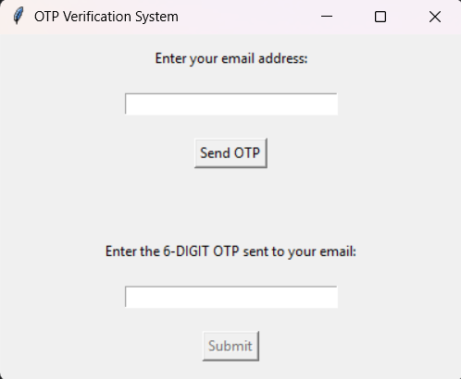
Tkinter Interface

Slide 11
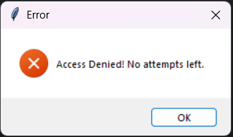
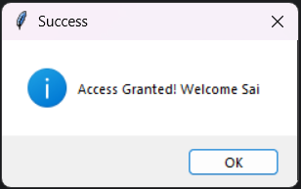
OTP Validation

Slide 12
Scope
Implementing OTP validation can significantly improve the security of that Particular application and reusable in other applications.

Slide 13
Thank You

