Slide 1
Presentation- 2
Leen Rslan

Slide 2
describe("default Economy", () => {
before(() => {
cy.visit("https://www.almosafer.com/en");
});
it(" Economy ", () => {
cy.get('.cta__saudi').click()
cy.get('.sc-jWxkHr')
.should('include.text', "Economy");
});
});
describe("date Tomorrow", () => {
before(() => {
cy.visit("https://www.almosafer.com/en");
});
it(" tomorrow", () => {
cy.get('.cta__saudi').click({ force: true });
cy.get('[data-testid="FlightSearchBox__FromDateButton"]').click({ force: true });
const today = new Date();
today.setDate(today.getDate() + 1);
const year = today.getFullYear();
const month = (today.getMonth() + 1).toString().padStart(2, '0');
const day = today.getDate().toString().padStart(2, '0');
const tomorrow = `${year}-${month}-${day}`;
cy.get('.hyEhCr .DayPicker-Day--selected,:hover', { timeout: 20000 }).each(($el) => {
const dateText = $el.text().trim();
if (dateText === tomorrow) {
const bgColor = $el.css('background-color');
expect(bgColor).to.equal('rgb(2, 100, 122)');
}
});
});
});
describe("date day after Tomorrow", () => {
before(() => {
cy.visit("https://www.almosafer.com/en");
});
it("date day after Tomorrow", () => {
cy.get('.cta__saudi').click({ force: true });
cy.get('[data-testid="FlightSearchBox__ToDateButton"]').click({ force: true });
const today = new Date();
today.setDate(today.getDate() + 2);
const year = today.getFullYear();
const month = (today.getMonth() + 1).toString().padStart(2, '0');
const day = today.getDate().toString().padStart(2, '0');
const twoDaysFromToday = `${year}-${month}-${day}`;
cy.get('.jlvzzg .DayPicker-Day--selected, .jlvzzg .DayPicker-Day--selected:hover', { timeout: 20000 }).each(($el) => {
const dateText = $el.text().trim();
if (dateText === twoDaysFromToday) {
const bgColor = $el.css('background-color');
expect(bgColor).to.equal('rgb(2, 100, 122)');
}
});
});
});

Slide 3
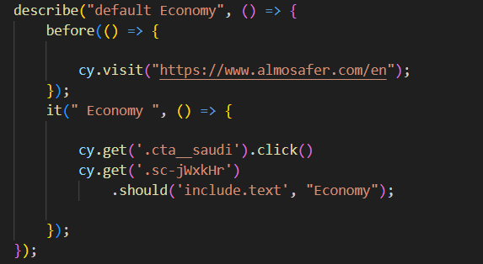
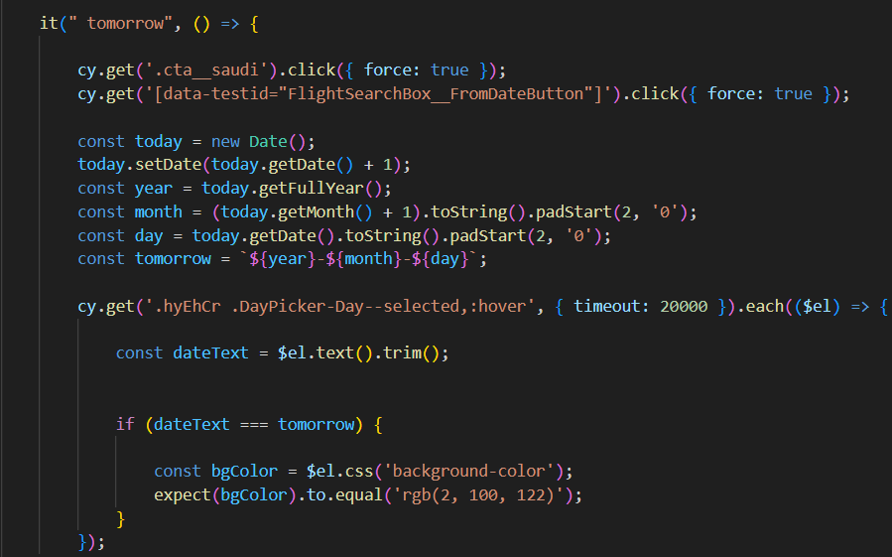
Default Economy Test:
Visit the website.
2. Click on an element with the class 'cta__saudi’.
3. Check if an element with the class 'sc-jWxkHr' contains the text "Economy". If it does, the test passes.
Date Tomorrow Test:
1. Visit the website.
2. Click on an element with the class 'cta__saudi'.
3. Click on a date picker to select the date for tomorrow.
4. Calculate tomorrow's date.
5. Check if the date picker highlights the calculated date in a specific color. If it does, the test passes.

Slide 4
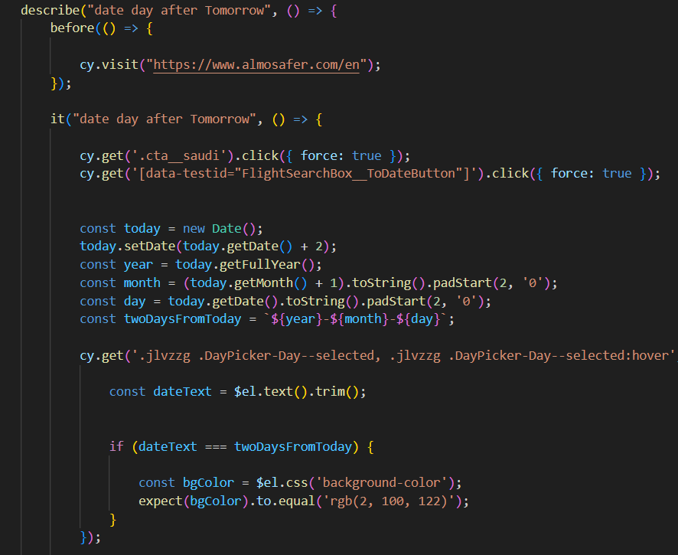
Date Day After Tomorrow Test:
1. Visit the website.
2. Click on an element with the class 'cta__saudi'.
3. Click on a different date picker to select a date two days from today.
4. Calculate the date two days from today.
5. Check if the date picker highlights the calculated date in a specific color. If it does, the test passes.

Slide 5
