Slide 1
DATA TRANSFORMATION
TRANSFORMING BUSINESS PROCESSES AND DECISION MAKING WITH REAL-WORLD APPLICATIONS
Leen Shareef Saleh - 22110090
Eng. Batool Al-Armouti

Slide 2
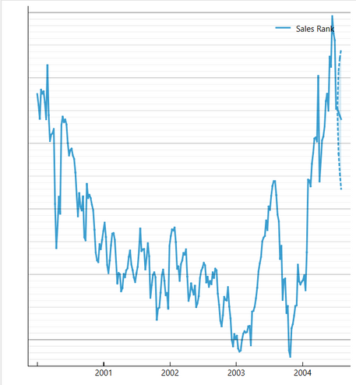
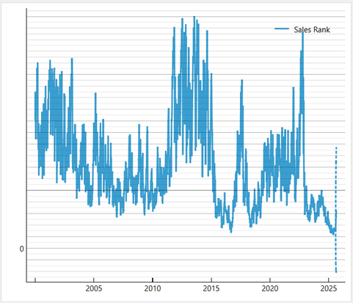
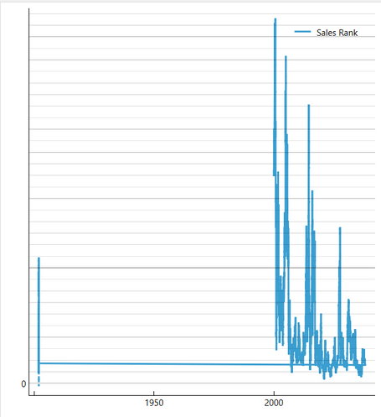
DATA SCIENCE TOOLS IN BUSINESS DECISION-MAKING
I'm forecasting sales ranks for three products—Lego Star Wars, Fitbit Charge 4 Fitness Tracker, and CMOS Digital Camera—using Orange. and I’m conducting a descriptive analysis of their datasets using Power BI to gain deeper insights into their performance trends.
for example the predictions of Orange:
Fibit Charge 4 Fitness
CMOS Digital Camera
Lego star wars

Slide 3
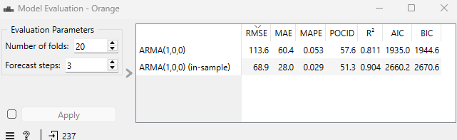
DATA SCIENCE TOOLS IN BUSINESS DECISION-MAKING
The sales rank has gone up and down a lot between 2001 and 2004. and from 2001 to early 2003, the rank got better (lower rank), but after mid-2003, it became more unstable.
The ARIMA model predicts that the sales rank will improve (lower rank) after a high point in 2004. (The dotted line shows the forecasted future values, which seem to go down.)
The out-of-sample model has an RMSE of 113.6, which means the predictions are off by a large margin. The in-sample RMSE (68.9) is better, meaning the model fits past data better than it predicts future values.
The out-of-sample MAE is 60.4, while the in-sample is 28. This shows the model performs worse on future predictions compared to past data.
The out-of-sample MAPE is 0.053 (5.3%), showing the percentage error in predictions.
Lego star wars

Slide 4
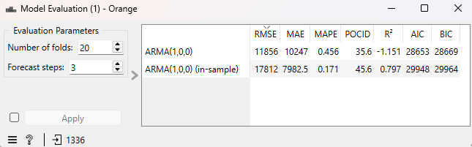
DATA SCIENCE TOOLS IN BUSINESS DECISION-MAKING
There are periods of high instability, especially around 2010–2015, with many sharp increases and decreases in rank.
In recent years (after 2020), the sales rank seems to have stabilized somewhat with fewer extreme changes.
Toward 2025, the sales rank appears to drop sharply (improving performance) based on the dotted prediction line. The forecast shows a promising improvement in the near future.
Despite the overall fluctuations, there are periods where the rank consistently performs better, such as around 2017–2019.
RMSE --> 11,856 shows a significant error in predicting future values. 17,812 is higher, meaning the model struggles to fit the historical data well.
MAPE --> 45.6% shows predictions are highly inaccurate for future data.
POCID --> 35.6%, meaning the model predicts the direction of change (up or down) correctly about a third of the time
R^2 --> -1.151, indicating the model performs worse than simply predicting the average. and 0.797, showing the model explains some of the historical variance but is far from perfect.
The model struggles to predict future sales accurately based on the high error values and low accuracy metrics.
In-sample performance is better than out-of-sample, but both need improvement.
Fibit Charge 4 Fitness

Slide 5
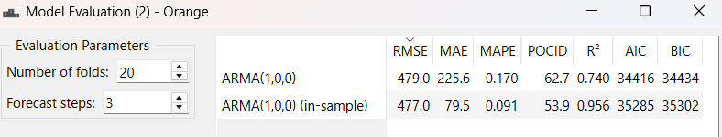
DATA SCIENCE TOOLS IN BUSINESS DECISION-MAKING
Little to no activity in sales rank before the 2000s.
Big changes start around the late 1990s or early 2000s, showing more dynamic data.
From 2000 onwards, the sales rank goes up and down a lot, indicating changes in product popularity.
Some short times where the sales rank stays steady with little change.
These stable periods might mean the product consistently held a certain rank.
Sales rank shows bigger drops and peaks after 2020.
This increased volatility could be due to market trends, promotions, or more competition.
The product became more relevant in the market after the 1990s. Before that, it either didn’t exist or had very low activity.
Big changes in sales rank might be linked to major events, changing consumer preferences, or promotional efforts.
CMOS Digital Camera
RMSE --> Out-of-sample: 479.1, In-sample: 474.4 --> Both values are close, indicating that the model performs consistently when predicting new data and within the dataset it was trained on.
MAE (Mean Absolute Error): Out-of-sample: 225.3 and In-sample: 78.7, The much lower MAE for in-sample data suggests that the model fits the training data better than it generalizes to new data.
R² (Coefficient of Determination): Out-of-sample: 0.740 and In-sample: 0.956, A high R² for in-sample data shows the model explains 95.6% of the variability. However, the out-of-sample R² (74%) drops, reflecting a decrease in performance when applied to unseen data.
The model performs reasonably well on both in-sample and out-of-sample data, with metrics showing only minor drops in prediction accuracy.
The model fits the training data (in-sample) very well, as seen by lower errors (MAE, MAPE) and a higher R². However, the slight reduction in out-of-sample performance could indicate slight overfitting.

Slide 6
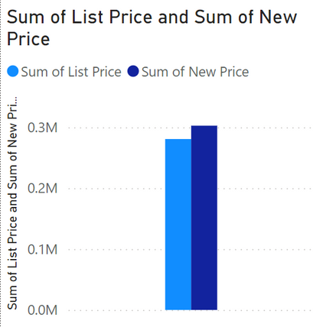
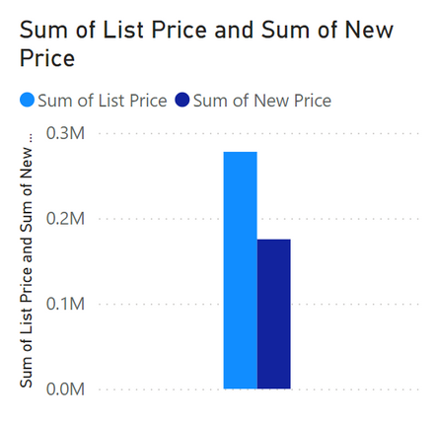
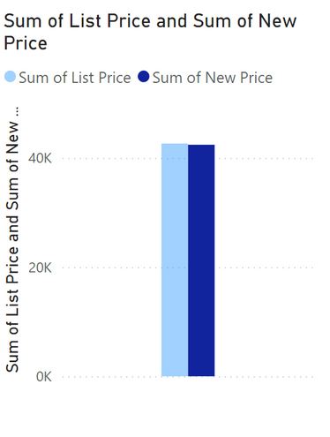
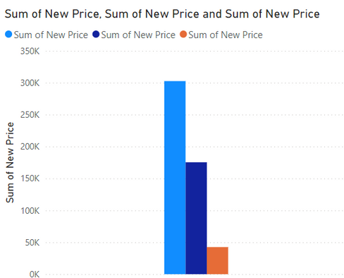
DATA SCIENCE TOOLS IN BUSINESS DECISION-MAKING
This chart is a bit different, showing three bars for Sum of new price in light blue, dark blue, and orange. The lights blue bar is significantly higher (CMOS), reaching 300k, while the other two are lower, with light blue (Fibit) slightly above 150k and orange (Lego) slightly below 50k.
Sum of List Price is slightly below 0.3M, while Sum of New Price is slightly above 0.3M.
Sum of List Price is slightly above 0.2M, while Sum of New Price is slightly below 0.2M.
Sum of List Price is slightly above 40K, while Sum of New Price is slightly below 40K.

Slide 7
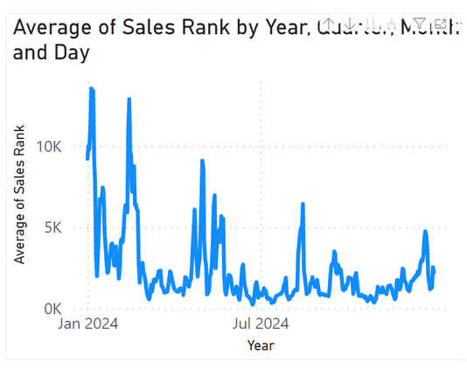
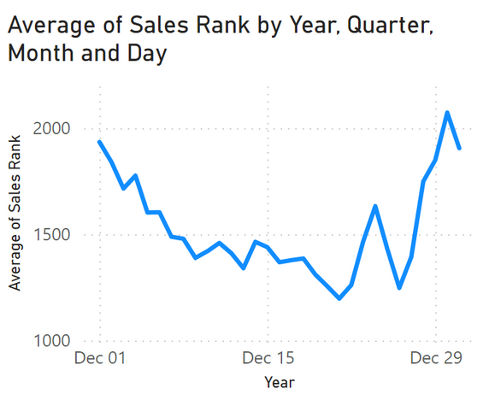
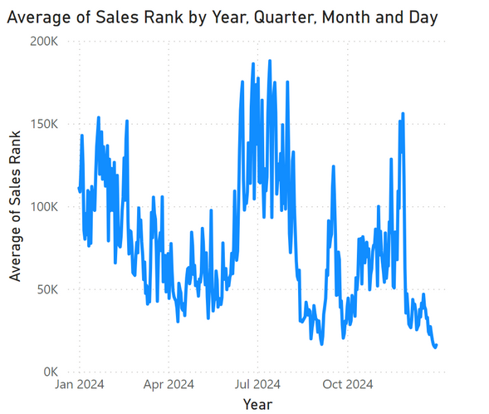
DATA SCIENCE TOOLS IN BUSINESS DECISION-MAKING
CMOS Digital Camera
Lego star wars
Fibit Charge 4 Fitness
The highest peaks are in January and mid-year. The lowest points occur around mid-year and towards the end of the year. and this helps in Identifying periods of high sales can help in planning marketing campaigns and inventory management. and Allocate more resources (staff, marketing budget) during peak periods.
The sales rank starts at around 2000, drops to around 1000 by mid-December, and rises again towards the end of December. and this helps in Understanding customer behavior during the holiday season to better target promotions and discounts. and ensuring good stock during peak times to avoid stockouts.
sales peaked mid-year in June and again towards the end of the year in October and December, likely due to mid-year sales events and holiday shopping. There were steady sales with minor fluctuations in the first half of the year and a gradual decline from July to September.

Slide 8
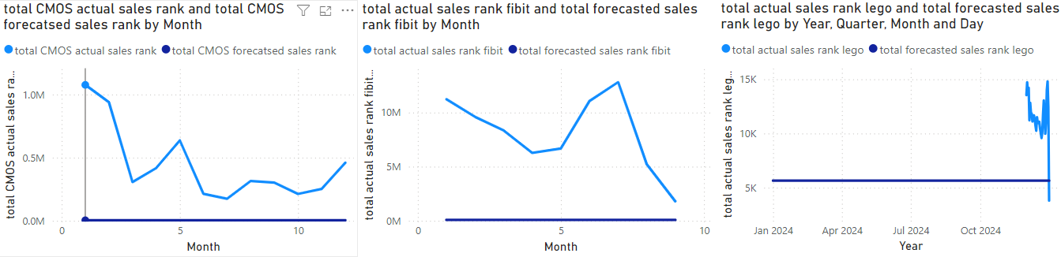
DATA SCIENCE TOOLS IN BUSINESS DECISION-MAKING
Total CMOS actual sales rank and total CMOS forecasted sales rank by Month
The actual sales rank has fluctuations, starting high and decreasing with ups and downs over the months. The forecasted sales rank remains consistently flat.
Total actual sales rank Fitbit and total forecasted sales rank Fitbit by Month
Actual sales rank starts high, decreases over time with some variability, while the forecasted sales rank is flat and does not change.Total actual
sales rank Lego and total forecasted sales rank Lego by Year, Quarter, Month, and Day
Actual sales rank changes rapidly, with some sharp decreases and increases, while the forecasted rank again stays constant.

Slide 9


DISCUSS HOW TOOLS AND TECHNOLOGIES ASSOCIATED WITH DATA SCIENCE ARE USED TO SUPPORT BUSINESS PROCESS AND INFORM DECISIONS.
Sales Rank Forecasting Insights
Future Planning: Predictions (a sharp drop in sales rank towards 2025) help businesses prepare strategies for improving performance.
Identifying Peaks: Recognizing high-sales periods (e.g., mid-year and end-of-year peaks) aids in planning promotions, discounts, and ensuring stock availability.
Customer Behavior: Understanding holiday season trends and mid-year sales events allows targeted marketing and operational adjustments.

Slide 10
DISCUSS HOW TOOLS AND TECHNOLOGIES ASSOCIATED WITH DATA SCIENCE ARE USED TO SUPPORT BUSINESS PROCESS AND INFORM DECISIONS.
Sales rank forecasting is an important process for businesses to understand how products perform in the market. Tools like Power BI and Orange help with this by providing ways to analyze and predict sales trends. Power BI makes it easy to look at past sales data using charts and graphs, helping businesses see patterns like when sales are high or low. This helps companies plan better, like having enough stock during busy times or spending money on ads when it’s most needed.
Orange is useful for predicting the future sales rank of products using models like ARIMA. It also shows how accurate the predictions are with numbers like RMSE and R². This helps businesses trust the predictions and use them for planning. With these tools, businesses can make smart decisions, like running special offers at the right time, setting better prices, and avoiding problems like having too much or too little stock. This makes their work more efficient and keeps customers happy.

Slide 11
ASSESS THE BENEFITS OF USING DATA SCIENCE TO SOLVE PROBLEMS IN THE CURRENT SCENARIO.
Better Decision-Making: Data science gives information that helps businesses make smart choices, which means less guessing. because it is relying on actual, real data.
Predictive Insights: Data science uses tools to predict future sales trends, helping companies plan ahead and get ready for changes. making sure of their inventory management.
Improved Resource Allocation: Data helps businesses use their resources wisely, like staff and marketing budgets, to meet what customers need.
Enhanced Customer Understanding: Data science helps businesses learn what customers like and how they behave, leading to better marketing and products. and making the most of their sales.
Risk Management: Predictive analytics in data science can find possible sales risks, allowing businesses to take steps to avoid them.
Competitive Advantage: Companies that use data science can react faster to market changes than others, giving them an advantage.

Slide 12
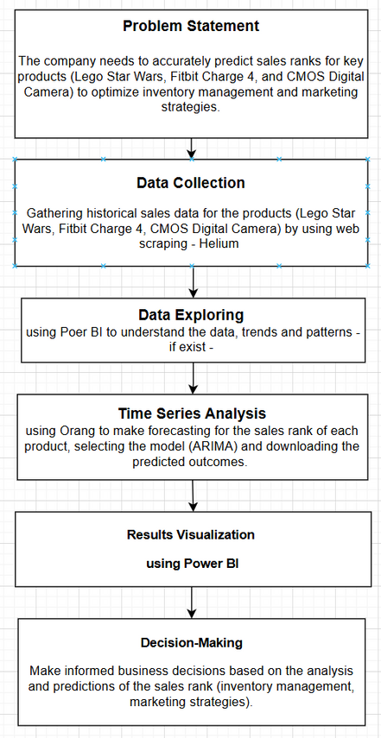
FLOWCHART OF THE SOLUTION

Slide 13
JUSTIFIED RECOMMENDATIONS TO SUPPORT DECISION-MAKING RELATED TO PREDICTING SALES RANKS
Integrate Real-Time Data Sources: Incorporating real-time sales data, customer behavior metrics, and market trends allows for more responsive forecasting, helping the business adapt quickly to changes in demand.
Monitor Key Performance Indicators (KPIs): Justification: Establishing and tracking KPIs related to sales rank accuracy can help assess the effectiveness of forecasting methods and identify areas for improvement.
Enhance Collaboration Across Departments: Involving sales, marketing, and supply chain teams in the forecasting process fosters a holistic approach, ensuring that all aspects of the business are aligned and informed by the same data insights.
Conduct Scenario Analysis: Running various scenarios based on different assumptions ( economic changes, competitive actions) helps prepare the business for potential market shifts and aids in strategic planning.

Slide 14
EVALUATION OF THE USE OF DATA SCIENCE TECHNIQUES AGAINST USER AND BUSINESS REQUIREMENTS FOR AMAZON
Business Requirements
Personalized Recommendations
Supply Chain Optimization
Accurate Forecasting
Fraud Detection
That Amazon needs detailed predictions of product demand to manage inventory effectively. using of the sales forecasting.
Evaluation: Data science techniques, such as time series analysis and machine learning algorithms (ARIMA), allow Amazon to analyze historical sales data, seasonal trends, and external factors (like holidays or promotions) to forecast demand accurately.
Enhancing customer experience through personalized product suggestions. based on what they have been reviewing.
Evaluation: Collaborative filtering and content-based filtering algorithms analyze user behavior and preferences, enabling Amazon to provide tailored recommendations, which significantly boost sales and customer satisfaction.
Identifying and mitigating fraudulent activities on the platform.
Evaluation: Machine learning techniques, such as anomaly detection and decision trees, help in detecting unusual patterns in transactions, thereby minimizing fraud and enhancing security for users and the company itself.
Efficiently managing logistics and fulfillment processes. to not get to the point of “out of stock” and to prevent the last-minute work.
Evaluation: Data analytics optimize supply chain operations by predicting delivery times, managing inventory across warehouses, and optimizing shipping routes, ensuring timely delivery and cost efficiency.

Slide 15
EVALUATION OF THE USE OF DATA SCIENCE TECHNIQUES AGAINST USER AND BUSINESS REQUIREMENTS FOR AMAZON
User Requirements
Fast and Accurate Search Results
Real-Time Assistance
Data Privacy and Security
Quick access to relevant products through search functionality.
Evaluation: Search algorithms powered by data science techniques, such as keyword extraction, ensure that users receive relevant search results rapidly, improving the overall shopping experience.
Immediate support for customer inquiries and issues.
Evaluation: Chatbots and virtual assistants powered by NLP can provide real-time assistance, enhancing customer service and reducing response times.
Protecting user data and maintaining trust.
Evaluation: Implementing robust data governance frameworks ,encryption techniques and machine learning algorithms to prevent fraud ensures user data is secure, complying with regulations like GDPR and maintaining customer trust for sure.

Slide 16
Thank you!
Leen Shareef Saleh
22110090@htu.edu.jo
Eng. Batool Al-Armouti

