Slide 1
Data Science Applications in Telecom Operations
LEEN SHAREEF SALEH

Slide 2
COMMON LIBRARIES USED IN DATA SCIENCE
numpy
A Python library called NumPy offers a robust and effective array object along with a number of tools and functions for scientific computing. NumPy arrays can handle and store a variety of multidimensional data types, including vectors, matrices, images, and more. Additionally, NumPy provides mathematical functions for statistics, random number generation, Fourier transform, and linear algebra. Data science, machine learning, and other disciplines requiring quick and dependable numerical calculations frequently use NumPy. NumPy is compatible with many other Python libraries, including Matplotlib, Scikit-learn, and Pandas.
NUMPY LINK

Slide 3
EXAMPLES
import numpy as np
# Creating a 1D array
arr_1d = np.array([1, 2, 3, 4, 5])
# Creating a 2D array
arr_2d = np.array([[1, 2, 3], [4, 5, 6]])
# Creating an array with zeros
zeros_array = np.zeros((3, 3))
# Creating an array with ones
ones_array = np.ones((2, 4))
# Creating an identity matrix
identity_matrix = np.eye(3)
import numpy as np
# Element-wise addition
arr1 = np.array([1, 2, 3])
arr2 = np.array([4, 5, 6])
result_addition = arr1 + arr2
# Element-wise multiplication
result_multiplication = arr1 * arr2
# Dot product of two arrays
dot_product = np.dot(arr1, arr2)
# Transposing a matrix
transposed_matrix = np.transpose(arr_2d)
import numpy as np
# Applying mathematical functions to an array
original_array = np.array([1, 2, 3, 4, 5])
square_root = np.sqrt(original_array)
exponential = np.exp(original_array)

Slide 4
COMMON LIBRARIES USED IN DATA SCIENCE
pandas
Pandas is a Python library that offers tools and data structures for analyzing and manipulating data. When handling tabular data from CSV files, Excel files, or SQL databases, pandas can be a helpful tool. Using a DataFrame object—a two-dimensional table with labeled rows and columns—Pandas enables you to read, filter, transform, aggregate, and visualize data. Additionally, Pandas supports a number of operations, including grouping, joining, reshaping, and merging data. Numerous other Python libraries, including NumPy, Matplotlib, and Scikit-learn, are compatible with Pandas.
PANDAS LINK

Slide 5
EXAMPLES
import pandas as pd
# Reading a CSV file into a DataFrame
df = pd.read_csv('example.csv')
# Writing a DataFrame to a CSV file
df.to_csv('output.csv', index=False)
import pandas as pd
# Displaying the first few rows of a DataFrame
head_of_dataframe = df.head()
# Displaying summary statistics
summary_stats = df.describe()
# Checking for missing values
missing_values = df.isnull().sum()
import pandas as pd
# Selecting a single column
single_column = df['Column_Name']
# Filtering rows based on a condition
filtered_data = df[df['Column_Name'] > 50]
# Selecting specific rows and columns
selected_data = df.loc[[1, 3, 5], ['Column1', 'Column2']]

Slide 6
COMMON LIBRARIES USED IN DATA SCIENCE
matplotlib
A Python package called Matplotlib offers visualization capabilities for making graphs, charts, and plots. Data exploration and presentation can benefit from it. Many plot types, including line, bar, scatter, histogram, pie, and more, are supported by Matplotlib. You can also add labels, legends, titles, axes, grids, and annotations to your plots using Matplotlib to alter their appearance and arrangement. Plots created with Matplotlib can be exported to a variety of file types, including PNG, PDF, SVG, and GIF. Additionally, Matplotlib is compatible with NumPy, Pandas, and Scikit-learn, among other Python libraries.
MATPLOTLIB LINK

Slide 7
EXAMPLES
import matplotlib.pyplot as plt
import numpy as np
# Generating data
x = np.linspace(0, 10, 100)
y = np.sin(x)
# Creating a line plot
plt.plot(x, y, label='Sine Curve')
plt.xlabel('X-axis')
plt.ylabel('Y-axis')
plt.title('Line Plot Example')
plt.legend()
plt.show()
import matplotlib.pyplot as plt
import numpy as np
# Generating data
x = np.random.rand(50)
y = np.random.rand(50)
# Creating a scatter plot
plt.scatter(x, y, color='blue', marker='o', label='Random Points')
plt.xlabel('X-axis')
plt.ylabel('Y-axis')
plt.title('Scatter Plot Example')
plt.legend()
plt.show()

Slide 8
COMMON LIBRARIES USED IN DATA SCIENCE
Scikit-learn
A Python library called Scikit-learn offers machine learning tools for data mining and analysis. It is helpful for developing and assessing dimensionality reduction, regression, classification, and clustering predictive models. NumPy, SciPy, and Matplotlib serve as the foundation for Scikit-learn, which is also compatible with a wide range of other Python libraries, including Pandas and TensorFlow. Numerous algorithms, including logistic regression, k-means, PCA, nearest neighbors, gradient boosting, random forest, and more, are available with Scikit-learn. Additionally, Scikit-learn offers tools and functions for metrics, visualization, cross-validation, model selection, feature extraction, and data preprocessing.
SCIKIT-LEARN LINK

Slide 9
EXAMPLES
from sklearn.linear_model import LinearRegression
from sklearn.model_selection import train_test_split
from sklearn.metrics import mean_squared_error
import numpy as np
# Generating random data
np.random.seed(42)
X = 2 * np.random.rand(100, 1)
y = 4 + 3 * X + np.random.randn(100, 1)
# Splitting the data into training and testing sets
X_train, X_test, y_train, y_test = train_test_split(X, y, test_size=0.2, random_state=42)
# Creating and training the linear regression model
lin_reg = LinearRegression()
lin_reg.fit(X_train, y_train)
# Making predictions on the test set
y_pred = lin_reg.predict(X_test)
# Evaluating the model
mse = mean_squared_error(y_test, y_pred)
print(f'Mean Squared Error: {mse}')
from sklearn.cluster import KMeans
from sklearn.datasets import make_blobs
import matplotlib.pyplot as plt
# Generating random data for clustering
X, y = make_blobs(n_samples=300, centers=4, random_state=42)
# Creating and fitting the KMeans model
kmeans = KMeans(n_clusters=4)
kmeans.fit(X)
# Visualizing the clusters
plt.scatter(X[:, 0], X[:, 1], c=kmeans.labels_, cmap='viridis')
plt.scatter(kmeans.cluster_centers_[:, 0], kmeans.cluster_centers_[:, 1], marker='X', s=200, color='red', label='Centroids')
plt.legend()
plt.title('K-Means Clustering')
plt.show()

Slide 10
COMMON LIBRARIES USED IN DATA SCIENCE
seaborn
A Python package called Seaborn offers visualization capabilities for making graphs, charts, and plots. Data exploration and presentation can benefit from it. Seaborn closely integrates with pandas data structures and is built upon the matplotlib framework. Plot types supported by Seaborn include line, bar, scatter, histogram, pie, and more. You can also add labels, legends, titles, axes, grids, and annotations to your plots in Seaborn to alter their appearance and arrangement. Plots from Seaborn can be exported to a variety of file types, including PNG, PDF, SVG, and GIF. Additionally, Seaborn is compatible with NumPy, Scikit-learn, and TensorFlow, among other Python libraries.
SEABORN LINK

Slide 11
EXAMPLES
import seaborn as sns
import matplotlib.pyplot as plt
# Generate random data
data = np.random.randn(1000)
# Plotting histogram with KDE
sns.histplot(data, kde=True, bins=30, color='skyblue')
plt.title('Histogram with KDE')
plt.show()
# Generate random data
data = np.random.randn(1000)
# Plotting boxplot
sns.boxplot(x=data, color='salmon')
plt.title('Boxplot')
plt.show()
# Load the Iris dataset
iris = sns.load_dataset('iris')
# Plotting pair plot
sns.pairplot(iris, hue='species', palette='Set2')
plt.title('Pair Plot: Iris Dataset')
plt.show()

Slide 12
COMMON LIBRARIES USED IN DATA SCIENCE
missingo
A Python package called missingno is used to analyze and visualize missing data in datasets. It offers a range of visualizations that make it easier to spot trends and patterns in missing data. The library is especially helpful when a project is in its data exploration phase.
MISSINGO LINK

Slide 13
EXAMPLES
import missingno as msno
import matplotlib.pyplot as plt
msno.matrix(df)
plt.show()
msno.bar(df)
plt.show()
msno.heatmap(df)
plt.show()

Slide 14
Plotting and visualization libraries
MATPLOTLIB
SEABORN
ALTAIR
PLOTLY
LEEN SHAREEF SALEH

Slide 15
Plotting and visualization libraries
Matplotlib is a popular and adaptable Python plotting library. To create different kinds of plots, such as line plots, scatter plots, bar charts, histograms, and more, it offers an object-oriented API.
Seaborn offers a high-level interface for producing statistical visualizations and is built on top of Matplotlib. It makes difficult tasks easier, such as estimating linear regression models, making multi-plot grids, and comparing multiple variables.
MATPLOTLIB
SEABORN
key benifites:
Helps understand correlations between variables.
Communicates model fitting results effectively.
Useful for outlier detection using scatter plots
key benifites:
Seaborn focuses on making hard things easy.
Seaborn has better aesthetics and customized themes.
Works well with pandas DataFrames.

Slide 16
Plotting and visualization libraries
Altair is a declarative statistical visualization library written in Python. With clear and simple syntax, users can produce interactive visualizations.
With the help of the interactive plotting library Plotly, Python users can easily produce dynamic, online-based visualizations. Numerous chart types are supported by it, such as line, scatter, bar, and three-dimensional plots.
ALTAIR
PLOTLY
key benifites:
Easy-to-use syntax
Interactive plots
Seamless integration with Pandas
Simplifies visualization complexities
key benifites:
Interactive plots with zooming, panning, and hovering capabilities.
Export plots to various formats, including HTML and PNG.
Integration with Pandas for easy data manipulation and analysis.

Slide 17
Experiments
I used Google Colab, a platform that is ideal for Python development, to work on my project. Colab's user-friendly interface and interactive cell-by-cell implementation made my work easier by providing features like robust error handling, streamlined project management, and extensive library support. Python was my main programming language of choice because of its high level of functionality and reputation, especially in the fields of data science and machine learning. Its robust libraries, such as NumPy, Pandas, and Matplotlib, along with its rich data structures made handling and analyzing datasets a lot easier. Python's ability to manage big datasets made it an excellent choice for my project, especially because it can make full use of the Pandas library.

Slide 18
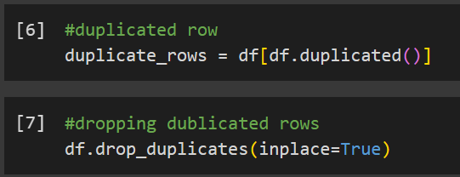
Load Data and Prepare Data (Preprocessing)
Preprocessingstep Name: dropping all duplicated rows
Description: having the same row with the same info. tiwce is not impotant
Justification: So I drop this duplicated rows because all the values are same in it. they have the same values of all values. should be dropped from the dataset.

Slide 19
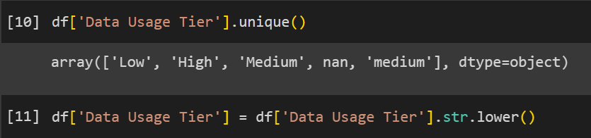
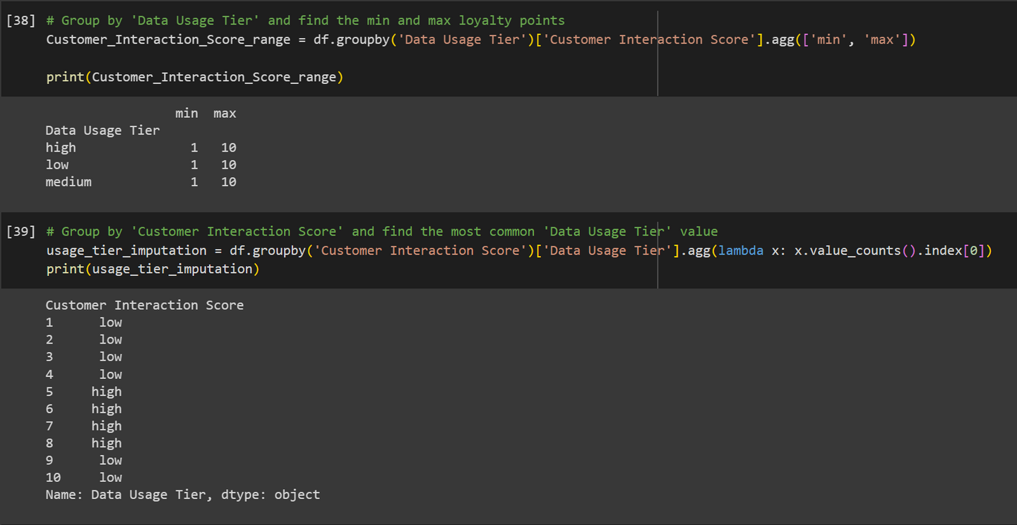
Load Data and Prepare Data (Preprocessing)
Preprocessingstep Name: filling null values in Data Usage Tier column
Description:Null values in the 'Data Usage Tier' column are filled based on the mode (most frequently occurring value) of each 'Customer Interaction Score'.
Justification: By filling null values based on the mode of 'Data Usage Tier' corresponding to each 'Customer Interaction Score', we utilize information about the frequency and quality of interactions customers have with customer service.

Slide 20
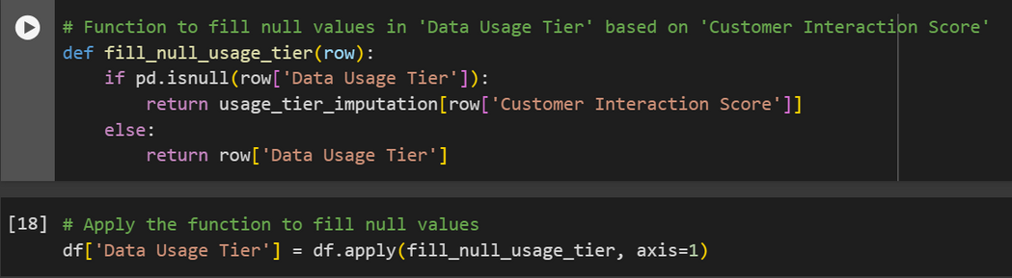
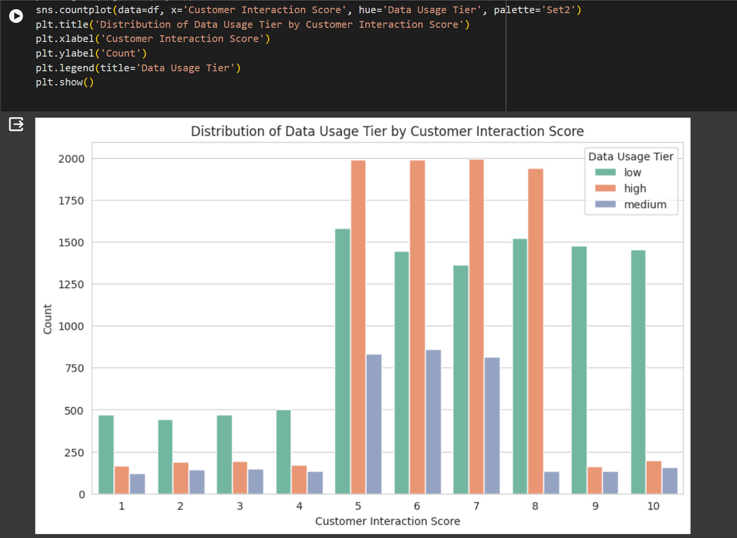

Slide 21

Load Data and Prepare Data (Preprocessing)
Preprocessingstep Name: Dropping Null Values in 'USER_CREATED_BY' Column
Description: Null values in the 'USER_CREATED_BY' column are removed from the DataFrame.
Justification: Removing null values in 'USER_CREATED_BY' column helps maintain data integrity and prevents potential errors or biases in analyses or modeling tasks that involve user-related information.
Since the number of null values is relatively small (100 null values), dropping them does not significantly impact the size or integrity of the dataset.

Slide 22
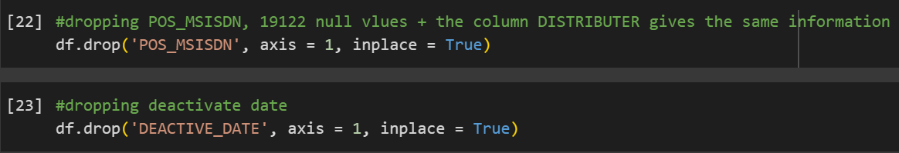
Load Data and Prepare Data (Preprocessing)
Preprocessingstep Name: Dropping POS_NSISDN and DEACTIVATE_DATE Columns
Description: no need for POS_NSISDN, and for the DEACTIVATE_DATE there was a problem when handling it’s missing values.
Justification: POS_MSISDN is a column that represents a information that alredy other column represnt it, and this column also got a high number of null values that are independent to other features. and for the DEACTIVATE_DATE this column when filling it based on the Customer Tenure column all dates will be filled as 1/1/2024 which it’s not giving an specific indicator to the time.

Slide 23
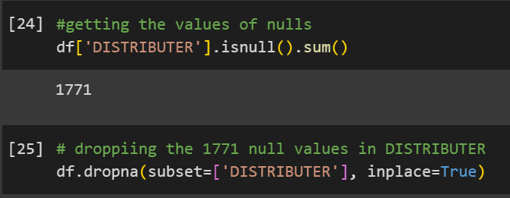
Load Data and Prepare Data (Preprocessing)
Preprocessing step Name: Dropping null values in DISTRIBUTER
Description: Null values in the 'DISTRIBUTER' column are removed from the DataFrame.
Justification: Dropping these null values ensures that only rows with valid distributor information are retained in the DataFrame.
Removing null values in the 'DISTRIBUTER' column helps maintain data integrity and prevents potential inaccuracies or biases in analyses or modeling tasks that involve distributor-related information.
and since it’s a column that dous not depend on other features, it was hard to fill them.

Slide 24
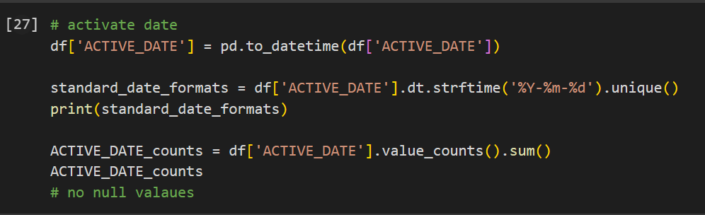
Load Data and Prepare Data (Preprocessing)
Preprocessing step Name: Standardizing 'ACTIVE_DATE' Format
Description: The format of the 'ACTIVE_DATE' column is standardized to ensure consistency across the dataset. The dates are converted to a standard format of 'YYYY-MM-DD'.
Justification: Converting dates to a consistent format enables easier comparison, sorting, and manipulation of date-related information during analysis or modeling tasks.
By converting dates to the 'YYYY-MM-DD' format, the dataset becomes more organized and interpretable for users and downstream processes.
The preprocessing step ensures that all dates in the 'ACTIVE_DATE' column follow the same format, reducing potential confusion or errors arising from inconsistent date representations.

Slide 25
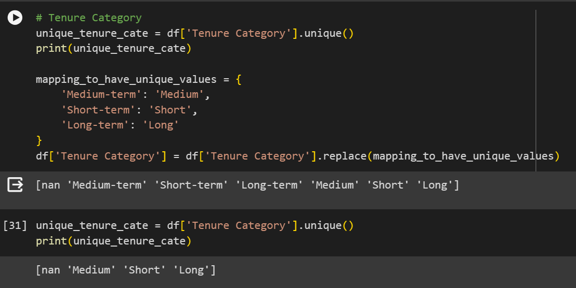
Load Data and Prepare Data (Preprocessing)
Preprocessing step Name: filling null values in Tenure category based on Customer Tenure and handilling the data of Tenure category
Description: Null values in the 'Tenure Category' column are filled based on the corresponding values in the 'Customer Tenure' column. Additionally, the 'Tenure Category' column data is adjusted to ensure consistency and meaningful categorization.
Justification: Filling null values in the 'Tenure Category' column ensures that every entry in the dataset has a corresponding tenure category, which is crucial for comprehensive analysis and modeling.
Aligning 'Tenure Category' values with 'Customer Tenure' data maintains consistency within the dataset. By using 'Customer Tenure' as a basis for filling null values, we ensure that the tenure categories accurately reflect the duration of customer relationships.

Slide 26
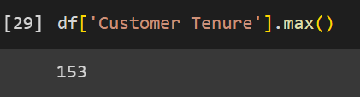
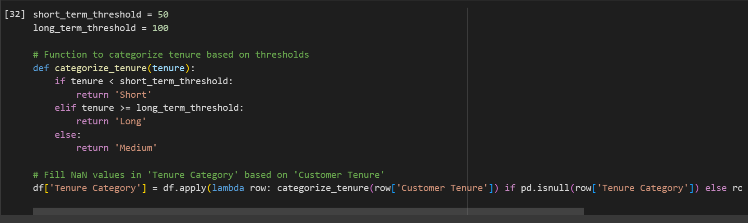

Slide 27
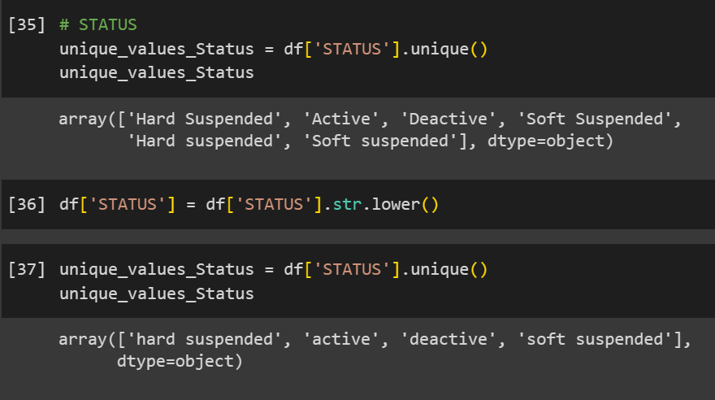
Load Data and Prepare Data (Preprocessing)
Preprocessing step Name: Standardizing 'STATUS' Values to Lowercase
Description: The values in the 'STATUS' column are converted to lowercase to ensure consistency and uniformity in the representation of status categories.
Justification: Converting all 'STATUS' values to lowercase ensures that comparisons, analyses, and operations involving status categories are performed consistently throughout the dataset.
Lowercasing the 'STATUS' values simplifies data processing and enhances readability, making it easier for users to interpret and work with the status information.

Slide 28
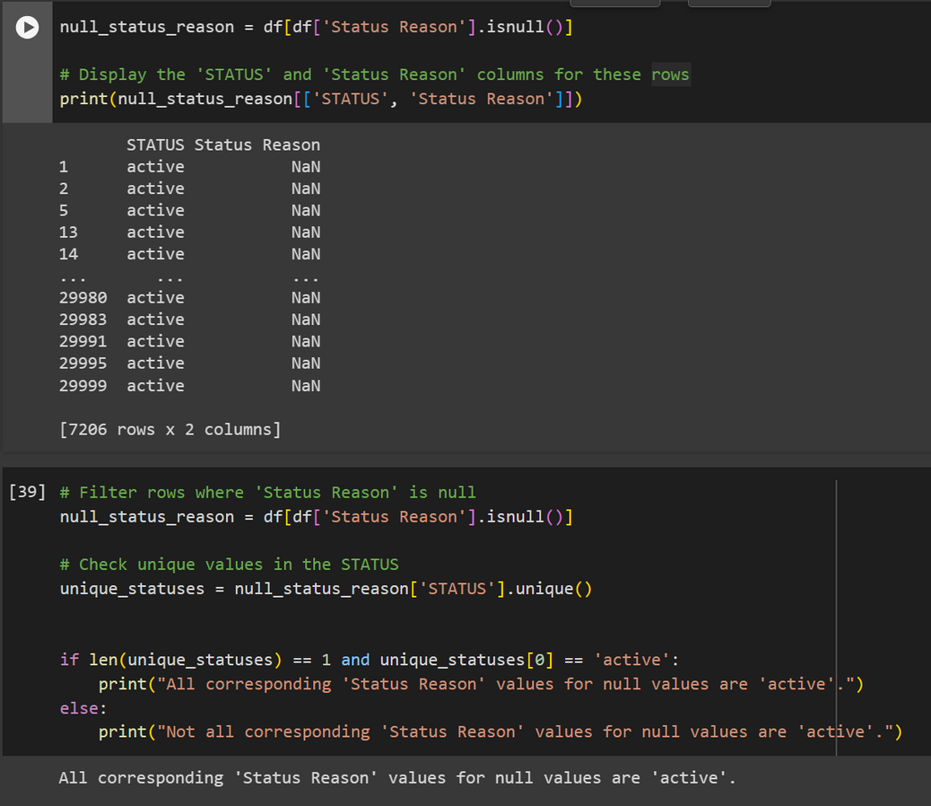
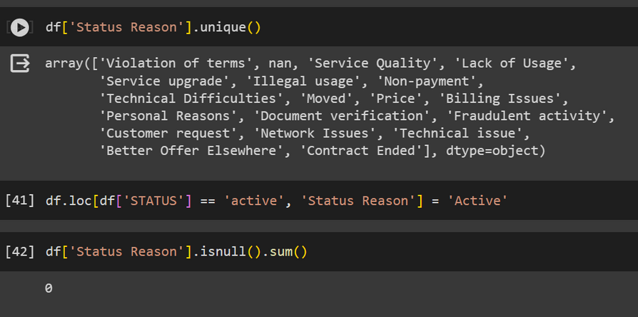
Load Data and Prepare Data (Preprocessing)
Preprocessing step Name: filling in STATUS reason null vales
Description: filling in STATUS reason null vales based on STATUS column
Justification: we first check the corresponding STATUS for all the null values in the Status reason, and it was found that all the null values the current status for them was all active so we filled them with active.

Slide 29
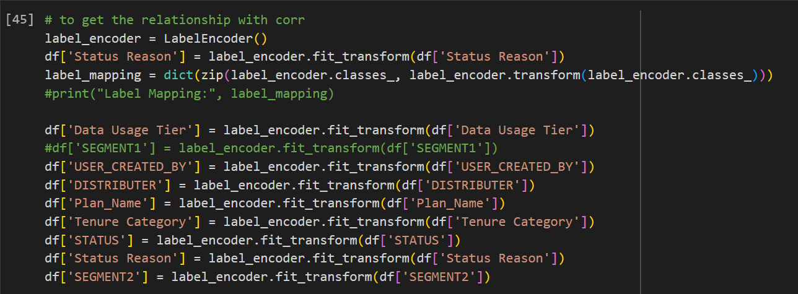
Load Data and Prepare Data (Preprocessing)
Preprocessing Step Name: Encoding Categorical Variables for Correlation Analysis
Description: Categorical variables in the dataset, are encoded using label encoding technique to convert them into numerical representations.
justification: By encoding categorical variables into numerical representations, we enable correlation analysis to be performed on a wider range of variables in the dataset.
Label encoding assigns unique numerical labels to each category within a categorical variable, allowing for straightforward numerical computations and comparisons.
The preprocessing step ensures that categorical variables are appropriately transformed into numerical format without introducing bias or altering the underlying relationships within the data.

Slide 30
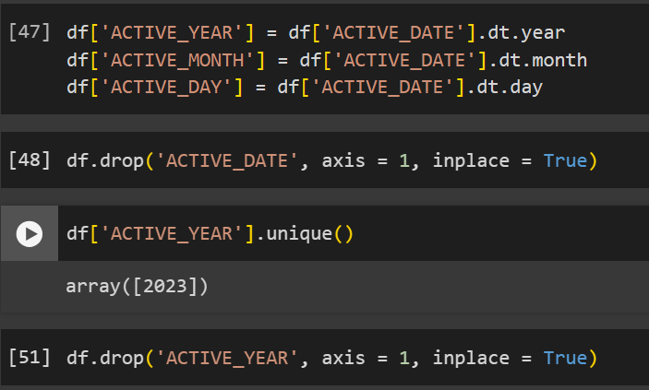
Load Data and Prepare Data (Preprocessing)
Preprocessing Step Name: numerical date, and dropping ACTIVE_YAER and ACTIVE_DATE.
Description: The date components, including year, month, and day, are extracted from the 'ACTIVE_DATE' column and added as separate columns in the DataFrame. Subsequently, the 'ACTIVE_DATE' column is dropped from the DataFrame. Additionally, the 'ACTIVE_YEAR' column is dropped from the DataFrame becuase the uear for all columns uis 2023
justification: Breaking down the date into its components allows for more detailed examination of temporal patterns and trends in the data.
Dropping the 'ACTIVE_DATE' column reduces redundancy and simplifies the DataFrame structure, as the information from the date components (year, month, day) is preserved in separate columns.

Slide 31
Approaches (Models)
Decision Trees are versatile and interpretable models that recursively partition the feature space based on feature values, creating a tree-like structure of decision rules. Each internal node represents a feature test, and each leaf node represents a class label or regression value. Decision Trees are prone to overfitting, especially with deep trees, but techniques like pruning and ensemble methods such as Random Forests can help mitigate this issue.
KNN is a simple yet effective classification algorithm that classifies data points based on the majority class of their nearest neighbors in the feature space. It is non-parametric and does not make assumptions about the underlying data distribution. KNN's simplicity and intuitive nature make it easy to implement, but its performance may degrade with high-dimensional data or imbalanced class distributions.
KNN
DECISION TREE

Slide 32
Approaches (Models)
Logistic Regression is a linear classification algorithm used for binary classification tasks. It models the probability that a given instance belongs to a particular class using a logistic function. Logistic Regression estimates coefficients for the linear decision boundary by maximizing the likelihood function of the observed data. It is efficient, interpretable, and well-suited for scenarios where the relationship between features and the target variable is linear or can be approximated as such.
LOGISTIC REGRESSION

Slide 33
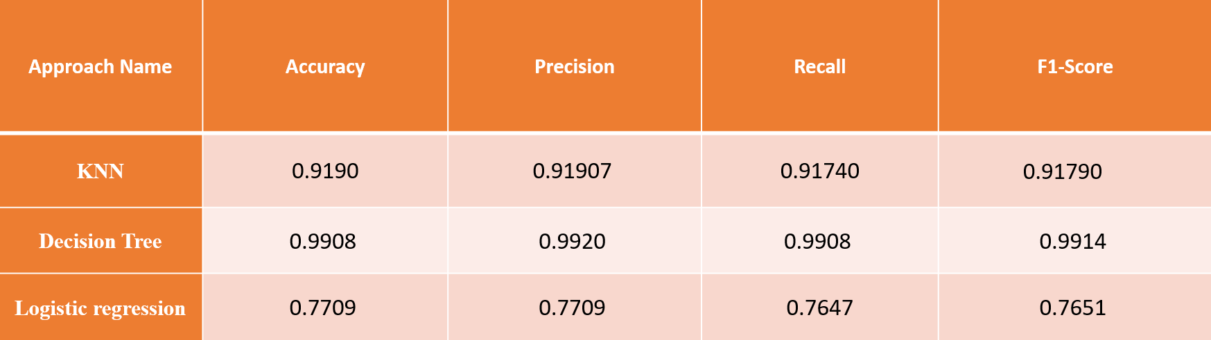
Compare the different models

Slide 34
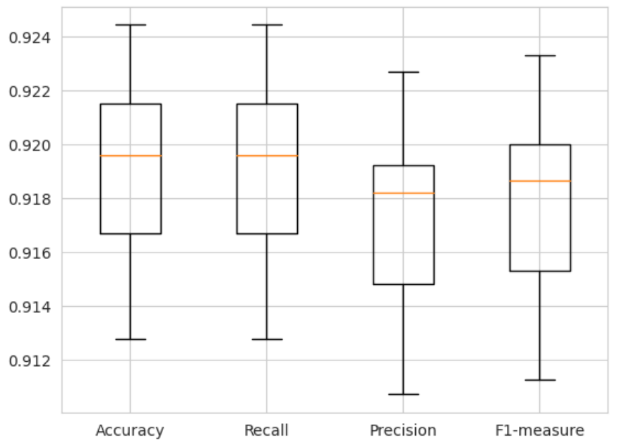
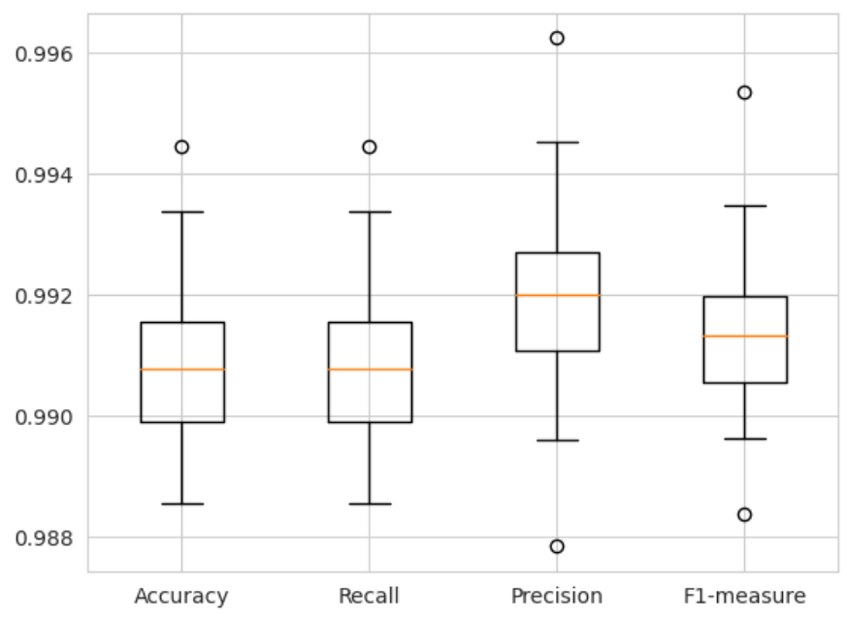
Compare the different models by Charts
KNN
DECISION TREE

Slide 35
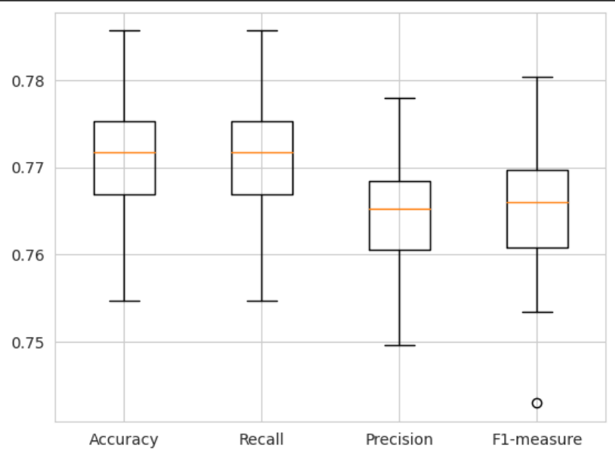
Compare the different models by Charts
LOGISTIC REGRESSION

Slide 36
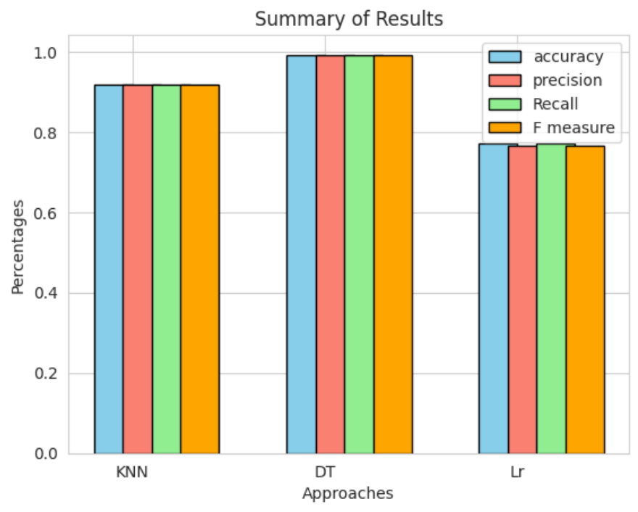
Compare the different models by Charts
The performance metrics for each model (accuracy, precision, recall, and F1-score) will be displayed as a bar graph. To differentiate each metric from the others, each will be represented by a different color. The performance metrics values for each model will be shown in a bar graph, making it simple to compare and understand the outcomes. Making informed decisions during the selection and evaluation of models will be made easier with the help of this visualization, which will offer insights into the relative performance of each model across all metrics.

Slide 37
Analysis of the results
KNN
Accuracy: The average accuracy across 30 runs of the K-Nearest Neighbors (KNN) classifier is 91.91%. It measures the proportion of correctly classified instances.
Precision: The average precision, which is 91.74%, reflects the ability of the classifier to correctly predict positive instances out of all instances predicted as positive.
Recall: The average recall, also 91.91%, indicates the proportion of actual positive instances that were correctly classified by the model.
F1 Score: With an average F1 score of 91.79%, the harmonic mean of precision and recall, the model showcases balanced performance in terms of precision and recall.

Slide 38
Analysis of the results
DECISION TREE
The average accuracy across 30 iterations is approximately 99.08%, indicating that the model correctly predicts the class label for about 99.08% of the instances in the test set.
The average precision score is around 99.20%, indicating a high level of correctness in classifying instances of each class.
The average recall score is approximately 99.08%, suggesting that the model effectively identifies most of the relevant instances in the dataset.
The average F1 score, which balances precision and recall, is about 99.14%, indicating robust performance overall.

Slide 39
Analysis of the results
LOGISTIC REGRESSION
Accuracy: Represents the proportion of correctly classified instances; the model, on average, correctly predicts around 77.10% of the cases, with values ranging from 75.47% to 78.57% across different runs.
Precision: Measures the ratio of correctly predicted positive observations to the total predicted positives; the model achieves an average precision of 76.48%, varying between 75.25% and 77.30% across different iterations.
Recall: Quantifies the proportion of actual positives correctly classified by the model; the average recall is 77.10%, with values fluctuating between 76.12% and 78.52% across different random states.
F1 Score: The harmonic mean of precision and recall, providing a balance between the two metrics; the model achieves an average F1 score of 76.54%, with values ranging from 75.29% to 77.84% across different runs.

Slide 40
Analysis of the results
Excellent performance of the model is indicated when values for each metric approach or surpass 0.999, which is close to the maximum of 1. These high values indicate that the model performed better than other models in processing the data. This indicates that the model performed better than other models in handling the dataset and producing accurate predictions.

Slide 41
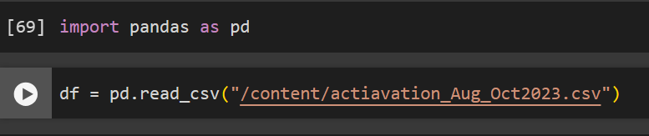
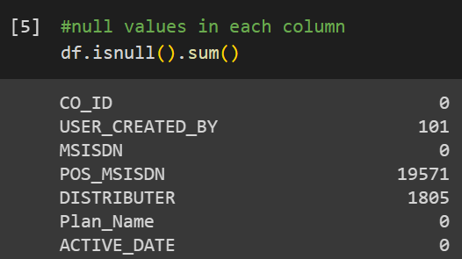
PANDAS
evaluation
During the project, I used Pandas a lot because it's really good for handling data. Pandas data frames are famous for how well they manage data, which was super helpful for our project. Right from the start, I used functions like `pd.DataFrame()` to create data frames and `pd.read_csv()` to read data from files. Pandas has a bunch of functions that made it easy to work with data, making it a key tool for analyzing and processing data.
I used a helpful function called `df.isnull()` a lot. It helped me handle the data I had by dealing with missing values. This function, along with others provided by Pandas, made it easy to work with the data and process it effectively.

Slide 42
PANDAS
evaluation
The Pandas data framework saved me time and effort, which is crucial for evaluating performance and results. Using its simple functions, I quickly prepared the dataset for modeling. I really admire this data structure because I didn't encounter any errors or negatives while using it.
The Pandas library was crucial for my project, enabling me to work with datasets effectively. With Pandas, I created data frames to store and manipulate data, using its functions to format and clean the data for analysis. From reading the dataset to preparing it for machine learning, Pandas played a central role, helping me understand the data better and handle missing values efficiently. The DataFrame function, in particular, provided all the necessary tools to explore and prepare the dataset, saving me considerable time and effort.

Slide 43
SIKIT-LEARN
evaluation
I extensively utilized the Scikit-learn library for machine learning tasks in my project. This library offers a wide range of machine learning models and tools for training them efficiently. With Scikit-learn, I easily implemented models like KNN, Decision Trees, Random Forest, and Logistic Regression, saving significant time and effort compared to writing them from scratch. By simply calling functions and writing a few lines of code, I could perform complex machine learning tasks.
Scikit-learn also provided essential metrics such as accuracy, recall, and F1-score, which helped me evaluate the performance of my models. Its availability of algorithms and metrics streamlined the machine learning process, allowing me to focus more on data analysis and model evaluation. As a data scientist, efficiency is crucial to me, and Scikit-learn proved to be an invaluable tool in completing my project effectively. I anticipate using it in future projects with different datasets.

Slide 44
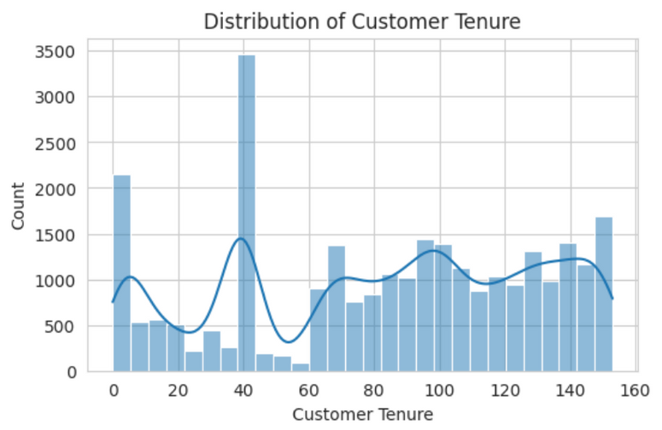
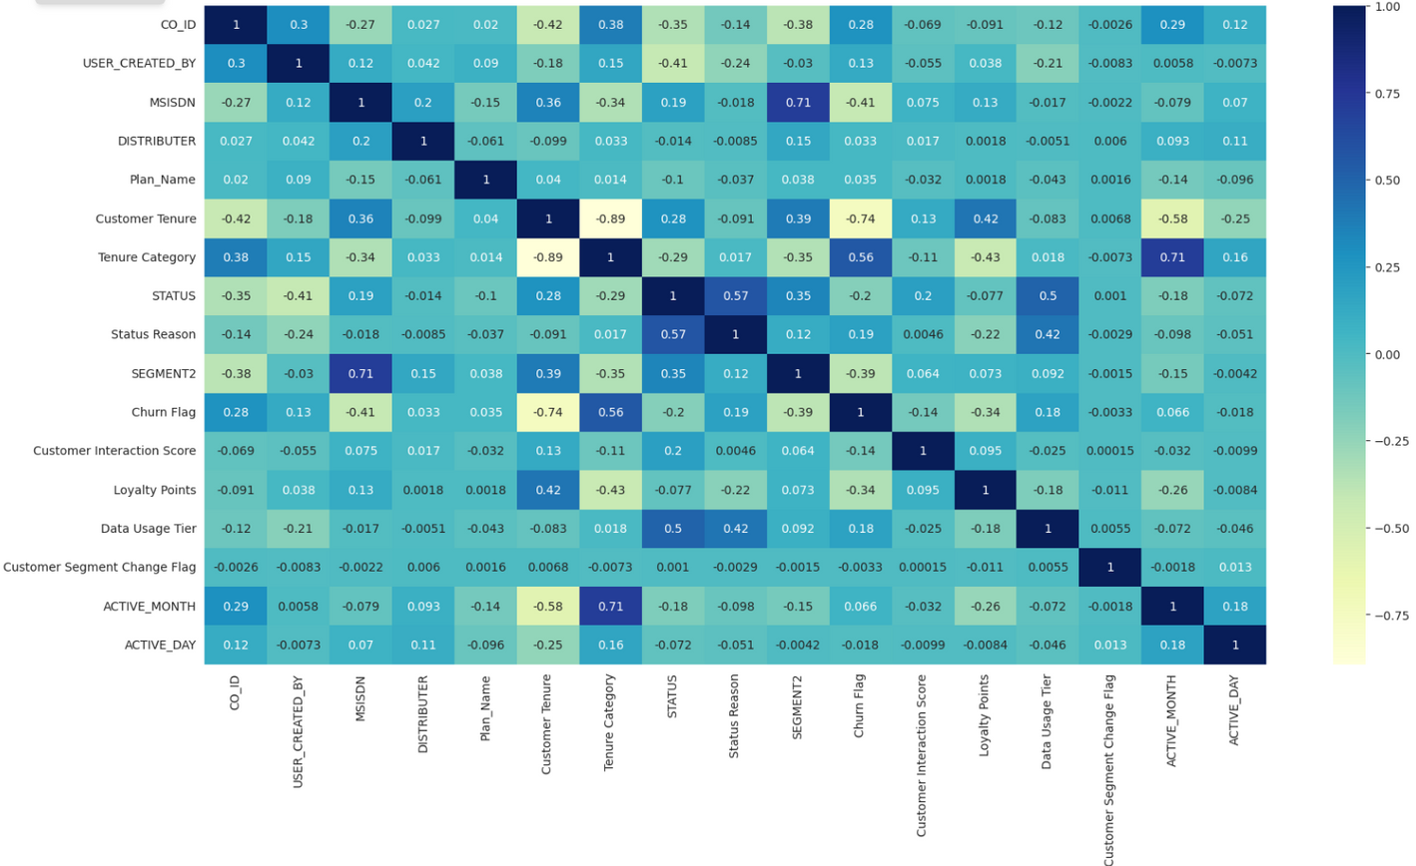
MATPLOTLIB AND SEABORN
evaluation
Matplotlib and Seaborn presented the results in visual forms like graphs, charts, and box plots, which offered a unique perspective on the data. These visualizations facilitated comparisons between different metrics and values, enhancing data interpretation. The libraries provided customizable functions for adjusting colors and other visual aspects, making them valuable tools for data scientists. I intend to utilize them extensively in future projects due to their user-friendly nature, simple functions, and versatility in visualizing and communicating data effectively.

Slide 45
THE EFFECTIVENESS OF DIFFERENT MODELS
evaluation
At the beginning, I have implemented 3 different models, KNN, Decision tree and logistic regression. the decision tree was the best resulting as the values were close to 1 as shown in the table before.
Using more machine learning models is advisable based on the findings from our analysis of the three models on the provided data. The results varied across models, with some performing well and others not as effectively. This indicates that exploring additional algorithms could lead to better results and facilitate a more comprehensive comparison between models. Continuing advancements in science are likely to produce improved models, enabling better predictions and insights in the future.

Slide 46
recomendations
After doing this project, I would point out some recommendations to enhance the project:
adding more models to train the data on, so we can compare better, and using alternative models could lead to better outcomes.
By removing redundant or unnecessary data from the dataset, dropping specific columns can enhance model performance. By comparing model performance with and without particular columns, this process aids in improving overall results.
thinking more of Standarization and normalization to get more accurate results.

Slide 47
references
https://www.edureka.co/blog/data-structures-in-python/
https://matplotlib.org/
https://seaborn.pydata.org/
https://www.coursera.org/articles/what-is-python-used-for-a-beginners-guide-to-using-python

Slide 48
Thanks!

