Slide 1
Construction Project
Management System
Leen Daghriri
Karima Musa Mubaraki
202206173
202107149
Rima Amashi
Sarah Maayel Harubi
202102695
202201650
Waad Ali Madkhali
202103520
Database Systems Project

Slide 2
Data Requirements
1. EMPLOYEE
2. PROJECT
Identified by: Employee ID
Attributes:
Name, Position, Email, Phone, Address
Can work on
multiple projects
Identified by: Project ID
Attributes:
Name, Description, Start Date, End Date
Worked on by a
group of employees
3. DEPARTMENT
4. TASKS
Defined by: D_Number + Dname + Contact Info
Has multiple
tasks and many employees
Controls multiple projects
Defined by: Task_ID
Attributes:
Description, Start/End Date, Status
Each employee handles
multiple tasks

Slide 3
Data Requirements (cont.)
5. RESOURCES
6. FACTORY
7. TIMELINE
Identified by: Resource_ID
Attributes: Name, Type, Information
Tied to: one factory
Projects need: many resources
Identified by: Factory Number
Attributes: Name, Location, Information
Supplies: building materials (resources)
Identified by: Timeline_ID
Attributes: Description, Start/End Date
Related to: one project (one-to-one)
Has: a set of associated reports
8. REPORTS
9. CLIENT
10. CONTRACT
Identified by: Report_ID
Attributes: Description, Creation Date
Includes: one timeline
Project has: many reports
Identified by: Client_ID
Attributes: Name, Telephone
Can have: multiple contracts
Identified by: Contract Number
Attributes: Info, Start/End Date
Relates to: one client, one project

Slide 4
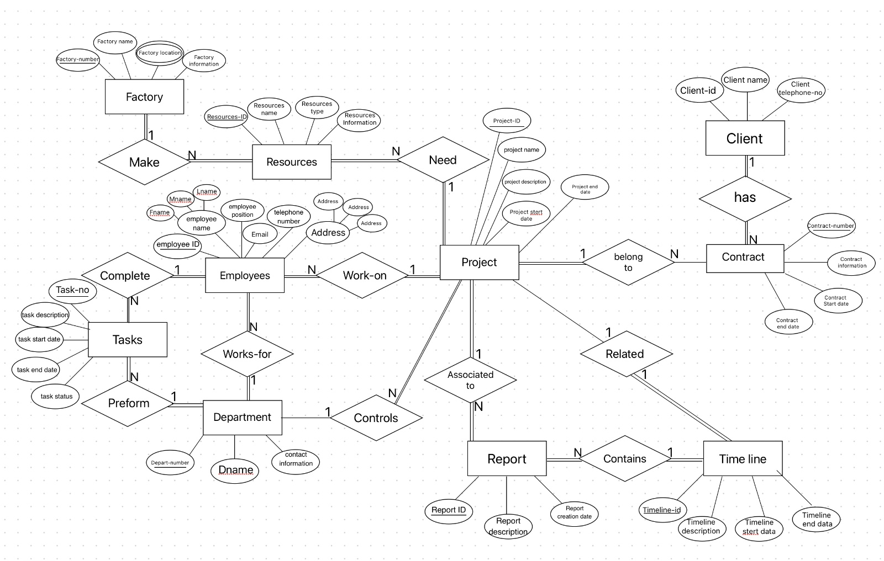
ER Diagram
Conceptual Data Model
[ ER Diagram Image ]
Replace this placeholder with the ER Diagram image

Slide 5
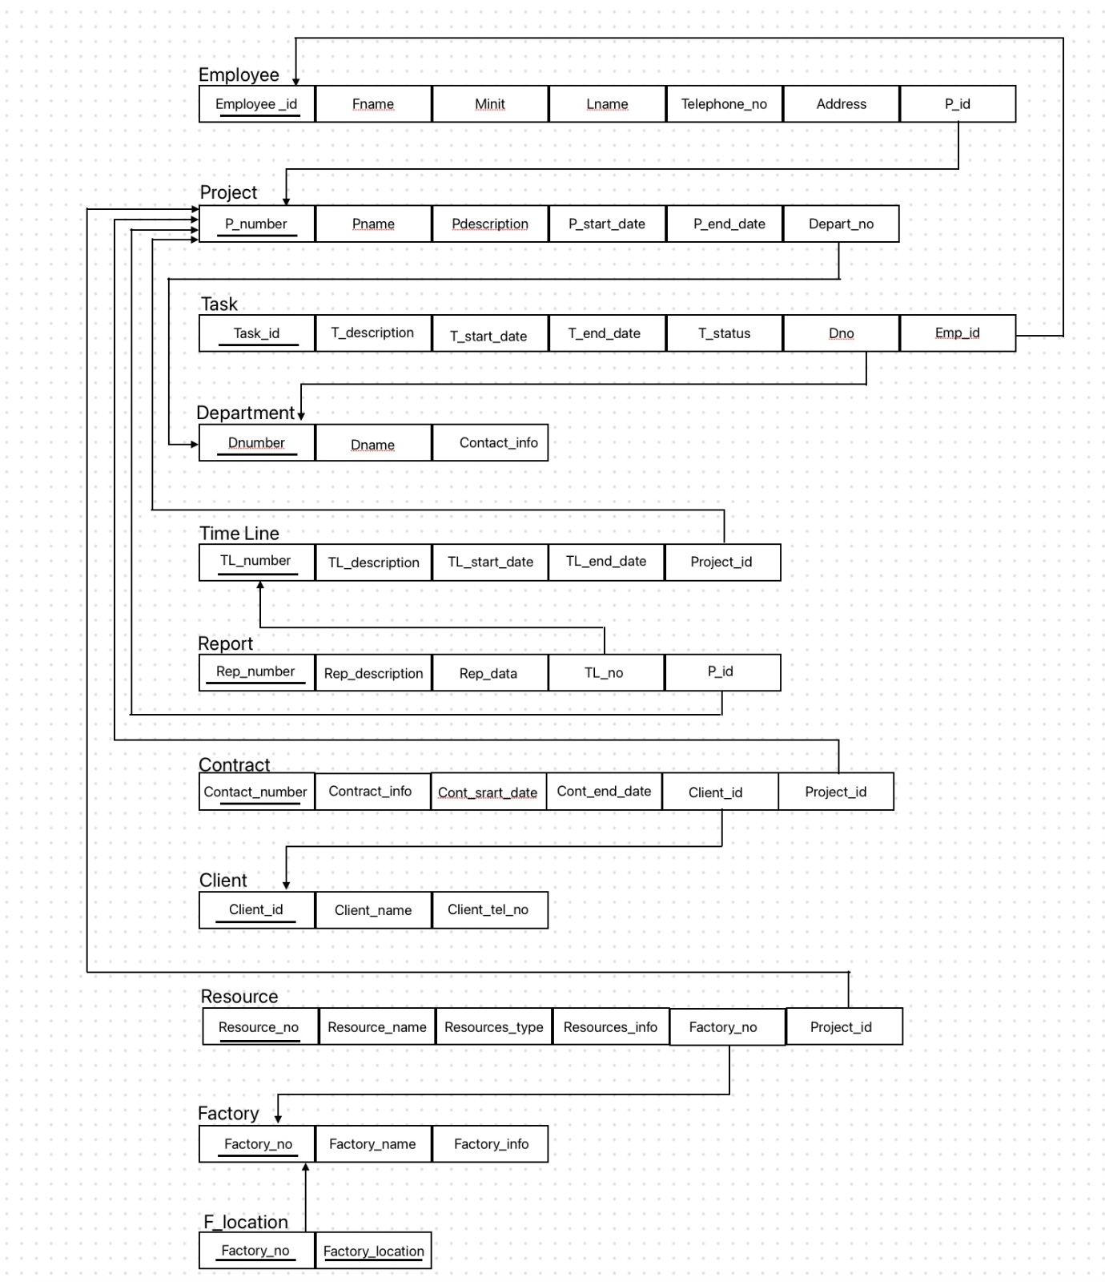
Relational Data Model / Relational Schema
Replace this placeholder with the Relational Schema image

Slide 6
EMPLOYEE
Employee master data — all project staff
Emp ID | First Name | Last Name | Position | Contact | Project ID
123456789 | Gorge | Molten | Anastasia | gorge@gmail.com | 104
276543219 | Jane | Smith | Developer | jane.smith@gmail.com | 102
345678912 | Sami | Ahmad Ibrahim |  | sam3@gmail.com | 105
987654312 | David | Johnson | Analyst | david.johnson@gmail.com | 103
987654321 | John | Doe | Manager | john.doe@gmail.com | 101

Slide 7
DEPARTMENT · CLIENT · FACTORY LOCATION
DEPARTMENT
CLIENT
FACTORY LOCATION
D# | Name | Contact
10 | HR | hr@gmail.com
20 | Finance | finance@gmail.com
30 | Marketing | marketing@gmail.com
40 | IT | it@gmail.com
50 | Operations | operations@gmail.com
Client ID | Name | Tel No.
111111111 | Sarah Johnson | 0198567382
222222222 | Daniel Anderson | 0183471384
333333333 | Olivia Brown | 0148254345
444444444 | William Taylor | 0144772298
555555555 | Sophia Martinez | 0145322768
Factory# | Location
1005 | Jazan
1010 | Makkah
1015 | Jeddah
1020 | Abha
1025 | Riyadh

Slide 8
FACTORY · TIMELINE
FACTORY
TIMELINE
Factory# | Name | Information
1005 | Cement Factory | Produces high-quality cement using advanced techniques
1010 | Steel Factory | Supplies reliable steel products for construction
1015 | Processed Glass Factory | Provides insulated glass for buildings
1020 | Tile & Ceramic Factory | Offers high-quality tiles and ceramic products
1025 | Gin Wood Factory | Provides environmentally protected wood materials
TL# | Start | Description | End | Proj
20 | 2023-04-10 | Plumbing & Electrical | 2023-07-20 | 104
21 | 2023-05-20 | Final Inspection | 2023-09-20 | 105
23 | 2023-03-30 | Foundation Work | 2023-08-15 | 103
24 | 2023-02-15 | Construction Start | 2023-04-20 | 102
25 | 2023-01-01 | Project Proposal | 2023-02-20 | 101

Slide 9
PROJECT · RESOURCES
PROJECT
RESOURCES
P# | Name | Description | Start | End | Dept
101 | ProjectM | Cooperative Task Mgmt System | 2023-01-01 | 2023-04-10 | 50
102 | ProjectQ | Online Language Learning Platform | 2023-02-15 | 2023-07-20 | 40
103 | ProjectZ | Digital Library Mgmt System | 2023-03-05 | 2023-06-15 | 30
104 | ProjectX | Corporate Social Networking App | 2023-07-20 | 2023-09-19 | 20
105 | ProjectK | Commercial & Entertainment Complex | 2023-08-12 | 2023-11-23 | 20
R# | Name | Type | Factory
5557 | Wood Metal | Metal | 1005
8766 | Iron Metal | Metal | 1010
3255 | Oil | Energy | 1015
4499 | Gas | Natural | 1020
8822 | Coal | Natural | 1025

Slide 10
REPORT
Progress reports linked to timelines and projects
Report# | Description | Creation Date | Timeline# | Project
3232 | Construction progress update | 2022-02-20 | 21 | 102
3344 | Initial project assessment | 2022-01-10 | 20 | 101
5432 | Quality inspection report | 2022-03-15 | 23 | 103
6789 | Post-construction evaluation | 2022-05-25 | 25 | 105
7766 | Project completion report | 2022-04-30 | 24 | 104

Slide 11
CONTRACT · TASK
CONTRACT
TASK
Contract# | Info | Start | End | Client
135792489 | Interior Design | 2022-04-10 | 2022-11-10 | 444444444
246813792 | Electrical Works | 2022-03-30 | 2022-09-30 | 333333333
789457897 | Construction Materials | 2022-01-01 | 2022-12-31 | 111111111
864297532 | Landscaping | 2022-05-20 | 2022-10-20 | 555555555
987657216 | Plumbing Services | 2022-02-15 | 2022-12-15 | 222222222
Task# | Description | Status | Dept
213 | Develop new feature | Pending | 40
232 | Research market trends | In Progress | 30
234 | Review code quality | Completed | 50
324 | Complete report | In Progress | 10
334 | Prepare presentation | Completed | 20

