Slide 1

The Garden Shed
Landscaping services

Slide 2

General idea of landscaping:
Garden design is the art of arranging and coordinating natural elements and green views to create beautiful and functional outdoor spaces. The design and coordination of gardens aims to create a comfortable and attractive environment that combines natural beauty with people's needs.

Slide 3
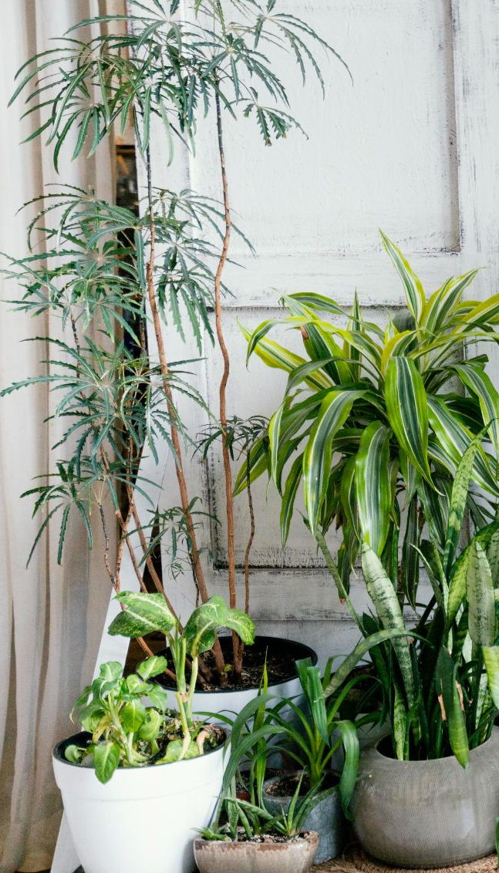
Objectives:
01
02
03
04
View the diverse services offered by the company
View previous projects implemented for former clients
Providing valuable information and articles for landscaping solutions and caring for them
Facilitate communication with the company by providing communication information and a consultation booking form

Slide 4

Home page
The home page represents the first impression because it is the first communication that happens between the visitor and the company online. The first visitor is an important preliminary impression, and the home page may be the decisive factor to motivate the visitor to explore more content and stay on site.

Slide 5
Page Contact Us:
The Contact Us page is one of the most important pages that promotes communication and meets customers' needs and allows them to express their needs and requirements and improve their experience

Slide 6
Services page:
consisting of a comprehensive list of services provided by the company in the field of garden design. Divide services into categories such as: front and rear garden design, floral and floral coordination, irrigation and lighting system design, and decorative elements coordination.

Slide 7

About us Page
This page is very important in all sites and is a definition of the site and project or company where I spoke about the company in a simple profile and then I talked about the mission of the company and what is its objectives and last talked about the founder and owner of this company and the new partners and the CEO

Slide 8
Warranty Policy Page
This page aims to clarify the guarantees and maintenance of work. It is one of the rights of the customer. It clarifies the terms and policy of warranty and maintenance at several policy points. The time of receipt and approval of maintenance request and the implementation of the policy is very important in safeguarding the right of the customer and the company

Slide 9
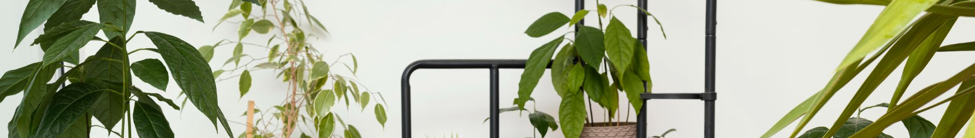
Tips to keep your garden healthy
This page talks about how to make your garden healthy and how to take care of it in the right way, so there are some tips for how to take care of your garden and plants and flowers and choose the right tools for your beautiful garden as well as some simple and affecting ways to keep your garden in the best condition.

Slide 10
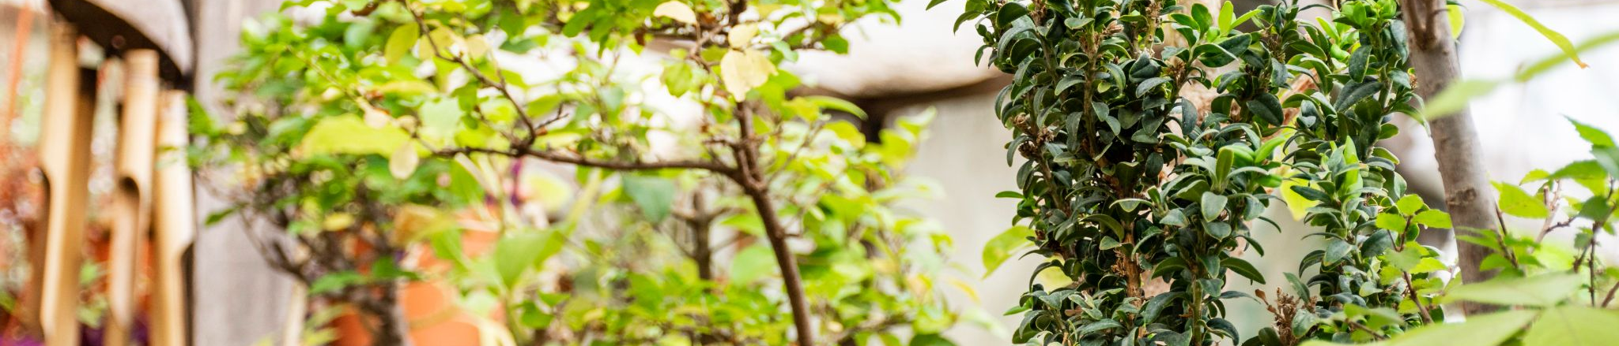
Garden design ideas
This page helps you to know the types of gardens and look at some of their images so that inspiration comes to you in thinking about how you want your garden to be so there are some models of some ideas that you may like and choose to apply to your garden

Slide 11
Customer Opinions:
Presenting the previous customer's assessment and opinions on the designs we have implemented, will enhance confidence and reflect the quality of the work we offer as a company.

Slide 12
RESOURCES
https://www.w3schools.com/
https://www.pinterest.com/
https://www.freepik.com/

Slide 13
Leen
Hind
Ghadah
Anwar
Nourah

