Slide 1


High Level Design
Leen Kharouf

Slide 2
Technical Architecture
CSV Files
ETL Pipeline
Data Warehouse
BI Dashboard
MVP (Minimum Viable Product): a simple working version of the data pipeline that ingests, cleans and stores monthly CSVs in a star schema, and powers dashboards.
Raw Data: Monthly sales CSV extracts
Processed with Python ETL scripts
Loaded into structured warehouse tables
Final output supports KPI dashboards
Python (Pandas)
SQLite/PostgreSQL (MVP)
Power BI / Excel

Slide 3
Data Processing Flow
A 5-step ETL process ensures clean, usable data
1. Extract
Import CSVs from folder (pipeline selects most recent)
3. Cleanse
Fix errors, remove duplicates
5. Load
Store in warehouse tables
2. Profile
Inspect columns & data types
4. Transform
Standardize formats, enrich fields

Slide 4
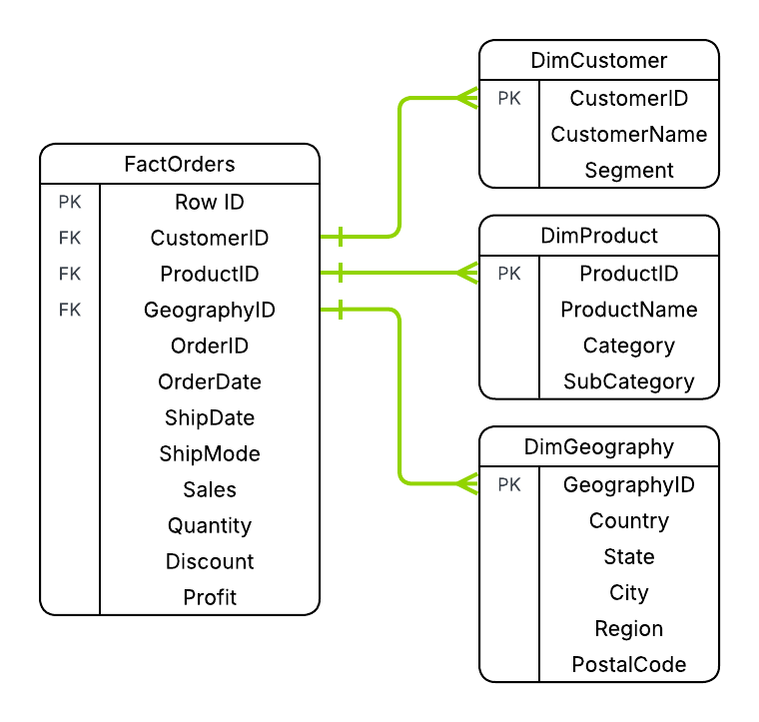
Data Warehouse Structure
Data stored in PostgreSQL database following star schema.
Star schema stores sales events in a central FactOrders table, linked to Customer, Product, and Geography dimensions.
This avoids duplication and makes KPI reporting consistent and flexible.

Slide 5
ETL pipeline automation
01
03
Scheduler
Simple scheduling with Task Scheduler (Windows) or cron (Linux).
MVP
Python Script
Automated runs
02
Pipeline refreshes data on a fixed schedule (e.g., monthly), ensuring clean inputs for dashboards e.g. Power BI Desktop / Excel
ETL script built in Python (Pandas) to clean and combine monthly CSVs.
01
03
Orchestration
Advanced orchestration with Apache Airflow or Prefect for monitoring, retries, and dependencies.
Production
ETL Workflow
Automated runs
02
Continuous, monitored jobs that keep dashboards up-to-date in near real time, e.g. BI Service.
Scalable data pipelines built with Python, Spark, or cloud ETL services.

Slide 6
Inconsistency Handling
Issue | Action
Negative quantity / sales | remove row
Ship date < order date | remove row
Mixed data types | standardize
Invalid discounts | confirm with SME (is 1.2 = 120% typo or special case?)
Negative profit | may be real (loss-making sale), requires SME context
Duplicates | decide with SME if they are real multi-line orders or accidental repeats
Automated checks detect and fix data issues before reporting
*These issues do not necessarily reflect the found inconsistencies in the given data.

Slide 7
THANK YOU
Leen Kharouf
leenkharouf@nyue.edu | https://leenkharouf.github.io/

