Slide 1
FRAUD DETECTION
CASE STUDY
Turning fraud detection into a review-capacity decision
Prepared for Deloitte & Touche Middle East · August 2026
Leen Al-Najjar
Notes:
Frame in one line: the model works, but the real deliverable is a threshold policy the fraud team can operate.

Slide 2
EXECUTIVE SUMMARY
The model identifies 96.8% of fraud value and converts detection into a capacity decision
96.8%
83.8%
91.3%
~881/day
of fraud VALUE identified
of fraud CASES identified
of alerts are genuine fraud
alerts ≈ 9 FTE review capacity
1
Value matters more than count. Fraud the model misses averages ~$101; fraud it identifies averages ~$590. Measured in money rather than transactions, coverage rises from 83.8% to 96.8%.
2
The technical threshold is not yet the business threshold. At ~$2.50 per manual review, one missed $101 fraud is worth ~40 reviews. The 0.5631 cut-off optimises F1, not economics which points toward testing a lower cut-off, to be confirmed with client cost and capacity inputs.
3
Deploy as prioritisation, not auto-decision. 8.7% of alerts are false positives and closely resemble genuine fraud. Scores should rank a review queue; humans confirm.
4
Low-value fraud needs a different control. Recall falls to ~43-45% under $50. This is a stable, known gap that rules-based limits not this model should close.
Fraud Detection Case Study · Deloitte Technical Case Study
2
Notes:
Lead with 96% of value, not 84% of cases. If they only remember one number, this is it.

Slide 3
THE BUSINESS QUESTION
The question is not “Can we detect fraud” it is how to spend finite review capacity
HOW THE BRIEF READS
HOW WE FRAMED IT
"Build a model that classifies transactions as fraudulent or benign."
"Given an investigation team of fixed size, which transactions should reach a human first?"
Optimises a metric. Produces a score. Stops short of a decision anyone can act on.
Produces a threshold policy, an alert volume, and a staffing implication.
WHY THE REFRAME CHANGES THE ANALYSIS
Errors are not symmetric
So accuracy is the wrong lens
And the deliverable is a threshold
A false positive costs minutes of analyst time. A missed fraud costs the full transaction value plus chargeback handling.
At 1.21% prevalence, predicting "never fraud" scores 98.8%. Detection must be judged on ranking quality and on money, not on hit rate.
The model is an input. The recommendation is where to set the cut-off, given what review capacity costs and what fraud costs.
Fraud Detection Case Study · Deloitte Technical Case Study
3
Notes:
This slide earns the right to talk about thresholds and money later. Do not skip it.

Slide 4
THE DATA
Two structural properties of the dataset drove every methodology decision that followed
594,643
7,200
1.21%
82:1
~7.5 days
Transactions
Confirmed fraud
Fraud prevalence
Class imbalance
Observation window
01
Severe class imbalance
A model predicting "never fraud" already scores ~98.8% accuracy. Accuracy cannot distinguish a working model from a useless one here so PR-AUC, precision and recall carry the evaluation instead.
02
Temporal drift with recurring entities
Fraud prevalence falls from 1.52% to ~1.08% across the window while the same customers and merchants reappear throughout. A random split would let the model see the future so validation is chronological.
Fraud Detection Case Study · Deloitte Technical Case Study
4

Slide 5
APPROACH
Statistical validation and operational deployment were deliberately kept in separate tools
1
2
3
4
5
6
Data audit
Behavioural
features
Chronological
validation
Model
selection
Threshold
policy
Operational
view
Leakage checks,
constant-column removal
Customer-relative,
strictly historical
Train past,
test future
Evidence-gated
complexity
Cost and capacity,
not F1
Review queue for
the fraud team
Python where the evidence is built
Operational layer where the decision is applied
Leakage-safe feature construction, chronological splits, model comparison, and interpretation.
Reproducible, diffable, and reviewable the statistical claims live here.
Built on scored model output, not raw data the operating layer converts model scores into a prioritized review queue. The business threshold should be set using review capacity, cost, intervention effectiveness and risk appetite rather than F1 alone.
Fraud Detection Case Study · Deloitte Technical Case Study
5
Notes:
The tooling split is a deliberate architectural choice, not a preference. Say so if asked.

Slide 6
EXPLORATORY ANALYSIS
Three findings from exploration shaped the modelling strategy directly
Amount separates risk sharply
SO WHAT
Fraud rate rises from ~0.1% below $25 to over 95% above $500. Amount alone reaches 0.70 PR-AUC.
Retained raw amount for cost analysis; added a log transform for the model.
Category carries structural signal
SO WHAT
The two highest-volume categories (~89% of transactions) show ~0% observed fraud. Risk concentrates in a handful of discretionary categories.
One-hot encoded; later confirmed as the strongest signal the model uses.
Customer-relative behaviour adds lift
SO WHAT
Fraudulent transactions run ~6.7x the customer's own typical spend a far stronger signal than absolute amount alone.
Motivated leakage-safe behavioural features built from strictly prior history.
Fraud rate and category mix both drift across the window reinforcing a chronological validation design.
Fraud Detection Case Study · Deloitte Technical Case Study
6

Slide 7
METHODOLOGY
Validation replicates deployment: train on the past, test on a genuine future period
TRAIN
VALIDATION
TEST
steps 0–119
steps 120–143
steps 144–179
374,914 txns · 1.28% fraud
86,498 txns · 1.11% fraud
133,231 txns · 1.08% fraud
The information rule
Same-step protection
A transaction at time t may use:
7.31% of transactions share a customer and an hourly step, with no reliable ordering inside the hour.
ALLOWED history strictly before t (step < t)
BLOCKED anything from step ≥ t, including the transaction's own outcome
These transactions are excluded from each other's prior-history features verified by confirming that every transaction sharing a step carries identical historical feature values.
Enforced in code, every historical aggregate is built from shifted windows.
This is the leakage path most likely to inflate results unnoticed.
Alternatives evaluated class weighting, SMOTE consideration, merchant-history features and 12 tuning configurations are set out in the appendix.
Fraud Detection Case Study · Deloitte Technical Case Study
7
Notes:
If a technical reviewer probes anywhere, it is here. Volunteer it before being asked.

Slide 8
RESULT · UNSEEN FUTURE-PERIOD TEST
Measured in money rather than transactions, coverage rises from 83.8% to 96.8%
Why the two numbers differ
The model is strongest on higher-value fraud. Fraud it identifies averages ~$590; fraud it misses averages ~$101.
$712k fraud value identified
$24k fraud value missed
Across the 36-hour test window.
0.948
91.3%
83.8%
87.4%
1,321
115
PR-AUC
Precision
Recall
F1 score
Alerts raised
False alarms
PR-AUC measures how well the model ranks genuine fraud above false alarms (1.0 = perfect; a no-skill model scores ~0.01 here). Accuracy was 99.74% and is not reported as a headline at 1.21% prevalence it is uninformative.
Fraud Detection Case Study · Deloitte Technical Case Study
8

Slide 9
THRESHOLD ECONOMICS
Illustrative scenario
The cut-off is an economic decision under the illustrative economics, test lower than 0.5631
THE BREAK-EVEN LOGIC
Illustrative break-even logic: one missed fraud (~$101 average) equals roughly 40 manual reviews (~$2.50 each). Under these assumptions, the economics support testing a lower threshold because additional review is cheap relative to the fraud value at risk.
OPERATING POINT
SENSITIVITY TO REVIEW CAPACITY
Measure | At 0.5631
Alerts per day | ~881
Review effort @ 5 min | ~73 hrs/day
Implied review headcount | ~9 FTE
Daily review cost | ~$2,200
Fraud value missed | ~$15.7k/day
Time per review | Analyst hrs/day | FTE
3 minutes | 44 | 5.5
5 minutes | 73 | 9.2
8 minutes | 117 | 14.7
Recommendation: test operating points below 0.5631 first. Under the illustrative ~$2.50 review cost, the economics favor buying additional recall; confirm the final cut-off with the client's real capacity, intervention effectiveness and loss economics.
Illustrative assumptions to confirm with the client: loaded analyst cost ~$30/hour, 5 minutes per review, chargeback handling and intervention success excluded. Figures scale with these inputs.
Fraud Detection Case Study · Deloitte Technical Case Study
9
Notes:
This is the slide that separates a consultant from an analyst. Own the assumptions rather than declining to answer.

Slide 10
WHERE THE MODEL IS WEAK
What escapes detection is small-ticket fraud that closely resembles normal behaviour
The pattern in what is missed
Missed fraud deviates far less from the customer's own spending history it does not look anomalous.
Recall falls to ~43–45% below $50, and this gap is stable rather than noisy.
Category is the strongest signal the model uses (cardinality-fair interpretation; built-in importance overstated merchant).
WHY THIS IS A SCOPING DECISION, NOT A DEFECT
The fraud this model misses is the fraud that costs least to miss — ~$24k of the ~$735k at risk in the test window. Closing the remaining gap with this model alone would likely require accepting materially more false positives across the whole population. A velocity or low-value rules layer may address it more efficiently, and the two controls should be scoped separately.
Interpretation describes model behaviour, not causation. No claim is made that category causes fraud.
Fraud Detection Case Study · Deloitte Technical Case Study
10

Slide 11
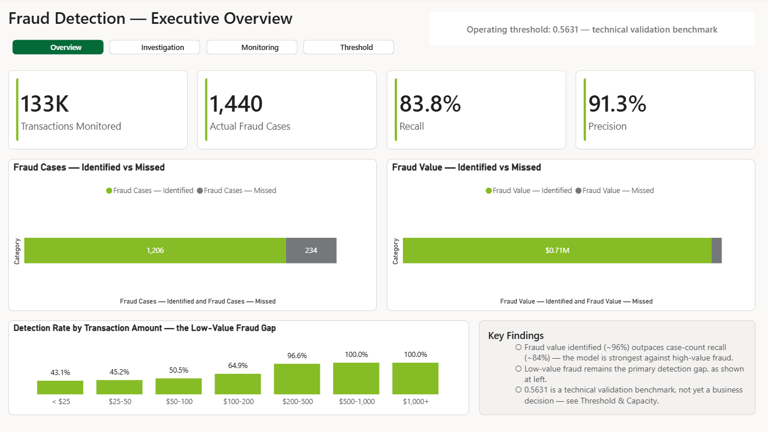
OPERATIONAL REVIEW SURFACE
The fraud team operates the model through a review surface — not a model score
The business-facing view shows what is identified, what remains exposed, and where investigation effort should focus.
Fraud Detection Case Study · Deloitte Technical Case Study
11

Slide 12
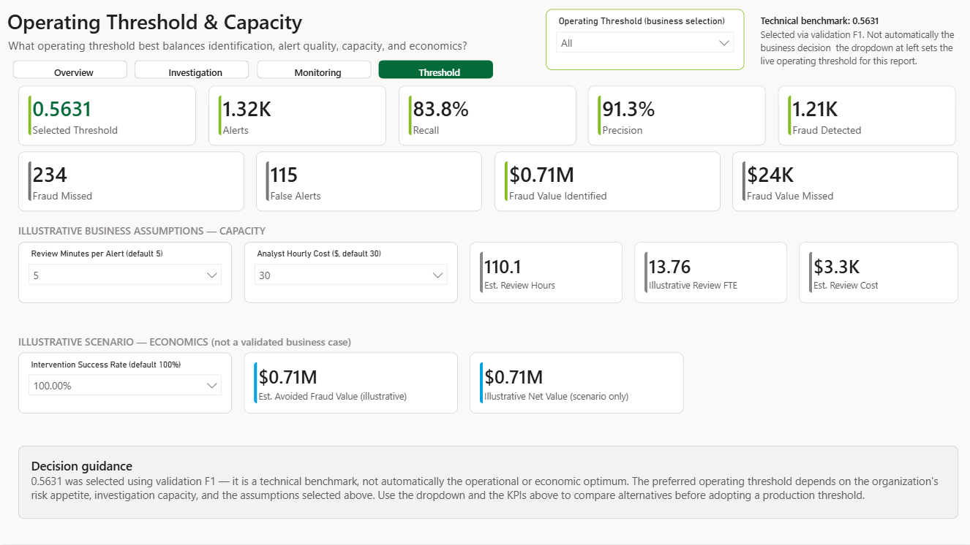
LIVE OPERATING DECISION
Threshold & capacity turns model performance into an operating policy
The live version of slide 9 lets decision-makers test fraud capture, alert quality, review capacity and illustrative economics together.
Fraud Detection Case Study · Deloitte Technical Case Study
12

Slide 13
RECOMMENDATIONS
Five recommendations, each owned, sequenced, and tied to a specific result
 | Recommendation | Rationale | Owner | Horizon
1 | Deploy as prioritisation, not auto-decision | 8.7% of alerts are false positives and resemble genuine fraud closely (slide 10). Use model scores to prioritise human review rather than auto-block transactions. | Fraud Operations | At launch
2 | Re-set the threshold on economics, not F1 | One missed fraud is worth ~40 reviews under the illustrative assumptions (slide 9). Test a lower cut-off, then confirm it against actual review capacity and cost. | Fraud Ops + Finance | Weeks 1–2
3 | Add a rules layer for low-value fraud | Recall falls to ~43–45% under $50 — a stable gap this model will not close (slide 10). | Fraud Strategy | Quarter 1
4 | Productionise the behavioural feature pipeline | Customer-history features deliver measurable incremental lift; they are also the most fragile component. | Data Engineering | Weeks 2–6
5 | Monitor drift and close the feedback loop | Prevalence already drifts within 7.5 days. Track score distribution, alert volume, realised precision and recall after deployment. | Data Science | Ongoing
Fraud Detection Case Study · Deloitte Technical Case Study
13

Slide 14
PATH TO PRODUCTION
A controlled pilot is feasible — three limitations must be closed before production
Transaction
Historical
context
Feature
generation
XGBoost
Risk
score
Review
queue
Outcome
feedback
Conceptual flow only — no APIs, databases or infrastructure were built for this case study.
WOULD CHANGE THE DECISION
WORTH NOTING
No business cost data the threshold is benchmarked, not economically optimised.
Only ~7.5 days observed no seasonality, and drift beyond this window is unmeasured.
Little evidence on customers and merchants unseen in training cold-start performance is untested.
Some data characteristics suggest a simulated source — stated cautiously.
A few categories show zero observed fraud and are therefore untested.
No fairness analysis was performed across age or gender segments.
Immediate next step: agree review cost and alert capacity with the client, then re-run the threshold sweep against those inputs.
Fraud Detection Case Study · Deloitte Technical Case Study
14

Slide 15
APPENDIX
Model selection evidence, feature-set contribution, and rejected alternatives
Fraud Detection Case Study · Deloitte Technical Case Study
15

Slide 16
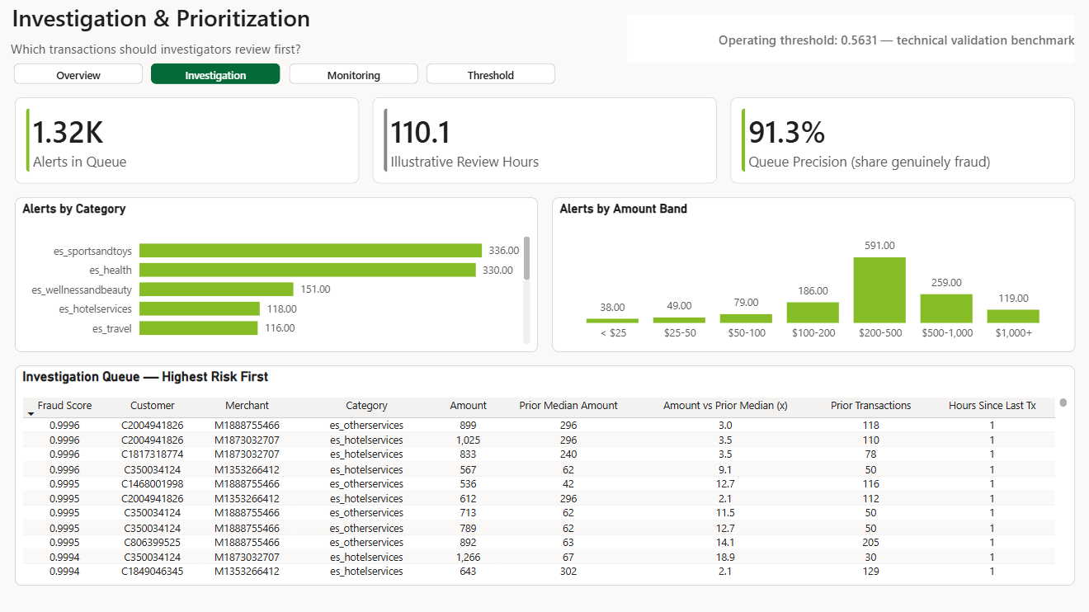
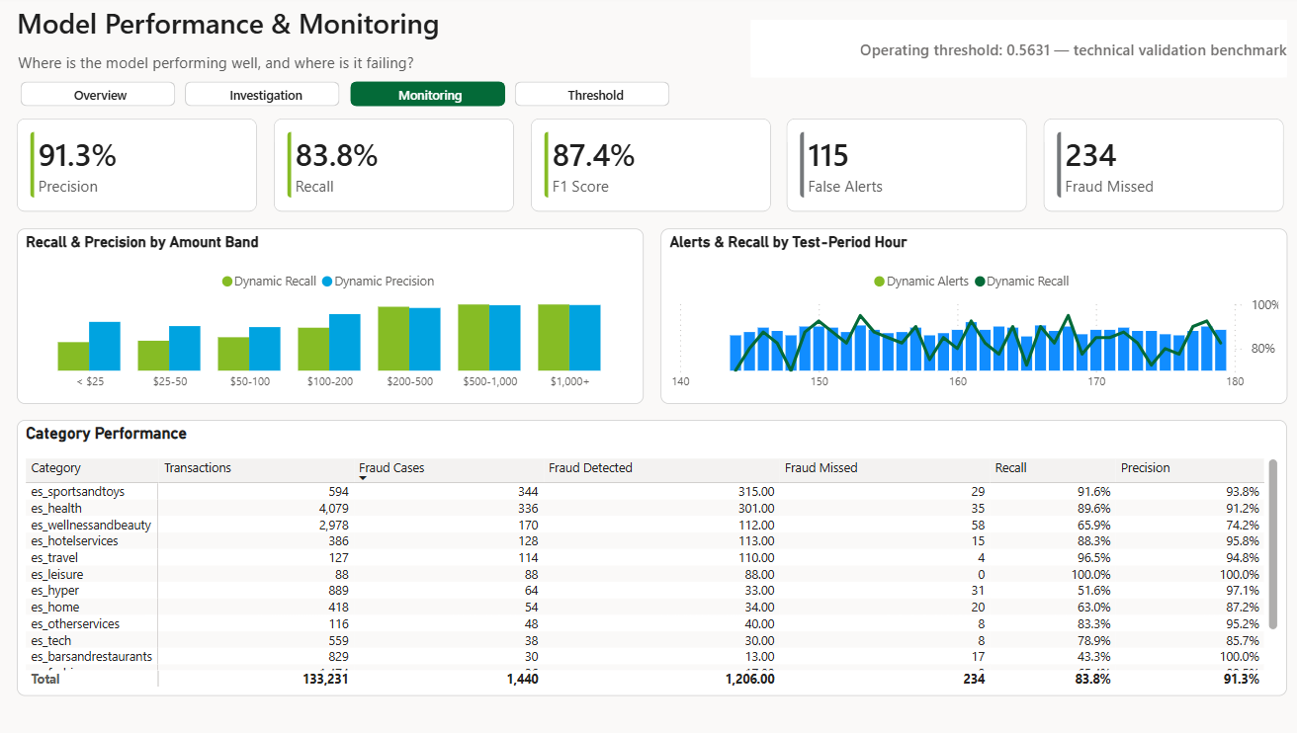
APPENDIX · OPERATIONAL VIEWS
Investigation and monitoring views
Supporting operational detail for fraud investigators, data science and model-risk discussion.
Investigation & Prioritization
Model Performance & Monitoring
Fraud Detection Case Study · Deloitte Technical Case Study
16

Slide 17
APPENDIX · MODEL SELECTION
Complexity was added only where the evidence justified it
Class weighting
No improvement in average precision or best achievable validation F1, even after independently optimising its own threshold.
Tested — not adopted
SMOTE oversampling
The unweighted model already showed strong minority-class ranking. No unresolved discrimination problem justified synthetic data.
Considered — not applied
Hyperparameter tuning
Best alternative gained +0.0011 PR-AUC at roughly double the trees — judged immaterial. The simpler baseline was retained.
12 configurations tested
Merchant history (Set C)
No meaningful gain over Set B for the leading model, so the added pipeline complexity was not kept.
Tested — rejected
The discipline applied throughout: an additional layer of complexity was kept only where it produced a measurable, reproducible gain on validation data.
Fraud Detection Case Study · Deloitte Technical Case Study
17

Slide 18
APPENDIX · FEATURE CONTRIBUTION
Each additional layer of information added measurable value on unseen test data
Feature set | Content | Verdict
Set A — baseline | Amount, category, age, gender — transaction-level attributes only. | Retained
Set B — behavioural | Set A plus customer-relative history: spend deviation from the customer's own baseline, built from strictly prior transactions. | Retained — largest lift
Set C — merchant history | Set B plus merchant-level historical aggregates. | Rejected — no gain
The finding that mattered
Customer-relative behaviour outperformed absolute transaction attributes. A $400 transaction is unremarkable in general and highly suspicious for a customer whose history sits below $30 — which is precisely the signal Set B captures and Set A cannot.
Fraud Detection Case Study · Deloitte Technical Case Study
18

