Slide 1

Information and Network Security
Attacks

Slide 2
Definition
an attack can be defined as a systematic threat generated by an entity in an artificial, deliberate and intelligent way to destroy ,expose ,alter ,disable ,steal or gain unauthorized access or use of an assets

Slide 3
Avenues of attack
Social engineering, wherein someone tries to gain access through social means (pretending to be a legitimate system user or administrator, tricking people into revealing secrets, etc.)
War dialing, wherein someone uses computer software and a modem to search for desktop computers equipped with modems that answer, providing a potential path into a corporate network.
Denial-of-service attacks, including all types of attacks intended to overwhelm a computer or a network in such a way that legitimate users of the computer or network cannot use it.
Protocol-based attacks, which take advantage of known (or unknown) weaknesses in network services

Slide 4
Host attacks, which attack vulnerabilities in certain computer operating systems or in how the system is set up and administered.
Password guessing; passwords are sequences of symbols, usually associated with a user name, which provide a mechanism for identification and authentication of a particular user. On almost all machines, the users themselves choose the passwords. This places the burden of security on end users who either do not know, or, sometimes do not care about sound security practices. As a general rule, passwords that are simple to remember, are, likewise, easy to guess. Attackers have several venues of guessing passwords and overcoming this obstacle.
Eavesdropping of all sorts, including stealing e-mail messages, files, passwords, and other information over a network connection by listening in on the connection.

Slide 5
Attacks classification
Attacks
Based on source
Based on behavior
Based on number of nodes

Slide 6
Attacks classification
Based on source
Internal
External

Slide 7
Attacks based on source
Internal :gain normal access to the network and participate in the network
Can be done through:
Compromising a current node
Impersonate a host to gain access as a new node
External :an attack from a node outside the network
Causes:
Congestion
Propagate fake routing information
Disturb nodes from providing services

Slide 8
Attacks classification
Based on number of nodes
Single
Collaborative
Direct
Indirect

Slide 9
Attacks based on the number of nodes
Collaborative attacks :when more than one node synchronize their action to disturb a target .
Direct Collaborative attack examples :
Black hole :an attack in which a routing protocol advertise itself as best path to nodes it wants to intercept
Worm hole :an attack in which the attacker receive packets at a point then tunnels them to another point then replays them in the network

Slide 10
Attacks classification
Based on behavior
Passive
Active

Slide 11
Passive attacks
Attempt to learn or make use of information from the system but do not affect system resources.
A passive attacker only threatens the confidentiality of data.
Two types of passive attacks are related to message contents and traffic analysis
Eavesdropping. In general, the majority of network communications occur in an unsecured or "cleartext" format, which allows an attacker who has gained access to data paths in the network to "listen in" or interpret (read) the data exchanged over the network.
Strong encryption can help in countering this attack
Traffic analysis. It refers to the process of intercepting and examining messages in order to deduce information from patterns in communication.
The greater the number of messages observed, or even intercepted and stored, the more can be inferred from the traffic.

Slide 12
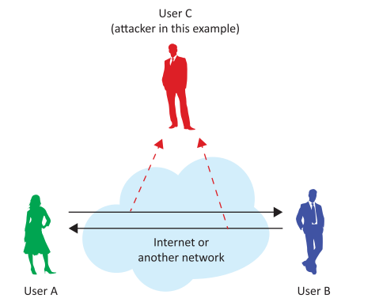
Passive attacks

Slide 13
Active attacks
Active attacks attempt to alter system resources or affect their operation.
Attempts to delete, add, or in some other way alter the transmission on the channel
An active attacker threatens data integrity and authentication as well as confidentiality.

Slide 14
Active attacks
Active can be divided into six categories:
Masquerade. It is a type of attack where the attacker pretends to be an authorized user of a system in order to gain access to it or to gain greater privileges than they are authorized for.
Main factor :vulnerable authentication
Can use spoofing to gain required information for the attack .such as using an email , a phone call or masking a trusted IP address .
Replay. In this kind of attack, a valid data transmission is maliciously or fraudulently repeated or delayed. This is carried out either by the originator or by an adversary who intercepts the data and retransmits them.

Slide 15
Modification of messages. The attacker removes a message from the network traffic, alters it, and reinserts it.
Man in the Middle (MitM). In this kind of attacks, an intruder intercepts communications between two parties, usually an end user and a website. The attacker can use the information accessed to commit identity theft or other types of fraud.
Denial of Service (DoS) and Distributed Denial of Service (DDoS). A denial of service (DoS) attack is an incident in which a user or organization is deprived of the services of a resource they would normally expect to have. In a distributed denial-of-service, large numbers of compromised systems attack a single target.

Slide 16
Advanced Persistent Threat (APT). It is a network attack in which an unauthorized person gains access to a network and stays there undetected for a long period of time. The intention of an APT attack is to steal data rather than cause damage to the network or organization. APT attacks target organizations in sectors with high-value information, such as national defense, manufacturing and the financial industry.

Slide 17
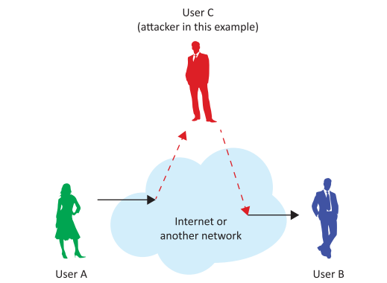
Active attacks

