Slide 1

TEAM 2 SQl analytic functions
Ashok Patil, Bharath N, Bumika N,
Cauvery C M, Shruthi M

Slide 2
Lets have a look at our database
We have selected the most trending and important dataset which has affected our life
Its COVID-19
Source: WHO Coronavirus Disease (COVID-19)

Slide 3
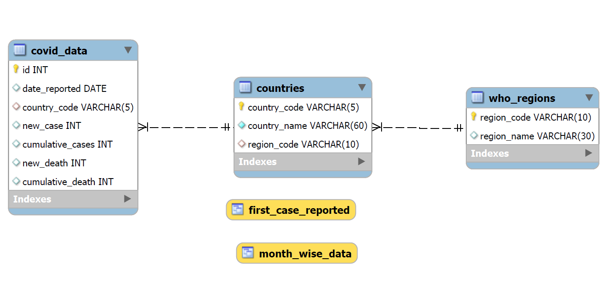
Er Diagram

Slide 4
MySQL Window Functions
MySQL has supported window functions since version 8.0.
The window functions allow you to solve query problems in new,
easier ways, and with better performance
Functions which we will be discussing are
FIRST_VALUE LAST_VALUE LAG

Slide 5
FIRST_VALUE
The FIRST_VALUE() is a window function that allows you to select the first row of a window frame, partition, or result set.
Syntax:
FIRST_VALUE (expression) OVER (
[partition_clause]
[order_clause]
[frame_clause]
)
The FIRST_VALUE() function returns the value of the expression from the first row of the window frame

Slide 6
LAST_VALUE
The LAST_VALUE() function is a window function that allows you to select the last row in an ordered set of rows.
Syntax:
LAST_VALUE (expression) OVER (
[partition_clause]
[order_clause]
[frame_clause]
)
The LAST_VALUE() function returns the value of the expression from the last row of a sorted set of rows.

Slide 7
LAG
The LAG() function is a window function that allows you to look back a number of rows and access data of that row from the current row.
Syntax:
LAG (expression [,offset[, default_value]]) OVER (
[partition_clause]
[order_clause]
)
The LAG() function returns the value of the expression from the row that precedes the current row by offset number of rows within its partition or result set.

Slide 8
Any queries?

Slide 9
Thank You

