Slide 1
DBMS MINI PROJECT
INVENTORY MANAGEMENT SYSTEM
A Relational Database Project Using MySQL
TEAM MEMBERS
S.Leena Chowdary
M.Bhagya Ratna Siri
R.Purna Sahithi
Group: [Group Name]

Slide 2
i
Introduction & Objectives
WHAT IS AN IMS?
Centralized Inventory
WHAT IS AN
INVENTORY MANAGEMENT SYSTEM?
1
All product & stock data stored in one MySQL database.
Product & Stock Tracking
2
A software application that digitally tracks products, stock levels, purchases and sales — replacing manual, error-prone record keeping.
Real-time visibility of available product quantities.
Purchase Management
3
Tracks products bought from suppliers.
Goal
Sales Management
Give the business one reliable, centralized source of truth for every product, purchase and sale.
4
Tracks products sold to customers.
Supplier & Customer Records
5
Maintains contact & transaction history.
Inventory Management System
2

Slide 3
!
Problem Statement & Proposed Solution
THE PROBLEM
THE SOLUTION
Manual stock tracking on paper / spreadsheets
Data duplication across records
Frequent stock inaccuracies
Difficult to trace purchases & sales
Slow, error-prone report generation
Centralized MySQL relational database
Structured, well-defined tables
Automated stock updates via triggers
Fast, accurate data retrieval & reporting
BOTTOM LINE: A well-designed relational database removes redundancy and keeps stock data accurate at all times.
Inventory Management System
3

Slide 4
→
System Workflow
SUPPLIER
PURCHASE
PURCHASE_ITEM
PRODUCT
SALE_ITEM
SALE
CUSTOMER
Provides products
Records products bought
Individual products in a purchase
Details & current stock qty
Individual products in a sale
Complete customer sale
Buys products from business
PURCHASE → Stock QUANTITY increases ▲
SALE → Stock QUANTITY decreases ▼
Business purchases finished products from suppliers and sells them to customers — no manufacturing involved.
Inventory Management System
4

Slide 5
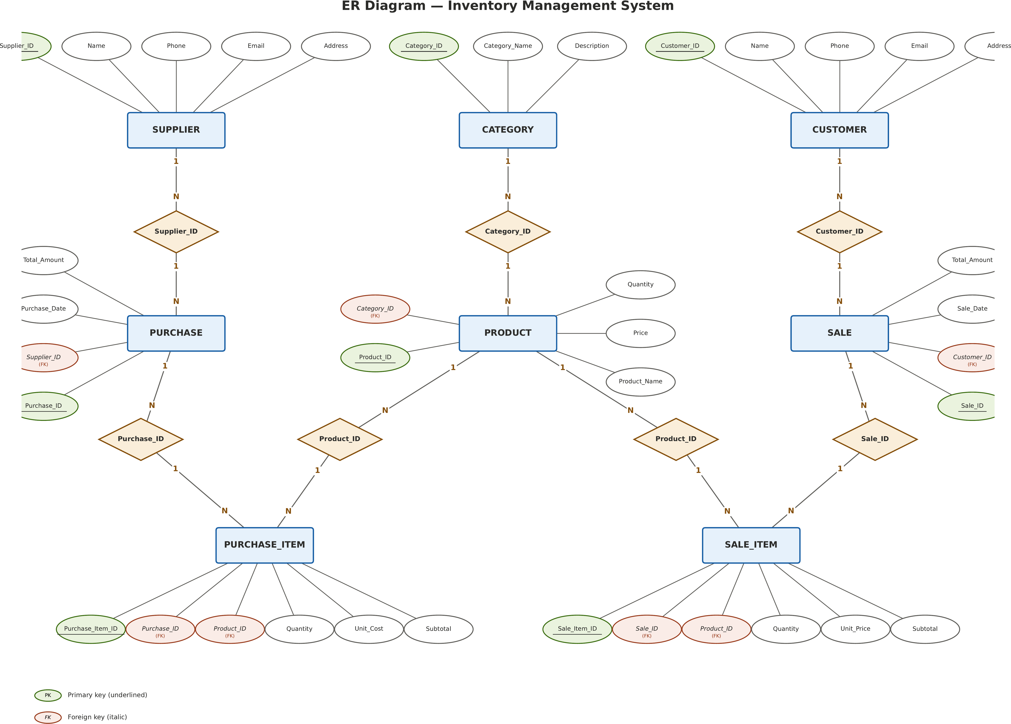
E
Entity-Relationship (ER) Diagram
Inventory Management System
5

Slide 6
K
Database Design, Keys & Relationships
Primary Key
Foreign Key
Referential Integrity
Uniquely identifies each record in a table.
Connects related tables to each other.
Ensures relationships stay valid & consistent.
Tables | Connecting Column | Cardinality
CATEGORY → PRODUCT | Category_ID | 1 : N
SUPPLIER → PURCHASE | Supplier_ID | 1 : N
PURCHASE → PURCHASE_ITEM | Purchase_ID | 1 : N
PRODUCT → PURCHASE_ITEM | Product_ID | 1 : N
CUSTOMER → SALE | Customer_ID | 1 : N
SALE → SALE_ITEM | Sale_ID | 1 : N
PRODUCT → SALE_ITEM | Product_ID | 1 : N
Inventory Management System
6

Slide 7
N
Normalization & Constraints
NORMALIZATION APPLIED
CONSTRAINTS USED
1NF
Every column holds atomic, single values (e.g. one Phone per row).
PRIMARY KEY
FOREIGN KEY
Product_ID, Category_ID, ...
Category_ID in PRODUCT
2NF
All non-key attributes depend on the whole primary key (e.g. Subtotal depends on full PURCHASE_ITEM key).
NOT NULL
UNIQUE
Product_Name, Price
Supplier / Customer Email
3NF
No transitive dependencies — Category_Name kept only in CATEGORY, not repeated in PRODUCT.
CHECK
DEFAULT
Result: less redundancy • better consistency
Quantity >= 0, Price > 0
Purchase_Date = CURRENT_DATE
Inventory Management System
7

Slide 8
C
MySQL Implementation & CRUD Operations
DATABASE CREATION
INSERT
Add new records
CREATE DATABASE inventory_db;
CREATE TABLE product (
Product_ID INT PRIMARY KEY,
Category_ID INT,
...
);
New product, purchase or sale entry
SELECT
Retrieve records
View product list or sales history
UPDATE
Modify records
KEY MYSQL DATA TYPES
Change stock quantity or price
DECIMAL — Price, Total_Amount, Subtotal
DATE — Purchase_Date, Sale_Date
DELETE
Remove records
VARCHAR — Names, Emails, Addresses
Remove a discontinued product
Inventory Management System
8

Slide 9
Q
SQL Queries, Joins & Reporting
QUERY CONCEPTS
AGGREGATE FUNCTIONS
REPORTS WE CAN GENERATE
WHERE — filter rows
ORDER BY — sort results
INNER JOIN — combine tables
GROUP BY — group rows
HAVING — filter groups
Subqueries — nested queries
COUNT() — total rows
SUM() — total value
AVG() — average value
MAX() — highest value
MIN() — lowest value
Products by category
Customer-wise sales
Supplier-wise purchases
Total sales revenue
Average product price
Products priced above average
Inventory Management System
9

Slide 10
T
Triggers & Automatic Stock Management
PURCHASE TRIGGER
SALE TRIGGER
New Purchase_Item inserted
New Sale_Item inserted
Identify Product_ID
Identify Product_ID
Product.Quantity INCREASES ▲
Product.Quantity DECREASES ▼
AFTER INSERT
FOR EACH ROW
NEW.Quantity
NEW.Product_ID
Inventory Management System
10

Slide 11
A
Advanced MySQL Features
Beyond core tables and triggers, these MySQL features extend the project's capability:
VIEWS
STORED PROCEDURES
FUNCTIONS
TRANSACTIONS
INDEXING
Ready-made inventory & sales reports
Add products, record purchases / sales
Calculate totals & subtotals
COMMIT / ROLLBACK for consistency
Faster data retrieval on large tables
1
2
3
4
5
Included as part of project scope — core schema, CRUD, joins & triggers are fully implemented; these extend it further.
Inventory Management System
11

Slide 12
O
Output, Advantages & Conclusion
SAMPLE OUTPUT AREAS
Product Inventory
Purchase Records
Sales Records
Customer-wise Sales
Supplier-wise Purchases
Updated Stock Qty
ADVANTAGES
Centralized data
Accurate inventory
Automated stock updates
Reduced redundancy
Easy reporting
CONCLUSION
“An efficient MySQL-based system for managing products, purchases, sales and inventory.”
Inventory Management System
12

