Slide 1
By
LEENA SALEEM ALTURJAMI
SALMA AIAD ALOQMANI

Slide 2

KINGDOM OF SAUDI ARABIA TABUK UNIVERSITY COLLEGE OF COMPUTER SCIENCE & INFORMATION SYSTEM
Auto For Rental Car website

Slide 3
Abstract
The Auto For Rental Car website is a user-friendly online platform designed to simplify the process of renting a car. With a sleek and intuitive interface, our website offers a seamless and convenient car rental experience for individuals and businesses alike.
The website incorporates modern HTML and CSS techniques to provide an engaging and responsive user interface. From the moment visitors land on our homepage, they are greeted with a visually appealing design that reflects the professionalism and reliability of our rental car services.

Slide 4
Home page
In this page you can see the list of cars that we have them you can rent any one of them.

Slide 5
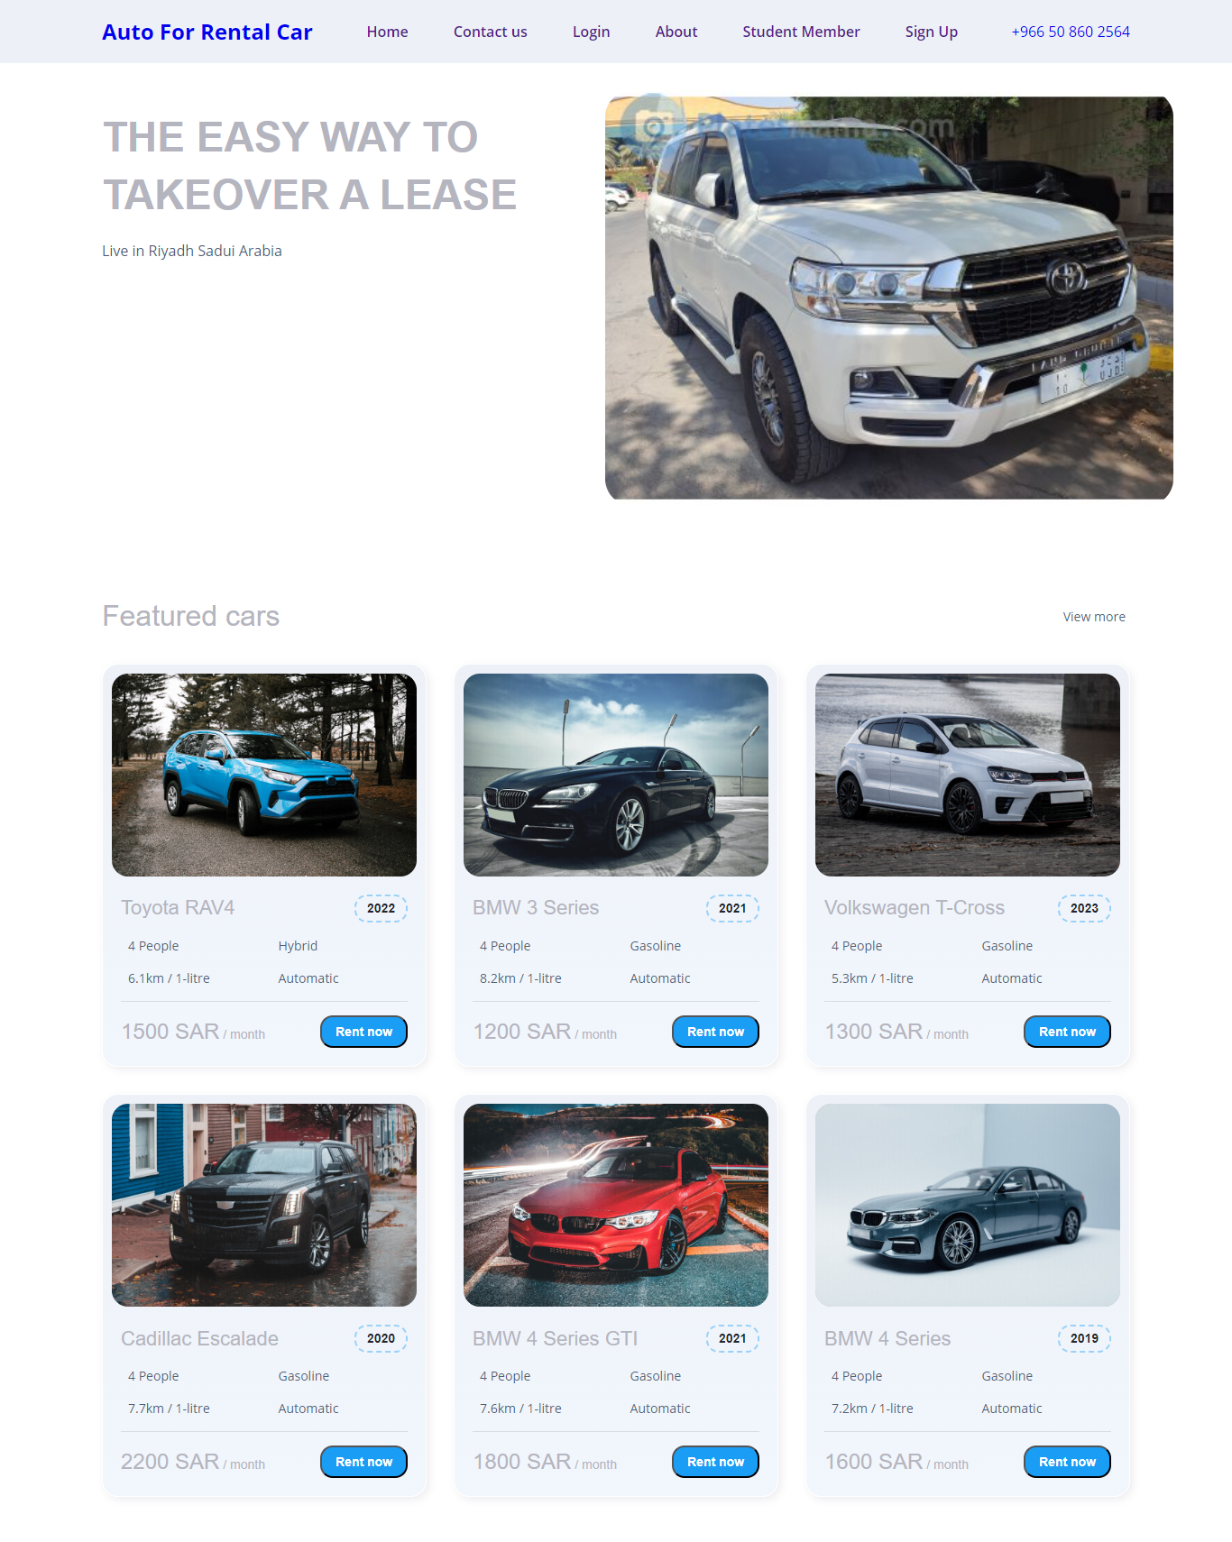
Home page

Slide 6
Contact Us
This page use for contact with us.

Slide 7
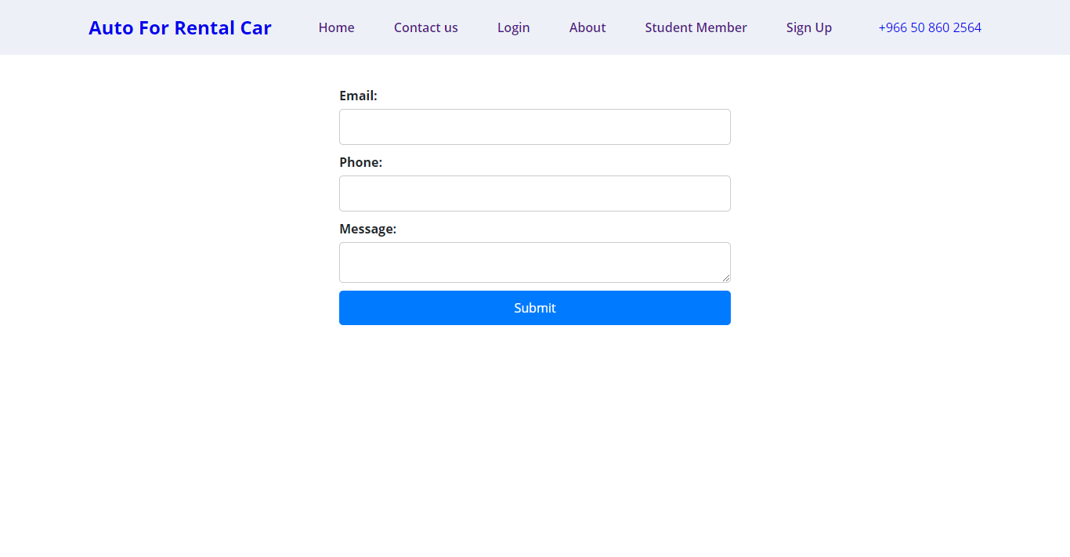
Contact Us

Slide 8
Student Member
In this page we display our name randomly by list and javaScript also we show table and video.

Slide 9
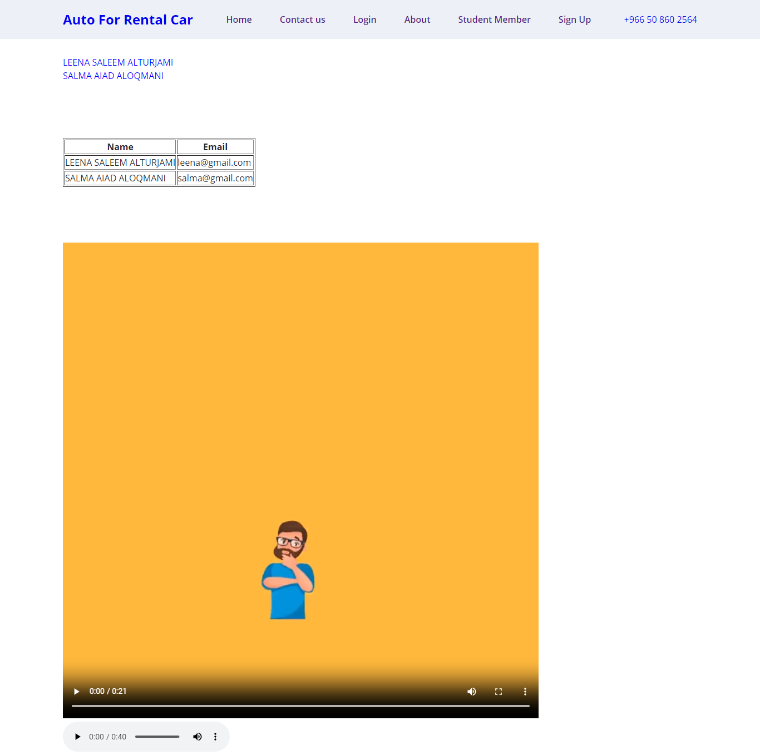
Student Member

Slide 10
Registration
When the user want to sign in our website he will sign in from this page.

Slide 11
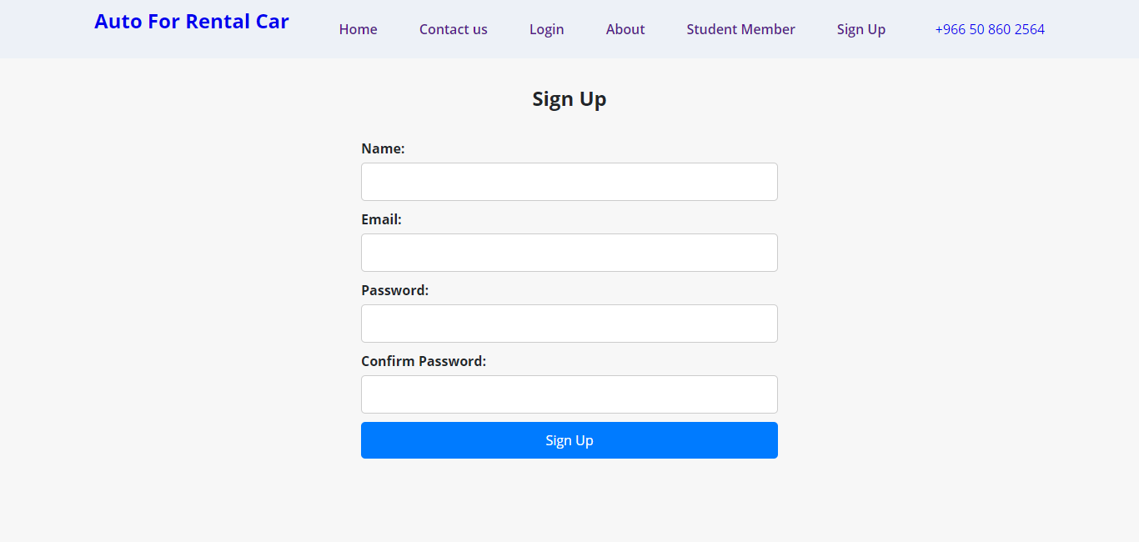
Registration

Slide 12
About
In this page we only show some info about the rental car website.

Slide 13
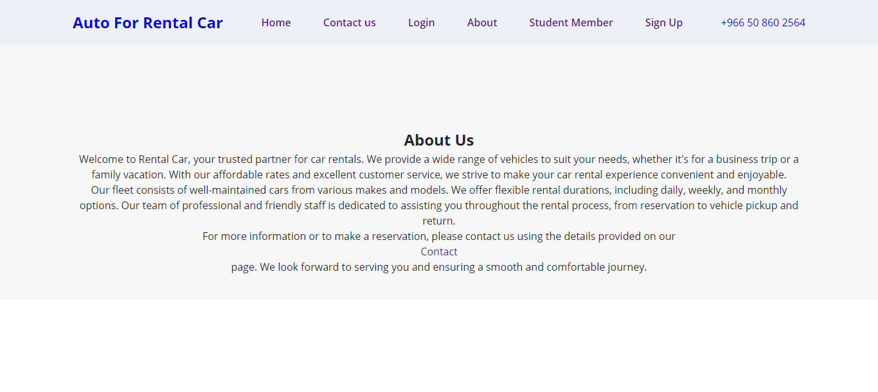
About

Slide 14
Login
From this page the user can login in to our website.

Slide 15
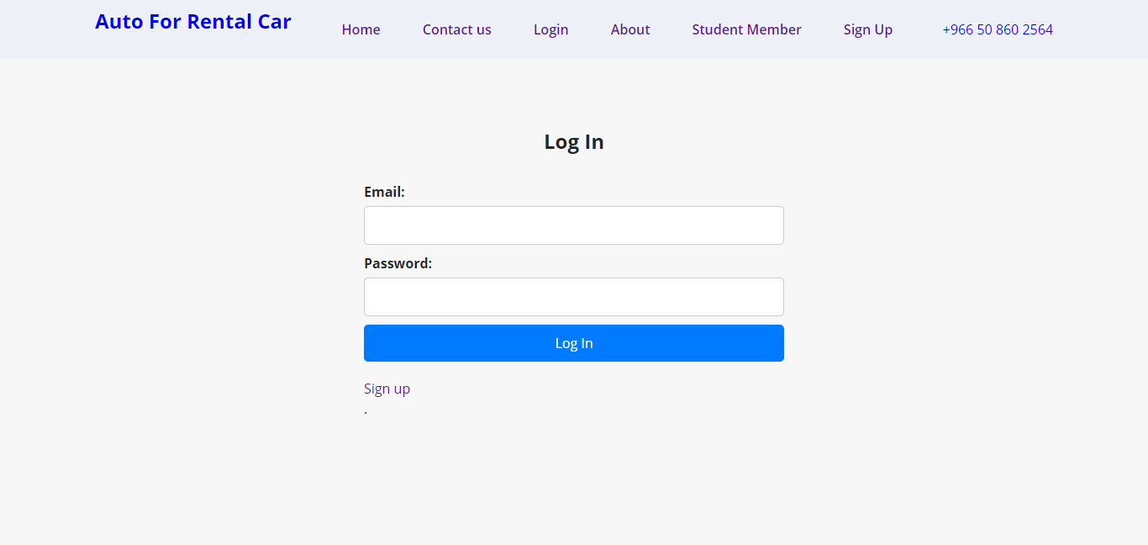
Login

