Slide 1
Data mining and machine learning
Final Project

Slide 2
Team members
Yashwanth Holur Narayanaswamy
Rajendra Leena Sai
Saichand Mekala
Pola Sudharshan
Jyothsna Yalamaddi

Slide 3
INTRODUCTION
We have taken a cardiovascular disease prediction dataset. In this dataset there are many features related to patients' health and lifestyle, including age, sex, general health, check-up frequency, exercise habits, smoking history, and the presence of various diseases. Each entry represents a unique patient, and the features capture various factors associated with disease prognosis.

Slide 4
Objective
Our main objective is to develop a predictive model that can effectively forecast the prognosis of various diseases based on the provided features. By leveraging the power of machine learning, we aim to enhance the model's accuracy and predictive performance.

Slide 5
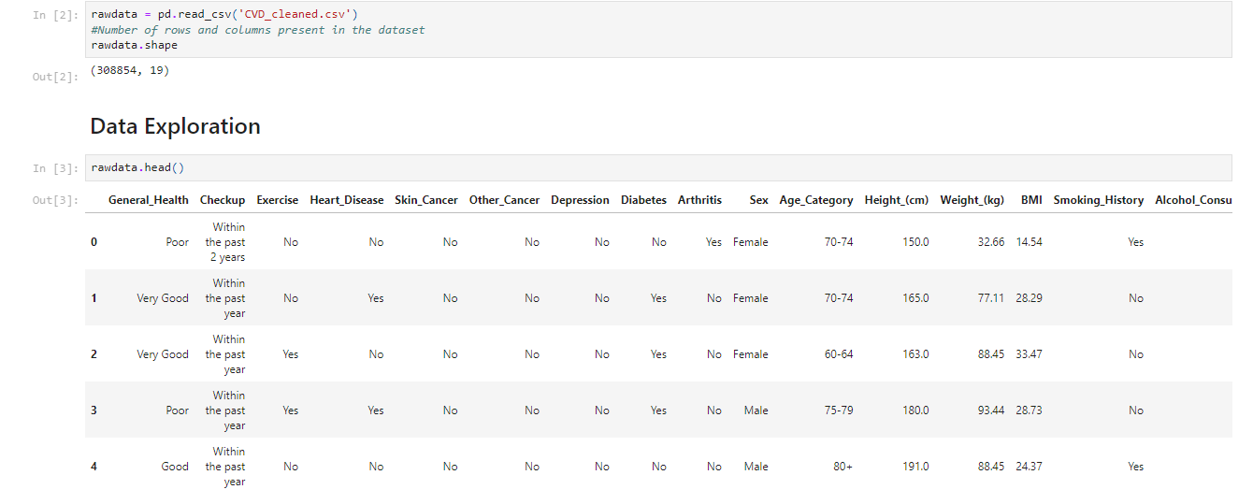
Count of rows and columns in Data
Our data is taken from kaggle
The data set has data about cardio vascular disease
It contains 308854 rows and 19 columns
11 columns are categorical columns
9 are numerical columns

Slide 6
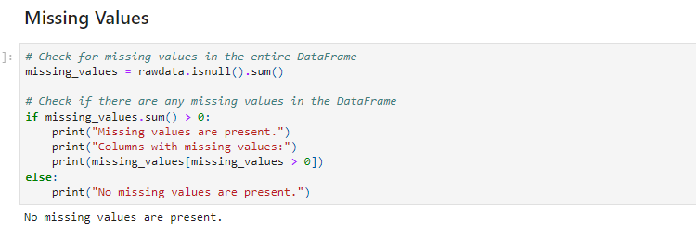
Missing values
Our data is cleaned and There are no missing values in the data

Slide 7
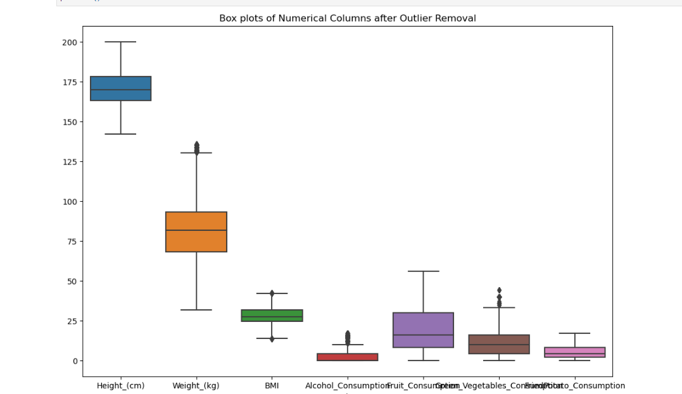
Handling outliers

Slide 8
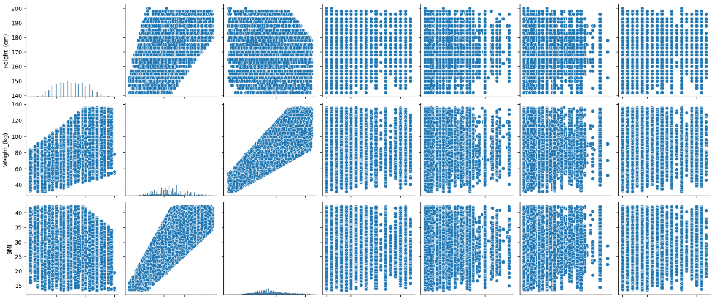
Correlation between numerical values

Slide 9
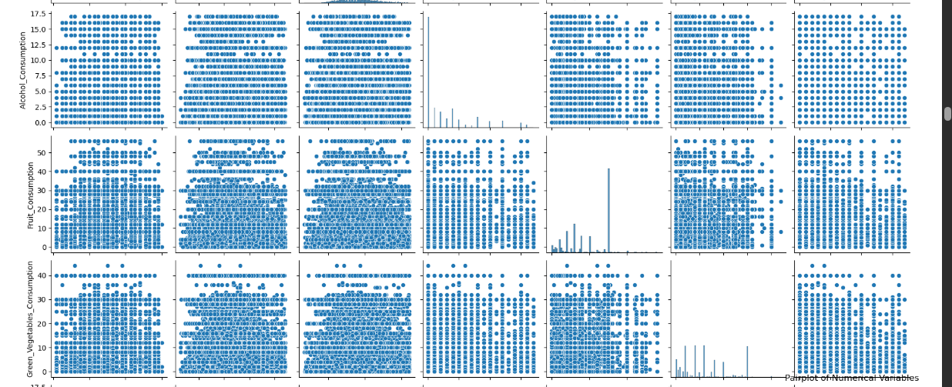
Correlation between numerical values

Slide 10
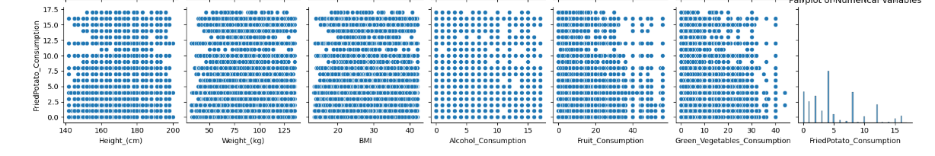
Correlation between numerical values

Slide 11
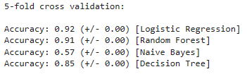
Model selection
We used 4 different classifiers which are logistic regression, random forest, naive Bayes, decision tree
Were the accuracies of logistic regression was 0.92
Random forest was 0.91
Naive Bayes was 0.57
Decision tree’ s accuracy was 0.85

Slide 12
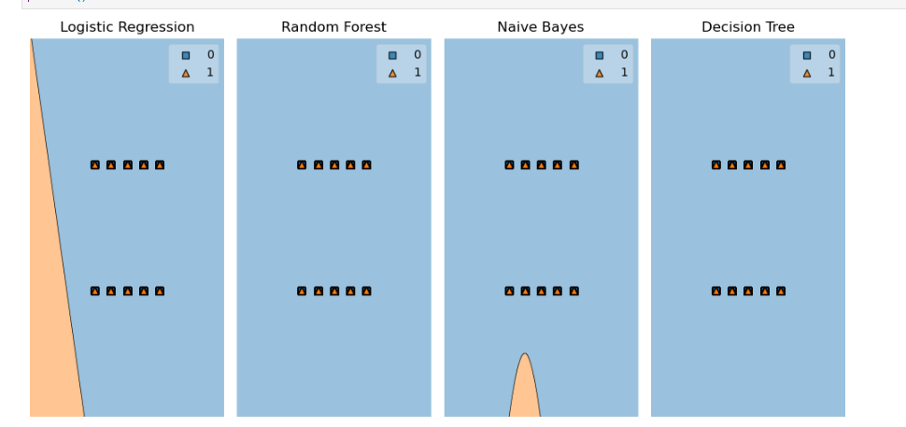
Decision regions graph for Models

Slide 13
Voting classifier
Voting classifier is an ensemble method in machine learning classifiers
Where voting classifier uses a voting rule i.e. hard or soft to predict the class labels
It balances out the individual weaknesses of model when the accuracy is same.
Here we have combined all the individual classifiers used to build a ensemble.

Slide 14

Output of voting classifier

Slide 15
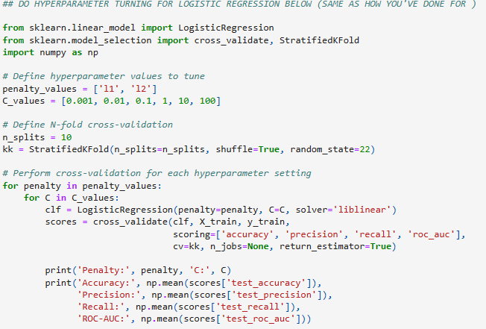
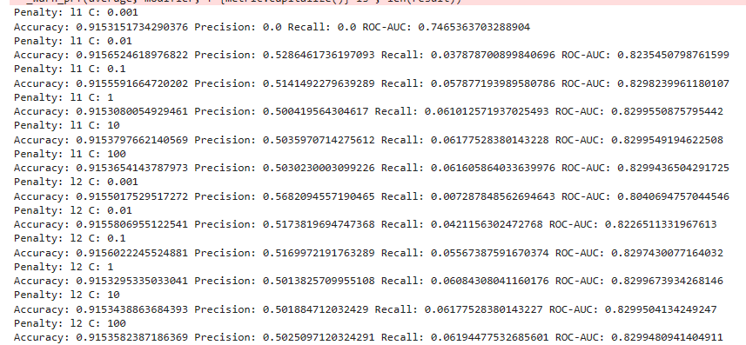
Hyper parameter tuning using linear regression

Slide 16
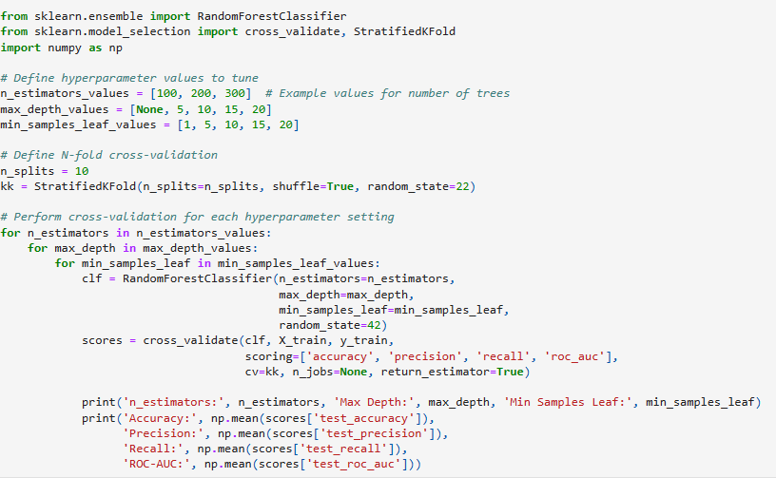
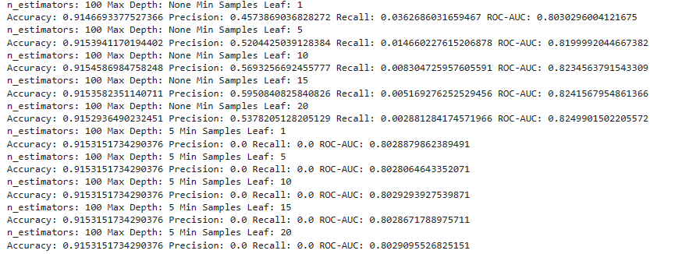
Hyper parameter tuning using random forest

Slide 17
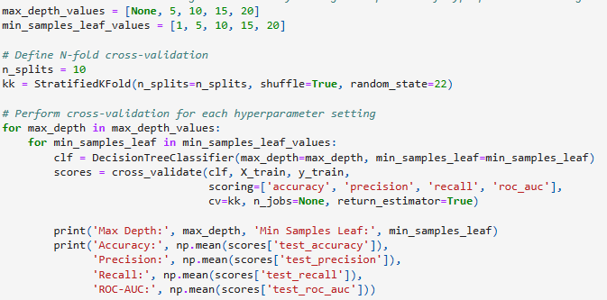
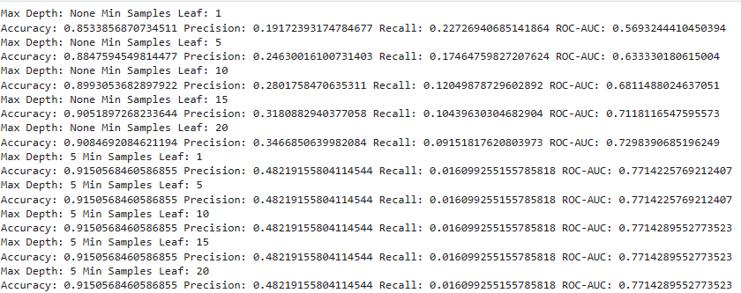
Hyper parameter tuning using decision tree

Slide 18
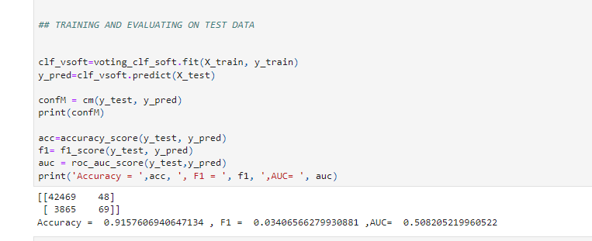
Model evaluation

Slide 19


