Slide 1

Using Data Analytics for Grocery Shopping
Applying the Data Analytics Process in Everyday Life

Slide 2
.
01 - Introduction
02 - Plan
03 - Prepare
04 - Process
05 - Analyze
06 - Share
07 - Act
08 - Conclusion

Slide 3

Introduction
Data analytics helps us make informed decisions in everyday activities. Let's explore how data analytics can simplify our weekly grocery shopping.

Slide 4

Step 1: Plan
The first step is to identify what groceries you need for the week.
- Check your pantry and refrigerator for items you already have
- List the meals you plan to cook during the week
- Note down the ingredients required for each meal

Slide 5
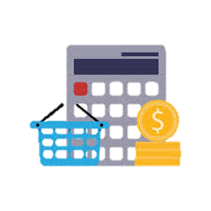
Step 2: Prepare
Next, determine your budget and gather financial resources.
- Set a budget for the weekly groceries
- Review your current financial status
- Plan how to allocate budget for groceries, including any coupons or discounts you may use

Slide 6
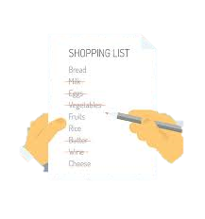
Step 3: Process
Collect detailed information on your grocery needs.
- Categorize items into groups such as vegetables, fruits, dairy, etc.
- Estimate the quantity needed for each item
- Check prices and availability of items at different stores

Slide 7
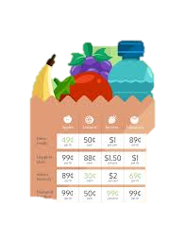
Step 4: Analyze
Analyze the collected data to make informed decisions.
- Compare prices of items at different stores
- Check for any ongoing sales or discounts
- Evaluate the nutritional value and freshness of items

Slide 8
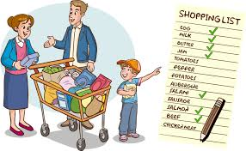
Step 5: Share
Communicate your plan and get input from others.
- Discuss the grocery list with family members
- Share any dietary preferences alteration or restrictions
- Adjust the list based on feedback

Slide 9
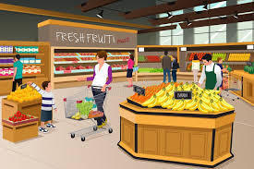
Step 6: Act
Finally, execute your plan and purchase the groceries.
- Visit the chosen stores and buy the items on your list
- Stick to the budget and prioritize essential items
- Ensure you buy fresh and high-quality products

Slide 10

Conclusion
Using data analytics helps you plan and execute your grocery shopping efficiently, saving time and money. By following these steps, you can ensure a well-organized and successful shopping trip.

