Slide 1
SQUAD INFOTECH PROJECT
Project Level-1
Presenter-Leena Suroshe

Slide 2
DOCTOR’S
APPOINTMENT

Slide 3
SUMMARY
This Project is entitled as “Doctor’s Appointment” and this Project can be used by Clinic, Hospitals & Patients.
It mainly has 3 sections. Admin, Receptionist and Patient. Where Admin log into Admin section and add details of Doctors and Receptionists. It can also change his ID and Passwords. Receptionist can create his/her password, After creating password they can log and view details of Doctors and Appointments. Receptionist can Confirm or Cancel Appointment as per availability of Doctors. Patient can take appointment and also cancel appointment. Patient can check his/her appointment status which can updated by Receptionist.
It is implemented using python where oops concepts are extensively used. It contains MySQL database for storage.

Slide 4
FEATURES
Admin Section:-
Admin (Doctor):-
Add Doctor Details
Add Receptionists Details
Change ID & Password
Receptionist Section:-
Receptionist Login:-
View Doctors Details
View Appointments
Change Your Password
Create Password
3. Admin Section:-
Patient:-
Make Appointment
Cancel Appointments
View Appointment Status

Slide 5
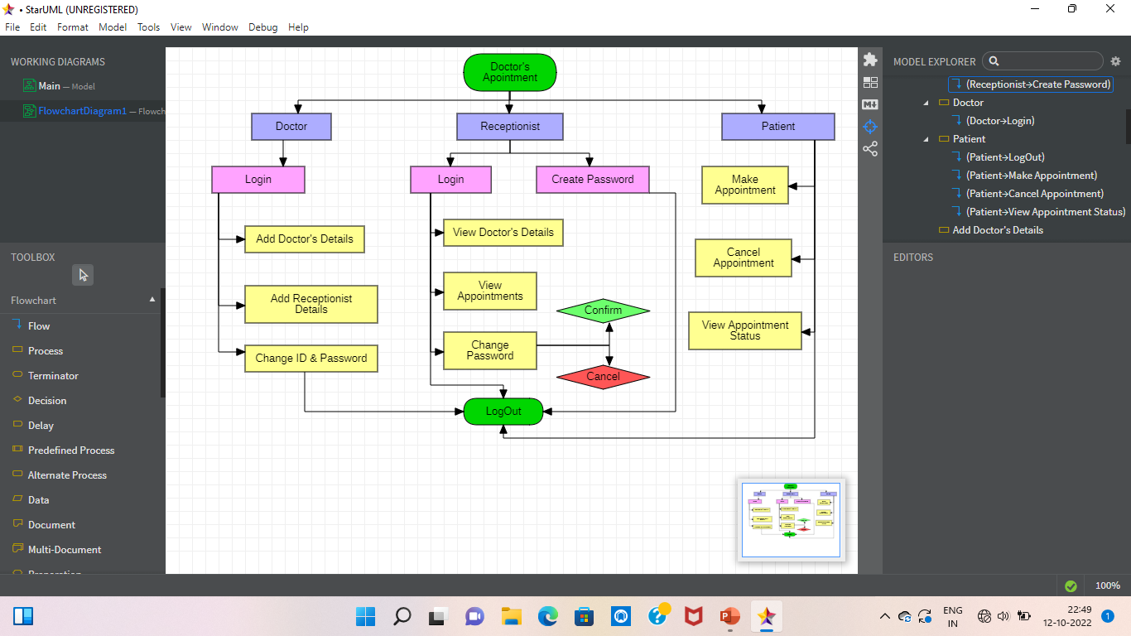
Data Flow Diagram

Slide 6
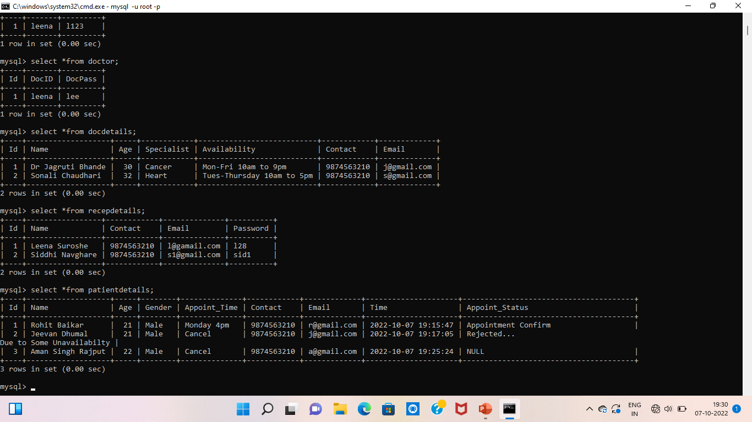
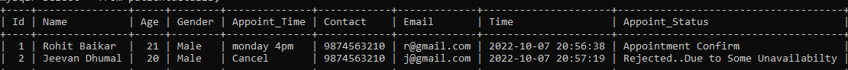
Tables
1. Admin Table
2.Doctor’s Details Table
3.Receptionist Details
4.Patient Details

Slide 7
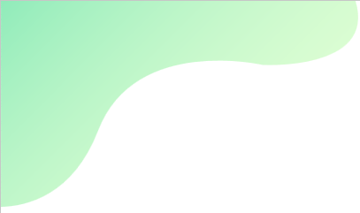
Thank You!!! Leena Suroshe leenasuroshe2001@gmail.com

