Slide 1

Law Finder
- An awareness application

Slide 2

Pitch
This is a chat application in which the user can query the social problems and get to know the related Laws from the Indian Constitution through this app.

Slide 3
Challenge Statement
Currently, many are not aware of the Indian Constitution and many people do not know about the rules and regulations of the Indian Constitution.

Slide 4
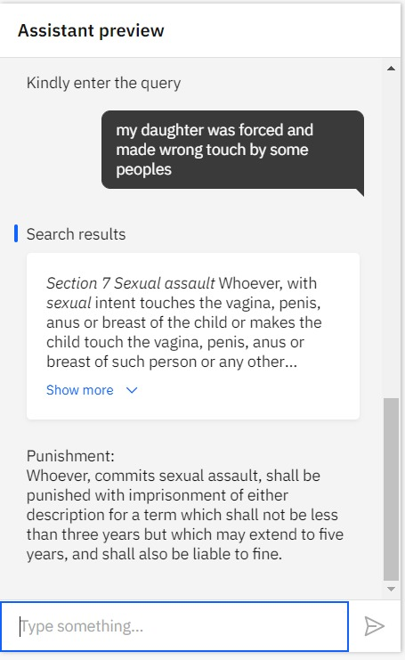
Solution
The chatbot provides the laws in the Indian Constitution for the queries about the social problems faced by the user.
FOR EXAMPLE
* Now the user types his query as “My daughter was forced and made wrong touch by some peoples.”
Then the chatbot displays the result as

Slide 5
Innovation and Novelty
In this tech world, anyone can find anything by surfing
the web, except one thing, that is the solution to
problem that he can’t tell it to anyone .
We have came up with this project, where the user
need not depend on anyone and student’s
too get benefited.

Slide 6
Team Details
Team name: Titans
Team members:
Gokulprasath R(Leader)
Hariguptha A
Ragul S

