Slide 1

Birla Vishvakarma Mahavidyalaya(BVM) Engineering College
Computer Engineering Department
SUBJECT : CP441 (Project)
“Virtual Therapist (Group-14)”
Prepared by: ​ Guided by: ​
Leenanci Parmar (17CP006)​ Dr. Mayur Vegad​
Dhruvi Lad (17CP012)​ Prof. Dipa Soni

Slide 2


Objective:
Virtual Therapy provides the therapy through sympathetic suggestions to the user.
Virtual Therapy
Project Description:
Provides real time emotion detection through image and speech.​
After that, suggestions will be provided according to mood of the user.​
The main component is emotion detection module.​

Slide 3
Recap
Modules:
Emotion Detection(image)
Emotion Detection(Speech)
Therapy Suggestions
Integration(GUI)

Slide 4
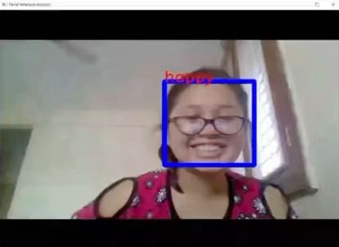
Emotion Detection(Image)
Updated Validation accuracy: 57->75%

Slide 5
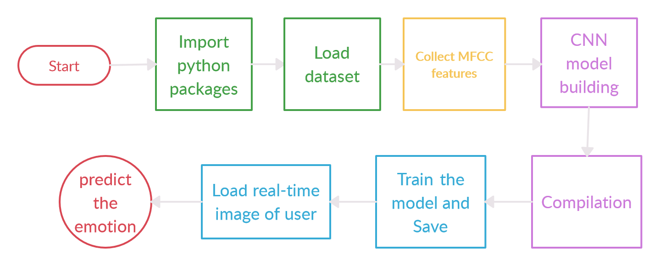
Flow of the Code (Emotion Detection through speech):
Prepared in : Creatly.com

Slide 6
Python Packages:
Librosa: python package for music and audio analysis. It provides the building blocks necessary to create music information retrieval systems.
Keras: API for CNN model building.
Pyaudio
Wav
Dataset:
RAVDESS -12 female, 12 male Speech file

Slide 7
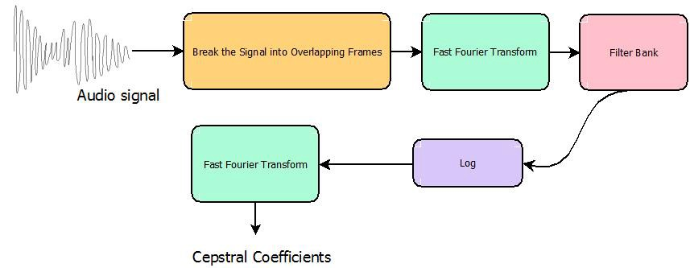
MFCC(Mel-frequency cepstral coefficient):
A way of extracting features from an audio.
MEL scale: scales the frequency in order to match more closely what the human ear can hear.
Pic courtesy:[3]

Slide 8
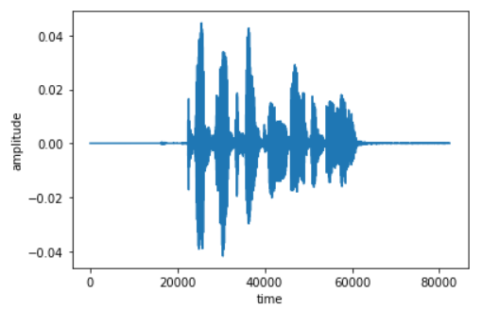
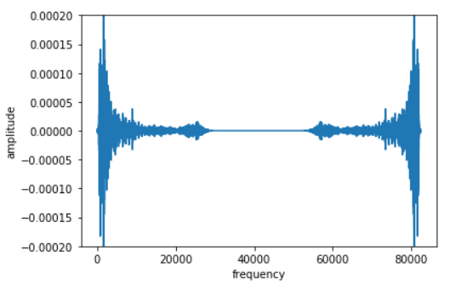


MFCC(Mel-frequency cepstral coefficient):
Filter
DCT
DFT(Discrete Fourier Transform)
Triangular Band pass Filter Bank
Mel scale
DCT(Discrete Cosine Transform)
Pic courtesy:[3]

Slide 9
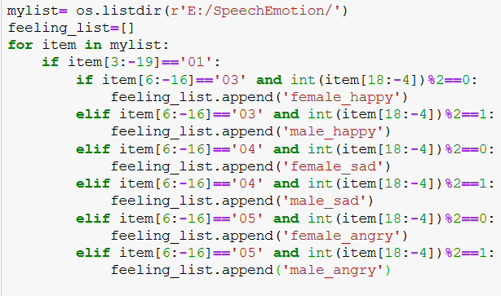
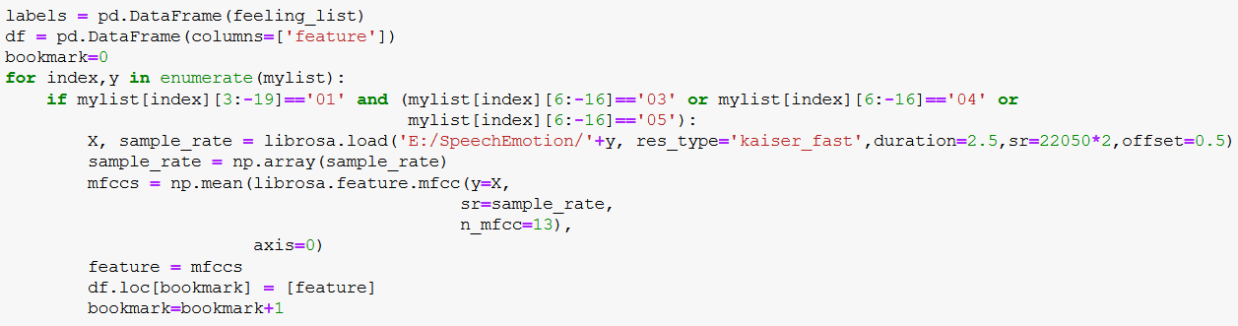
Emotion Detection(Speech)

Slide 10
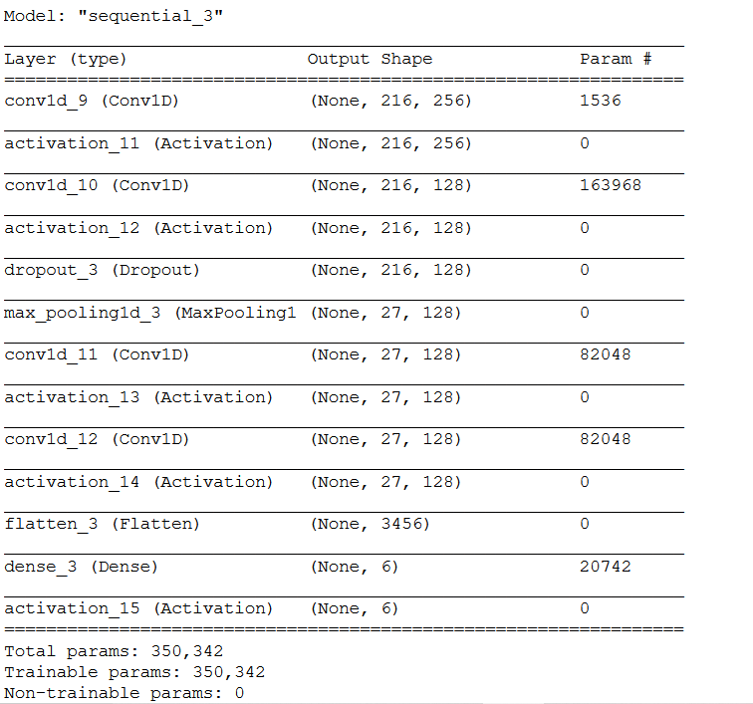
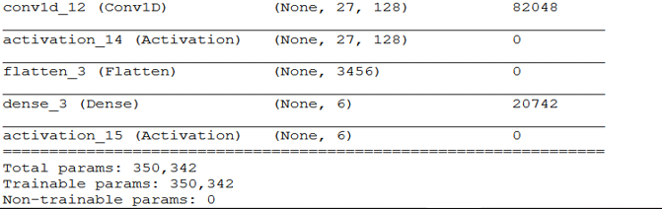
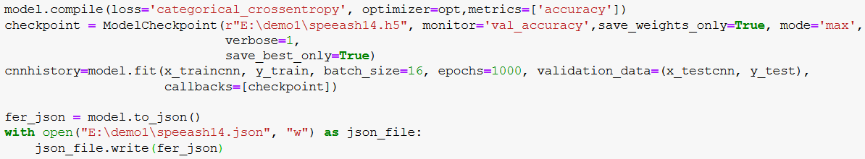

Slide 11
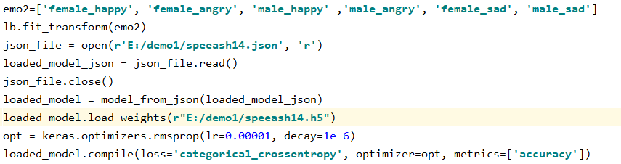
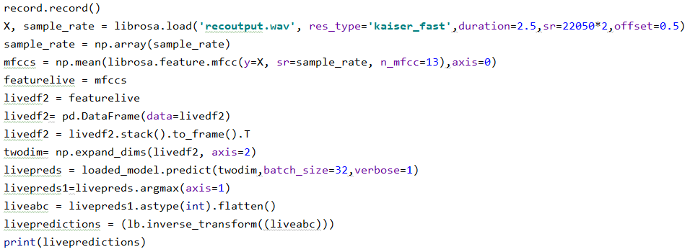

Slide 12
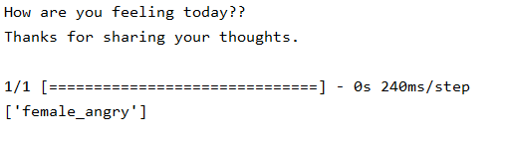
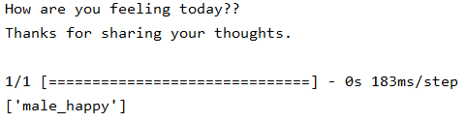
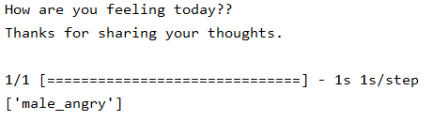
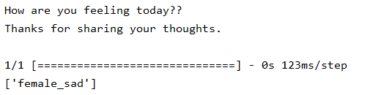
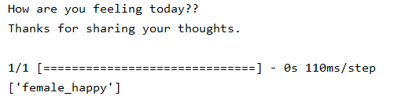
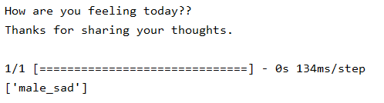
Output:

Slide 13
Upcoming targets:
1)Creating a module to provide suggestions.
2)Integration of modules(GUI)

Slide 14
Thank you!!
Bibliography:
[1] kaggle.com/uwrfkaggler/ravdess-emotional-speech-audio
[2] medium.com/prathena/the-dummys-guide-to-mfcc
[3] jonathan-hui.medium.com/speech-recognition-feature-extraction-mfcc-plp
[4] towardsdatascience.com/speech-emotion-recognition-with-convolution-neural-network
[5] github.com/MITESHPUTHRANNEU/Speech-Emotion-Analyzer
[6] analyticsinsight.net/speech-emotion-recognition-ser-through-machine-learning/
[7] kaggle.com/ilyamich/mfcc-implementation-and-tutorial
17CP006 Leenanci Parmar
17CP012 Dhruvi Lad

