Slide 1
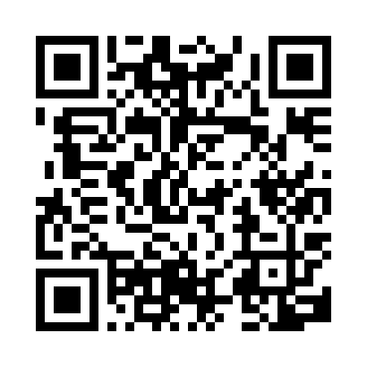
make-a-monster
See more at https://trojancs.org/courses/graphics/make-a-monster/

