Slide 1
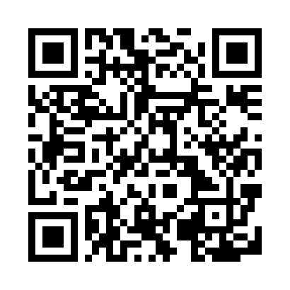











test
See more at https://trojancs.org/courses/graphics/test/

