Slide 1
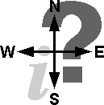
Managerial Economics & Business Strategy
Chapter 12
The Economics of Information
Modified by DF 3/12

Slide 2
Overview
I. Mean, Variance, etc.
Uncertainty and Consumer Behavior
      Utility function
      Consumer search
III. Uncertainty and the Firm
Uncertainty and the Market
      Adverse selection, moral hazard
      Possible solutions
Auctions

Slide 3
The Mean
The expected value or average of a random variable
Computed as the sum of the probabilities that different outcomes will occur multiplied by the resulting payoffs:
μ =E[x] = q₁ x₁ + q₂ x₂ +…+q_{n} x_{n},
where x_{i} is payoff i, q_{i} is the probability that payoff i occurs, and q₁ + q₂ +…+q_{n} = 1.
Note that the probabilities (weights) on the possible outcomes need not be identical. For example, if outcome i has very high q_{i,} then E[x] is close to x_{i}.
The mean provides information about the average value of a random variable but yields no information about the degree of risk associated with the random variable.

Slide 4
Variance & Standard Deviation
Variance is:
A measure of risk.
The sum of the probabilities that different outcomes will occur multiplied by the squared deviations from the mean of the random variable. Var[x]=
  σ² =q₁ (x₁- E[x])² + q₂ (x₂- E[x])² +…+q_{n}(x_{n}- E[x])²
Again, weights may not be equal…
Standard Deviation is:
The square root of the variance.
Interpreted as average (Euclidean) distance from the mean.

Slide 5
Uncertainty and Risk Aversion
  Handy utility function representation:
  U_{i} = CE_{i} = E[x] – ½ r_{i}Var[x]
  CE is the certainty equivalent, the person’s WTP for the bet.
  ½ r_{i}Var[x] is the risk premium, E[x] – CE.
  For a bet E[x]=$5 and Var[x]=25, most students in class indicated a CE between $4 and $5, or a RP between 1 and 0.
  This implies that most students have risk aversion parameter r_{i.} between 0.08 and 0.00.
  Risk averse: CE_{i} < E[x] or (equivalently) r_{i.} > 0. The majority.
  Risk neutral: CE_{i} = E[x] or r_{i.} = 0. This is fairly common too.
  Risk seeking: CE_{i} > E[x] or r_{i.} < 0. Las Vegas needs you!

Slide 6
Diversification
  Diversification can actually reduce risk.
  Suppose that 100 people face independent risks:
    x_{i} = 0 or 10, p_{i} = 0.5, so E[x]=5 and Var[x] = 25 each.
  Pooling, the total is E[T]=500 and Var[T] = 2500.
    (Var[T] would be higher if the risks were positively correlated.)
  For an equal share s = T/100 in the pool:
    E[s] = E[T]/100 = $5…no magic there, but
    Var[s]=Var[T/100]=Var[T]/100^2 = 25/100 !
    and σ_{s} is 0.5 instead of 5.0!
  Intuition: T is usually near 500, since independent risks often offset. So a share of the pool is much less risky.
  The magic works better the wider the pool and the lower the correlation.
    cor mismeasured in subprime loans…

Slide 7
Risk Sharing
  The other way to reduce the cost of risk is for more risk averse people to sell the risk to less risk averse people.
  E.g., in the bet discussed in class, those whose CE was $4.00 could sell the gamble to classmates whose CE was $5.00. At a price of $4.50, both would be better off. The sum of risk premiums would decrease, and consumer surplus would increase.
  The insurance industry diversifies away a lot of risk, and shares the rest (with re-insurers and shareholders).
    Fire insurance and national tornado insurance diversify well.
    Earthquake insurance less well due to high correlation among losses. But risk sharing still helps.

Slide 8
How Risk Aversion Influences Consumer Decisions
Customers perceive new products as risky-- unknown quality.
Devices to overcome the problem either raise the expected value or decrease perceived variance.
  Informative advertising
  Free samples
  Guarantees
Brand names exist mainly to ease the problem.

Slide 9
Searching for a good price
$
The Optimal Search Strategy.
EB
c
c
Reservation Price
P
0
Accept
R
Reject

Slide 10
Consumer Search
An increase in search costs raises the reservation price.
$
EB
c*
c*
c
c
P
0
R
R*

Slide 11
Uncertainty and the Firm
Risk Aversion
  Are managers risk averse or risk neutral or …?
  What should they be for the sake of:
    Shareholders
    Managers
    Taxpayers
    ?

Slide 12
Profit Maximization in an uncertain world
When demand is uncertain, expected profits are maximized at the point where expected marginal revenue equals marginal cost: E[MR] = MC
Practice problem: suppose demand
  high with probability 1/3 and low with probability 2/3.
  Pick high and low demand functions…
  Compute MR in each case
  Compute E[MR] and solve E[MR] = MC
  The biotech industry
What if costs are uncertain?

Slide 13
Asymmetric Information
Situation that exists when some people have better information than others.
First example: Insider trading, the accusation against Martha Stewart

Slide 14
Two Types of Asymmetric Information
Hidden characteristics→Adverse selection
  Things one party to a transaction knows about itself, but which are unknown by the other party.
Hidden actions → Moral hazard
  Actions taken by one party in a relationship that cannot be observed by the other party.

Slide 15
Adverse Selection
Situation where individuals have hidden characteristics, and they self-select to the detriment of the less informed party.
Examples
  Choice of medical plans
  High-interest loans
  Auto insurance for drivers with bad records

Slide 16
Moral Hazard
Situation where one party to a contract takes a hidden action that benefits him or her at the expense of another party.
Examples
  The principal-agent problem
  Care taken with rental cars

Slide 17
Possible Solutions
1. Signaling
  Attempt by an informed party to send an observable indicator of his or her hidden characteristics to an uninformed party.
  To work, the signal must not be easily mimicked by other types.
  Example: Education

Slide 18
Possible Solutions
2. Screening
  Attempt by an uninformed party to sort individuals according to their characteristics.
  Often accomplished through a self-selection device
    A mechanism in which informed parties are presented with a set of options, and the options they choose reveals their hidden characteristics to an uninformed party.
  Examples include price discrimination via
    quantity discounts and
    quality increments in a product line, eg. bicycles

Slide 19
Auctions
Seller has item, solicits bids from buyers
The bids determine the price and new owner
The word goes back to Rome
Idea probably goes back at least to Sumeria
Seemingly are becoming more important in recent years
  eBay
  Spectrum auctions
  Real estate …

Slide 20
Auctions better than posted price when:
The good does not have a known, stable price that equates supply and demand
  For example, fresh fish--the price depends sensitively on the quantity and quality of the day’s catch and on demand conditions.
Buyers’ participation costs and waiting costs are low relative to the value of items at auction.
  Otherwise intermediaries can profitably offer immediacy, and buy from the sellers and sell to the buyers on demand.
Inventories are expensive to carry.
  Otherwise the retailers can profitably create a convenient shop, post a relatively high fixed price and periodically offer clearance sales.
Buyers do not highly value customization
  so sellers can sell “as is” to a wide range of potential buyers.
  Otherwise again there is a role for intermediaries in catering to buyers’ diverse preferences

Slide 21
Classic types of Auction
  English
  First-price, sealed-bid
  Second-price, sealed-bid
  Dutch
  May also consider non-classic All-pay auction

Slide 22
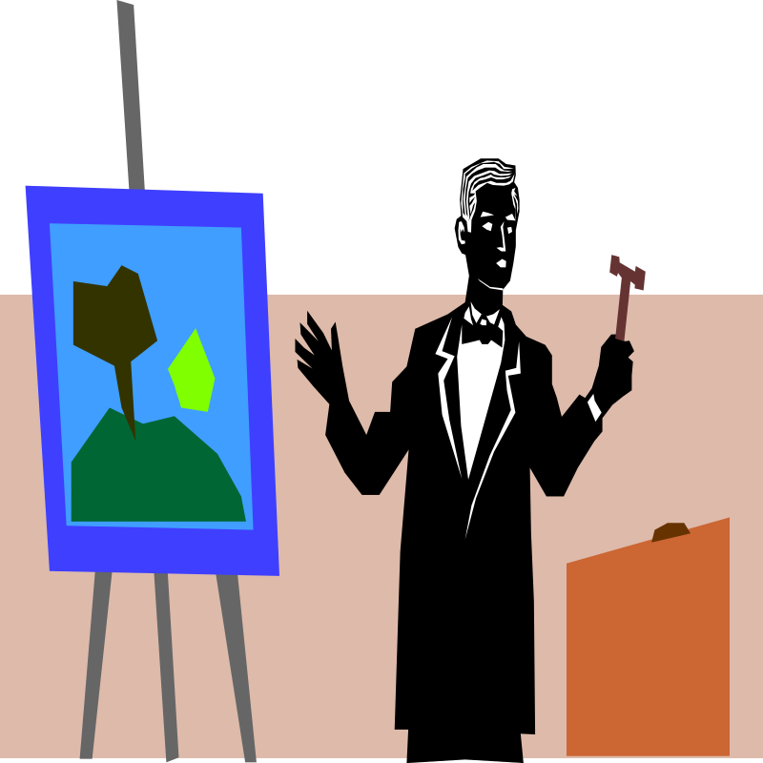
English Auction
An ascending sequential bid auction.
Bidders observe the bids of others and decide whether or not to increase the bid.
The item is sold to the highest bidder.

Slide 23
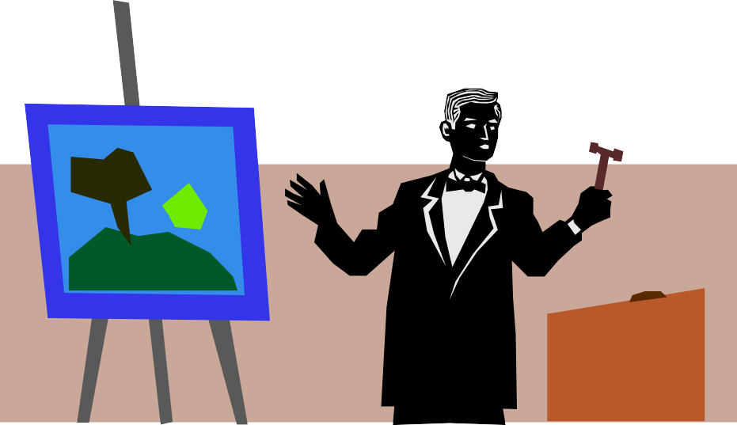
First-Price, Sealed-bid
An auction whereby bidders simultaneously submit bids on pieces of paper.
The item goes to the highest bidder.
Bidders do not know the bids of other players.

Slide 24
Second Price, Sealed-bid
The same bidding process as a first price auction.
However, the high bidder pays the amount bid by the 2nd highest bidder.

Slide 25
Dutch Auction
A descending price auction.
The auctioneer begins with a high asking price.
The bid decreases until one bidder is willing to pay the quoted price.
Strategically equivalent to a first-price auction

Slide 26
Information Structures
Independent private values
  Bidders know their own valuation of the item, but not other bidders’ valuations
  Bidders’ valuations do not depend on those of other bidders
Affiliated (or correlated) value estimates
  Bidders do not know their own valuation of the item or the valuations of others
  Bidders use their own information to form a value estimate
  Value estimates are affiliated: the higher a bidder’s estimate, the more likely it is that other bidders also have high value estimates.
  Common values is the special case in which the true (but unknown) value of the item is the same for all bidders

Slide 27
Optimal Bidding Strategy in an English Auction
With independent private valuations, the optimal strategy is to remain active until the price exceeds your own valuation of the object.

Slide 28
Optimal Bidding Strategy in a Second-Price Sealed-Bid Auction
Strategically equivalent to English auction.
The optimal strategy is to bid your own valuation of the item.
This is a dominant strategy.
  You don’t pay your own bid, so bidding less than your value only increases the chance that you don’t win.
  If you bid more than your valuation, you risk buying the item for more than it is worth to you.

Slide 29
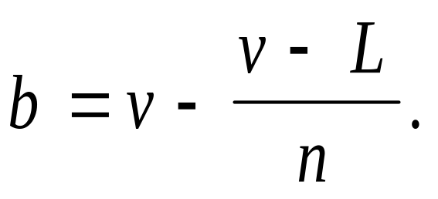
Optimal Bidding Strategy in a First-Price, Sealed-Bid Auction
Bidding higher increases probability of winning but reduces surplus for winner.
Given:
  n bidders, who all
  perceive valuations to be evenly (i.e., uniformly) distributed between a lowest possible valuation of L and a highest possible valuation of H
  are risk neutral and know own valuation v
Then your (Bayesian Nash) equilibrium bid is

Slide 30
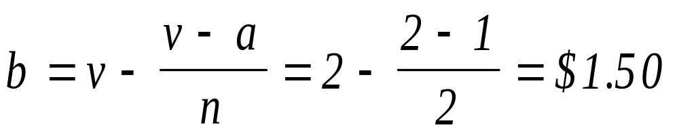
Example
Two bidders with independent private valuations (n = 2)
Lowest perceived valuation L = 1
Optimal bid for a player whose valuation is two (v = 2) is given by

Slide 31
Optimal Bidding Strategies with Affiliated Value Estimates
Difficult to describe because
  Bidders do not know their own valuations of the item, let alone the valuations others.
  The auction process itself may reveal information about how much the other bidders value the object.
Optimal bidding requires that players use any information gained during the auction to update their own value estimates.

Slide 32
The Winner’s Curse
In a common-values auction, the winner is the bidder who is the most optimistic about the true value of the item.
To avoid the winner's curse, a bidder should revise downward his or her private estimate of the value to account for this fact.
The winner’s curse is most pronounced in sealed-bid auctions.

Slide 33
E[Revenue] in NE for Auctions with Risk Neutral Bidders
Independent Private Values
  English = Second Price = First Price = Dutch
Affiliated Value Estimates
  English > Second Price > First Price = Dutch
  Bids are more closely linked to other players information, which mitigates players’ concerns about the winner’s curse.

Slide 34
Conclusion
Information plays an important role in how economic agents make decisions.
  When information is costly to acquire, consumers will continue to search for price information as long as the observed price is greater than the consumer’s reservation price.
  When there is uncertainty surrounding the price a firm can charge, a firm maximizes profit at the point where the expected marginal revenue equals marginal cost.
Many items are sold via auctions
  English auction
  First-price, sealed bid auction
  Second-price, sealed bid auction
  Dutch auction

