Slide 1

DefendX Solution Type: Prototype
Team Eclipse
Leerish Arvind
Suryakumar P Kalyanasundaram V
Notes:
Korrie

Slide 2
The Problem Statement
Sensitive Societal Issue: Security Challenges in Public Spaces
Unauthorized intruders in sensitive areas like educational institutions and public spaces can cause serious societal problems.
Incidents like violent crimes, including the recent rape cases in reputed institutions, highlight the pressing need for better security systems.
These events not only harm individuals but also create a sense of insecurity and fear in the community.
Notes:
Opening Line (20 sec) In India, unauthorized intruders in sensitive institutions and public spaces have led to severe societal issues, including alarming incidents of violence and assault. For example, in recent years, there have been reports of such incidents occurring within reputed educational institutions, which have resulted in tragic outcomes, including violent crimes against women.
Connecting to the Solution (10 sec) These incidents highlight the growing need for better security systems to prevent unauthorized access and provide immediate responses to potential threats, ensuring the safety and well-being of individuals in vulnerable environments.

Slide 3
The Solution: DefendX
Introducing DefendX
AI-powered facial recognition system for real-time intruder detection.
Compares faces against a database of authorized personnel, sending immediate alerts if an intruder is detected.
Helps enhance safety, prevent unauthorized access, and reduce response time to threats.

Slide 4
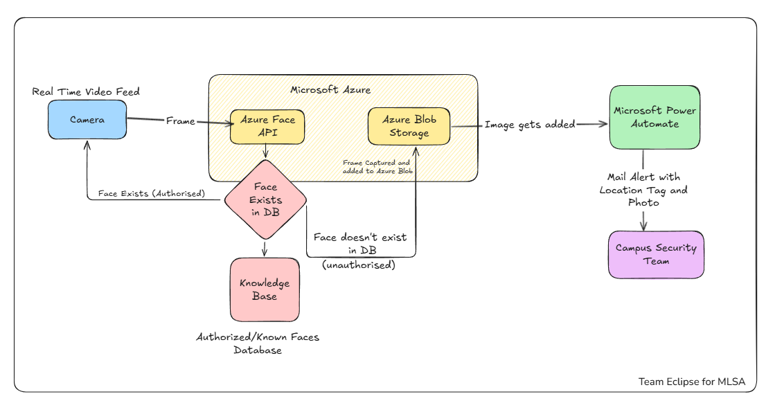
How DefendX works
Notes:
Korrie
updated 7/21

Slide 5
Azure Services Used
The following are the Services used for DefendX:
Azure Face API
Azure Blob Storage
Microsoft Power Automate
Notes:
Korrie
updated 7/21

Slide 6
Demo
Notes:
Korrie
updated 7/21

