Slide 1
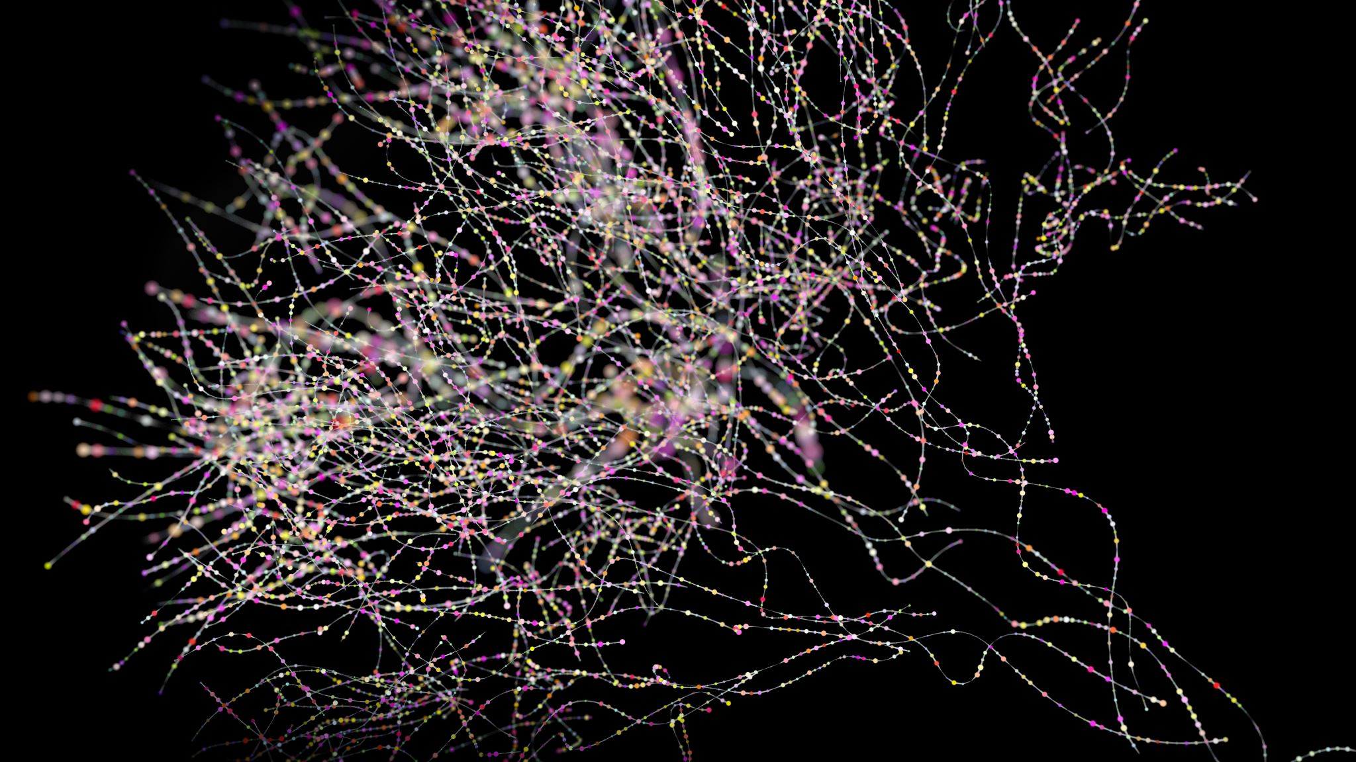
Explainable Generative Adversarial Network for Noisy Kidney Disease Detection
Team Members: B Mohnish Karthikeyan – 21BCE1371
S Navaneetha Krishnan – 21BCE1729
H G Leerish Arvind - 21BCE1867

Slide 2
Abstract
Noise in Medical Images: CT Scans often suffer from noise, complicating accurate diagnoses
Traditional vs. GAN Methods: Traditional methods have limitations; GANs offer denoising potential but lack transparency
Kidney Disease Detection: The proposed GAN denoises CT Scan images and an EfficientNet model detects the presence of Kidney disease.
Explainability: The CNN model predictions are explained using GradCAM that visualizes the feature maps.

Slide 3
Introduction
Challenges with Noisy Medical Images: Noisy CT Scan from hardware/software faults lead to errors in diagnosis and treatment
Limitations of Traditional Denoising: Techniques like smoothing and filtering don't leverage AI's advancements in image enhancement
The Need for Explainable AI: GANs show promise in denoising but require explainability for trust in critical healthcare applications

Slide 4
Motivation
Noisy Images Impact Diagnostics: Poor image quality complicates accurate diagnosis and patient care
Limited Trust in AI Systems: The black-box nature of GANs hinders their acceptance in clinical settings
Importance of Transparency: Clinicians need to understand AI decisions to make informed patient care choices

Slide 5
Objective
Denoise CT Images: Use GANs to produce high-quality, denoised Kidney CT Scans.
Explainability for AI Outputs: Provide transparent, interpretable insights into the GAN’s image generation process
Kidney Disease Detection with CNN: Develop an explainable CNN to predict the presence of Kidney Disease in the denoised images

Slide 6
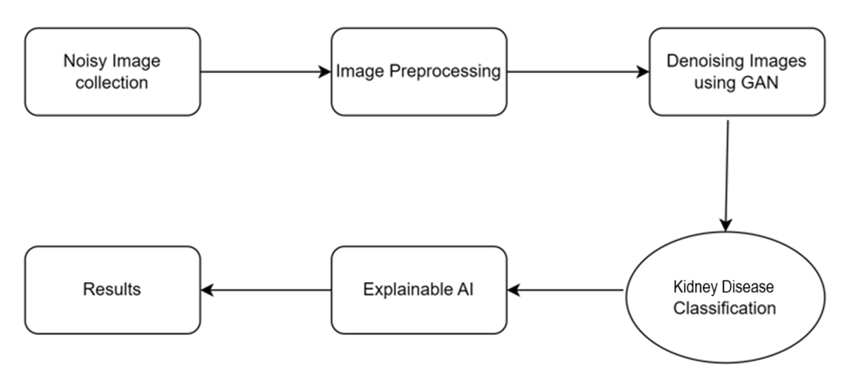
PROPOSED WORKFLOW DIAGRAM

Slide 7
Proposed Work
Dataset Utilized: The Kaggle CT KIDNEY DATASET, containing images of normal kidneys and cases with kidney stones, cyst and tumors
GAN Architecture: A GAN model specifically designed for denoising the CT Scans of Kidneys
Training and Testing: Model trained to denoise noisy CT images and generate high-quality outputs

Slide 8
Proposed Work
Explainable CNN for Kidney Disease Detection: An explainable EfficientNet is used to predict the presence of Kidney Disease in denoised images.
Explainability Methods: Use of XAI techniques like Grad-CAM to visualize which parts of the image influenced the model's decisions.
Performance Metrics: The model's efficacy is evaluated using accuracy, precision, recall, and F1 score.

Slide 9
Proposed Work
GAN Performance: Measure quality of denoised images using SNR and Generator loss metrics to ensure image fidelity.
Integration of Explainability: The proposed system emphasizes transparency in decision-making to foster clinician trust.
Real-world Applications: The system is intended for use in real-world healthcare environments, ensuring outputs are reliable and understandable.

Slide 10
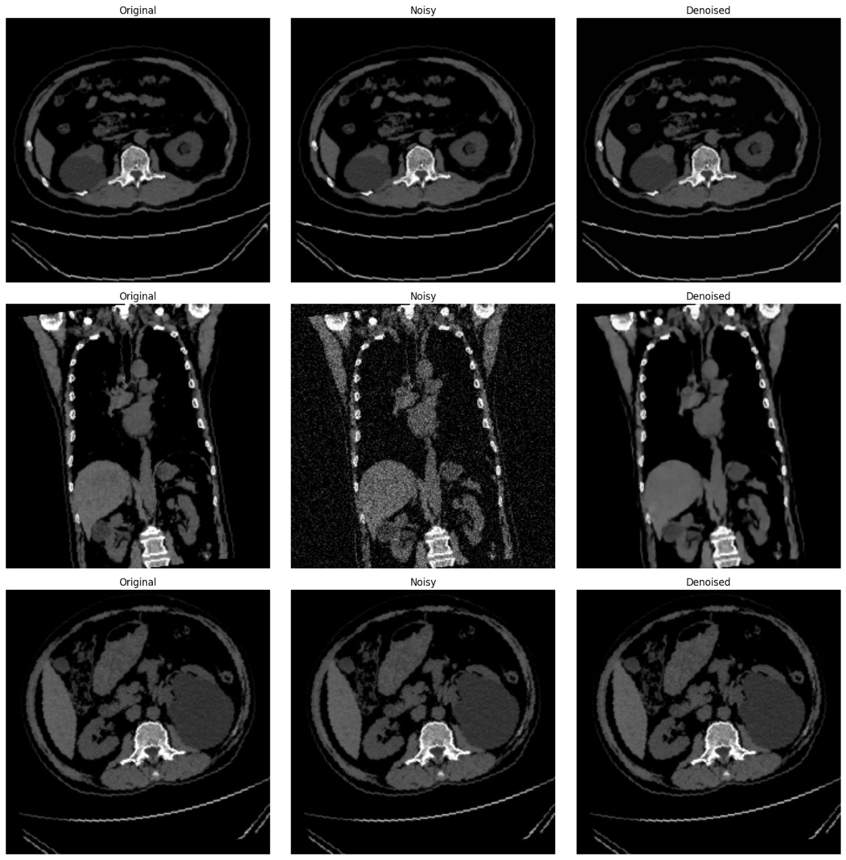
Sample Input and Output Images

Slide 11
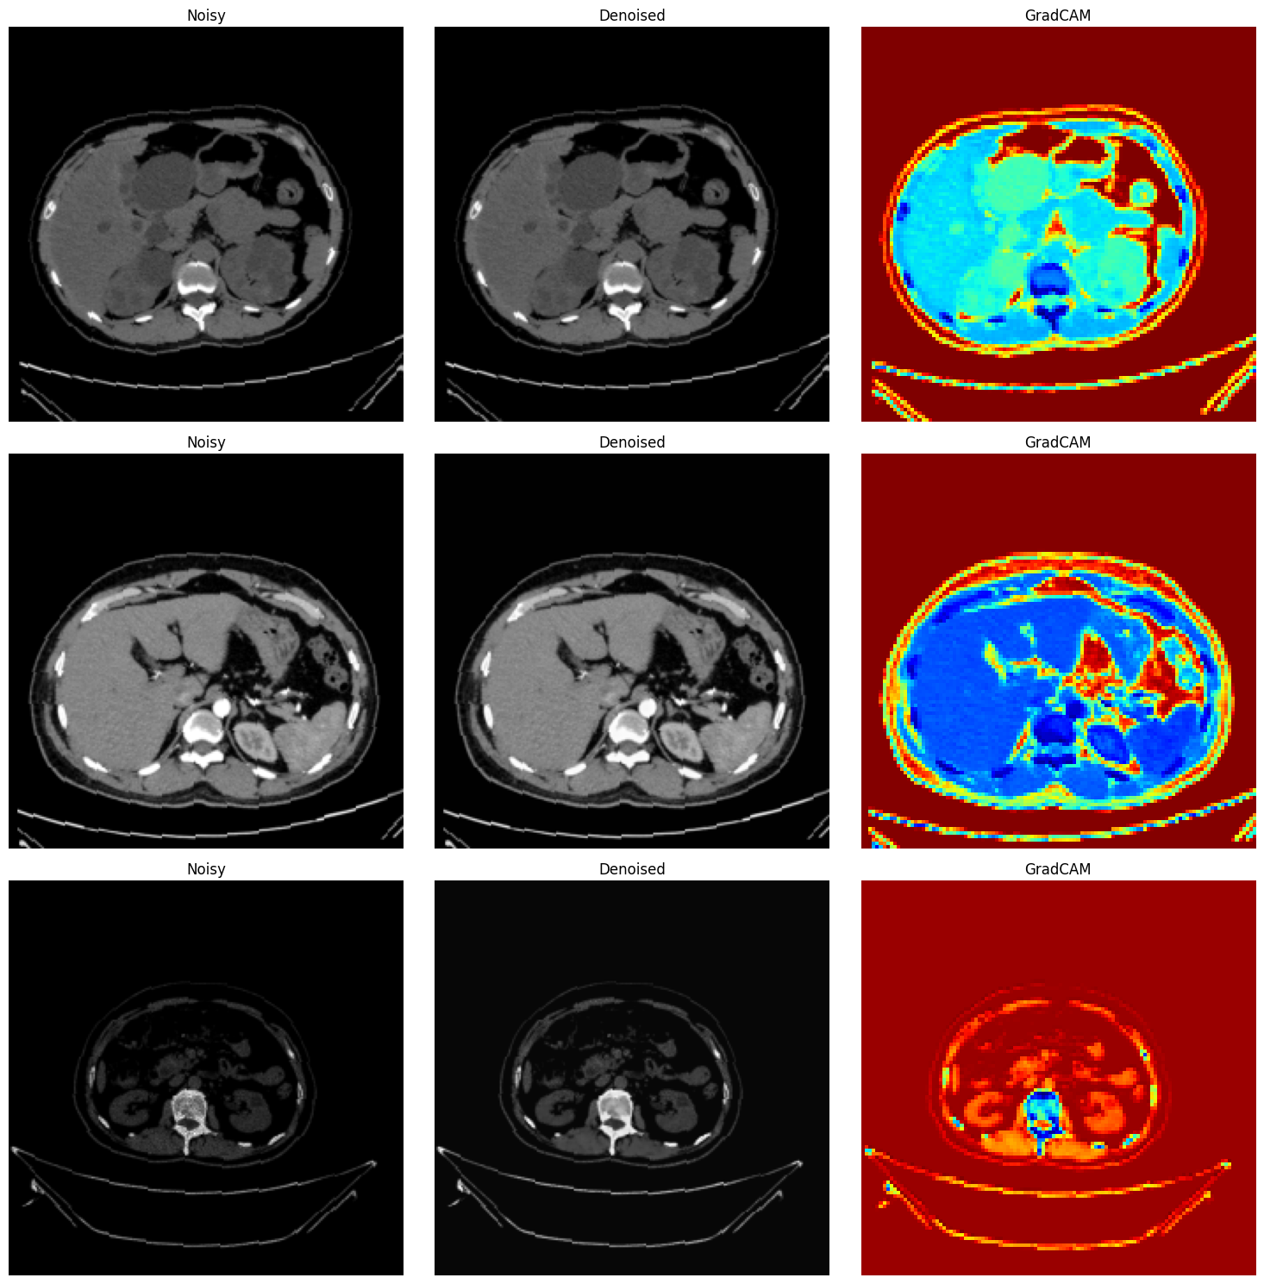
Results

Slide 12
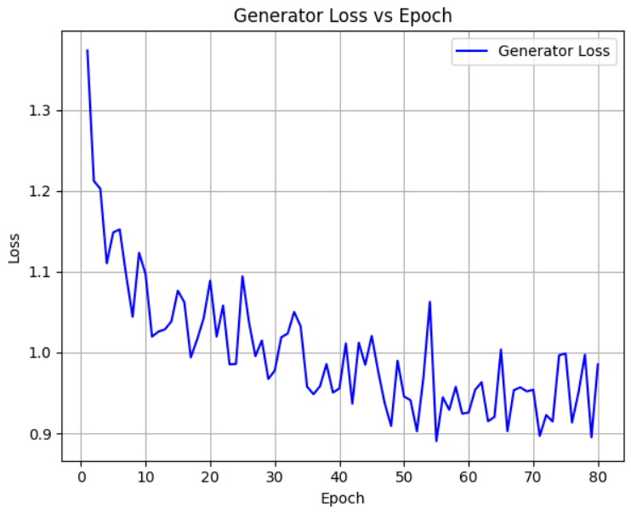
Results
GAN Performance Metrics: The generator of the GAN had its loss reduced to 0.89 after 80 epochs under the adversarial effect. Moreover, SNR of reconstructed image is 43.43 as compared to 39.54 in noisy image
Efficient Net performance: The proposed model has an accuracy of 99.82%
GradCAM Use case: GradCAM shows the features that affect the prediction of kidney diseases.

Slide 13
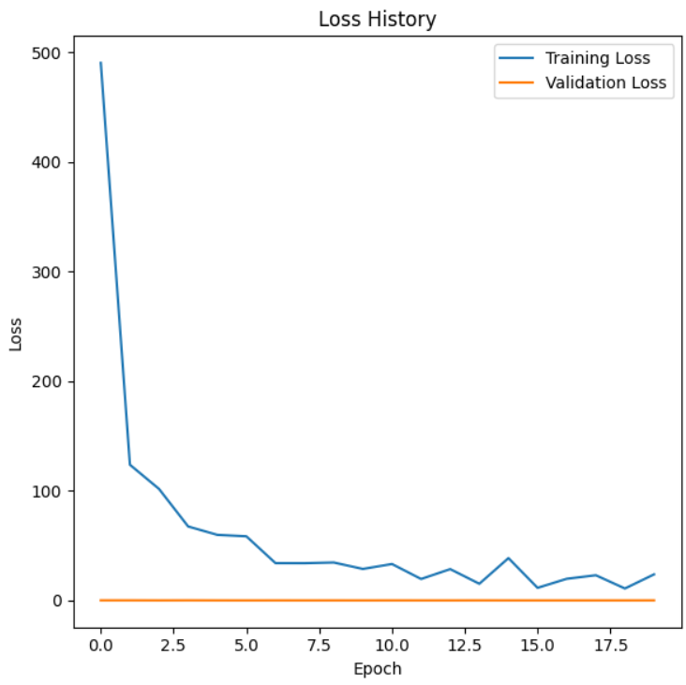
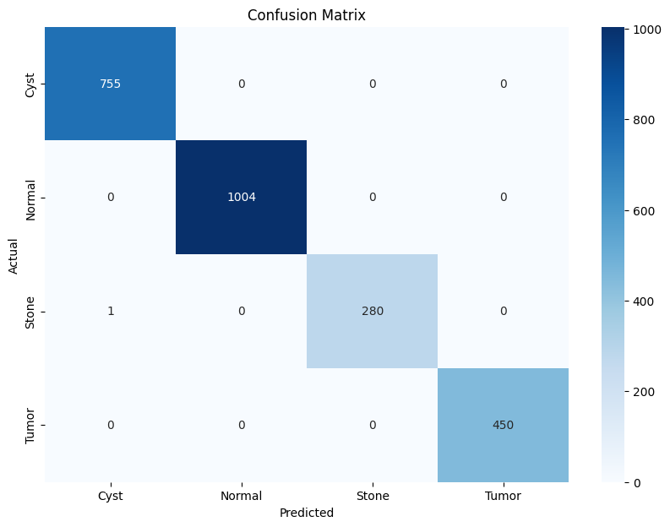
Results

Slide 14
Conclusion
Use of GAN: The GAN has an exceptional ability to denoise the noisy CT Scan images
Efficient Net: Efficient Net, with its incredible accuracy of 99.82% is effective of classifying noisy CT Scan images.
Explainability and Future Scope: GradCAM represents the feature maps very well and in the future could be integrated with the GAN as a hybrid model.

Slide 15
Thank YOU

