Slide 1
Prescription Wars
Notes:
We are going to try out a public health simulation on prescription drug abuse. Your team will be playing the part of a criminal organization known as a “pill mill”. Your M.O. is to pass fake/stolen prescrptions to pharmacies and then resell the drugs on the street. I will be playing the part of the government. I will be trying to stop you by setting into place various public health measures (historical and otherwise). As we go through the simulation, I’ll announce the changes that are being made.
Your team score today consists of the assignment your team just completed on the purple page. All teams get 70% on the team assignment portion just by turning in that purple page.
You will be competing for the remaining 30% of the team score. The team that makes the most money at the end of this simulation will get another 30% added onto their team score. That means their team score for this week will be 70% + 30% = 100%.
The team that makes the least amount of money on this simulation will get nothing. Their team score this week will be 70% (from the purple sheet) plus nothing.
All other teams will received somewhere between zero and 30% added onto the 70% they already got, depending on how much money they made. So, all teams will end up with a score today somewhere between 70-100%. If you sit down and do the math, how you do on this simulation represents less than 1% of your course grade. So, don’t get too stressed. It counts, but not a whole lot.

Slide 2
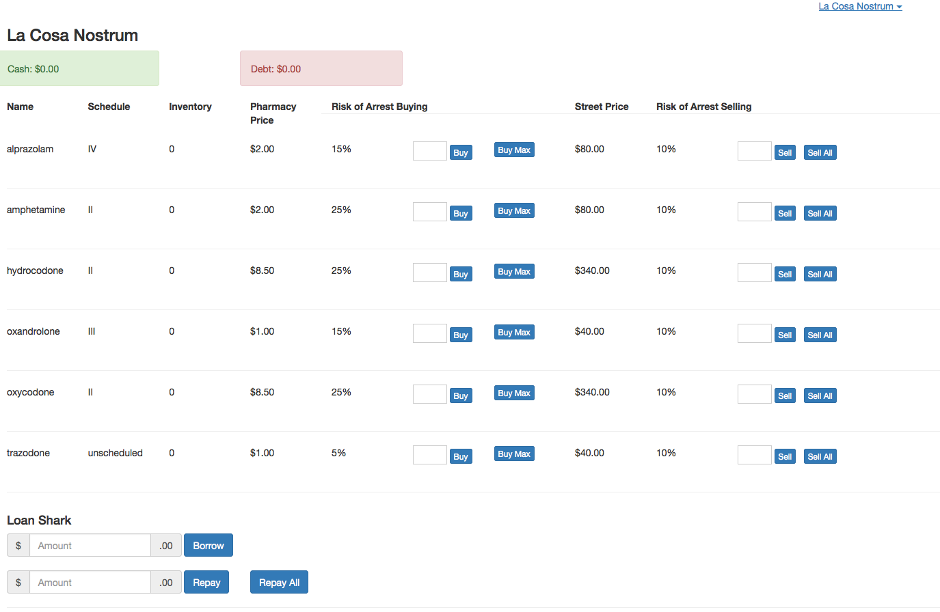

Slide 3
Buying Drugs
Pharmacy price stays the same throughout game
About 10 transactions allowed per minute
Automatically adjusts if you don’t have enough money or ask for too many

Slide 4
Risk of Arrest
Based on number of units being bought
Buying 100 units:
Absolute risk = Relative risk
Buying less than 100 units;
Absolute risk < Relative Risk
Buying more than 100 units
Absolute risk > Relative Risk

Slide 5
Selling Drugs
You can always sell drugs
Street price updates 3 x minute
Street price is always greater than pharmacy price

Slide 6
Street Prices
Driven by supply
Supply = # of units being held by all the teams together
The more teams buy, the lower the street price
Other factors remain constant until announced by instructor

Slide 7
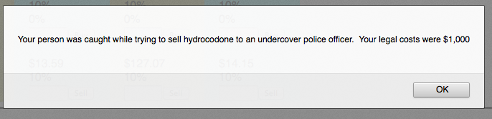
Notes:
If you get caught either buying or selling drugs, a message will come up on the screen. It tells you what happened an how much money you lost.

Slide 8
Legal Fees
Calculated based on
Street value of what you were trying to sell
How many you were trying to sell
Valuable drugs = higher fees
More drugs = higher fees
Notes:
There is no “jail time” or anything like that. Getting caught is a business expense. You have to pay legal feels.
The fine you get slapped with depends on the street value of what you were trying to buy or sell and how many you were trying to move.
More valuable drugs bring bigger fines. Moving large amounts of drugs results in bigger fines.

Slide 9
Warning
Don’t get carried away early in the game
Keep risks small until a bankroll is built up
If you can’t pay the fine, don’t do the crime
Notes:
So, be careful, especially early in the game. If you try big risk transactions without having a bankroll that can absorb the fine, you could find yourself getting deeply in debt and finding it very hard to recover.

Slide 10
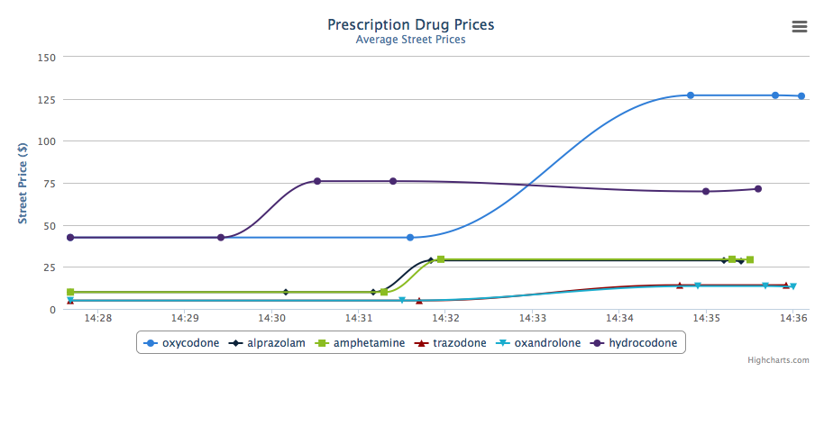

Slide 11
Motivation
Team with most money at the end of the game gets the highest grade

Slide 13
Scenario 1: Prior to 1970
“Schedules” not yet created
Little-to-no oversight of prescribing
Risk of buying: 1%
Risk of selling: 1%
Notes:
Our first scenario is the United States prior to 1970. Now, I know that Xanax and oxycodone did not exist in the 1960’s, but we are going to pretend that they do.
The controlled substance ‘schedules’ had not yet been established.
Not a whole lot of oversight of prescribing and what little was done was by the States in a patchwork of different state laws.
Pharmacists were encouraged NOT to question a physician’s prescription and prescription drug abuse was not seen as much of a problem as “illicit” drug abuse. We also didn’t have “the war on drugs” on the Federal level.
At this point, I’m going to set the risk of both buying and selling at 1%. So, go ahead and start.

Slide 14
Scenario 2: 1970
Controlled Substances Act passed
Created Schedule I-V system
Schedule II on separate prescription and no refills
Schedule II: Buying: 15% Selling: 10%
Schedule III-V: Buying: 10% Selling: 10%
Non-Scheduled: Buying: 1% Selling: 10%
Notes:
In 1970, the Federal government passed the Controlled Substances Act. This created the Schedule I-V system
Schedule II drugs had to be on a separate prescription blank and there were no refills on CII drugs.
However, there still isn’t systematic oversight of prescribing.
So, I’m going to set the baseline risk of buying CII’s at 15%.
The remaining schedules aren’t looked at as closely, so I’m setting that at 10%.
Non-scheduled drugs (e.g., trazadone), has almost no risk of getting caught.
The risk of selling, now goes up to 10% for all agents.

Slide 15
Scenario 3: 1985
First PDMPs established
Only looked at Schedule II drugs
Paper records
Schedule II: Buying: 25% Selling: 10%
Schedule III-V: Buying: 10% Selling: 10%
Non-Scheduled: Buying: 1% Selling: 10%
Notes:
In the 1980’s prescription drug management programs start being established by the states.
These programs only looked at Schedule II drugs. They mandated the use of serialized, state issued CII prescription forms.
All of this record keeping is still being done on paper.
So, I’m now going to increase the risk of buying CII’s to 25%. Everything else will remain the same.

Slide 16
Scenario 4: 1995-2005
Started monitoring all scheduled drugs
Migrating from paper to computerized record
The “War on Drugs”
Schedule II: Buying: 40% Selling: 10%
Schedule III-V: Buying: 25% Selling: 10%
Non-Scheduled: Buying: 1% Selling: 10%
Notes:
The next scenario is around the year 2000.
States are now monitoring all scheduled drugs. Paper records are being replaced by computerized records. We also have a doubling-down on the War on Drugs.
Now, the risk of arrest for Schedule II Is 40%. Schedule III –V risk is up to 25%.

Slide 17
Scenario 5: 2010
“Abuse Resistant” Oxycontin introduced
Turns to “mush” when crushed
Demand for Oxycontin drops
Notes:
Scenario 5: Abuse resistant oxycontin introduced

Slide 18
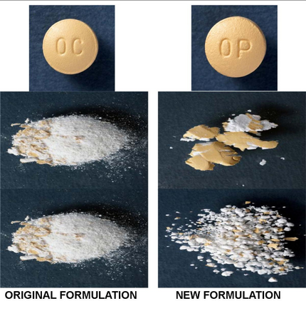

Slide 19
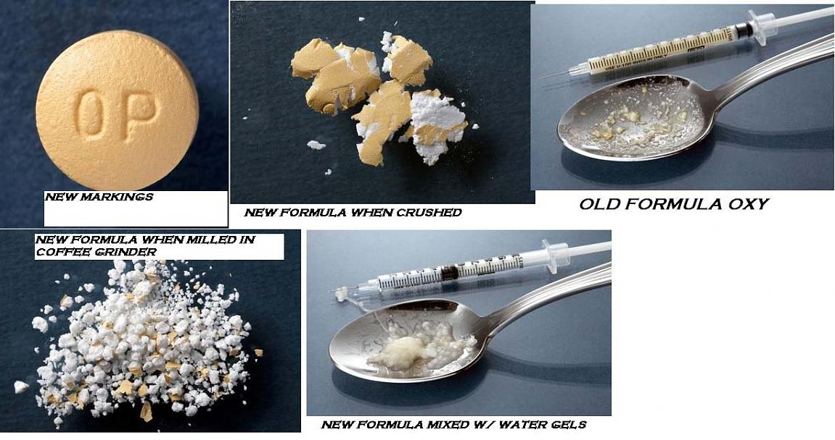

Slide 20
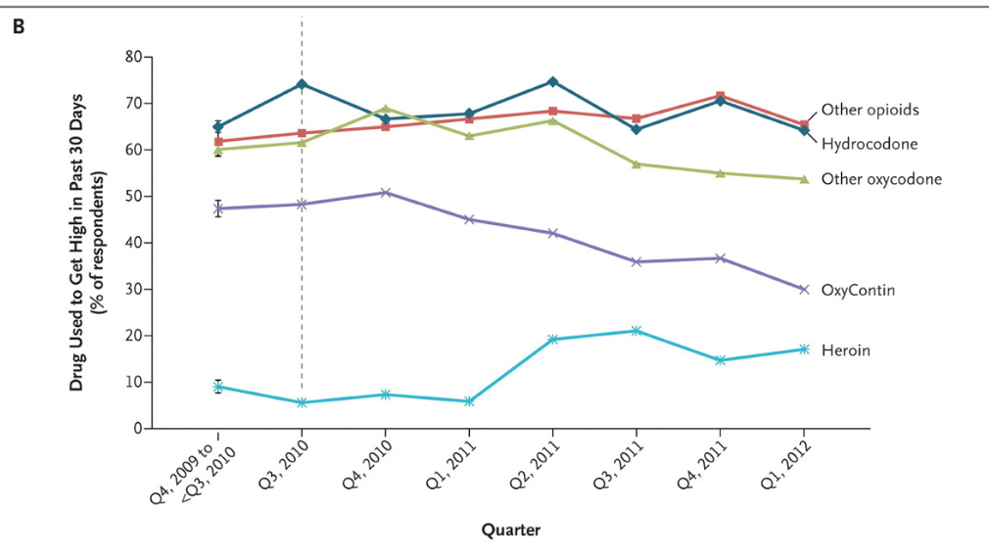
Notes:
What we see is that the demand for Oxycontin drops

Slide 21
Scenario 6: 2020
Public Health approach to prescription drugs
Modeled on cigarette smoking successes
Halves demand for prescription drugs
Notes:
The next scenario is in the future.
A public health approach is tried, modeled on the success with cigarette smoking
The government tries to “de-glamorize” drug use and make it appear kind of sad and pathetic.
As a result, the demand for prescription drugs drops by 50%.

Slide 22
Scenario 7: 2035
Decriminalization
Supply effectively infinite
Notes:
The last scenario we will try is in the year 2035. The government adopts a strategy of decriminalization of prescription drugs. Now, anyone can get any drug they want. Supply becomes essentially infitite. Risks drop to zero.

