Slide 1
Chapter 17:
Stacks and Queues

Slide 2
Objectives
In this chapter, you will:
  Learn about stacks
  Examine various stack operations
  Implement a stack as an array
  Implement a stack as a linked list
  Discover stack applications
  Use a stack to remove recursion
  Learn about queues
  Examine various queue operations
  Implement a queue as an array
  Implement a queue as a linked list
  Discover queue applications
C++ Programming: Program Design Including Data Structures, Sixth Edition

Slide 3
Stacks
Stack: a data structure in which elements are added and removed from one end only
  Addition/deletion occur only at the top of the stack
  Last in first out (LIFO) data structure
Operations:
  Push: to add an element onto the stack
  Pop: to remove an element from the stack
C++ Programming: Program Design Including Data Structures, Sixth Edition

Slide 4
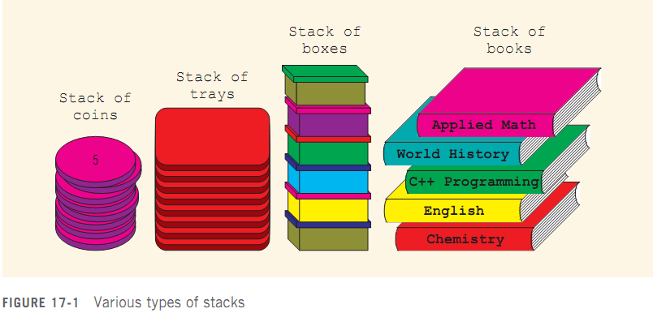
Stacks (cont’d.)
C++ Programming: Program Design Including Data Structures, Sixth Edition

Slide 5
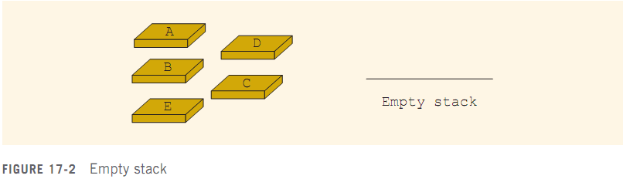
Stacks (cont’d.)
C++ Programming: Program Design Including Data Structures, Sixth Edition

Slide 6
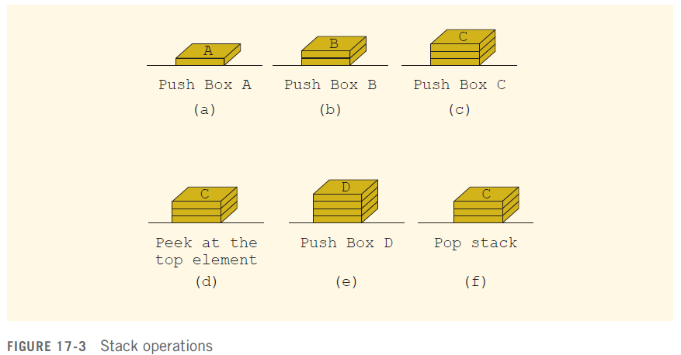
Stacks (cont’d.)
C++ Programming: Program Design Including Data Structures, Sixth Edition

Slide 7
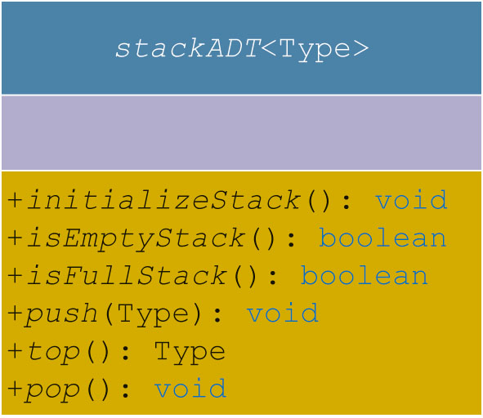

Stack Operations
In the abstract class stackADT:
  initializeStack
  isEmptyStack
  isFullStack
  push
  top
  pop
C++ Programming: Program Design Including Data Structures, Sixth Edition

Slide 8
Implementation of Stacks
as Arrays
First element goes in first array position, second in the second position, etc.
Top of the stack is index of the last element added to the stack
Stack elements are stored in an array, which is a random access data structure
  Stack element is accessed only through top
To track the top position, use a variable called stackTop
C++ Programming: Program Design Including Data Structures, Sixth Edition

Slide 9
Implementation of Stacks as Arrays (cont’d.)
Can dynamically allocate array
  Enables user to specify size of the array
class stackType implements the functions of the abstract class stackADT
C++ Programming: Program Design Including Data Structures, Sixth Edition

Slide 10
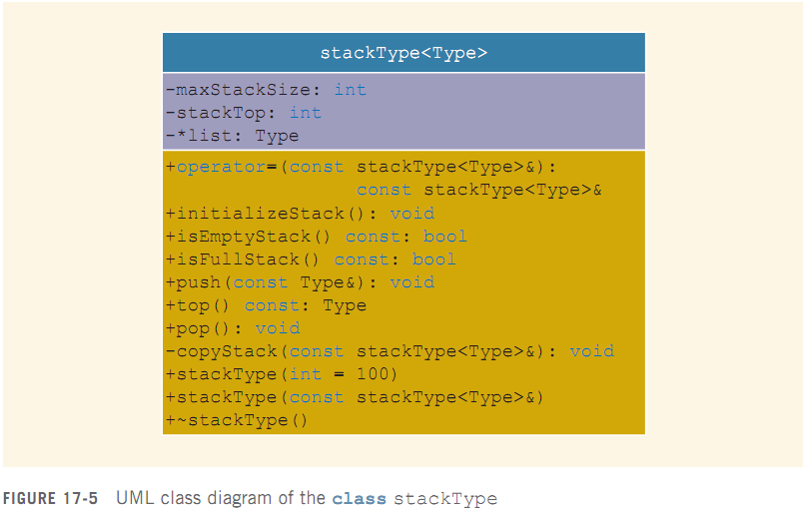
Implementation of Stacks as Arrays (cont’d.)
C++ Programming: Program Design Including Data Structures, Sixth Edition

Slide 11
Implementation of Stacks as Arrays (cont’d.)
C++ arrays begin with the index 0
  Must distinguish between:
    Value of stackTop
    Array position indicated by stackTop
If stackTop is 0, stack is empty
If stackTop is nonzero, stack is not empty
  Top element is given by stackTop - 1
C++ Programming: Program Design Including Data Structures, Sixth Edition

Slide 12
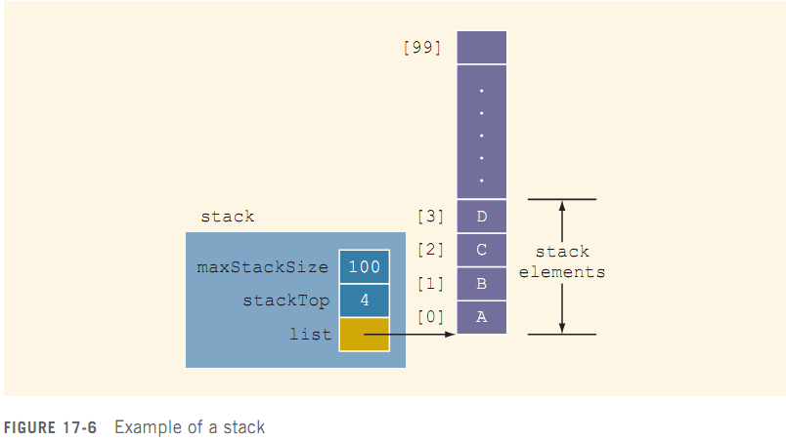
Implementation of Stacks as Arrays (cont’d.)
C++ Programming: Program Design Including Data Structures, Sixth Edition

Slide 13
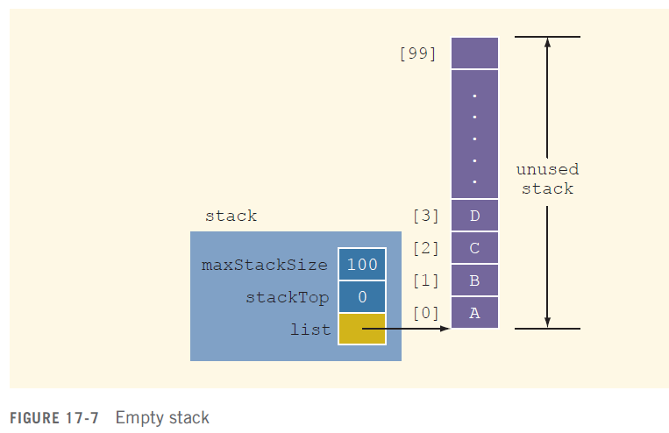
Initialize Stack
C++ Programming: Program Design Including Data Structures, Sixth Edition

Slide 14
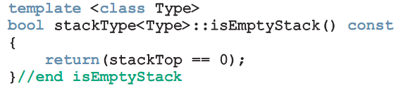
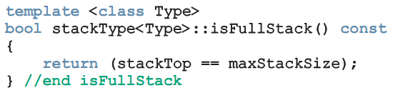
Empty Stack/Full Stack
Stack is empty if stackTop = 0
Stack is full if stackTop = maxStackSize
C++ Programming: Program Design Including Data Structures, Sixth Edition

Slide 15
Push
Store the newItem in the array component indicated by stackTop
Increment stackTop
Overflow occurs if we try to add a new item to a full stack
C++ Programming: Program Design Including Data Structures, Sixth Edition

Slide 16
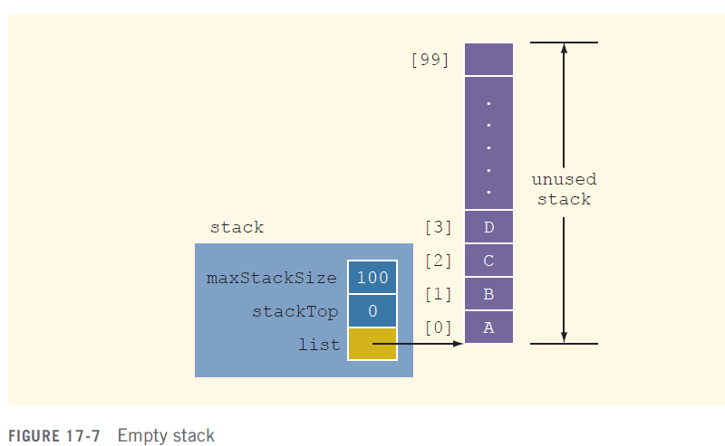
Push (cont’d.)
C++ Programming: Program Design Including Data Structures, Sixth Edition

Slide 17
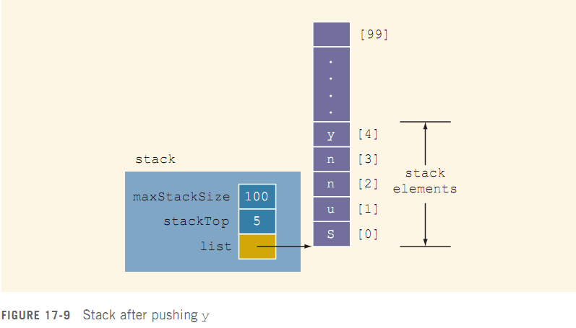
Push (cont’d.)
C++ Programming: Program Design Including Data Structures, Sixth Edition

Slide 18
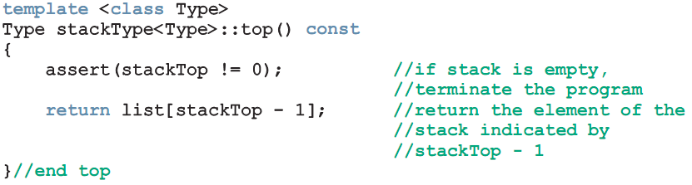
Return the Top Element
top operation:
  Returns the top element of the stack
C++ Programming: Program Design Including Data Structures, Sixth Edition

Slide 19
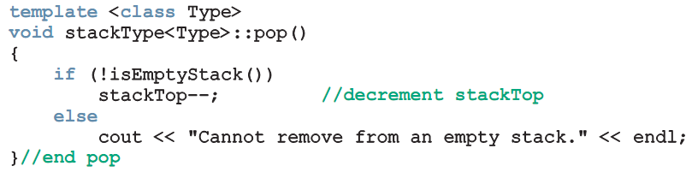
Pop
To remove an element from the stack, decrement stackTop by 1
Underflow condition: trying to remove an item from an empty stack
C++ Programming: Program Design Including Data Structures, Sixth Edition

Slide 20
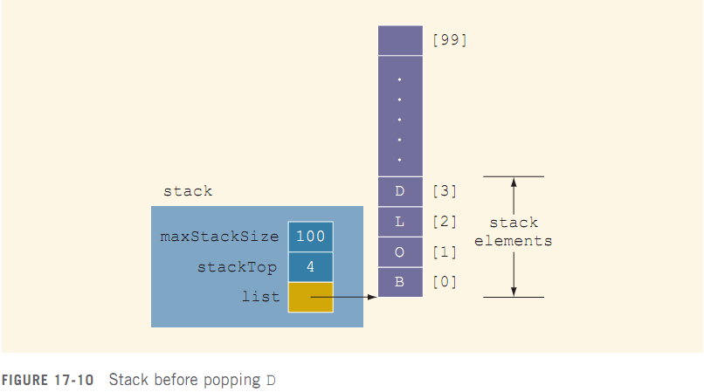
Pop (cont’d.)
C++ Programming: Program Design Including Data Structures, Sixth Edition

Slide 21

Pop (cont’d.)
C++ Programming: Program Design Including Data Structures, Sixth Edition

Slide 22
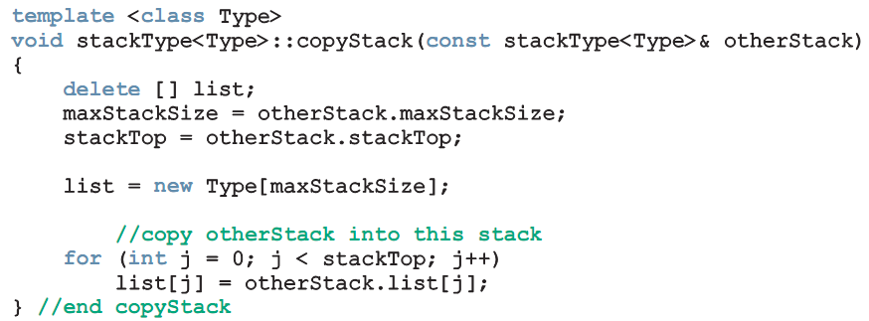
Copy Stack
copyStack function: copies a stack
C++ Programming: Program Design Including Data Structures, Sixth Edition

Slide 23
Constructor and Destructor
Constructor:
  Sets stack size to parameter value (or default value if not specified)
  Sets stackTop to 0
  Creates array to store stack elements
Destructor:
  Deallocates memory occupied by the array
  Sets stackTop to 0
C++ Programming: Program Design Including Data Structures, Sixth Edition

Slide 24
Copy Constructor
Copy constructor:
  Called when a stack object is passed as a (value) parameter to a function
  Copies values of member variables from actual parameter to formal parameter
C++ Programming: Program Design Including Data Structures, Sixth Edition

Slide 25

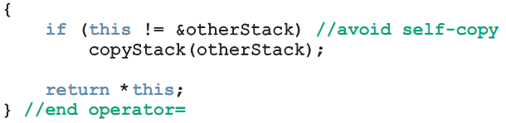
Overloading the
Assignment Operator (=)
Assignment operator must be explicitly overloaded because of pointer member variables
C++ Programming: Program Design Including Data Structures, Sixth Edition

Slide 26
Stack Header File
Place definitions of class and functions (stack operations) together in a file
  Called myStack.h
C++ Programming: Program Design Including Data Structures, Sixth Edition

Slide 27
Linked Implementation of Stacks
Array only allows fixed number of elements
If number of elements to be pushed exceeds array size, the array will have to be re-created
Linked lists can dynamically organize data
In a linked representation, stackTop is pointer to memory address of top element in stack
C++ Programming: Program Design Including Data Structures, Sixth Edition

Slide 28
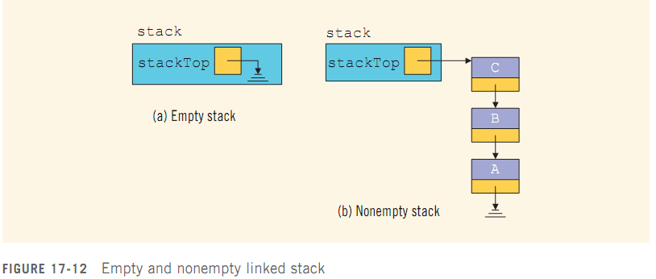
Linked Implementation of Stacks (cont’d.)
C++ Programming: Program Design Including Data Structures, Sixth Edition

Slide 29
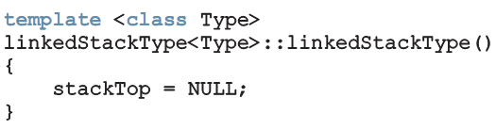
Default Constructor
Initializes the stack to an empty state when a stack object is declared
  Sets stackTop to NULL
C++ Programming: Program Design Including Data Structures, Sixth Edition

Slide 30
Empty Stack and Full Stack
In a linked implementation of stacks, function isFullStack does not apply
  Logically, the stack is never full
Stack is empty if stackTop is NULL
C++ Programming: Program Design Including Data Structures, Sixth Edition

Slide 31
Initialize Stack
initializeStack: reinitializes stack to an empty state
  Must deallocate memory occupied by current element
  Sets stackTop to NULL
C++ Programming: Program Design Including Data Structures, Sixth Edition

Slide 32
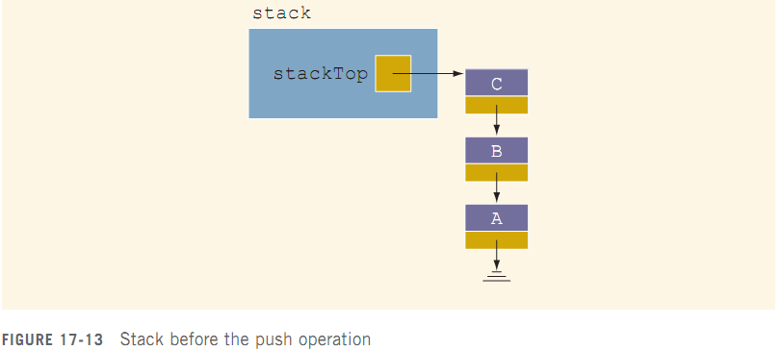
Push
newNode is added at the beginning of the linked list pointed to by stackTop
C++ Programming: Program Design Including Data Structures, Sixth Edition

Slide 33
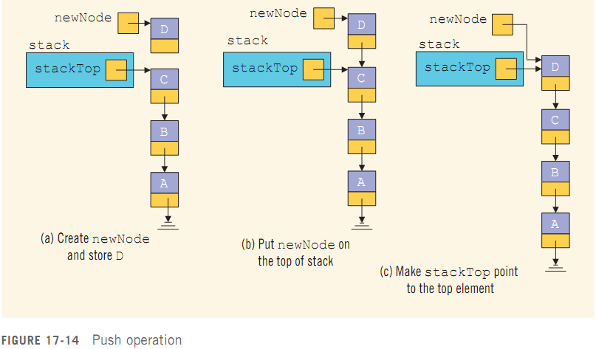
Push (cont’d.)
C++ Programming: Program Design Including Data Structures, Sixth Edition

Slide 34
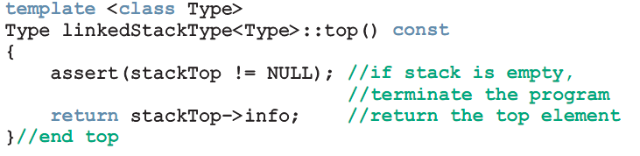
Return the Top Element
top operation: returns top element of stack
C++ Programming: Program Design Including Data Structures, Sixth Edition

Slide 35
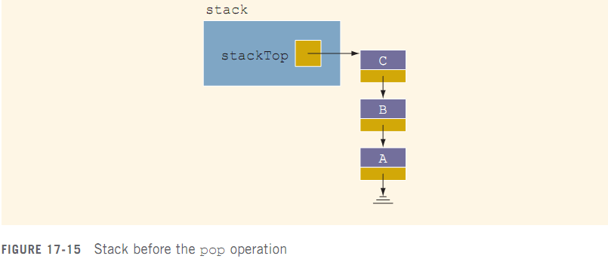
Pop
Node pointed to by stackTop is removed
  Second element becomes top element
C++ Programming: Program Design Including Data Structures, Sixth Edition

Slide 36
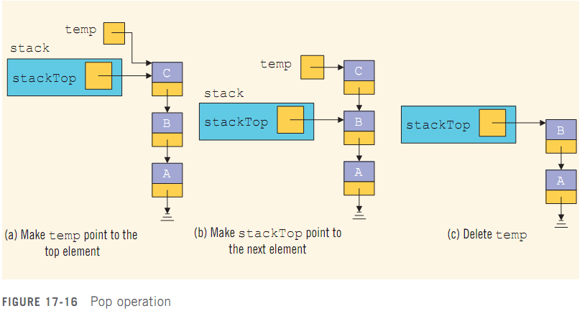
Pop (cont’d.)
C++ Programming: Program Design Including Data Structures, Sixth Edition

Slide 37
Copy Stack
copyStack function: makes an identical copy of a stack
  Similar definition to copyList for linked lists
C++ Programming: Program Design Including Data Structures, Sixth Edition

Slide 38
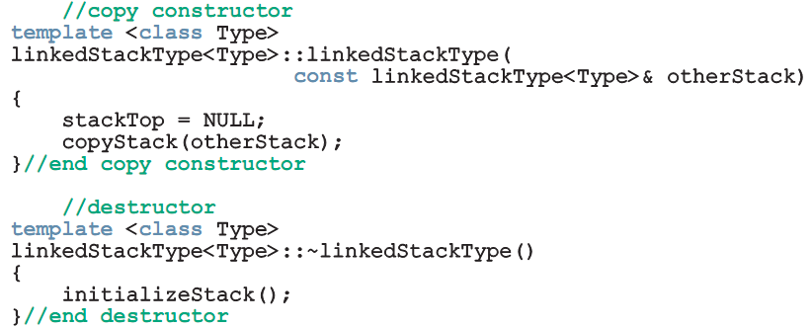
Constructors and Destructors
Copy constructor and destructor:
  Similar to those for linked lists
C++ Programming: Program Design Including Data Structures, Sixth Edition

Slide 39

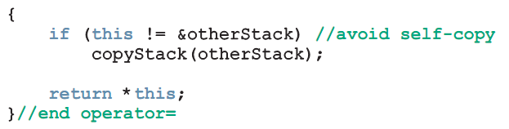
Overloading the Assignment Operator (=)
Overloading the assignment operator:
C++ Programming: Program Design Including Data Structures, Sixth Edition

Slide 40
Stack as Derived from the class unorderedLinkedList
Implementation of push is similar to insertFirst for general lists
Other similar functions:
  initializeStack and initializeList
  isEmptyList and isEmptyStack
linkedStackType can be derived from linkedListType
  class linkedListType is abstract
C++ Programming: Program Design Including Data Structures, Sixth Edition

Slide 41
Derived Stack (cont’d.)
unorderedLinkedListType is derived from linkedListType
  Provides the definitions of the abstract functions of the class linkedListType
and derive linkedStackType from unorderedLinkedListType
C++ Programming: Program Design Including Data Structures, Sixth Edition

Slide 42
Application of Stacks: Postfix Expressions Calculator
Infix notation: usual notation for writing arithmetic expressions
  Operator is written between the operands
  Example: a + b
  Evaluates from left to right
  Operators have precedence
    Parentheses can be used to override precedence
C++ Programming: Program Design Including Data Structures, Sixth Edition

Slide 43
Application of Stacks: Postfix Expressions Calculator (cont’d.)
Prefix (Polish) notation: operators are written before the operands
  Introduced by the Polish mathematician Jan Lukasiewicz in early 1920s
  Parentheses can be omitted
  Example: + a b
C++ Programming: Program Design Including Data Structures, Sixth Edition

Slide 44
Application of Stacks: Postfix Expressions Calculator (cont’d.)
Reverse Polish notation: operators follow the operands (postfix operators)
  Proposed by Australian philosopher and early computer scientist Charles L. Hamblin in the late 1950s
  Advantage: operators appear in the order required for computation
  Example: a + b * c becomes a b c * +
C++ Programming: Program Design Including Data Structures, Sixth Edition

Slide 45
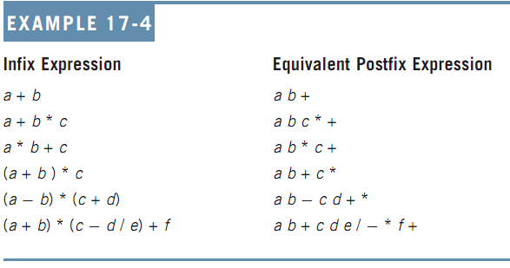
Application of Stacks: Postfix Expressions Calculator (cont’d.)
C++ Programming: Program Design Including Data Structures, Sixth Edition

Slide 46
Application of Stacks: Postfix Expressions Calculator (cont’d.)
Postfix notation has important applications in computer science
  Many compilers first translate arithmetic expressions into postfix notation and then translate this expression into machine code
Evaluation algorithm:
  Scan expression from left to right
  When an operator is found, back up to get operands, perform the operation, and continue
C++ Programming: Program Design Including Data Structures, Sixth Edition

Slide 47
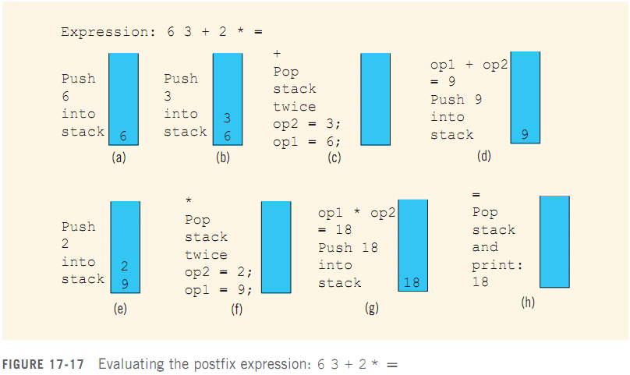
Application of Stacks: Postfix Expressions Calculator (cont’d.)
C++ Programming: Program Design Including Data Structures, Sixth Edition

Slide 48
Application of Stacks: Postfix Expressions Calculator (cont’d.)
Symbols can be numbers or anything else:
  +, -, *, and / are operators, require two operands
    Pop stack twice and evaluate expression
    If stack has less than two elements → error
  If symbol is =, expression ends
    Pop and print answer from stack
    If stack has more than one element → error
  If symbol is anything else
    Expression contains an illegal operator
C++ Programming: Program Design Including Data Structures, Sixth Edition

Slide 49
Application of Stacks: Postfix Expressions Calculator (cont’d.)
Assume postfix expressions are in this form:
#6 #3 + #2 * =
  If symbol scanned is #, next input is a number
  If the symbol scanned is not #, then it is:
    An operator (may be illegal) or
    An equal sign (end of expression)
Assume expressions contain only +, -, *, and / operators
C++ Programming: Program Design Including Data Structures, Sixth Edition

Slide 50
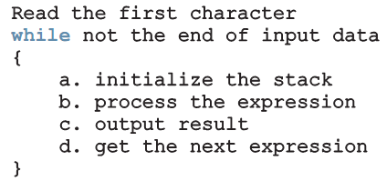
Main Algorithm
Pseudocode:
Four functions are needed:
  evaluateExpression, evaluateOpr, discardExp, and printResult
C++ Programming: Program Design Including Data Structures, Sixth Edition

Slide 51

Function evaluateExpression
Function evaluateExpression:
  Evaluates each postfix expression
  Each expression ends with = symbol
C++ Programming: Program Design Including Data Structures, Sixth Edition

Slide 52
Function evaluateOpr
Function evaluateOpr:
  Evaluates an expression
  Needs two operands saved in the stack
    If less than two → error
  Also checks for illegal operations
C++ Programming: Program Design Including Data Structures, Sixth Edition

Slide 53
Function discardExp
Function discardExp:
  Called when an error is discovered in expression
  Reads and writes input data until the ‘=’
C++ Programming: Program Design Including Data Structures, Sixth Edition

Slide 54
Function printResult
The function printResult: If the postfix expression contains no errors, it prints the result
  Otherwise, it outputs an appropriate message
Result of the expression is in the stack, and output is sent to a file
C++ Programming: Program Design Including Data Structures, Sixth Edition

Slide 55
Nonrecursive Algorithm to Print a Linked List Backward
To print a list backward nonrecursively, first get to the last node of the list
  Problem: Links go in only one direction
  Solution: Save a pointer to each of node in a stack
    Uses the LIFO principle
Since number of nodes is usually not known, use the linked implementation of a stack
C++ Programming: Program Design Including Data Structures, Sixth Edition

Slide 56
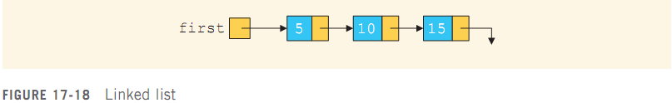
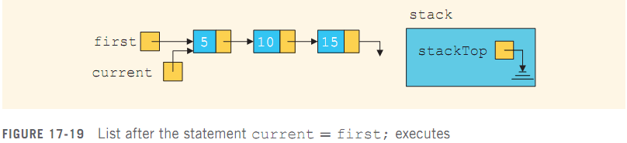
Nonrecursive Algorithm to Print a Linked List Backward (cont’d.)
C++ Programming: Program Design Including Data Structures, Sixth Edition

Slide 57
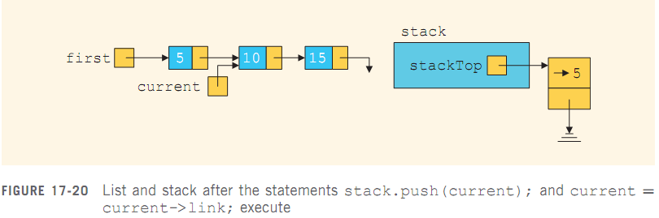
Nonrecursive Algorithm to Print a Linked List Backward (cont’d.)
C++ Programming: Program Design Including Data Structures, Sixth Edition

Slide 58
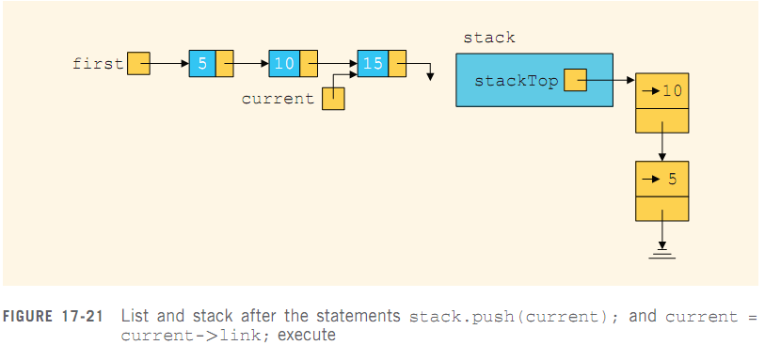
Nonrecursive Algorithm to Print a Linked List Backward (cont’d.)
C++ Programming: Program Design Including Data Structures, Sixth Edition

Slide 59
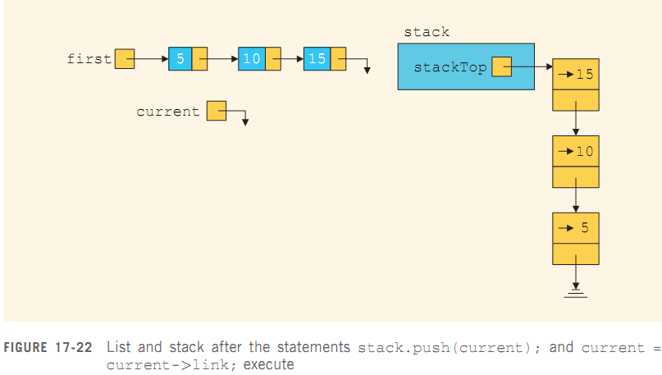
Nonrecursive Algorithm to Print a Linked List Backward (cont’d.)
C++ Programming: Program Design Including Data Structures, Sixth Edition

Slide 60
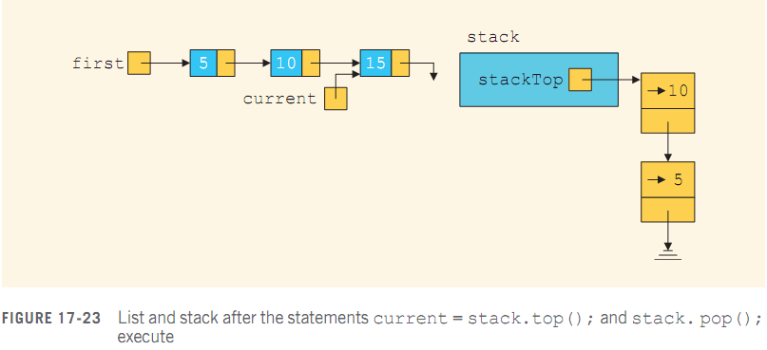
Nonrecursive Algorithm to Print a Linked List Backward (cont’d.)
C++ Programming: Program Design Including Data Structures, Sixth Edition

Slide 61
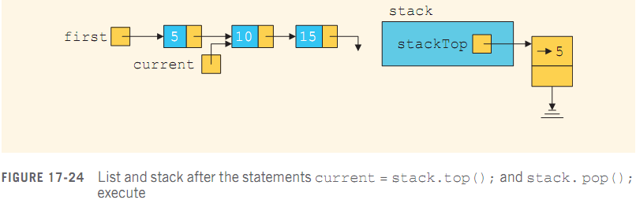
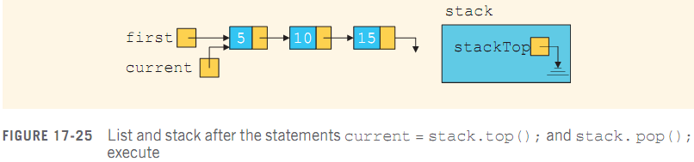
Nonrecursive Algorithm to Print a Linked List Backward (cont’d.)
C++ Programming: Program Design Including Data Structures, Sixth Edition

Slide 62
Queues
Queue: set of elements of the same type
Elements are:
  Added at one end (the back or rear)
  Deleted from the other end (the front)
First In First Out (FIFO) data structure
  Middle elements are inaccessible
Example:
  Waiting line in a bank
C++ Programming: Program Design Including Data Structures, Sixth Edition

Slide 63
Queue Operations
Queue operations include:
  initializeQueue
  isEmptyQueue
  isFullQueue
  front
  back
  addQueue
  deleteQueue
Abstract class queueADT defines these operations
C++ Programming: Program Design Including Data Structures, Sixth Edition

Slide 64
Implementation of Queues as Arrays
Need at least four (member) variables:
  Array to store queue elements
  queueFront and queueRear
    To track first and last elements
  maxQueueSize
    To specify maximum size of the queue
C++ Programming: Program Design Including Data Structures, Sixth Edition

Slide 65
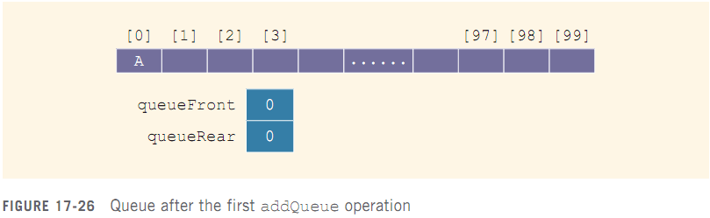
Implementation of Queues as Arrays (cont’d.)
To add an element to the queue:
  Advance queueRear to next array position
  Add element to position pointed by queueRear
C++ Programming: Program Design Including Data Structures, Sixth Edition

Slide 66
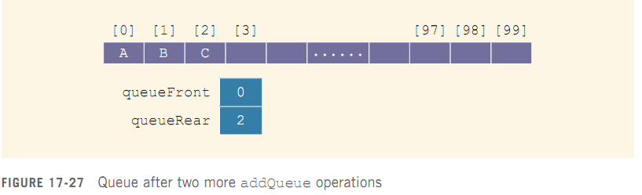
Implementation of Queues as Arrays (cont’d.)
C++ Programming: Program Design Including Data Structures, Sixth Edition

Slide 67
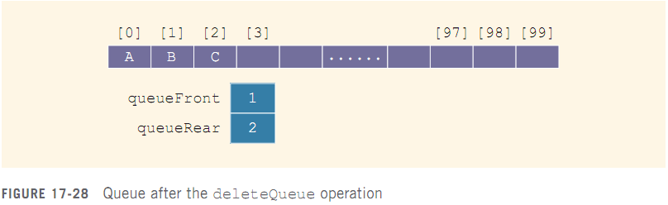
Implementation of Queues as Arrays (cont’d.)
To delete an element from the queue:
  Retrieve element pointed to by queueFront
  Advance queueFront to next queue element
C++ Programming: Program Design Including Data Structures, Sixth Edition

Slide 68
Implementation of Queues as Arrays (cont’d.)
Will this queue design work?
  Let A represent adding an element to the queue
  Let D represent deleting an element from the queue
  Consider the following sequence of operations:
    AAADADADADADADADA...
C++ Programming: Program Design Including Data Structures, Sixth Edition

Slide 69
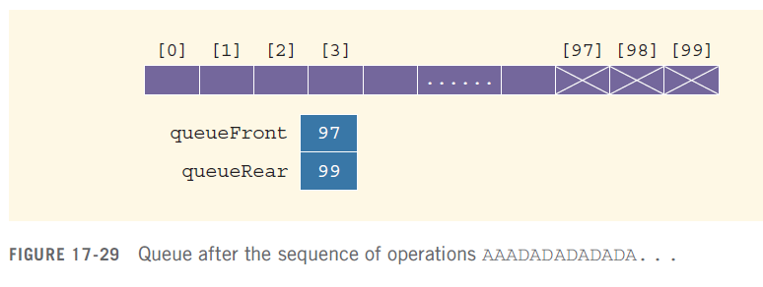
Implementation of Queues as Arrays (cont’d.)
This would eventually set queueRear to point to the last array position
  Giving the impression that the queue is full
C++ Programming: Program Design Including Data Structures, Sixth Edition

Slide 70
Implementation of Queues as Arrays (cont’d.)
Solution 1: When queue overflows at rear (queueRear points to the last array position):
  Check value of queueFront
  If queueFront indicates there is room at front of array, slide all queue elements toward the first array position
Problem: too slow for large queues
Solution 2: Assume that the array is circular
C++ Programming: Program Design Including Data Structures, Sixth Edition

Slide 71
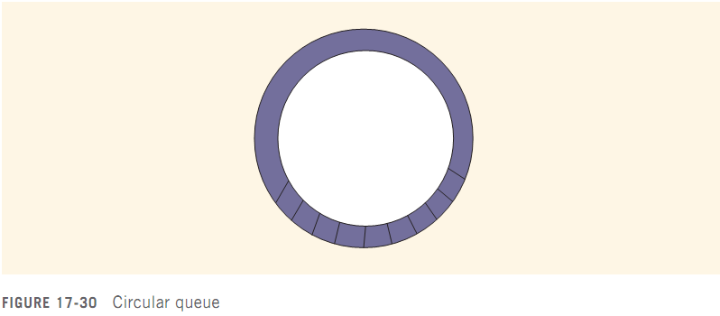
Implementation of Queues as Arrays (cont’d.)
C++ Programming: Program Design Including Data Structures, Sixth Edition

Slide 72
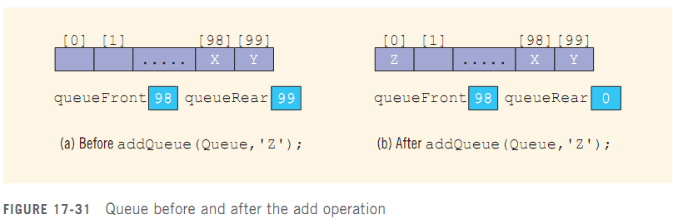
Implementation of Queues as Arrays (cont’d.)
C++ Programming: Program Design Including Data Structures, Sixth Edition

Slide 73
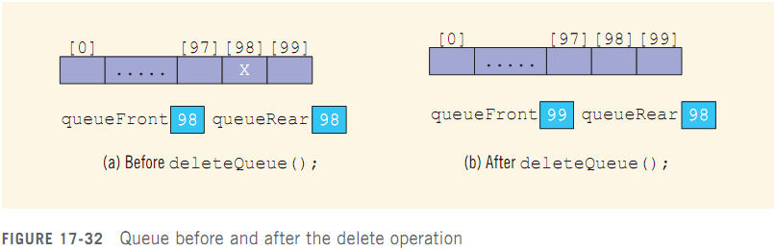
Implementation of Queues as Arrays (cont’d.)
Deletion Case 1:
C++ Programming: Program Design Including Data Structures, Sixth Edition

Slide 74
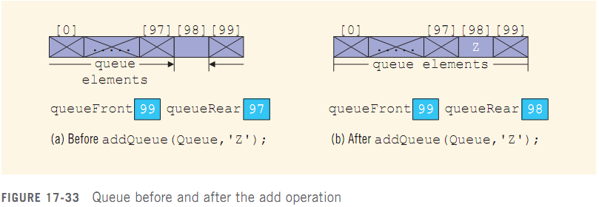
Implementation of Queues as Arrays (cont’d.)
Deletion Case 2:
C++ Programming: Program Design Including Data Structures, Sixth Edition

Slide 75
Implementation of Queues as Arrays (cont’d.)
Problem:
  Figures 18-32b and 18-33b have identical values for queueFront and queueRear
  However, Figure 18-32b represents an empty queue, whereas Figures 18-33b shows a full queue
Solution?
C++ Programming: Program Design Including Data Structures, Sixth Edition

Slide 76
Implementation of Queues as Arrays (cont’d.)
Solution 1: keep a count
  Incremented when a new element is added to the queue
  Decremented when an element is removed
  Initially set to 0
  Very useful if user (of queue) frequently needs to know the number of elements in the queue
C++ Programming: Program Design Including Data Structures, Sixth Edition

Slide 77
Implementation of Queues as Arrays (cont’d.)
Solution 2: Let queueFront indicate index of array position preceding the first element
  queueRear still indicates index of last one
  Queue empty if:
    queueFront == queueRear
  Slot indicated by queueFront is reserved
  Queue is full if next available space is the reserved slot indicated by queueFront
C++ Programming: Program Design Including Data Structures, Sixth Edition

Slide 78
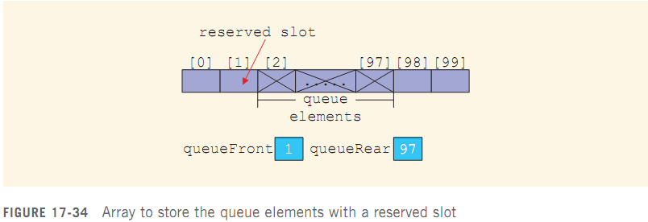
Implementation of Queues as Arrays (cont’d.)
C++ Programming: Program Design Including Data Structures, Sixth Edition

Slide 79
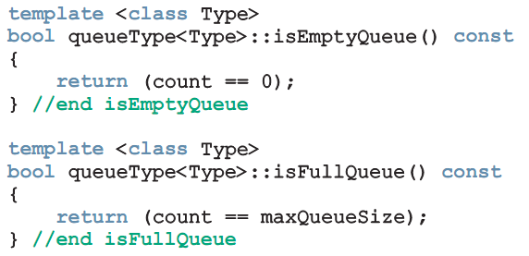
Empty Queue and Full Queue
Queue is empty if count ==0
Queue is full if count == maxQueueSize
C++ Programming: Program Design Including Data Structures, Sixth Edition

Slide 80
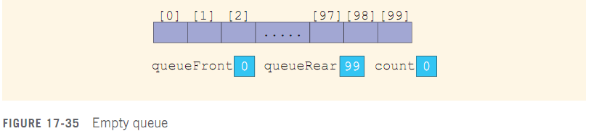
Initialize Queue
Initializes queue to empty state
  First element is added at first array position
  queueFront set to 0
  queueRear set to maxQueueSize -1
  count set to 0
C++ Programming: Program Design Including Data Structures, Sixth Edition

Slide 81
Front and Back
front operation: returns the first element of the queue
  If queue is empty, program terminates
back operation: returns the last element of the queue
  If queue is empty, program terminates
C++ Programming: Program Design Including Data Structures, Sixth Edition

Slide 82
addQueue
addQueue operation:
  Advance queueRear to next array position
  Add new element to array position indicated by queueRear
  Increment count by 1
C++ Programming: Program Design Including Data Structures, Sixth Edition

Slide 83
deleteQueue
deleteQueue operation:
  Decrement count by 1
  Advance queueFront to next queue element
C++ Programming: Program Design Including Data Structures, Sixth Edition

Slide 84
Constructors and Destructors
Constructor:
  Sets maxQueueSize to user specification
  Creates array of size maxQueueSize (or default size)
  Initializes queueFront and queueRear to indicate empty queue
Destructor:
  Deallocates memory occupied by array
C++ Programming: Program Design Including Data Structures, Sixth Edition

Slide 85
Linked Implementation of Queues
Array implementation has issues:
  Array size is fixed: only a finite number of queue elements can be stored in it
  Requires array to be treated in a special way, together with queueFront and queueRear
Linked implementation of a queue simplifies many issues
  Queue is never full because memory is allocated dynamically
C++ Programming: Program Design Including Data Structures, Sixth Edition

Slide 86
Linked Implementation of Queues (cont’d.)
Elements are added at one end and removed from the other
  Need only two pointers to maintain the queue: queueFront and queueRear
C++ Programming: Program Design Including Data Structures, Sixth Edition

Slide 87
Empty and Full Queue
Queue is empty if queueFront is NULL
Queue is never full
  Unless the system runs out of memory
Note: must provide isFullQueue function definition because it is an abstract function in parent class queueADT
C++ Programming: Program Design Including Data Structures, Sixth Edition

Slide 88
Initialize Queue
Initializes queue to an empty state
  Must remove all existing elements, if any
  Deallocates memory occupied by elements
C++ Programming: Program Design Including Data Structures, Sixth Edition

Slide 89
addQueue, front, back, and deleteQueue operations
addQueue operation: adds new element to end of queue
front operation: returns first element of queue
back operation: returns last element of queue
deleteQueue operation: removes first element of queue
C++ Programming: Program Design Including Data Structures, Sixth Edition

Slide 90
Constructors and Destructors
Constructor
  Accesses maxQueueSize, queueFront, and queueRear
Destructor: destroys the queue
  Deallocates memory occupied by elements
Copy constructor and overloading assignment operator:
  Similar to corresponding function for stack
C++ Programming: Program Design Including Data Structures, Sixth Edition

Slide 91
Queue Derived from the class unorderedLinkedListType
Linked implementation of queue: similar to implementation of a linked list created in a forward manner
  addQueue similar to insertFirst
  initializeQueue is like initializeList
  isEmptyQueue similar to isEmptyList
  deleteQueue can be implemented as before
  queueFront is same as first
  queueRear is same as last
C++ Programming: Program Design Including Data Structures, Sixth Edition

Slide 92
Application of Queues: Simulation
Simulation: a technique in which one system models the behavior of another system
Computer models are used to study the behavior of real systems
Queuing systems: computer simulations using queues as the data structure
  Queues of objects are waiting to be served
C++ Programming: Program Design Including Data Structures, Sixth Edition

Slide 93
Designing a Queuing System
Server: object that provides the service
Customer: object receiving the service
Transaction time: service time, or the time it takes to serve a customer
Model: system that consists of a list of servers and a waiting queue holding the customers to be served
  Customer at front of queue waits for the next available server
C++ Programming: Program Design Including Data Structures, Sixth Edition

Slide 94
Designing a Queuing System (cont’d.)
Need to know:
  Number of servers
  Expected arrival time of a customer
  Time between the arrivals of customers
  Number of events affecting the system
Performance of system depends on:
  How many servers are available
  How long it takes to serve a customer
  How often a customer arrives
C++ Programming: Program Design Including Data Structures, Sixth Edition

Slide 95
Designing a Queuing System (cont’d.)
If it takes too long to serve a customer and customers arrive frequently, then more servers are needed
  System can be modeled as a time-driven simulation
Time-driven simulation: the clock is a counter
  The passage of one unit of time can be implemented by incrementing a counter by 1
  Simulation is run for a fixed amount of time
C++ Programming: Program Design Including Data Structures, Sixth Edition

Slide 96
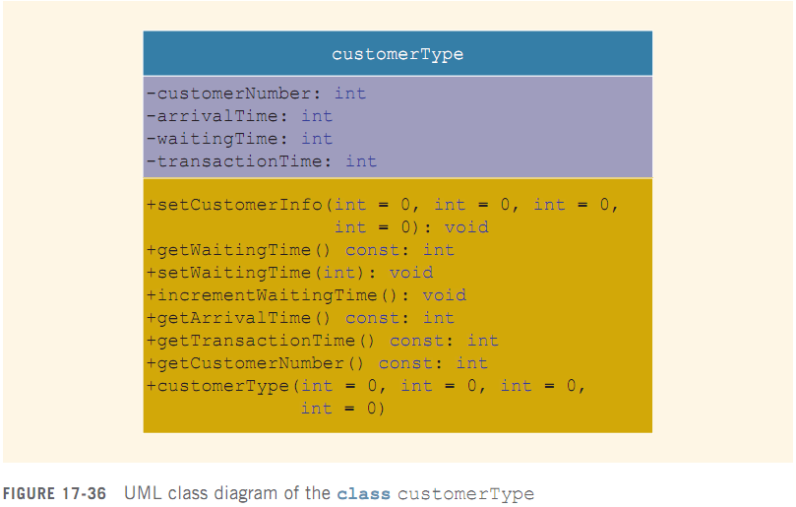
Customer
C++ Programming: Program Design Including Data Structures, Sixth Edition

Slide 97
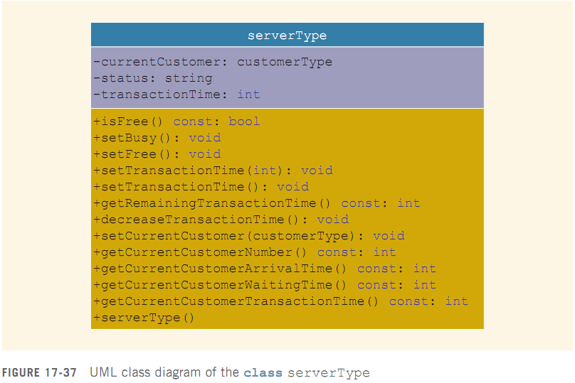
Server
C++ Programming: Program Design Including Data Structures, Sixth Edition

Slide 98
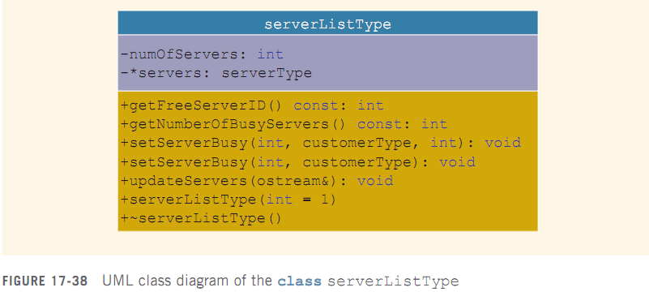
Server List
Server list: a set of servers
  At any given time, a server is either free or busy
C++ Programming: Program Design Including Data Structures, Sixth Edition

Slide 99
Waiting Customers Queue
When customer arrives, he/she goes to end of queue
When a server becomes available, customer at front of queue leaves to conduct the transaction
After each time unit, the waiting time of each customer in the queue is incremented by 1
Can use queueType but must add an operation to increment waiting time
C++ Programming: Program Design Including Data Structures, Sixth Edition

Slide 100

Main Program
Algorithm for main loop:
C++ Programming: Program Design Including Data Structures, Sixth Edition

Slide 101
Summary
Stack: items are added/deleted from one end
  Last In First Out (LIFO) data structure
  Operations: push, pop, initialize, destroy, check for empty/full stack
  Can be implemented as array or linked list
  Middle elements should not be accessed directly
Postfix notation: operators are written after the operands (no parentheses needed)
C++ Programming: Program Design Including Data Structures, Sixth Edition

Slide 102
Summary (cont’d.)
Queue: items are added at one end and removed from the other end
  First In First Out (FIFO) data structure
  Operations: add, remove, initialize, destroy, check if queue is empty/full
  Can be implemented as array or linked list
  Middle elements should not be accessed directly
  Is a restricted version of array and linked list
C++ Programming: Program Design Including Data Structures, Sixth Edition

