Slide 1
Chapter 18:
Searching and Sorting Algorithms

Slide 2
Objectives
In this chapter, you will:
Learn the various search algorithms
Implement sequential and binary search algorithms
Compare sequential and binary search algorithm performance
Become aware of the lower bound on comparison-based search algorithms
C++ Programming: Program Design Including Data Structures, Sixth Edition

Slide 3
Objectives (cont’d.)
Learn the various sorting algorithms
Implement bubble, selection, insertion, quick, and merge sorting algorithms
Compare sorting algorithm performance
C++ Programming: Program Design Including Data Structures, Sixth Edition

Slide 4
Introduction
Using a search algorithm, you can:
  Determine whether a particular item is in a list
  If the data is specially organized (for example, sorted), find the location in the list where a new item can be inserted
  Find the location of an item to be deleted
C++ Programming: Program Design Including Data Structures, Sixth Edition

Slide 5
Searching and Sorting Algorithms
Data can be organized with the help of an array or a linked list
  unorderedLinkedList
  unorderedArrayListType
C++ Programming: Program Design Including Data Structures, Sixth Edition

Slide 6
Search Algorithms
Key of the item
  Special member that uniquely identifies the item in the data set
Key comparison: comparing the key of the search item with the key of an item in the list
  Can count the number of key comparisons
C++ Programming: Program Design Including Data Structures, Sixth Edition

Slide 7
Sequential Search
Sequential search (linear search):
  Same for both array-based and linked lists
  Starts at first element and examines each element until a match is found
Our implementation uses an iterative approach
  Can also be implemented with recursion
C++ Programming: Program Design Including Data Structures, Sixth Edition

Slide 8
Sequential Search Analysis
Statements before and after the loop are executed only once
  Require very little computer time
Statements in the for loop repeated several times
  Execution of the other statements in loop is directly related to outcome of key comparison
Speed of a computer does not affect the number of key comparisons required
C++ Programming: Program Design Including Data Structures, Sixth Edition

Slide 9

Sequential Search Analysis (cont’d.)
L: a list of length n
If search item (target) is not in the list: n comparisons
If the search item is in the list:
  As first element of L → 1 comparison (best case)
  As last element of L → n comparisons (worst case)
  Average number of comparisons:
C++ Programming: Program Design Including Data Structures, Sixth Edition

Slide 10
Binary Search
Binary search can be applied to sorted lists
Uses the “divide and conquer” technique
  Compare search item to middle element
  If search item is less than middle element, restrict the search to the lower half of the list
    Otherwise restrict the search to the upper half of the list
C++ Programming: Program Design Including Data Structures, Sixth Edition

Slide 11
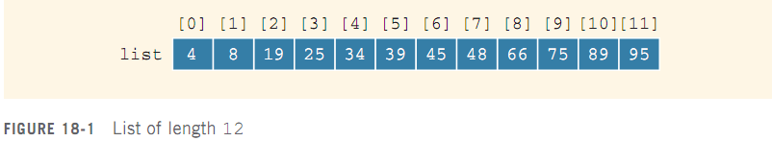
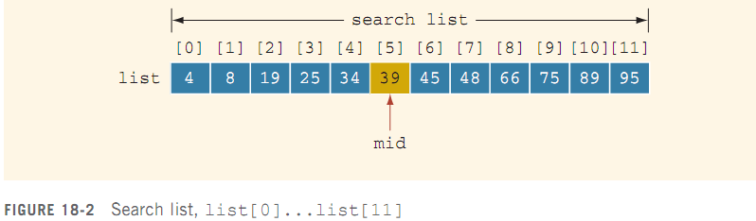
Binary Search (cont’d.)
C++ Programming: Program Design Including Data Structures, Sixth Edition

Slide 12
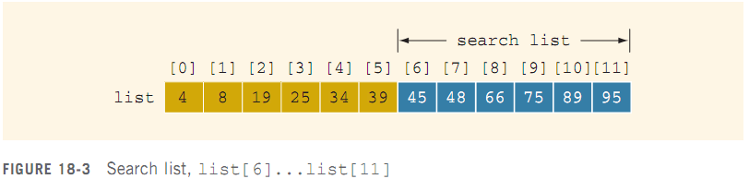
Binary Search (cont’d.)
Search for value of 75:
C++ Programming: Program Design Including Data Structures, Sixth Edition

Slide 13
Performance of Binary Search
Every iteration cuts size of the search list in half
If list L has 1024 = 2¹⁰ items
  At most 11 iterations needed to find x
Every iteration makes two key comparisons
  In this case, at most 22 key comparisons
  Max # of comparisons = 2log₂n+2
Sequential search required 512 key comparisons (average) to find if x is in L
C++ Programming: Program Design Including Data Structures, Sixth Edition

Slide 14
Binary Search Algorithm and the class orderedArrayListType
To use binary search algorithm in class orderedArrayListType:
  Add binSearch function
C++ Programming: Program Design Including Data Structures, Sixth Edition

Slide 15
Asymptotic Notation:
Big-O Notation
After an algorithm is designed, it should be analyzed
May be various ways to design a particular algorithm
  Certain algorithms take very little computer time to execute
  Others take a considerable amount of time
C++ Programming: Program Design Including Data Structures, Sixth Edition

Slide 16
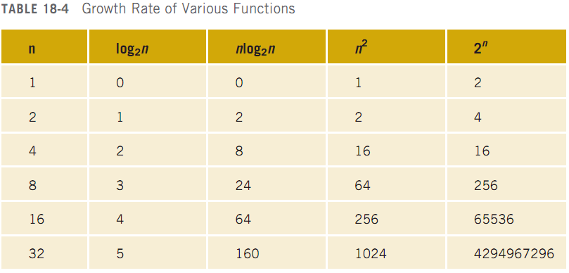
Asymptotic Notation:
Big-O Notation (cont’d.)
C++ Programming: Program Design Including Data Structures, Sixth Edition

Slide 17
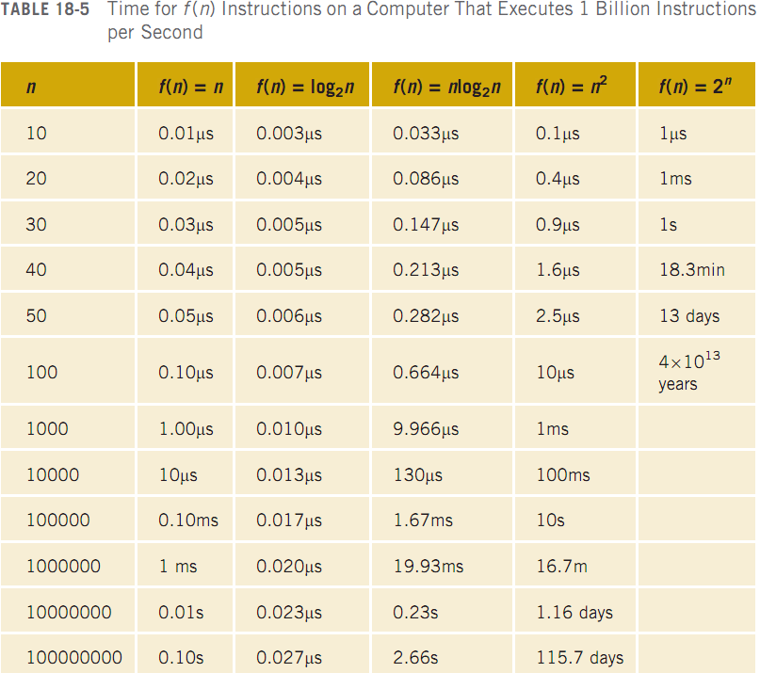
Asymptotic Notation:
Big-O Notation (cont’d.)
C++ Programming: Program Design Including Data Structures, Sixth Edition

Slide 18
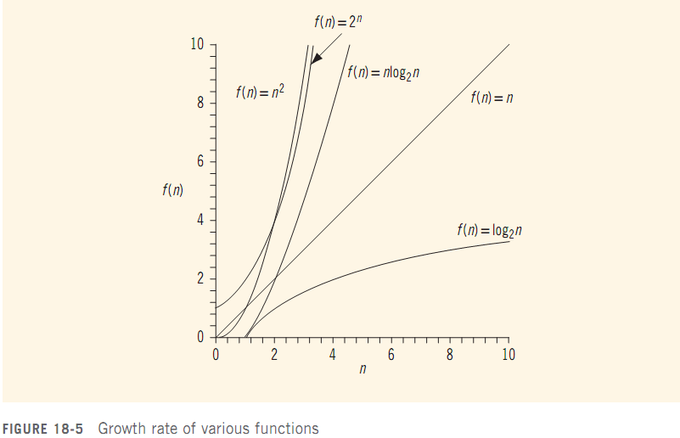
Asymptotic Notation:
Big-O Notation (cont’d.)
C++ Programming: Program Design Including Data Structures, Sixth Edition

Slide 19
Asymptotic Notation:
Big-O Notation (cont’d.)
Let f be a function of n
Asymptotic: the study of the function f as n becomes larger and larger without bound
Let f and g be real-valued, non-negative functions
f(n) is Big-O of g(n), written f(n)=O(g(n)) if there are constants c and n₀ such that
f(n)≤cg(n) for all n ≥n₀
C++ Programming: Program Design Including Data Structures, Sixth Edition

Slide 20
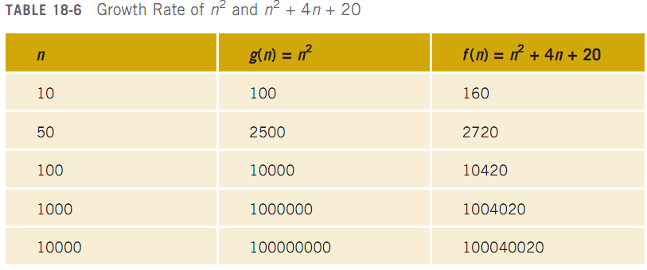
Asymptotic Notation:
Big-O Notation (cont’d.)
C++ Programming: Program Design Including Data Structures, Sixth Edition

Slide 21
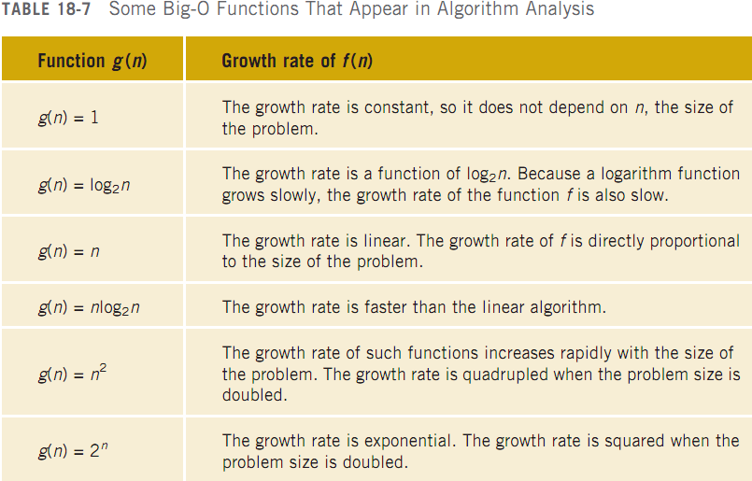
Asymptotic Notation:
Big-O Notation (cont’d.)
C++ Programming: Program Design Including Data Structures, Sixth Edition

Slide 22
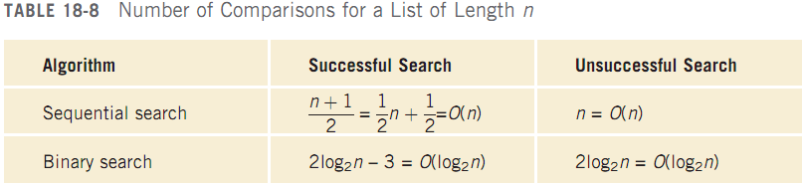
Asymptotic Notation:
Big-O Notation (cont’d.)
We can use Big-O notation to compare sequential and binary search algorithms:
C++ Programming: Program Design Including Data Structures, Sixth Edition

Slide 23
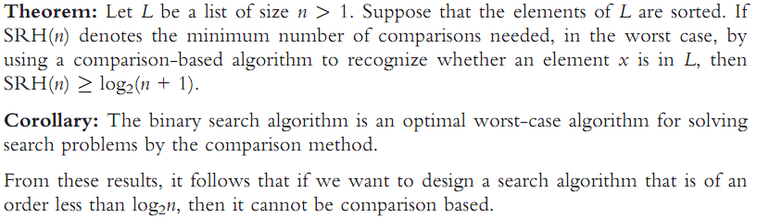
Lower Bound on Comparison-Based Search Algorithms
Comparison-based search algorithms:
  Search a list by comparing the target element with list elements
C++ Programming: Program Design Including Data Structures, Sixth Edition

Slide 24
Sorting Algorithms
To compare the performance of commonly used sorting algorithms
  Must provide some analysis of these algorithms
These sorting algorithms can be applied to either array-based lists or linked lists
C++ Programming: Program Design Including Data Structures, Sixth Edition

Slide 25
Sorting a List: Bubble Sort
Suppose list[0]...list[n–1] is a list of n elements, indexed 0 to n–1
Bubble sort algorithm:
  In a series of n-1 iterations, compare successive elements, list[index] and list[index+1]
  If list[index] is greater than list[index+1], then swap them
C++ Programming: Program Design Including Data Structures, Sixth Edition

Slide 26
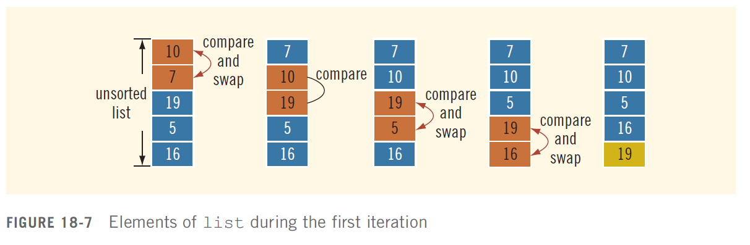
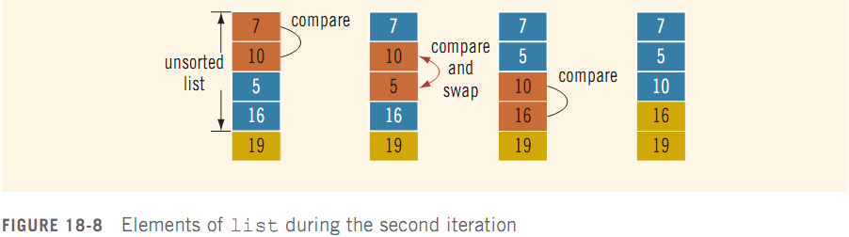
Sorting a List: Bubble Sort (cont’d.)
C++ Programming: Program Design Including Data Structures, Sixth Edition

Slide 27
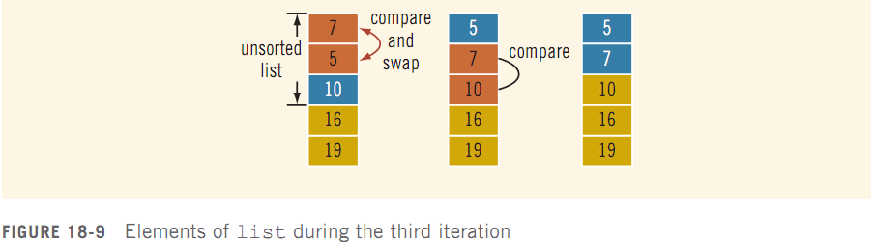
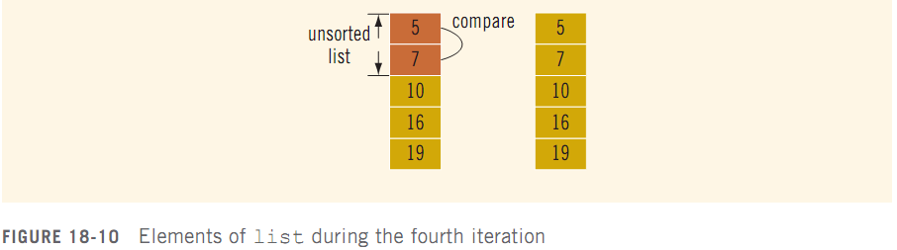
Sorting a List: Bubble Sort (cont’d.)
C++ Programming: Program Design Including Data Structures, Sixth Edition

Slide 28

Analysis: Bubble Sort
bubbleSort contains nested loops
  Outer loop executes n – 1 times
  For each iteration of outer loop, inner loop executes a certain number of times
Total number of comparisons:
Number of assignments (worst case):
C++ Programming: Program Design Including Data Structures, Sixth Edition

Slide 29
Bubble Sort Algorithm and the class unorderedArrayListType
class unorderedArrayListType does not have a sorting algorithm
  Must add function sort and call function bubbleSort instead
C++ Programming: Program Design Including Data Structures, Sixth Edition

Slide 30
Selection Sort: Array-Based Lists
Selection sort algorithm: rearrange list by selecting an element and moving it to its proper position
Find the smallest (or largest) element and move it to the beginning (end) of the list
Can also be applied to linked lists
C++ Programming: Program Design Including Data Structures, Sixth Edition

Slide 31




Analysis: Selection Sort
function swap: does three assignments; executed n−1 times
  3(n − 1) = O(n)
function minLocation:
  For a list of length k, k−1 key comparisons
  Executed n−1 times (by selectionSort)
  Number of key comparisons:
C++ Programming: Program Design Including Data Structures, Sixth Edition

Slide 32
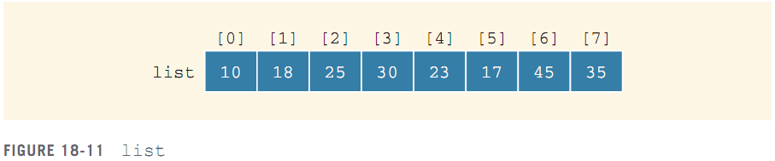
Insertion Sort: Array-Based Lists
Insertion sort algorithm: sorts the list by moving each element to its proper place in the sorted portion of the list
C++ Programming: Program Design Including Data Structures, Sixth Edition

Slide 33
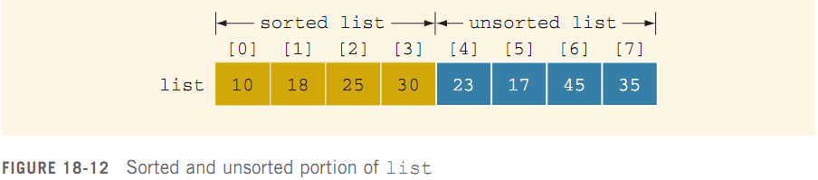
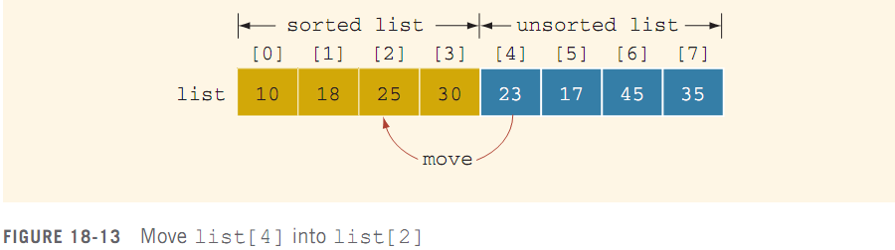
Insertion Sort: Array-Based Lists (cont’d.)
C++ Programming: Program Design Including Data Structures, Sixth Edition

Slide 34
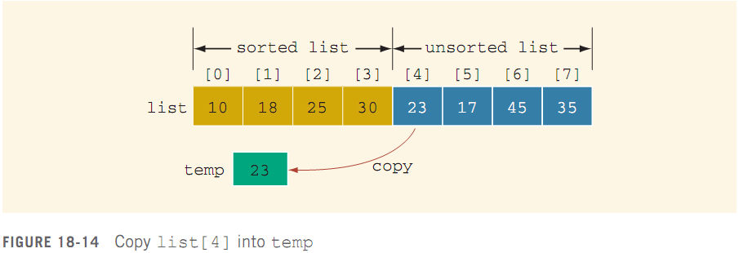
Insertion Sort: Array-Based Lists (cont’d.)
C++ Programming: Program Design Including Data Structures, Sixth Edition

Slide 35
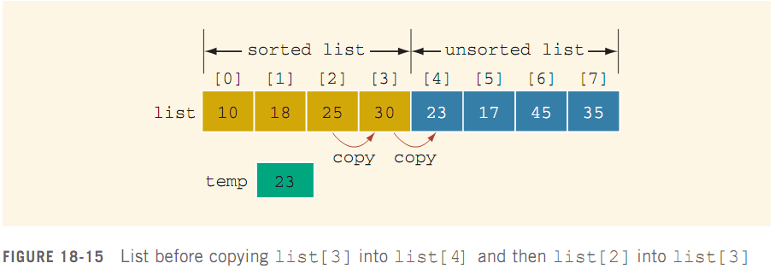
Insertion Sort: Array-Based Lists (cont’d.)
C++ Programming: Program Design Including Data Structures, Sixth Edition

Slide 36
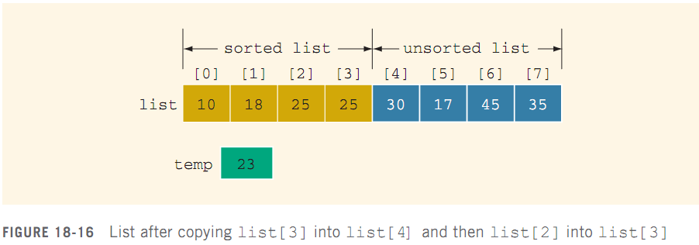
Insertion Sort: Array-Based Lists (cont’d.)
C++ Programming: Program Design Including Data Structures, Sixth Edition

Slide 37
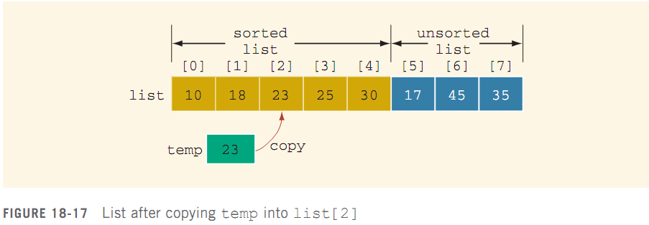
Insertion Sort: Array-Based Lists (cont’d.)
C++ Programming: Program Design Including Data Structures, Sixth Edition

Slide 38
Analysis: Insertion Sort
The for loop executes n – 1 times
Best case (list is already sorted):
  Key comparisons: n – 1 = O(n)
Worst case: for each for iteration, if statement evaluates to true
  Key comparisons: 1 + 2 + … + (n – 1) = n(n – 1) / 2 = O(n²)
Average number of key comparisons and of item assignments: ¼ n² + O(n) = O(n²)
C++ Programming: Program Design Including Data Structures, Sixth Edition

Slide 39
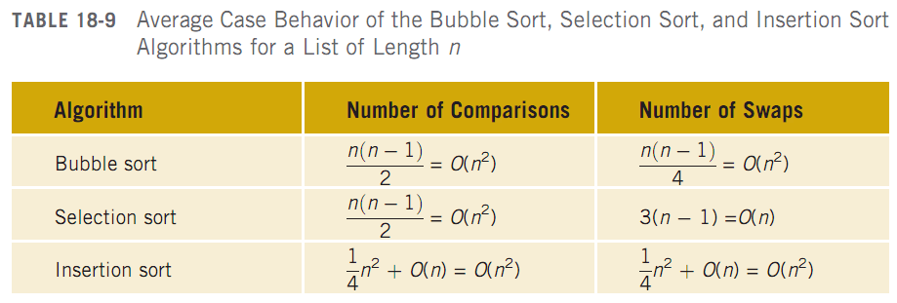
Analysis: Insertion Sort (cont’d.)
C++ Programming: Program Design Including Data Structures, Sixth Edition

Slide 40
Lower Bound on Comparison-Based Sort Algorithms
Comparison tree: graph used to trace the execution of a comparison-based algorithm
  Let L be a list of n distinct elements; n > 0
    For any j and k, where 1 ≤ j ≤ n, 1 ≤ k ≤ n,
    either L[j] < L[k] or L[j] > L[k]
Binary tree: each comparison has two outcomes
C++ Programming: Program Design Including Data Structures, Sixth Edition

Slide 41
Lower Bound on Comparison-Based Sort Algorithms (cont’d.)
Node: represents a comparison
  Labeled as j:k (comparison of L[j] with L[k])
  If L[j] < L[k], follow the left branch; otherwise, follow the right branch
Leaf: represents final ordering of the nodes
Root: the top node
Branch: line that connects two nodes
Path: sequence of branches from one node to another
C++ Programming: Program Design Including Data Structures, Sixth Edition

Slide 42
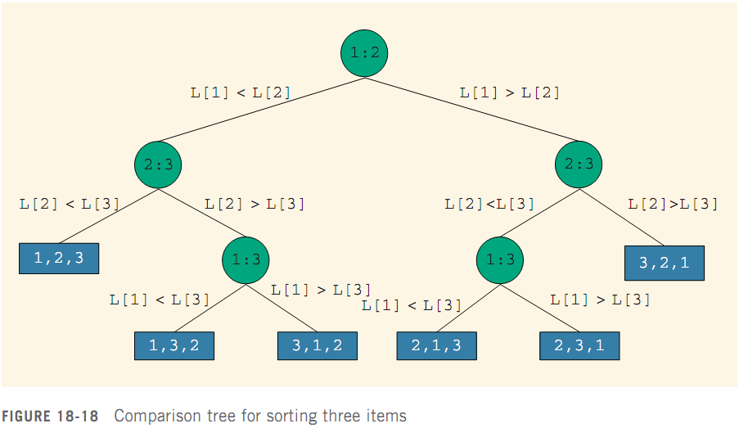
Lower Bound on Comparison-Based Sort Algorithms (cont’d.)
C++ Programming: Program Design Including Data Structures, Sixth Edition

Slide 43
Lower Bound on Comparison-Based Sort Algorithms (cont’d.)
A unique permutation of the elements of L is associated with each root-to-leaf path
  Because the sort algorithm only moves the data and makes comparisons
For a list of n elements, n > 0, there are n! different permutations
  Any of these might be the correct ordering of L
Thus, the tree must have at least n! leaves
C++ Programming: Program Design Including Data Structures, Sixth Edition

Slide 44
Lower Bound on Comparison-Based Sort Algorithms (cont’d.)
Theorem: Let L be a list of n distinct elements. Any sorting algorithm that sorts L by comparison of the keys only, in its worst case, makes at least O(nlog₂n) key comparisons.
C++ Programming: Program Design Including Data Structures, Sixth Edition

Slide 45
Quick Sort: Array-Based Lists
Quick sort: uses the divide-and-conquer technique
  The list is partitioned into two sublists
  Each sublist is then sorted
  Sorted sublists are combined into one list in such a way that the combined list is sorted
  All of the sorting work occurs during the partitioning of the list
C++ Programming: Program Design Including Data Structures, Sixth Edition

Slide 46
Quick Sort: Array-Based Lists (cont’d.)
pivot element is chosen to divide the list into: lowerSublist and upperSublist
  The elements in lowerSublist are < pivot
  The elements in upperSublist are ≥ pivot
Pivot can be chosen in several ways
  Ideally, the pivot divides the list into two sublists of
  nearly- equal size
C++ Programming: Program Design Including Data Structures, Sixth Edition

Slide 47
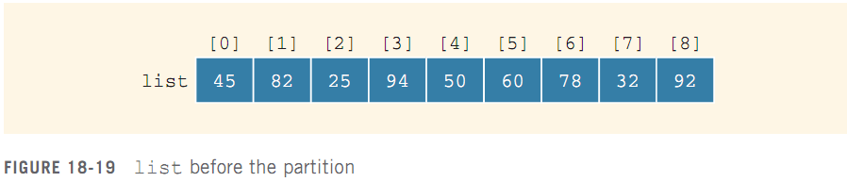
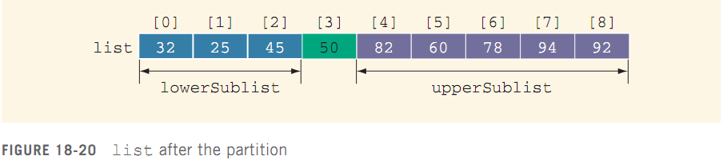
Quick Sort: Array-Based Lists (cont’d.)
C++ Programming: Program Design Including Data Structures, Sixth Edition

Slide 48
Quick Sort: Array-Based Lists (cont’d.)
Partition algorithm (assumes that pivot is chosen as the middle element of the list):
  Determine pivot; swap it with the first element of the list
  For the remaining elements in the list:
    If the current element is less than pivot, (1) increment smallIndex, and (2) swap current element with element pointed by smallIndex
  Swap the first element (pivot), with the array element pointed to by smallIndex
C++ Programming: Program Design Including Data Structures, Sixth Edition

Slide 49
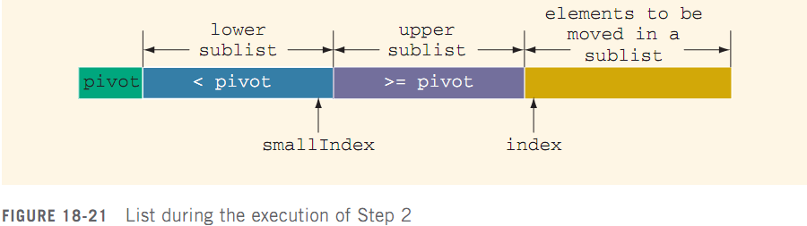
Quick Sort: Array-Based Lists (cont’d.)
Step 1 determines the pivot and moves pivot to the first array position
During Step 2, list elements are arranged
C++ Programming: Program Design Including Data Structures, Sixth Edition

Slide 50
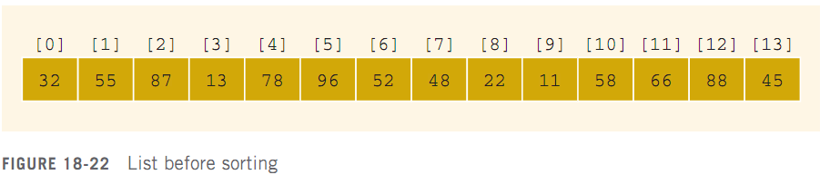
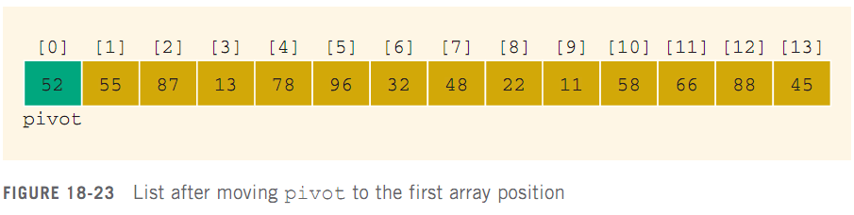
Quick Sort: Array-Based Lists (cont’d.)
C++ Programming: Program Design Including Data Structures, Sixth Edition

Slide 51
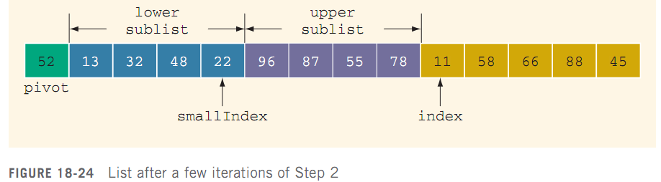
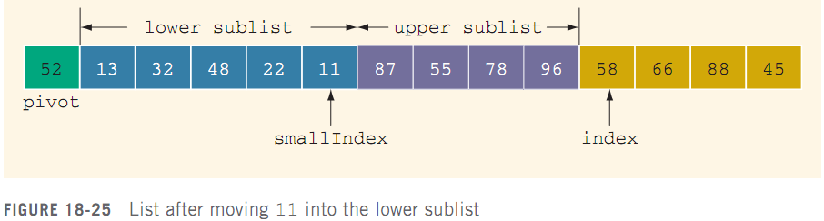
Quick Sort: Array-Based Lists (cont’d.)
C++ Programming: Program Design Including Data Structures, Sixth Edition

Slide 52
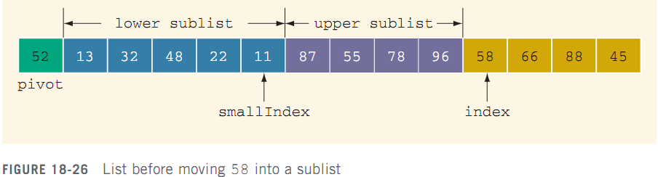
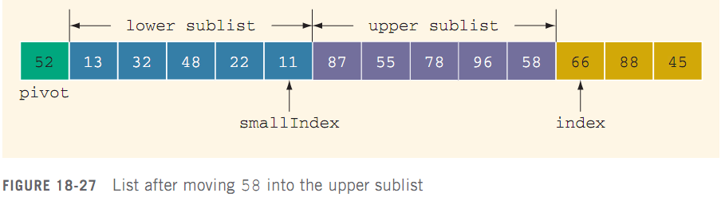
Quick Sort: Array-Based Lists (cont’d.)
C++ Programming: Program Design Including Data Structures, Sixth Edition

Slide 53
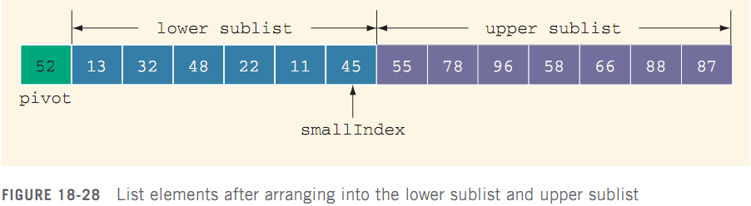
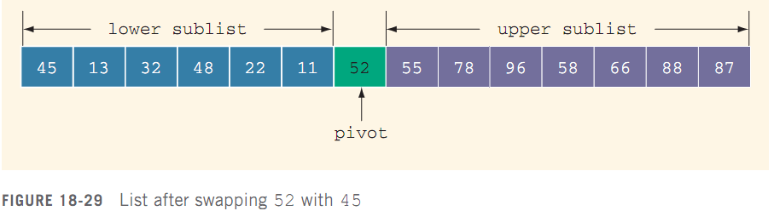
Quick Sort: Array-Based Lists (cont’d.)
C++ Programming: Program Design Including Data Structures, Sixth Edition

Slide 54
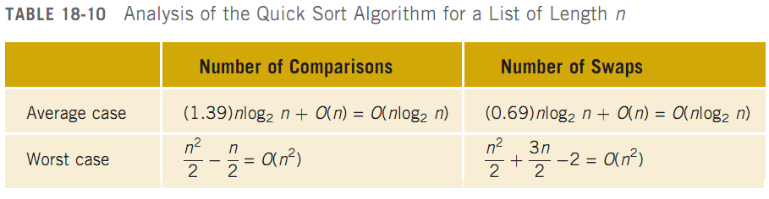
Analysis: Quick Sort
C++ Programming: Program Design Including Data Structures, Sixth Edition

Slide 55
Merge Sort: Linked List-Based Lists
Quick sort: O(nlog₂n) average case; O(n²) worst case
Merge sort: always O(nlog₂n)
  Uses the divide-and-conquer technique
    Partitions the list into two sublists
    Sorts the sublists
    Combines the sublists into one sorted list
  Differs from quick sort in how list is partitioned
    Divides list into two sublists of nearly equal size
C++ Programming: Program Design Including Data Structures, Sixth Edition

Slide 56
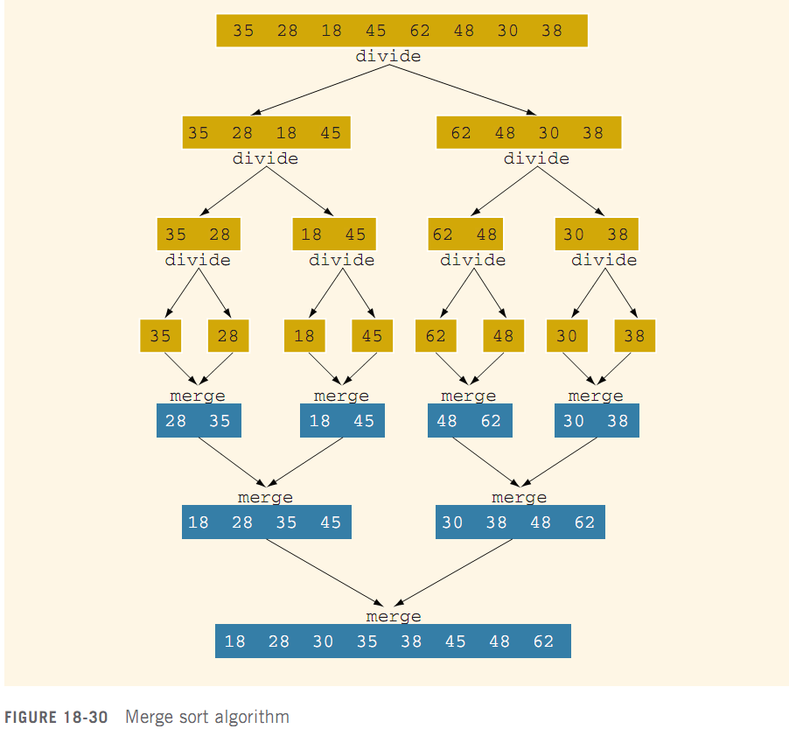
Merge Sort: Linked List-Based Lists (cont’d.)
C++ Programming: Program Design Including Data Structures, Sixth Edition

Slide 57
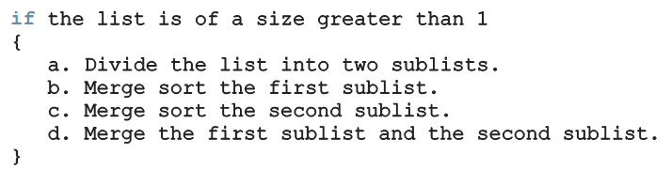
Merge Sort: Linked List-Based Lists (cont’d.)
General algorithm:
Uses recursion
C++ Programming: Program Design Including Data Structures, Sixth Edition

Slide 58
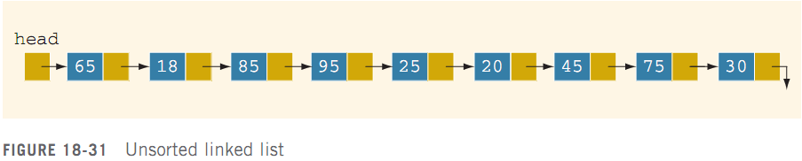
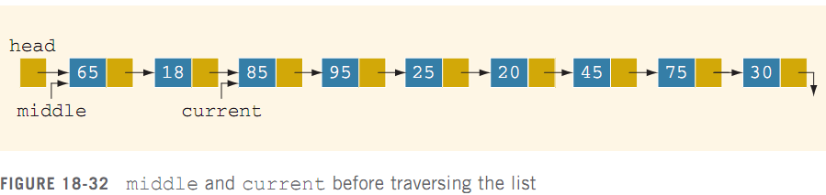
Divide
C++ Programming: Program Design Including Data Structures, Sixth Edition

Slide 59
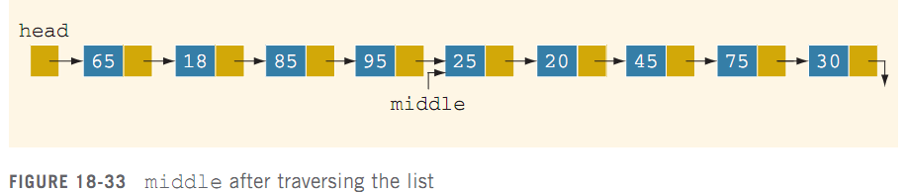
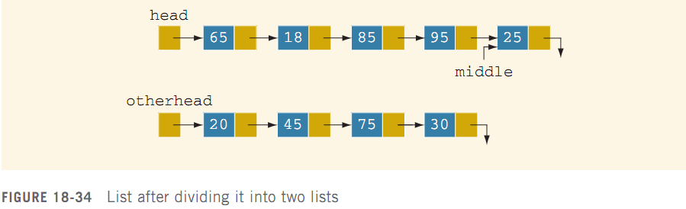
Divide (cont’d.)
C++ Programming: Program Design Including Data Structures, Sixth Edition

Slide 60
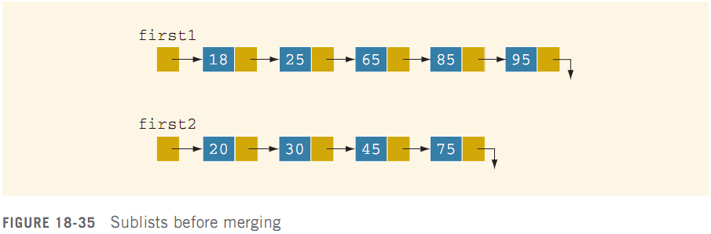
Merge
Sorted sublists are merged into a sorted list
  Compare elements of sublists
  Adjust pointers of nodes with smaller info
C++ Programming: Program Design Including Data Structures, Sixth Edition

Slide 61
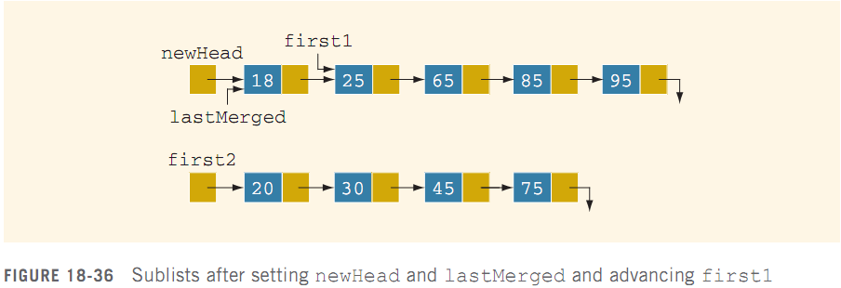
Merge (cont’d.)
C++ Programming: Program Design Including Data Structures, Sixth Edition

Slide 62
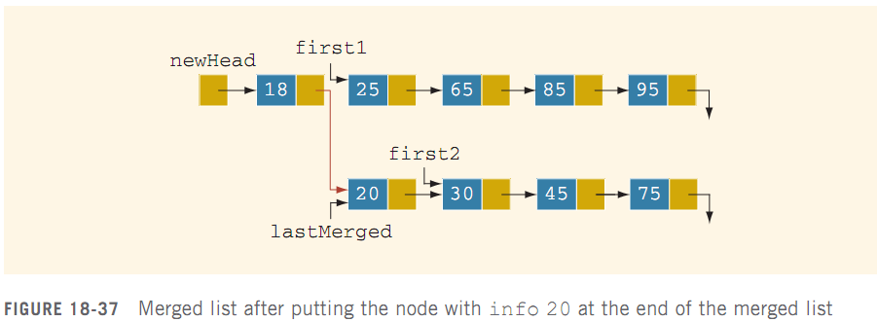
Merge (cont’d.)
C++ Programming: Program Design Including Data Structures, Sixth Edition

Slide 63

Analysis: Merge Sort
Suppose that L is a list of n elements, with n > 0
Suppose that n is a power of 2; that is, n = 2^{m} for some integer m > 0, so that we can divide the list into two sublists, each of size:
  m will be the number of recursion levels
C++ Programming: Program Design Including Data Structures, Sixth Edition

Slide 64
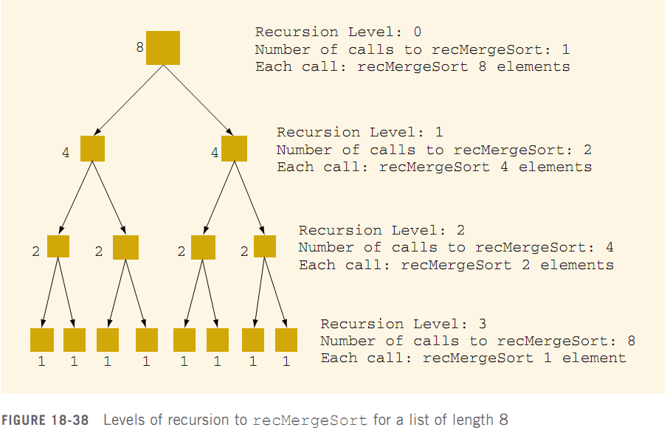
Analysis: Merge Sort (cont’d.)
C++ Programming: Program Design Including Data Structures, Sixth Edition

Slide 65

Analysis: Merge Sort (cont’d.)
To merge two sorted lists of size s and t, the maximum number of comparisons is s + t − 1
Function mergeList merges two sorted lists into a sorted list
  This is where the actual comparisons and assignments are done
Max. # of comparisons at level k of recursion:
C++ Programming: Program Design Including Data Structures, Sixth Edition

Slide 66

Analysis: Merge Sort (cont’d.)
The maximum number of comparisons at each level of the recursion is O(n)
  Maximum number of comparisons is O(nm), where m = number of levels of recursion
  Thus, O(nm) ≡ O(n log₂n)
W(n): # of key comparisons in worst case
A(n): # of key comparisons in average case
C++ Programming: Program Design Including Data Structures, Sixth Edition

Slide 67
Summary
On average, a sequential search searches half the list and makes O(n) comparisons
  Not efficient for large lists
A binary search requires the list to be sorted
  2log₂n – 3 key comparisons
Let f be a function of n: by asymptotic, we mean the study of the function f as n becomes larger and larger without bound
C++ Programming: Program Design Including Data Structures, Sixth Edition

Slide 68
Summary (cont’d.)
Binary search algorithm is the optimal worst-case algorithm for solving search problems by using the comparison method
  To construct a search algorithm of the order less than log₂n, it cannot be comparison based
Bubble sort: O(n²) key comparisons and item assignments
Selection sort: O(n²) key comparisons and O(n) item assignments
C++ Programming: Program Design Including Data Structures, Sixth Edition

Slide 69
Summary (cont’d.)
Insertion sort: O(n²) key comparisons and item assignments
Both the quick sort and merge sort algorithms sort a list by partitioning it
  Quick sort: average number of key comparisons is O(nlog₂n); worst case number of key comparisons is O(n²)
  Merge sort: number of key comparisons is O(nlog₂n)
C++ Programming: Program Design Including Data Structures, Sixth Edition

