Slide 1
CSCI 315
Hashing

Slide 2
Maps/Dictionary
Map (dictionary) is a relation between set of keys and set of values

Slide 3
Implementing Dynamic Maps/Dictionaries
Want a data structure in which finds/searches are very fast
  As close to O(1) as possible
  minimum number of executed instructions per method
Insert and Deletes should be fast too
Objects in map have unique keys
  A key may be a single property/attribute value
  Or may be created from multiple properties/values

Slide 4
Hash tables vs. Other Data Structures
We want to implement the map operations Insert(), Delete() and Search()/Find() efficiently.
Arrays:
  can accomplish in O(1) time
  but are not space efficient (assumes we leave empty space for keys not currently in map)
Binary search trees
  can accomplish in O(log n) time
  are space efficient.
Hash Tables:
  A generalization of an array that under some reasonable assumptions is O(1) for Insert/Delete/Search of a key

Slide 5
Array Approach – example
A social security application keeping track of people where the primary search key is a person’s social security number (SSN)
You can use an array to hold references to all the person objects
  Use an array with range 0 - 999,999,999
  Using the SSN as a key, you have O(1) access to any person object
Unfortunately, the number of active keys (Social Security Numbers) is much less than the array size (1 billion entries)
  Est. US population, Oct. 20th 2004: 294,564,209
  Over 60% of the array would be unused

Slide 6
Hash Tables
Very useful data structure
  Good for storing and retrieving key-value pairs
  Not good for iterating through a list of items
Example applications:
  Storing objects according to ID numbers
    When the ID numbers are widely spread out
    When you don’t need to access items in ID order

Slide 7
Hash Tables – Conceptual View
buckets
table
obj1
key=15
7
6
5
4
3
2
1
0
Obj3
key=4
Obj2
key=28
hash value/index
Obj4
key=2
Obj5
key=1

Slide 8
Hash Tables
Hash Tables solve these problems by using a much smaller array and mapping keys with a hash function.
Let universe of keys U and an array of size m. A hash function h is a function from U to 0…m, that is:
h : U 0…m
0
1
2
3
4
5
6
7
U
k₁ k₂
k₃ k₄
k₆
h (k₂)=2
h (k₁)=h (k₃)=3
h (k₆)=5
h (k₄)=7
(universe of keys)

Slide 9
Hash index/value
A hash value or hash index is used to index the hash table (array)
A hash function takes a key and returns a hash value/index
  The hash index is a integer (to index an array)
The key is specific value associated with a specific object being stored in the hash table
  It is important that the key remain constant for the lifetime of the object

Slide 10
Hash Functions & insert(…)
Usage summary:
int hashValue = hashFunction (int key);
  Or hashValue = hashFunction (String key);
  Or hashValue = hashFunction (itemType item);
Insert method:
public void insert (int key, itemType item) {
int hashValue = hashFunction (key);
table[hashValue] = item;
}

Slide 11
Hash Function
You want a hash function/algorithm that is:
  Fast
  Creates a good distribution of hash values so that the items (based on their keys) are distributed evenly through the array
Hash functions can use as input
  Integer key values
  String key values
  Multipart key values
    Multipart fields, and/or
    Multiple fields

Slide 12
The mod function
Stands for modulo
When you divide x by y, you get a result and a remainder
Mod is the remainder
  8 mod 5 = 3
  9 mod 5 = 4
  10 mod 5 = 0
  15 mod 5 = 0
Thus for key-value mod M, multiples of M give the same result, 0
  But multiples of other numbers do not give the same result
  So what happens when M is a prime number where the keys are not multiples of M?

Slide 13
Hash Tables: Insert Example
For example, if we hash keys 0…1000 into a hash table with 5 entries and use h(key) = key mod 5 , we get the following sequence of events:
Insert 2
Insert 21
Insert 34
Insert 54
key data
key data
key data
0
1
2
3
4
0
1
2
3
4
0
1
2
3
4
21 …
21 …
There is a
collision at
array entry #4
2 …
2 …
2 …
34 …
???

Slide 14
Dealing with Collisions
A problem arises when we have two keys that hash in the same array entry – this is called a collision.
There are two ways to resolve collision:
  Hashing with Chaining (a.k.a. “Separate Chaining”): every hash table entry contains a pointer to a linked list of keys that hash in the same entry
  Hashing with Open Addressing: every hash table entry contains only one key. If a new key hashes to a table entry which is filled, systematically examine other table entries until you find one empty entry to place the new key

Slide 15
Hashing with Chaining
The problem is that keys 34 and 54 hash in the same entry (4). We
solve this collision by placing all keys that hash in the same hash table
entry in a chain (linked list) or bucket (array) pointed by this entry:
Insert 54
other
key key data
Insert 101
0
1
2
3
4
0
1
2
3
4
21
21
101
2
2
54
34
54
34
CHAIN

Slide 16
Hashing with Chaining
What is the running time to insert/search/delete?
  Insert: It takes O(1) time to compute the hash function and insert at head of linked list
  Search: It is proportional to max linked list length
  Delete: Same as search
Therefore, in the unfortunate event that we have a “bad” hash function all n keys may hash in the same table entry giving an O(n) run-time!
So how can we create a “good” hash function?

Slide 17
Choosing a Hash Function – 1
The performance of the hash table depends on having a hash function that evenly distributes the keys: uniform hashing is the ideal target
Choosing a good hash function requires taking into account the kind of data that will be used.
  The statistics of the key distribution needs to be accounted for
  E.g., Choosing the first letter of a last name will likely cause lots of collisions depending on the nationality of the population
Most programming languages (including java) have hash functions built in

Slide 18
Choosing a Hash Function – 2
Division/modulo method
  key mod m
  m is the array size; in general, it should be prime number
Multiplication method
  Floor ((key*someFraction mod 1)*arraySize)
  Where some fraction is typically 0.618
Java Hash Map method
  Create a “hash” by performing a series of shifts, adds, and xors on the key
  index = hash mod arraySize

Slide 19
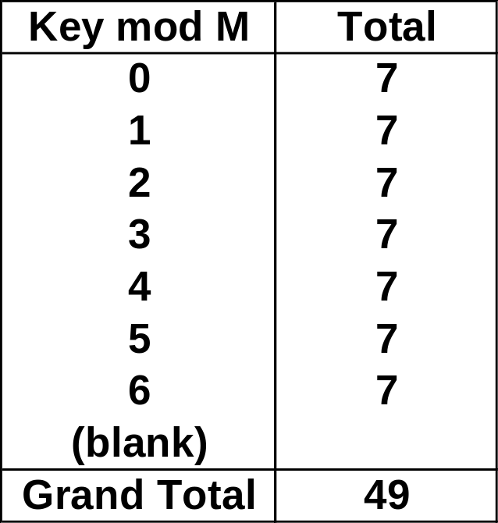
Prime Number Distribution
For example, assume
Keys (key values) are multiples of 5
  5, 10, 15, 20, 25…
The keys are evenly distributed 5 to 245
An M (the divisor) of 7
Then, the hash values will be evenly distributed from 0 to 6 for the keys
  See table →
If M was 5, then you would have what kind of distribution?
hash value = key mod m
(m is typically the table size)

Slide 20
Choosing Hash Function – 3
If keys are non-random – e.g. part numbers
  Use all data to contribute to the hash function to get a better distribution
  Consider folding – sum the natural (or arbitrary) groups of digits in key
  Don’t use redundant or non-data (.e.g. checksum values)
  Do not use information that might change!
➔ Analyze your expected key values (or some representative subset) to make sure your hash function gives a good distribution!

Slide 21
Hash Tables – Open Addressing
table
obj1
key=15
7
6
5
4
3
2
1
0
Obj3
key=4
Index=4
Obj2
key=28
hash value/index
Index=4
Obj4
key=2
Obj5
key=1

Slide 22
Hashing with Open Addressing
So far we have studies hashing with chaining, using a list to store the items that hash to the same location
Another option is to store all the items (references to single items) directly in the table.
Open addressing
  collisions are resolved by systematically examining other table indexes, i₀ , i₁ , i₂ , … until an empty slot is located.

Slide 23
Open Addressing
The key is first mapped to an array cell using the hash function (e.g. key % array-size)
If there is a collision find an available array cell
There are different algorithms to find (to probe for) the next array cell
  Linear
  Quadratic
  Double Hashing

Slide 24
Probe Algorithms (Collision Resolution)
Linear Probing
  Choose the next available array cell
    First try arrayIndex = hash value + 1
    Then try arrayIndex = hash value + 2
    Be sure to wrap around the end of the array!
    arrayIndex = (arrayIndex + 1) % arraySize
    Stop when you have tried all possible array indices
  If the array is full, you need to throw an exception or, better yet, resize the array
Quadratic Probing
  Variation of linear probing that uses a more complex function to calculate the next cell to try

Slide 25
Double Hashing
Apply a second hash function after the first
The second hash function, like the first, is dependent on the key
Secondary hash function must
  Be different than the first
  And, obviously, not generate a zero
Good algorithm:
  arrayIndex = (arrayIndex + stepSize) % arraySize;
  Where stepSize = constant – (key % constant)
  And constant is a prime less than the array size

Slide 26
Load Factor
Understanding the expected load factor will help you determine the efficiency of you hash table implementation and hash functions
Load factor = number of items in hash table / array size
For Open Addressing:
  If < 0.5, wasting space
  If > 0.8, overflows significant
For Chaining:
  If < 1.0, wasting space
  If > 2.0, then search time to find a specific item may factor in significantly to the [relative] performance

Slide 27
Deletion
delete(2)
find(7)
0
0
0
0
1
1
1
1
Where is it?!
2
2
2
3
7
3
7
4
4
Must use lazy deletion!
On insertion, treat a (lazily) deleted item as an empty slot
5
5
6
6

Slide 28
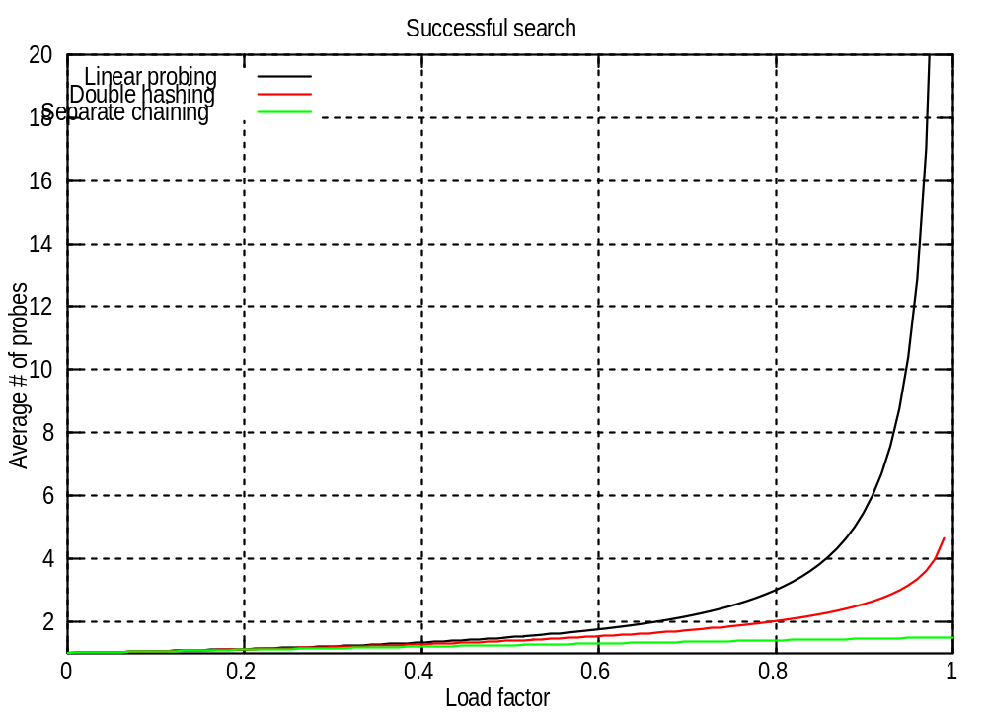

Slide 29
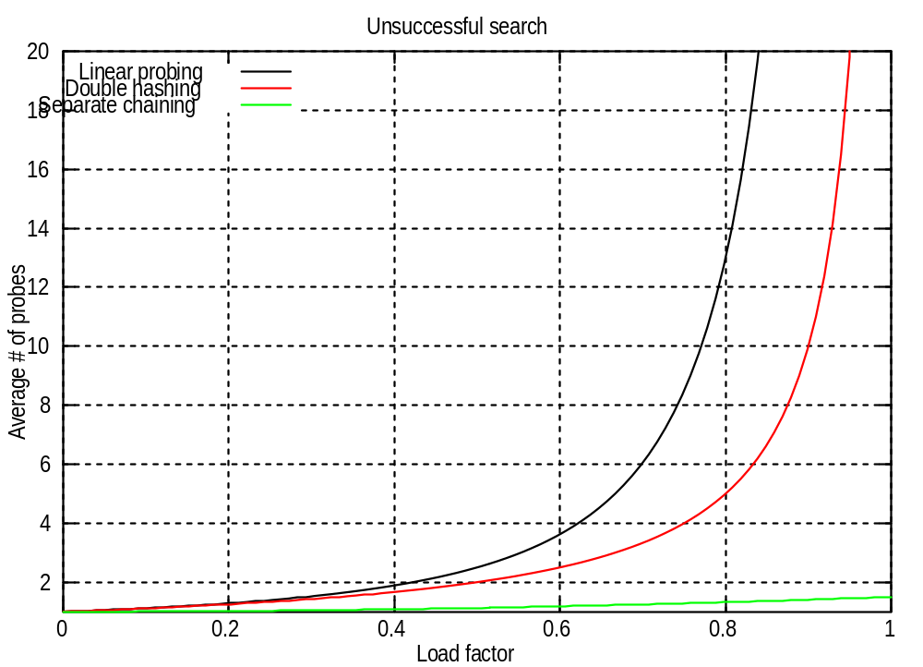

Slide 30
Open Addressing vs. Separate Chaining
When should you be concerned about Open Addressing and Separate Chaining implementations?
Note that there are Hash libraries… Java supports Hashtable, HashMap, LinkedHashMap, HashSet,…
But, if you are implementing your own hash table consider:
  Do you know the total number of items to be inserted into the table?
  Do you have plenty of memory?
  Do you know the expected load factor?

Slide 31
Hash Tables in Java
Java supports a number of hash table classes
  Hashtable, HashMap, LinkedHashMap, HashSet, …
  See Sun Java API Documentation
  http://java.sun.com/j2se/1.4.1/docs/api/
  Note that, like Vector and ArrayList, the items that are put into the hash tables are Objects
  Use Java casting when you remove items!
As a programmer, you don’t see the collision detection, chaining, etc.
You can set
  The initial table size
  The load factor (Default is .75)
  hashCode() – hash function (also need to override equals()) for the item to be hashed

