Slide 1
Chapter 12:
Pointers, Classes, Virtual Functions, Abstract Classes, and Lists

Slide 2
Objectives
In this chapter, you will:
  Use the pointer data type and pointer variables
  Declare and manipulate pointer variables
  Learn about the address of operator and the dereferencing operator
  Discover dynamic variables
  Use the new and delete operators to manipulate dynamic variables
  Learn about pointer arithmetic
C++ Programming: Program Design Including Data Structures, Sixth Edition

Slide 3
Objectives (cont’d.)
In this chapter, you will (cont’d.)
  Discover dynamic arrays
  Explore shallow and deep copies of data
  Discover the peculiarities of classes with pointer member variables
  Learn about virtual functions
  Examine the relationship between the address of operator and classes
  Become aware of abstract classes
C++ Programming: Program Design Including Data Structures, Sixth Edition

Slide 4
Pointer Data Type and Pointer Variables
Pointer variable: content is a memory address
No name associated with the pointer data type in C++
C++ Programming: Program Design Including Data Structures, Sixth Edition

Slide 5

Declaring Pointer Variables
Syntax:
Examples:
  int *p;
  char *ch;
These statements are equivalent:
  int *p;
  int* p;
  int * p;
C++ Programming: Program Design Including Data Structures, Sixth Edition

Slide 6
Declaring Pointer Variables (cont’d.)
In the statement:
  int* p, q;
  Only p is a pointer variable
  q is an int variable
To avoid confusion, attach the character * to the variable name:
int *p, q;
int *p, *q;
C++ Programming: Program Design Including Data Structures, Sixth Edition

Slide 7
Address of Operator (&)
Address of operator (&):
  A unary operator that returns the address of its operand
Example:
int x;
int *p;
p = &x;
  Assigns the address of x to p
C++ Programming: Program Design Including Data Structures, Sixth Edition

Slide 8
Dereferencing Operator (*)
Dereferencing operator (or indirection operator):
  When used as a unary operator, * refers to object to which its operand points
Example:
cout << *p << endl;
  Prints the value stored in the memory location pointed to by p
C++ Programming: Program Design Including Data Structures, Sixth Edition

Slide 9
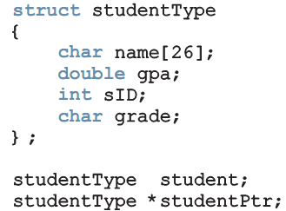
Classes, structs, and Pointer Variables
You can declare pointers to other data types:
  student is an object of type studentType
  studentPtr is a pointer variable of type studentType
C++ Programming: Program Design Including Data Structures, Sixth Edition

Slide 10
Classes, structs, and Pointer Variables (cont’d.)
To store address of student in studentPtr:
  studentPtr = &student;
To store 3.9 in component gpa of student:
  (*studentPtr).gpa = 3.9;
  ( ) used because dot operator has higher precedence than dereferencing operator
  Alternative: use member access operator arrow (->)
C++ Programming: Program Design Including Data Structures, Sixth Edition

Slide 11

Classes, structs, and Pointer Variables (cont’d.)
Syntax to access a class (struct) member using the operator -> :
Thus,
  (*studentPtr).gpa = 3.9;
  is equivalent to:
  studentPtr->gpa = 3.9;
C++ Programming: Program Design Including Data Structures, Sixth Edition

Slide 12
Initializing Pointer Variables
C++ does not automatically initialize variables
Pointer variables must be initialized if you do not want them to point to anything
  Initialized using the null pointer: the constant value 0
  Or, use the NULL named constant
  The number 0 is the only number that can be directly assigned to a pointer variable
C++ Programming: Program Design Including Data Structures, Sixth Edition

Slide 13
Dynamic Variables
Dynamic variables: created during execution
C++ creates dynamic variables using pointers
new and delete operators: used to create and destroy dynamic variables
  new and delete are reserved words in C++
C++ Programming: Program Design Including Data Structures, Sixth Edition

Slide 14
Operator new
new has two forms:
  intExp is any expression evaluating to a positive integer
new allocates memory (a variable) of the designated type and returns a pointer to it
  The allocated memory is uninitialized
C++ Programming: Program Design Including Data Structures, Sixth Edition

Slide 15
Operator new (cont’d.)
Example: p = new int;
  Creates a variable during program execution somewhere in memory
  Stores the address of the allocated memory in p
To access allocated memory, use *p
A dynamic variable cannot be accessed directly
  Because it is unnamed
C++ Programming: Program Design Including Data Structures, Sixth Edition

Slide 16
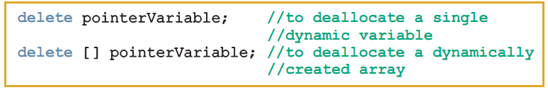
Operator delete (cont’d.)
Memory leak: previously allocated memory that cannot be reallocated
  To avoid a memory leak, when a dynamic variable is no longer needed, destroy it to deallocate its memory
delete operator: used to destroy dynamic variables
Syntax:
C++ Programming: Program Design Including Data Structures, Sixth Edition

Slide 17
Operator delete (cont’d.)
delete only marks the memory space as deallocated
  Pointer variable may still contain address of deallocated memory space
If you try to access via the pointer, could result in corrupting data or termination
Avoid this by setting pointers to NULL after delete operation
C++ Programming: Program Design Including Data Structures, Sixth Edition

Slide 18
Operations on Pointer Variables
delete only marks the memory space as deallocated
  Pointer variable may still contain address of deallocated memory space
If you try to access via the pointer, could result in corrupting data or termination
Avoid this by setting pointers to NULL after delete operation
C++ Programming: Program Design Including Data Structures, Sixth Edition

Slide 19
Operations on Pointer Variables (cont’d.)
Pointer arithmetic can be very dangerous:
  Program can accidentally access memory locations of other variables and change their content without warning
    Some systems might terminate the program with an appropriate error message
Always exercise extra care when doing pointer arithmetic
C++ Programming: Program Design Including Data Structures, Sixth Edition

Slide 20
Dynamic Arrays
Dynamic array: array created during program execution
Example:
  int *p;
  p = new int[10];
  *p = 25;
  p++; //to point to next array component
  *p = 35;
stores 25 into the first memory location
stores 35 into the second memory location
C++ Programming: Program Design Including Data Structures, Sixth Edition

Slide 21
Dynamic Arrays (cont’d.)
Can use array notation to access these memory locations
Example:
p[0] = 25;
p[1] = 35;
  Stores 25 and 35 into the first and second array components, respectively
An array name is a constant pointer
C++ Programming: Program Design Including Data Structures, Sixth Edition

Slide 22
Functions and Pointers
Pointer variable can be passed as a parameter either by value or by reference
As a reference parameter in a function heading, use &:
void pointerParameters(int* &p, double *q)
{
. . .
}
C++ Programming: Program Design Including Data Structures, Sixth Edition

Slide 23
Pointers and Function Return Values
A function can return a value of type pointer:
int* testExp(...)
{
. . .
}
C++ Programming: Program Design Including Data Structures, Sixth Edition

Slide 24


Dynamic Two-Dimensional Arrays
You can create dynamic multidimensional arrays
Examples:
declares board to be an array of four pointers wherein each pointer is of type int
creates the rows of board
declares board to be a pointer to a pointer
C++ Programming: Program Design Including Data Structures, Sixth Edition

Slide 25
Shallow Versus Deep Copy and Pointers
Shallow copy: when two or more pointers of the same types point to the same memory
  They point to the same data
  Danger: deleting one deletes the data pointed to by all of them
Deep copy: when the contents of the memory pointed to by a pointer are copied to the memory location of another pointer
  Two copies of the data
C++ Programming: Program Design Including Data Structures, Sixth Edition

Slide 26

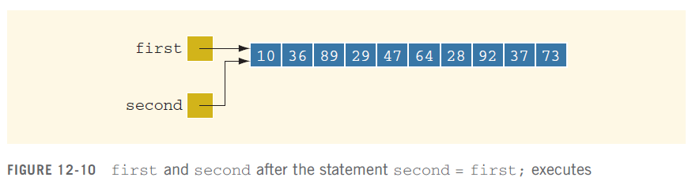
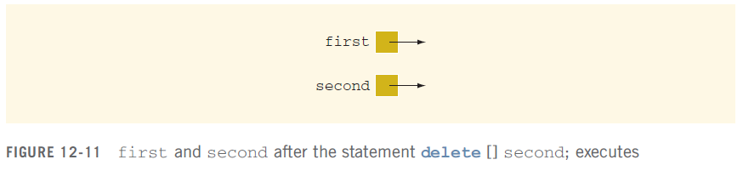
Shallow Versus Deep Copy and Pointers (cont’d.)
C++ Programming: Program Design Including Data Structures, Sixth Edition

Slide 27

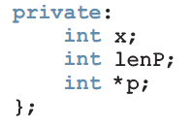
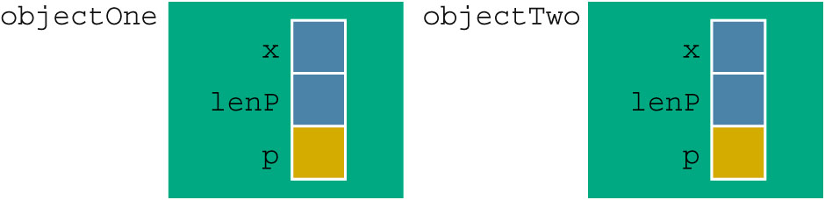

Classes and Pointers: Some Peculiarities
Example class:
Example program statements:
C++ Programming: Program Design Including Data Structures, Sixth Edition

Slide 28

Destructor
If objectOne goes out of scope, its member variables are destroyed
  Memory space of dynamic array stays marked as allocated, even though it cannot be accessed
Solution: in destructor, ensure that when objectOne goes out of scope, its array memory is deallocated:
C++ Programming: Program Design Including Data Structures, Sixth Edition

Slide 29
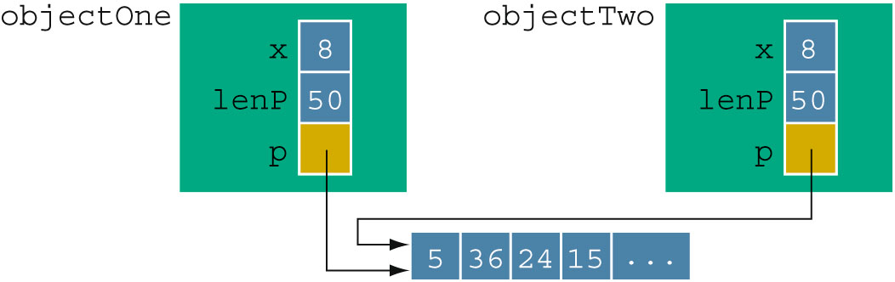
Assignment Operator
After a shallow copy: if objectTwo.p deallocates memory space to which it points, objectOne.p becomes invalid
Solution: extend definition of the assignment operator to avoid shallow copying of data
C++ Programming: Program Design Including Data Structures, Sixth Edition

Slide 30
Copy Constructor
Default member-wise initialization:
  Initializing a class object by using the value of an existing object of the same type
Example:
ptrMemberVarType objectThree(objectOne);
Copy constructor: provided by the compiler
  Performs this initialization
  Leads to a shallow copying of the data if class has pointer member variables
C++ Programming: Program Design Including Data Structures, Sixth Edition

Slide 31
Copy Constructor (cont’d.)
Similar problem occurs when passing objects by value
Copy constructor automatically executes in three situations:
  When an object is declared and initialized by using the value of another object
  When an object is passed by value as a parameter
  When the return value of a function is an object
C++ Programming: Program Design Including Data Structures, Sixth Edition

Slide 32
Copy Constructor (cont’d.)
Solution: override the copy constructor
For classes with pointer member variables, three things are normally done:
  Include the destructor in the class
  Overload the assignment operator for the class
  Include the copy constructor
C++ Programming: Program Design Including Data Structures, Sixth Edition

Slide 33
Inheritance, Pointers, and Virtual Functions
Can pass an object of a derived class to a formal parameter of the base class type
Compile-time binding: the necessary code to call specific function is generated by compiler
  Also known as static binding or early binding
Virtual function: binding occurs at program execution time, not at compile time
  Declared with reserved word virtual
C++ Programming: Program Design Including Data Structures, Sixth Edition

Slide 34
Inheritance, Pointers, and Virtual Functions (cont’d.)
Run-time binding:
  Compiler does not generate code to call a specific function: it generates information to enable run-time system to generate specific code for the function call
  Also known as dynamic or late binding
Note: cannot pass an object of base class type to a formal parameter of the derived class type
C++ Programming: Program Design Including Data Structures, Sixth Edition

Slide 35
Inheritance, Pointers, and Virtual Functions (cont’d.)
Values of a derived class object can be copied into a base class object
Slicing problem: if derived class has more data members than base class, some data could be lost
Solution: use pointers for both base and derived class objects
C++ Programming: Program Design Including Data Structures, Sixth Edition

Slide 36
Classes and Virtual Destructors
Classes with pointer member variables should have the destructor
  Destructor should deallocate storage for dynamic objects
If a derived class object is passed to a formal parameter of the base class type, destructor of the base class executes
  Regardless of whether object is passed by reference or by value
Solution: use a virtual destructor (base class)
C++ Programming: Program Design Including Data Structures, Sixth Edition

Slide 37
Classes and Virtual Destructors (cont’d.)
Virtual destructor of a base class automatically makes the destructor of a derived class virtual
  After executing the destructor of the derived class, the destructor of the base class executes
If a base class contains virtual functions, make the destructor of the base class virtual
C++ Programming: Program Design Including Data Structures, Sixth Edition

Slide 38
Abstract Classes and Pure Virtual Functions
New classes can be derived through inheritance without designing them from scratch
  Derived classes inherit existing members of base class
  Can add their own members
  Can redefine or override public and protected member functions
Base class can contain functions that you would want each derived class to implement
  However, base class may contain functions that may not have meaningful definitions in the base class
C++ Programming: Program Design Including Data Structures, Sixth Edition

Slide 39
Abstract Classes and Pure Virtual Functions (cont’d.)
Pure virtual functions:
  Do not have definitions (bodies have no code)
Example: virtual void draw() = 0;
Abstract class: a class with one or more virtual functions
  Can contain instance variables, constructors, and functions that are not pure virtual
  Class must provide the definitions of constructor/functions that are not pure virtual
C++ Programming: Program Design Including Data Structures, Sixth Edition

Slide 40
Array Based Lists
List: a collection of element of the same type
Length of a list: the number of elements in a list
Array: an effective way to store a list
Three variables needed to process a list:
  list: holds the elements
  length: number of elements currently in array
  maxSize: maximum number of elements that can be stored (array size)
C++ Programming: Program Design Including Data Structures, Sixth Edition

Slide 41
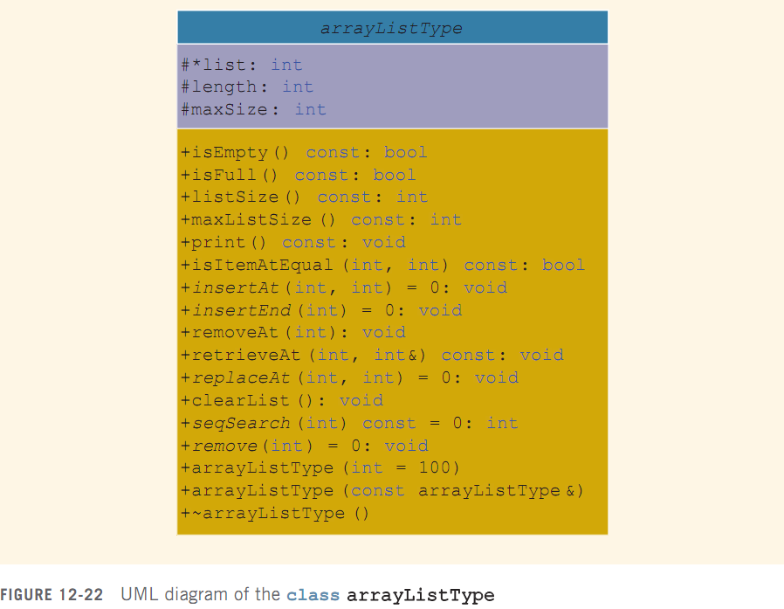
Array Based Lists (cont’d.)
C++ Programming: Program Design Including Data Structures, Sixth Edition

Slide 42
Unordered Lists
unorderedArrayListType class derived from class arrayListType
Implements insertAt, insertEnd, replaceAt, seqSearch, insert, and remove
Note that elements of a list need not be distinct
  Unlike a set, which does not allow duplicates
C++ Programming: Program Design Including Data Structures, Sixth Edition

Slide 43
Ordered Lists
orderedArrayListType class derived from class arrayListType
Elements are in ascending order
C++ Programming: Program Design Including Data Structures, Sixth Edition

Slide 44
Address of Operator and Classes
& operator can create aliases to an object
Example:
int x;
int &y = x;
x and y refer to the same memory location
y is like a constant pointer variable
  y = 25; sets the value of y (and of x) to 25
  x = 2 * x + 30; updates value of x and y
C++ Programming: Program Design Including Data Structures, Sixth Edition

Slide 45
Address of Operator and Classes (cont’d.)
Address of operator can also be used to return the address of a private member variable of a class
  However, if you are not careful, this operation can result in serious errors in the program
C++ Programming: Program Design Including Data Structures, Sixth Edition

Slide 46
Summary
Pointer variables contain the addresses of other variables as their values
  Declare a pointer variable with an asterisk, *, between the data type and the variable
  Address of operator (&)returns the address of its operand
  Unary operator * is the dereferencing operator
  Member access operator (->) accesses the object component pointed to by a pointer
C++ Programming: Program Design Including Data Structures, Sixth Edition

Slide 47
Summary (cont’d.)
Dynamic variable: created during execution
  Created using new, deallocated using delete
Shallow copy: two or more pointers of the same type point to the same memory
Deep copy: two or more pointers of the same type have their own copies of the data
Binding of virtual functions occurs at execution time (dynamic or run-time binding)
C++ Programming: Program Design Including Data Structures, Sixth Edition

