Slide 1
Chapter 20:
Graphs

Slide 2
Objectives
In this chapter, you will:
Learn about graphs
Learn the basic terminology of graph theory
Represent graphs in computer memory
Explore graphs as ADTs
C++ Programming: Program Design Including Data Structures, Sixth Edition

Slide 3
Objectives (cont’d.)
Examine and implement various graph traversal algorithms
Implement the shortest path algorithm
Implement the minimal spanning tree algorithm
C++ Programming: Program Design Including Data Structures, Sixth Edition

Slide 4
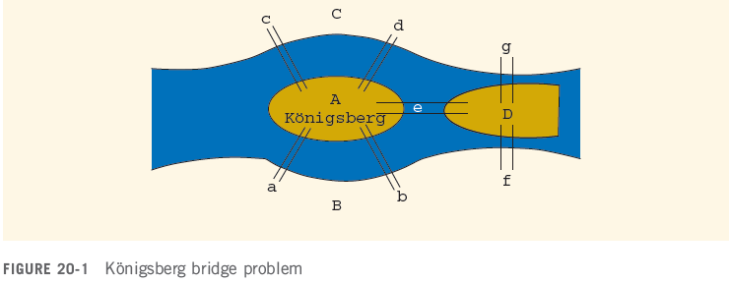
Introduction
Königsberg bridge problem:
  The river Pregel flows around the island Kneiphof and then divides into two branches
C++ Programming: Program Design Including Data Structures, Sixth Edition

Slide 5
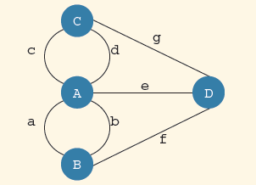
Introduction (cont’d.)
Starting at one land area, can you cross all bridges exactly once and return to the start?
  In 1736, Euler represented the problem as a graph and answered the question: No
C++ Programming: Program Design Including Data Structures, Sixth Edition

Slide 6
Introduction (cont’d.)
Over the past 200 years, graph theory has been applied to a variety of problems, including:
  Model electrical circuits, chemical compounds, highway maps, etc.
  Analysis of electrical circuits, finding the shortest route, project planning, linguistics, genetics, social science, etc.
C++ Programming: Program Design Including Data Structures, Sixth Edition

Slide 7
Graph Definitions and Notations
a ∈ X: a is an element of the set X
Subset (Y ⊆ X): every element of Y is also an element of X
Intersection (A ∩ B): contains all the elements in A and B
  A ∩ B = {x | x ∈ A and x ∈ B}
Union (A ∪ B): set of all the elements that are in A or in B
  A ∪ B = {x | x ∈ A or x ∈ B}
C++ Programming: Program Design Including Data Structures, Sixth Edition

Slide 8
Graph Definitions and Notations (cont’d.)
A × B: set of all the ordered pairs of elements of A and B
  A × B = {(a, b) | a ∈ A, b ∈ B}
Graph G: G = (V, E)
  V is a finite nonempty set of vertices of G
  E ⊆ V × V
  Elements in E are the pairs of elements of V
  E is called set of edges
C++ Programming: Program Design Including Data Structures, Sixth Edition

Slide 9
Graph Definitions and Notations (cont’d.)
Directed graph or digraph: elements of E(G) are ordered pairs
Undirected graph: elements not ordered pairs
If (u, v) is an edge in a directed graph
  Origin: u
  Destination: v
Subgraph H of G: if V(H) ⊆ V(G) and E(H) ⊆ E(G)
  Every vertex and edge of V is in G
C++ Programming: Program Design Including Data Structures, Sixth Edition

Slide 10
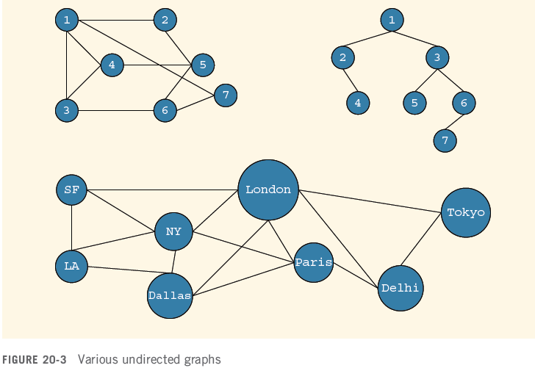
Graph Definitions and Notations (cont’d.)
C++ Programming: Program Design Including Data Structures, Sixth Edition

Slide 11
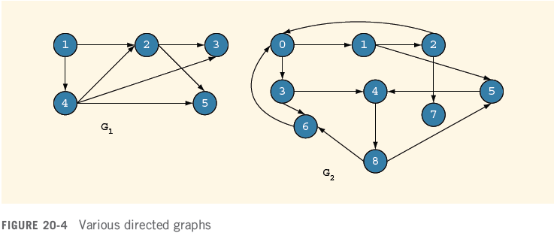
Graph Definitions and Notations (cont’d.)
C++ Programming: Program Design Including Data Structures, Sixth Edition

Slide 12
Graph Definitions and Notations (cont’d.)
Adjacent: there is an edge from one vertex to the other; i.e., (u, v) ∈ E(G)
Incident: if edge e = (u, v) then e is incident on u and v
  Loop: edge incident on a single vertex
Parallel edges: associated with the same pair of vertices
Simple graph: has no loops or parallel edges
C++ Programming: Program Design Including Data Structures, Sixth Edition

Slide 13
Graph Definitions and Notations (cont’d.)
Path: sequence of vertices u₁, u₂, ..., u_{n} such that u = u₁, u_{n} = v, and (u_{i}, u_{i + 1}) is an edge for all i = 1, 2, ..., n − 1
Connected vertices: there is a path from u to v
Simple path: path in which all vertices, except possibly the first and last, are distinct
  Cycle: simple path in which the first and last vertices are the same
C++ Programming: Program Design Including Data Structures, Sixth Edition

Slide 14
Graph Definitions and Notations (cont’d.)
Connected: path exists from any vertex to any other vertex
  Component: maximal subset of connected vertices
In a connected graph G, if there is an edge from u to v, i.e., (u, v) ∈ E(G), then u is adjacent to v and v is adjacent from u
Strongly connected: any two vertices in G are connected
C++ Programming: Program Design Including Data Structures, Sixth Edition

Slide 15
Graph Representations
To write programs that process and manipulate graphs
  Must store graphs in computer memory
A graph can be represented in several ways:
  Adjacency matrices
  Adjacency lists
C++ Programming: Program Design Including Data Structures, Sixth Edition

Slide 16

Adjacency Matrix
G: graph with n vertices (n > 0)
  V(G) = {v₁, v₂, ..., v_{n}}
Adjacency matrix (A_{G} of G): two-dimensional n × n matrix such that:
Adjacency matrix of an undirected graph is symmetric
C++ Programming: Program Design Including Data Structures, Sixth Edition

Slide 17
Adjacency Lists
G: graph with n vertices (n > 0)
  V(G) = {v₁, v₂, ..., v_{n}}
Linked list corresponding to each vertex, v,
  Each node of linked list contains the vertex, u, such that (u,v) ∈ E(G)
  Each node has two components, such as vertex and link
C++ Programming: Program Design Including Data Structures, Sixth Edition

Slide 18
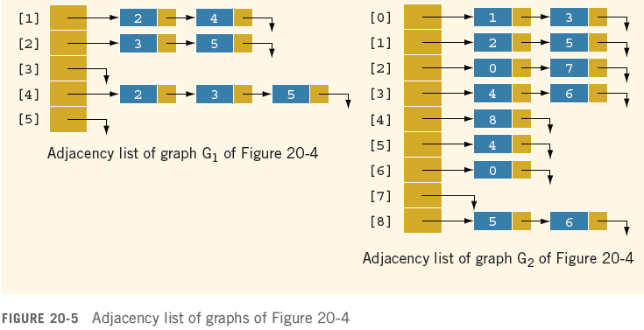
Adjacency Lists (cont’d.)
C++ Programming: Program Design Including Data Structures, Sixth Edition

Slide 19
Operations on Graphs
Operations commonly performed on a graph:
  Create the graph
  Clear the graph
    Makes the graph empty
  Determine whether the graph is empty
  Traverse the graph
  Print the graph
C++ Programming: Program Design Including Data Structures, Sixth Edition

Slide 20
Operations on Graphs (cont’d.)
The adjacency list (linked list) representation:
  For each vertex, v, vertices adjacent to v are stored in linked list associated with v
    In a directed graph, vertices adjacent to v are called immediate successors
  To manage data in a linked list, use class unorderedLinkedList
C++ Programming: Program Design Including Data Structures, Sixth Edition

Slide 21
Graphs as ADTs
We implement graphs as an abstract data type (ADT), including functions to:
  Create/clear the graph
  Print the graph
  Traverse the graph
  Determine the graph’s size
C++ Programming: Program Design Including Data Structures, Sixth Edition

Slide 22
Graph Traversals
Traversing a graph is similar to traversing a binary tree, except that:
  A graph might have cycles
  Might not be able to traverse the entire graph from a single vertex
Most common graph traversal algorithms:
  Depth first traversal
  Breadth first traversal
C++ Programming: Program Design Including Data Structures, Sixth Edition

Slide 23
Depth First Traversal
Depth first traversal at a given node, v:
  Mark node v as visited
  Visit the node
  for each vertex u adjacent to v
  if u is not visited
  start the depth first traversal at u
This is a recursive algorithm
C++ Programming: Program Design Including Data Structures, Sixth Edition

Slide 24
Breadth First Traversal
Breadth first traversal of a graph
  Similar to traversing a binary tree level by level
  Nodes at each level are visited from left to right
Starting at the first vertex, the graph is traversed as much as possible
  Then go to next vertex not yet visited
Use a queue to implement the breadth first search algorithm
C++ Programming: Program Design Including Data Structures, Sixth Edition

Slide 25
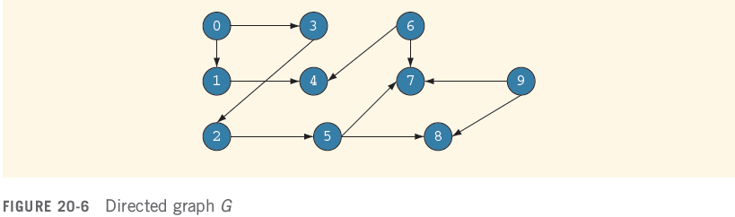
Depth First Traversal (cont’d.)
Depth-first ordering of vertices:
  0, 1, 4, 3, 2, 5, 7, 8, 6, 9
Breadth-first ordering of vertices:
  0, 1, 3, 4, 2, 5, 7, 8, 6, 9
C++ Programming: Program Design Including Data Structures, Sixth Edition

Slide 26
Shortest Path Algorithm
Weight of the edge: nonnegative real number assigned to the edges connecting two vertices
Weighted graph: every edge has a nonnegative weight
Weight of the path P
  Sum of the weights of all edges on the path P
  Also called the weight of v from u via P
Source: starting vertex in the path
C++ Programming: Program Design Including Data Structures, Sixth Edition

Slide 27
Shortest Path Algorithm (cont’d.)
Shortest path: path with the smallest weight
Shortest path algorithm
  Called the greedy algorithm, developed by Dijkstra
  G: graph with n vertices, where n ≥ 0
  V(G) = {v₁, v₂, ..., v_{n}}
  W: two-dimensional n × n matrix
C++ Programming: Program Design Including Data Structures, Sixth Edition

Slide 28
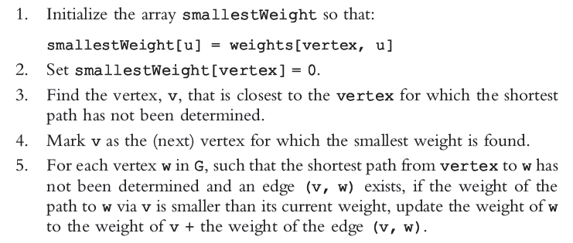
Shortest Path Algorithm (cont’d.)
Shortest path algorithm:
C++ Programming: Program Design Including Data Structures, Sixth Edition

Slide 29
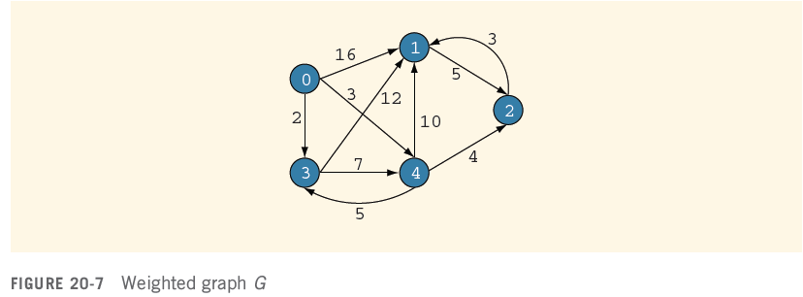
Shortest Path Algorithm (cont’d.)
C++ Programming: Program Design Including Data Structures, Sixth Edition

Slide 30
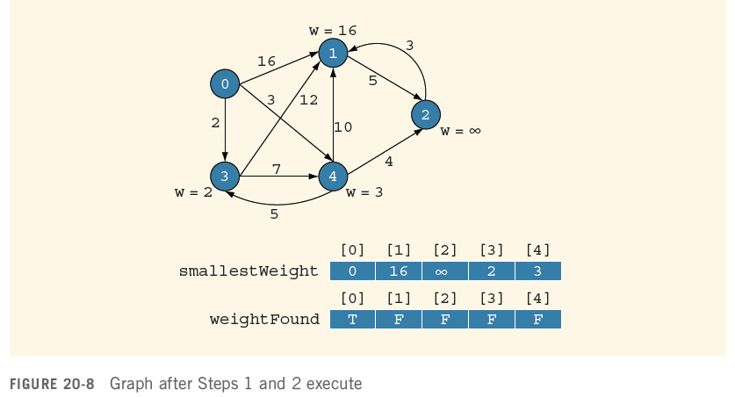
Shortest Path Algorithm (cont’d.)
C++ Programming: Program Design Including Data Structures, Sixth Edition

Slide 31
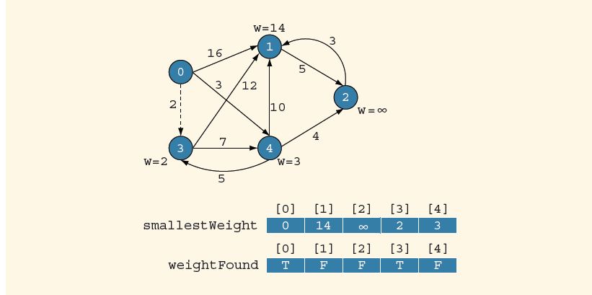
Shortest Path Algorithm (cont’d.)
Graph after first iteration of Steps 3, 4, and 5
C++ Programming: Program Design Including Data Structures, Sixth Edition

Slide 32
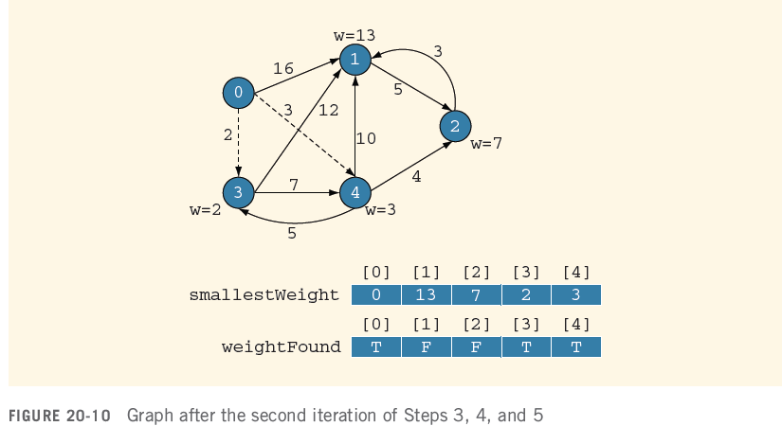
Shortest Path Algorithm (cont’d.)
Graph after second iteration of Steps 3, 4, and 5
C++ Programming: Program Design Including Data Structures, Sixth Edition

Slide 33
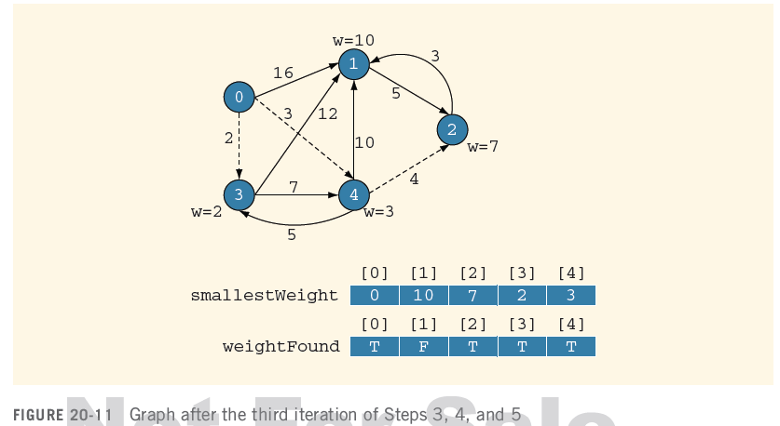
Shortest Path Algorithm (cont’d.)
Graph after third iteration of Steps 3, 4, and 5
C++ Programming: Program Design Including Data Structures, Sixth Edition

Slide 34
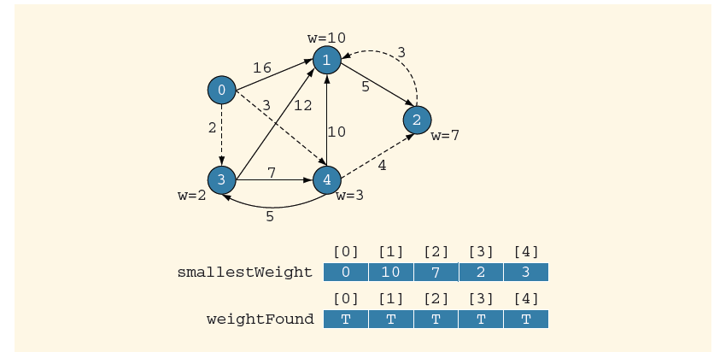
Shortest Path Algorithm (cont’d.)
Graph after fourth iteration of Steps 3, 4, and 5
C++ Programming: Program Design Including Data Structures, Sixth Edition

Slide 35
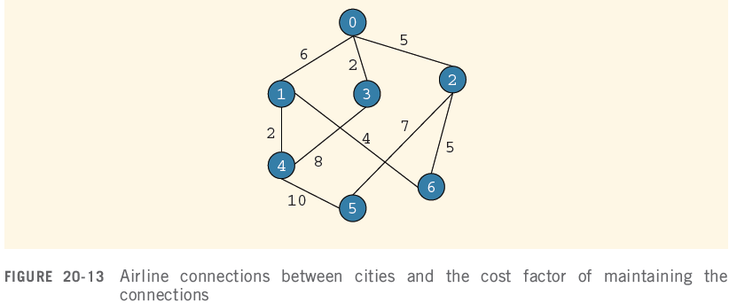
Minimal Spanning Tree
Company needs to shut down a maximum number of connections and still be able to fly from one city to another
C++ Programming: Program Design Including Data Structures, Sixth Edition

Slide 36
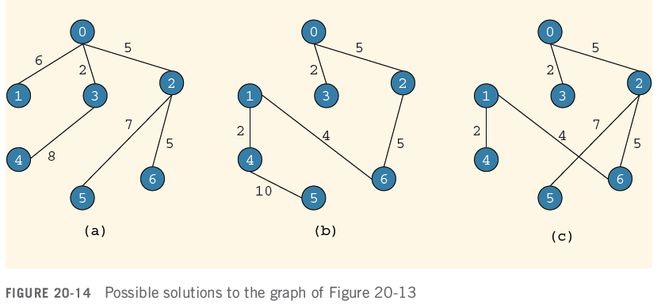
Minimal Spanning Tree (cont’d.)
C++ Programming: Program Design Including Data Structures, Sixth Edition

Slide 37
Minimal Spanning Tree (cont’d.)
(Free) tree: simple graph such that if u and v are two vertices in T, then there is a unique path from u to v
Rooted tree: tree in which a particular vertex is designated as a root
Weighted tree: tree in which a weight is assigned to the edges
  Weight of T: sum of the weights of all the edges in T, denoted by W(T)
C++ Programming: Program Design Including Data Structures, Sixth Edition

Slide 38
Minimal Spanning Tree (cont’d.)
Spanning tree of graph G: if T is a subgraph of G such that V(T) = V(G)
  All the vertices of G are in T
  Figure 20-14 shows three spanning trees of the graph shown in Figure 20-13
Theorem: a graph G has a spanning tree if and only if G is connected
Minimal spanning tree: spanning tree in a weighted graph with the minimum weight
C++ Programming: Program Design Including Data Structures, Sixth Edition

Slide 39
Minimal Spanning Tree (cont’d.)
Two well-known algorithms to find a minimal spanning tree:
  Kruskal’s algorithm
  Prim’s algorithm
    Builds the tree iteratively by adding edges until a minimal spanning tree is obtained
    Start with a designated vertex, called the source vertex
    At each iteration, a new edge that does not complete a cycle is added to the tree
C++ Programming: Program Design Including Data Structures, Sixth Edition

Slide 40
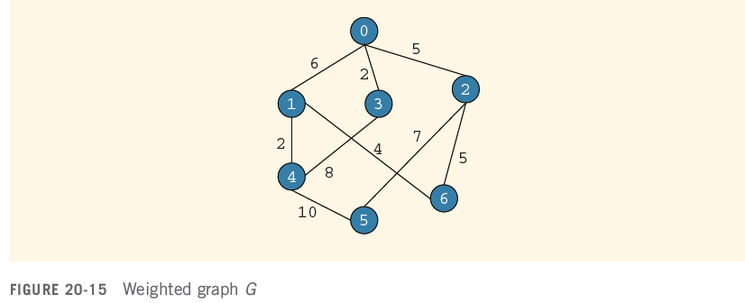
Minimal Spanning Tree (cont’d.)
C++ Programming: Program Design Including Data Structures, Sixth Edition

Slide 41
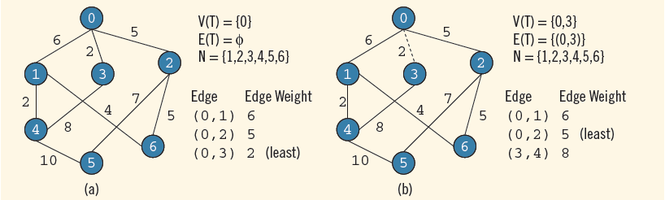
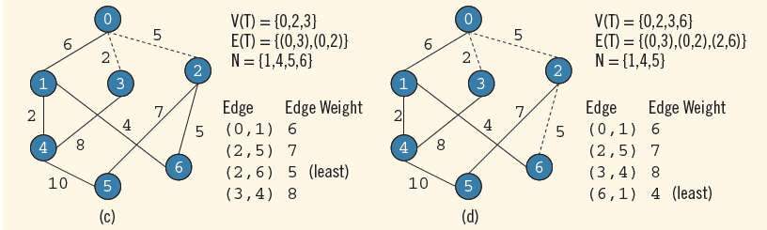
Prim’s Algorithm to Find a Minimal Spanning Tree
C++ Programming: Program Design Including Data Structures, Sixth Edition

Slide 42
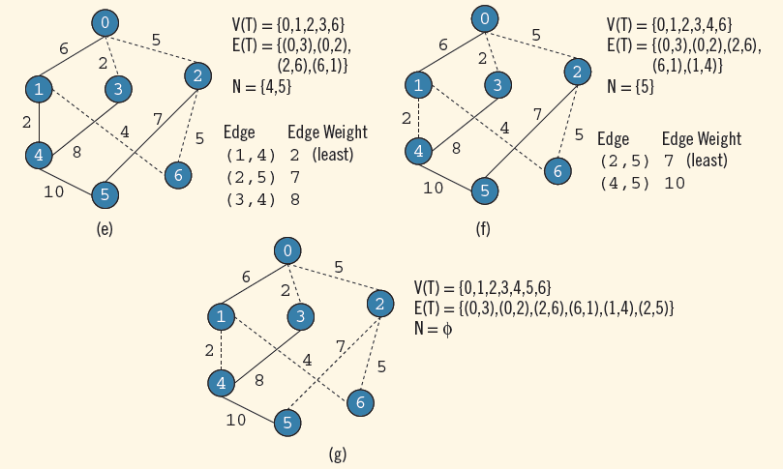
Prim’s Algorithm to Find a Minimal Spanning Tree (cont’d.)
C++ Programming: Program Design Including Data Structures, Sixth Edition

Slide 43
Summary
A graph G is a pair, G = (V, E)
In an undirected graph G = (V, E), the elements of E are unordered pairs
In a directed graph G = (V, E), the elements of E are ordered pairs
H is a subgraph of G if every vertex of H is a vertex of G and every edge is an edge in G
Two vertices in an undirected graph are adjacent if there is an edge between them
C++ Programming: Program Design Including Data Structures, Sixth Edition

Slide 44
Summary (cont’d.)
Loop: an edge incident on a single vertex
Simple graph: no loops and no parallel edges
Simple path: all the vertices, except possibly the first and last vertices, are distinct
Cycle: a simple path in which the first and last vertices are the same
An undirected graph is connected if there is a path from any vertex to any other vertex
C++ Programming: Program Design Including Data Structures, Sixth Edition

Slide 45
Summary (cont’d.)
Shortest path algorithm gives the shortest distance for a given node to every other node in the graph
In a weighted graph, every edge has a nonnegative weight
A tree in which a particular vertex is designated as a root is called a rooted tree
A tree T is called a spanning tree of graph G if T is a subgraph of G such that V(T) = V(G)
C++ Programming: Program Design Including Data Structures, Sixth Edition

