Slide 1
Chapter 21:
Standard Template Library (STL)

Slide 2
Objectives
In this chapter, you will:
Learn about the Standard Template Library (STL)
Explore the basic components of the STL: containers, iterators, and algorithms
Use containers to manipulate data in a program
Use iterators
Learn about various generic algorithms
C++ Programming: Program Design Including Data Structures, Sixth Edition

Slide 3
Introduction
ANSI/ISO Standard C++ is equipped with a Standard Template Library (STL)
STL includes class templates to process lists, stacks, and queues
This chapter:
  Discusses many important features of the STL
  Shows how to use its tools
C++ Programming: Program Design Including Data Structures, Sixth Edition

Slide 4
Components of the STL
Components of the STL:
  Containers
  Iterators
  Algorithms
Containers and iterators: class templates
Iterators: used to step through the elements of a container
Algorithms: used to manipulate data
C++ Programming: Program Design Including Data Structures, Sixth Edition

Slide 5
Container Types
Manage objects of a given type
Three categories:
  Sequence (sequential) containers
  Associative containers
  Container adapters
C++ Programming: Program Design Including Data Structures, Sixth Edition

Slide 6
Sequence Containers
Sequence container: every object in the container has a specific position
Three predefined sequence containers:
  vector
  deque
  list
C++ Programming: Program Design Including Data Structures, Sixth Edition

Slide 7
Sequence Container: vector
Stores and manages its objects in a dynamic array
Must use: #include <vector>
To define an object of type vector, specify the type of the object
  Examples:
    vector<int> intList;
    vector<string> stringList;
vector contains several constructors
C++ Programming: Program Design Including Data Structures, Sixth Edition

Slide 8
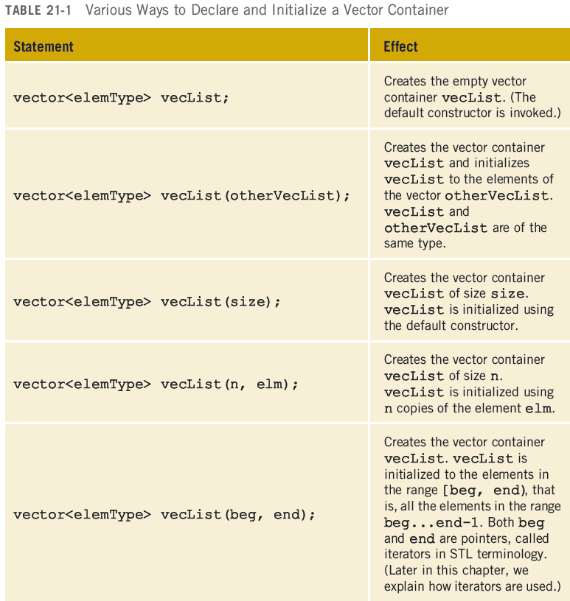
Sequence Container: vector (cont’d.)
C++ Programming: Program Design Including Data Structures, Sixth Edition

Slide 9
Sequence Container: vector (cont’d.)
Basic vector operations:
  Item insertion
  Item deletion
  Stepping through the elements
Vector elements can be processed just as they can in an array
C++ Programming: Program Design Including Data Structures, Sixth Edition

Slide 10
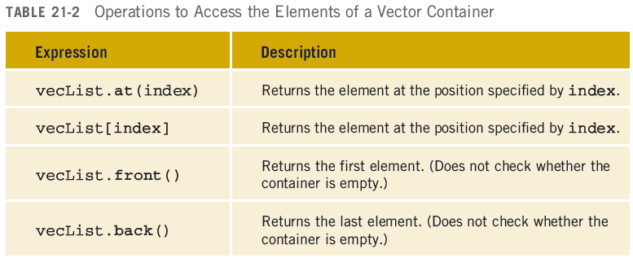
Sequence Container: vector (cont’d.)
C++ Programming: Program Design Including Data Structures, Sixth Edition

Slide 11
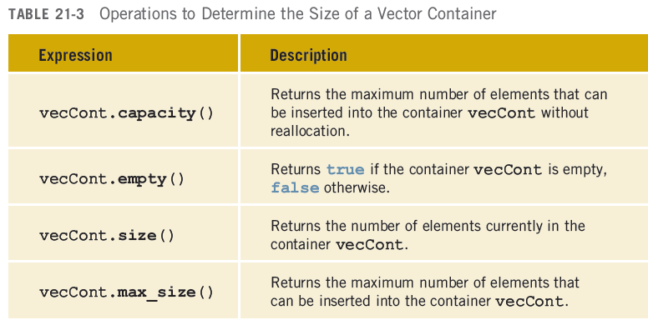
Sequence Container: vector (cont’d.)
C++ Programming: Program Design Including Data Structures, Sixth Edition

Slide 12
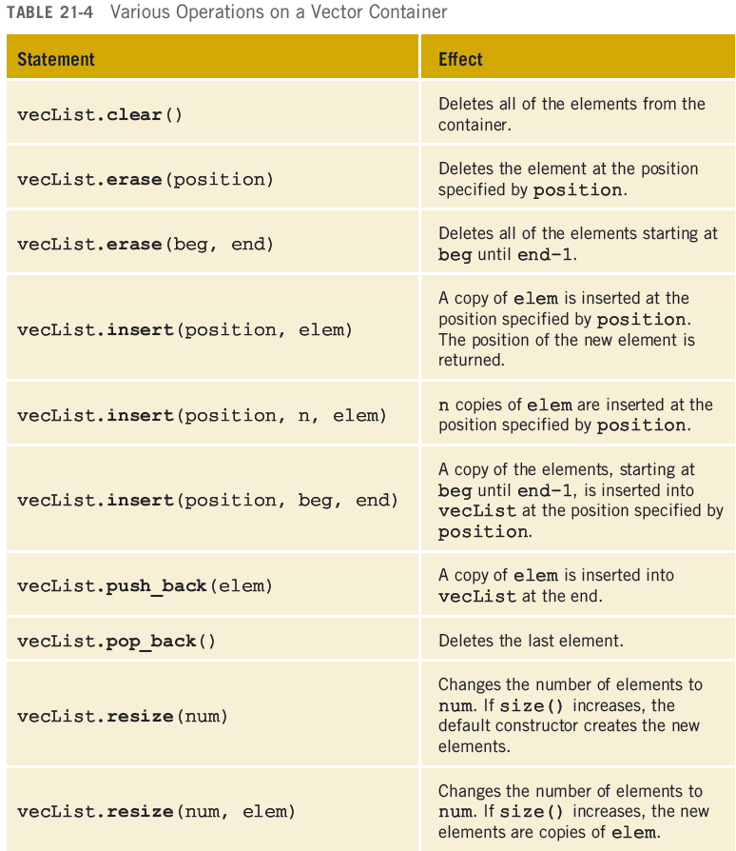
Sequence Container: vector (cont’d.)
C++ Programming: Program Design Including Data Structures, Sixth Edition

Slide 13
Declaring an Iterator to a
Vector Container
A vector contains a typedef iterator
Examples:
  vector<int>::iterator intVecIter;
  Declares intVecIter to be an iterator into a vector container of type int
++intVecIter
  Advances the iterator
  *intVecIter
  Returns element at current iterator position
C++ Programming: Program Design Including Data Structures, Sixth Edition

Slide 14
Containers and the
Functions begin and end
Every container contains member functions:
  begin: returns the position of the first element
  end: returns the position of the last element
Both functions have no parameters
C++ Programming: Program Design Including Data Structures, Sixth Edition

Slide 15
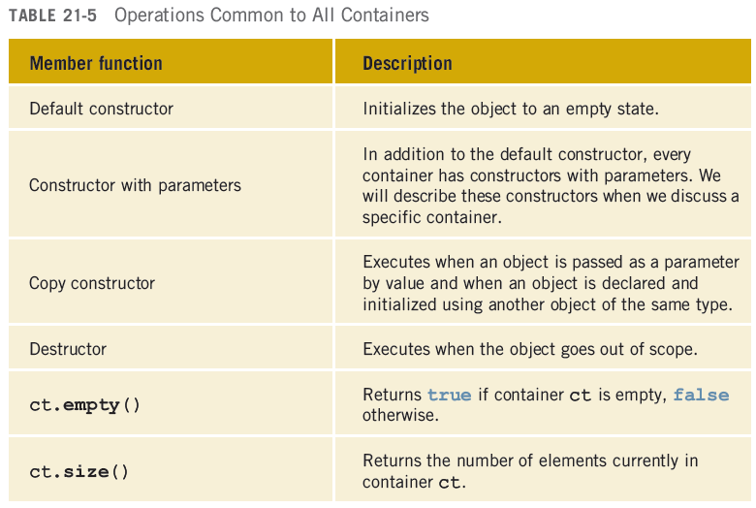
Member Functions Common to All Containers
C++ Programming: Program Design Including Data Structures, Sixth Edition

Slide 16
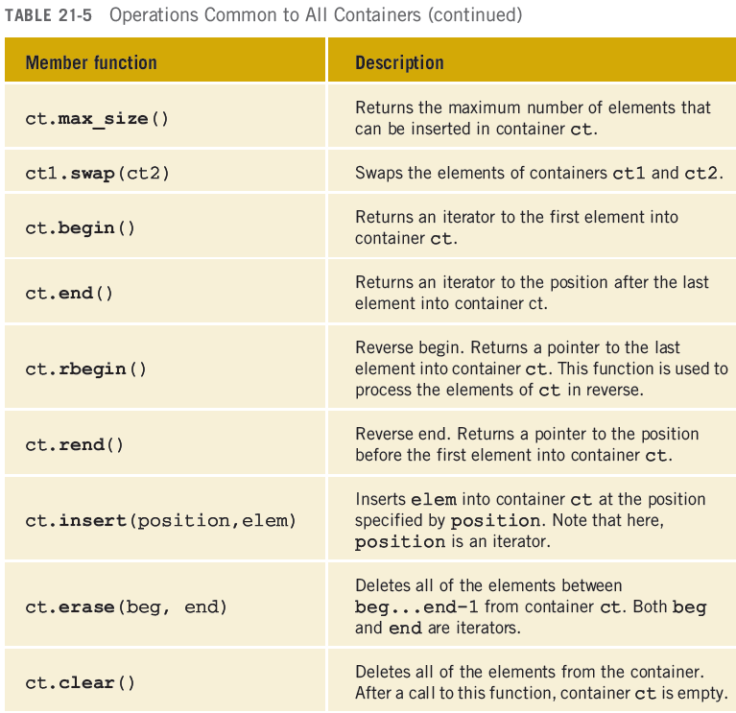
Member Functions Common to All Containers (cont’d.)
C++ Programming: Program Design Including Data Structures, Sixth Edition

Slide 17

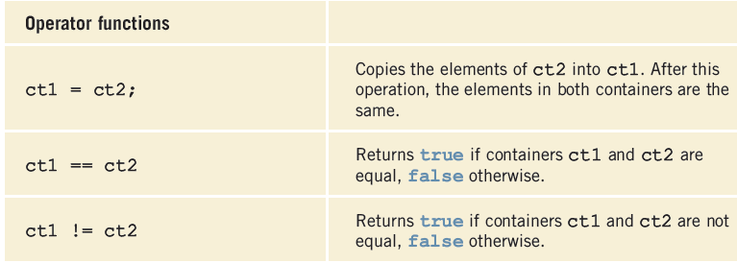
Member Functions Common to All Containers (cont’d.)
C++ Programming: Program Design Including Data Structures, Sixth Edition

Slide 18
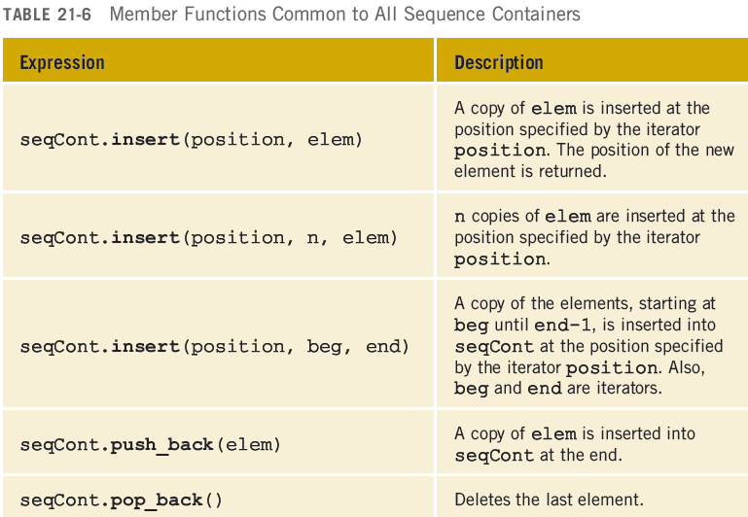
Member Functions Common to Sequence Containers
C++ Programming: Program Design Including Data Structures, Sixth Edition

Slide 19
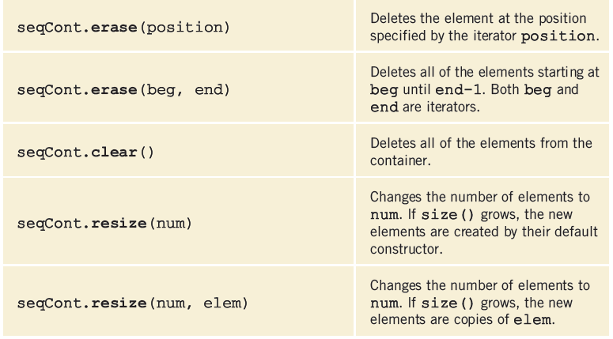
Member Functions Common to Sequence Containers (cont’d.)
C++ Programming: Program Design Including Data Structures, Sixth Edition

Slide 20
The copy Algorithm
Function copy: convenient way to output the elements of a container
Copies elements from one place to another
  Can output the elements of a vector
Prototype:
  Copies elements within range first1...last-1
Must use: #include <algorithm>
C++ Programming: Program Design Including Data Structures, Sixth Edition

Slide 21
The ostream Iterator and the Function copy
copy can output a container using an iterator
  Iterator of type ostream specifies destination
When creating an iterator of type ostream:
  Specify the type of element that the iterator will output
C++ Programming: Program Design Including Data Structures, Sixth Edition

Slide 22
Sequence Container: deque
deque: double-ended queue
  Implemented as dynamic arrays
A deque can expand in either direction
  Elements can be inserted at both ends and in the middle
Must use #include <deque>
class deque has several constructors
C++ Programming: Program Design Including Data Structures, Sixth Edition

Slide 23
Sequence Container: list
List containers are implemented as doubly linked lists
  Every element in a list points to immediate predecessor and immediate successor
  Except the first and last element
Linked list is not a random access data structure
class list has several constructors
C++ Programming: Program Design Including Data Structures, Sixth Edition

Slide 24
Iterators
Iterator: points to the elements of a container (sequence or associative)
  provide access to each element
Most common operations on iterators
  ++ (increment)
  * (dereference)
C++ Programming: Program Design Including Data Structures, Sixth Edition

Slide 25
Types of Iterators
Input iterators:
  Have read access; step forward element-by-element
Output iterators:
  Have write access; step forward element-by-element
Forward iterators:
  Have all functionality of input and almost all of output iterators
C++ Programming: Program Design Including Data Structures, Sixth Edition

Slide 26
Types of Iterators (cont’d.)
Bidirectional iterators:
  Can go backward
Random access iterators:
  Bidirectional iterators that can randomly process the elements of a container
C++ Programming: Program Design Including Data Structures, Sixth Edition

Slide 27
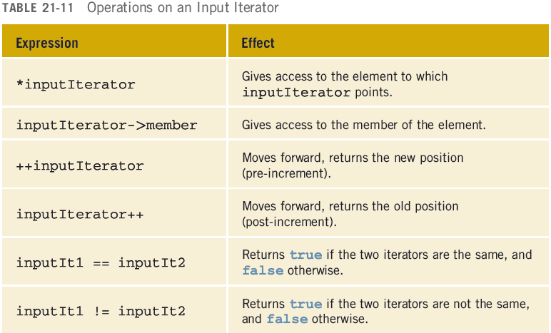
Input Iterators
C++ Programming: Program Design Including Data Structures, Sixth Edition

Slide 28
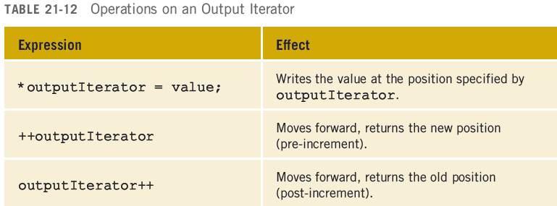
Output Iterators
Output iterators cannot be used to iterate over a range twice
C++ Programming: Program Design Including Data Structures, Sixth Edition

Slide 29
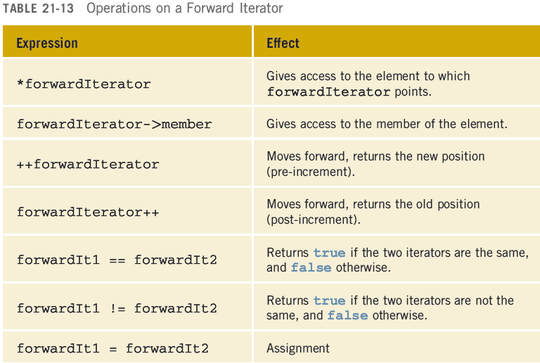
Forward Iterators
C++ Programming: Program Design Including Data Structures, Sixth Edition

Slide 30
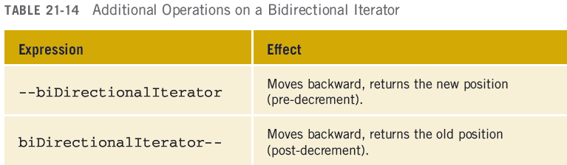
Bidirectional Iterators
Bidirectional iterator: a forward iterator that can also iterate backward over the elements
  The operations defined for forward iterators apply to bidirectional iterators
Use the decrement operator to step backward
C++ Programming: Program Design Including Data Structures, Sixth Edition

Slide 31
Random Access Iterators
Random access iterator: a bidirectional iterator that can randomly process elements of the container
  Can be used with containers of the types vector, deque, string, as well as arrays
  Operations defined for bidirectional iterators apply to random access iterators
C++ Programming: Program Design Including Data Structures, Sixth Edition

Slide 32
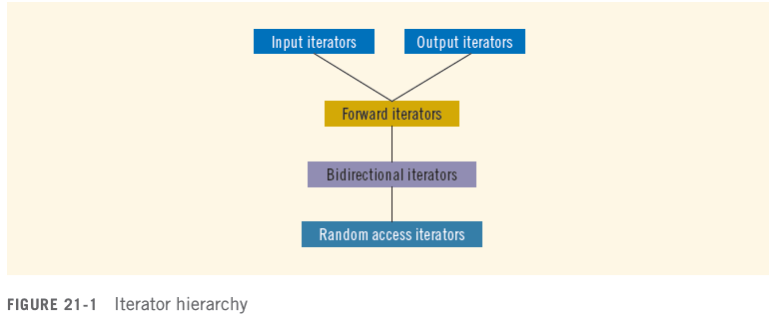
Types of Iterators (redux)
C++ Programming: Program Design Including Data Structures, Sixth Edition

Slide 33
typedef iterator
Every container contains a typedef iterator
  Used to declare the iterator
Example:
  vector<int>::iterator intVecIter;
declares intVecIter to be an iterator into a vector container of the type int
C++ Programming: Program Design Including Data Structures, Sixth Edition

Slide 34
typedef const_iterator
Use an iterator and the dereference operator, *, to modify the elements of the container
Every container also contains typedef const_iterator to prevent the iterator from modifying the elements of a const container
C++ Programming: Program Design Including Data Structures, Sixth Edition

Slide 35
typedef reverse_iterator
Every container also contains the typedef reverse_iterator
Used to iterate through the elements of a container in reverse
C++ Programming: Program Design Including Data Structures, Sixth Edition

Slide 36
typedef const_reverse_iterator
Read-only iterator
Used to iterate through the elements of a container in reverse
Required if the container is declared as const, and need to iterate through the elements of the container in reverse
C++ Programming: Program Design Including Data Structures, Sixth Edition

Slide 37
Stream Iterators
istream_iterator
  Used to input data into a program from an input stream
ostream_iterator
  Used to output data into an output stream
C++ Programming: Program Design Including Data Structures, Sixth Edition

Slide 38
Associative Containers
Associative container: stores elements automatically sorted according to some ordering criteria
  Default criteria: < (less than)
Predefined associative containers in the STL:
  Sets
  Multisets
  Maps
  Multimaps
C++ Programming: Program Design Including Data Structures, Sixth Edition

Slide 39
Associative Containers: set and multiset
Associative containers set and multiset automatically sort elements in ascending order
  multiset allows duplicates; set does not
Default sorting criterion is < (less than)
  Ascending order
Must use #include <set>
See Tables 21-17 and 21-18 in text
C++ Programming: Program Design Including Data Structures, Sixth Edition

Slide 40
Container Adapters
Container adapters: containers to accommodate special situations
Three container adapters:
  Stacks
  Queues
  Priority Queues
Do not support any type of iterator
C++ Programming: Program Design Including Data Structures, Sixth Edition

Slide 41
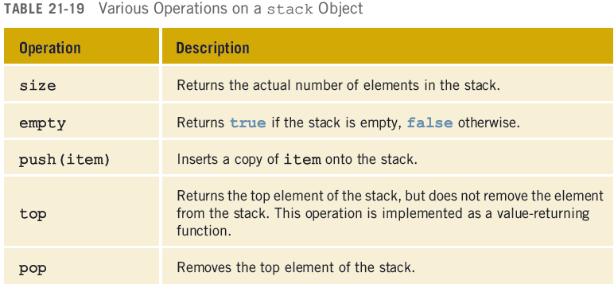
Stack
The STL provides a stack class
C++ Programming: Program Design Including Data Structures, Sixth Edition

Slide 42
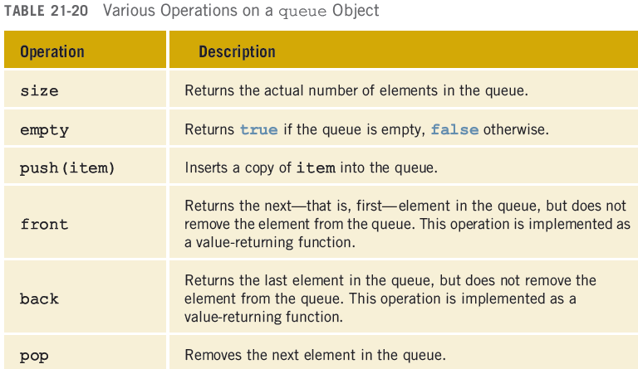
Queue
C++ Programming: Program Design Including Data Structures, Sixth Edition

Slide 43
Containers, Associated Header Files, and Iterator Support
Every container is a class
Definition of the class implementing a specific container is contained in the header file
See Table 21-21 in text
C++ Programming: Program Design Including Data Structures, Sixth Edition

Slide 44
Algorithms
Several operations can be defined for a container
  Some are very specific to a container; are provided as part of the container definition
  Other operations are common to all containers
Generic algorithms contained in the header file algorithm
C++ Programming: Program Design Including Data Structures, Sixth Edition

Slide 45
STL Algorithm Classification
Operations such as clear, sort, and merge are common to all containers
  Provided as generic algorithms
STL algorithm classifications:
  Nonmodifying algorithms
  Modifying algorithms
  Numeric algorithms
  Heap algorithms
C++ Programming: Program Design Including Data Structures, Sixth Edition

Slide 46
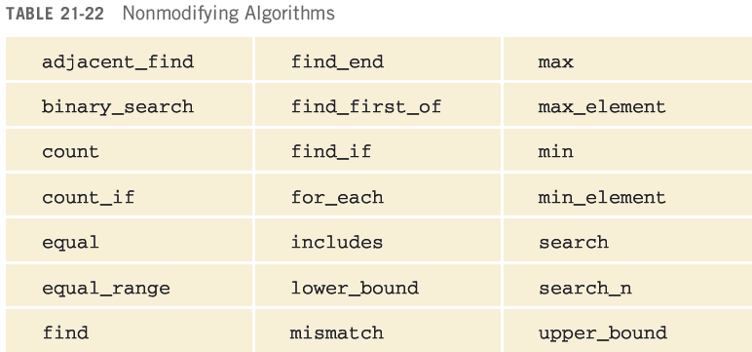
Nonmodifying Algorithms
Nonmodifying algorithms: do not modify the elements of the container
C++ Programming: Program Design Including Data Structures, Sixth Edition

Slide 47
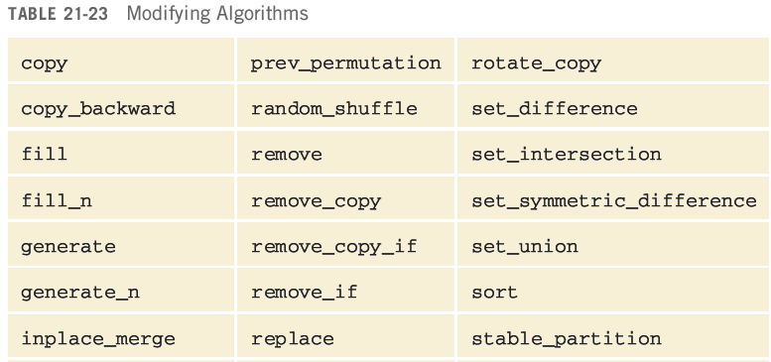
Modifying Algorithms
Modifying algorithms: do modify the elements of the container
C++ Programming: Program Design Including Data Structures, Sixth Edition

Slide 48
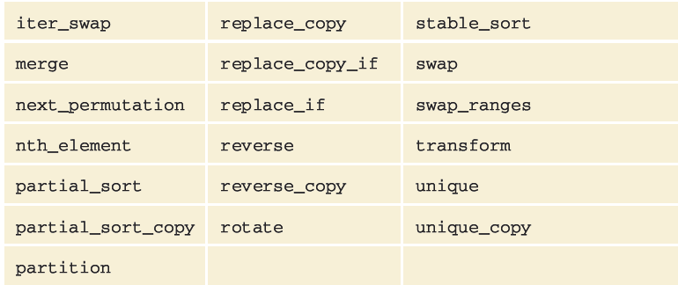
Modifying Algorithms (cont’d.)
C++ Programming: Program Design Including Data Structures, Sixth Edition

Slide 49
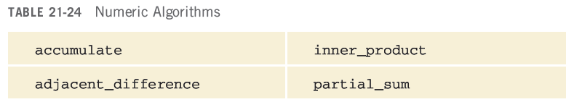
Numeric Algorithms
Perform numeric calculations on elements of a container
C++ Programming: Program Design Including Data Structures, Sixth Edition

Slide 50
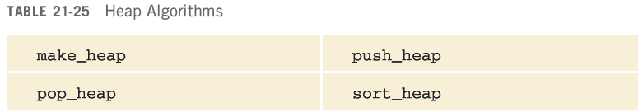
Heap Algorithms
Heap sort algorithm sorts array data
  Array containing the data is viewed as a binary tree
C++ Programming: Program Design Including Data Structures, Sixth Edition

Slide 51
Function Objects
To make a generic algorithm flexible, the STL usually provides two forms:
  Use the natural operation to accomplish the goal
  Specify criteria based on which algorithm processes the elements
Criteria are passed as a function object
C++ Programming: Program Design Including Data Structures, Sixth Edition

Slide 52
Function Objects (cont’d.)
Function object: contains a function that can be treated as such using the operator()
  Class template that overloads the function call operator
STL provides arithmetic, relational, and logical function objects
  Contained in the header file functional
  See Tables 21-26 through 21-28 in the text
Can also create your own
C++ Programming: Program Design Including Data Structures, Sixth Edition

Slide 53
Predicates
Predicates: special types of function objects that return Boolean values
Two types:
  Unary: check a property for a single argument
  Binary: check a specific property for a pair
Predicate must always return the same result for the same value
  Functions that modify their internal states cannot be considered predicates
C++ Programming: Program Design Including Data Structures, Sixth Edition

Slide 54
Insert Iterator
STL provides 3 insert iterators to insert elements at the desired destination
  back_inserter: uses push_back in place of = operator; the argument is the container
  front_inserter: uses push_front; argument is the container itself
    Cannot be used for the vector container
  inserter: uses insert operation; must pass container and an iterator specifying the position at which the insertion should begin
C++ Programming: Program Design Including Data Structures, Sixth Edition

Slide 55
STL Algorithms
STL algorithms include documentation with the function prototypes
The parameter types indicate for which type of container the algorithm is applicable
C++ Programming: Program Design Including Data Structures, Sixth Edition

Slide 56
The Functions fill and fill_n
Fill functions:
  fill: fills a container with elements
  fill_n: fills in the next n elements
    filling element is passed as a parameter
Defined in header file algorithm
C++ Programming: Program Design Including Data Structures, Sixth Edition

Slide 57
The Functions generate and generate_n
Generate functions:
  generate: fills a sequence
  generate_n: fills a sequence in a range
Defined in header file algorithm
C++ Programming: Program Design Including Data Structures, Sixth Edition

Slide 58
Find Functions
Find functions:
  find: searches for searchValue
  find_if: searched for element for which op(rangeElement) is true
  find_end: searches for last occurrence
  find_first_of: searches for first occurrence
C++ Programming: Program Design Including Data Structures, Sixth Edition

Slide 59
Remove Functions
Remove functions:
  remove: removes certain elements from a sequence
  remove_if: removes elements from a sequence by using some criteria
  remove_copy: copies all elements except those specified by value
  remove_copy_if: copies all elements except those for which op(element) is true
C++ Programming: Program Design Including Data Structures, Sixth Edition

Slide 60
Replace and Copy Functions
Replace and copy functions:
  replace: replaces all occurrences with given range
  replace_if: replaces all occurrences with given range satisfying some criteria
  replace_copy: combination of replace and copy
  replace_copy_if: combination of replace_if and copy_if
C++ Programming: Program Design Including Data Structures, Sixth Edition

Slide 61
Swap Functions
Swap functions:
  swap: swaps values of object1 and object2
  iter_swap: swaps values to which iterators first and second point
  swap_ranges: swaps one range of elements with another range of elements
C++ Programming: Program Design Including Data Structures, Sixth Edition

Slide 62
Search and Sort Functions
Search and sort functions:
  search: searches for a subrange
  search_n: searches count consecutive occurrences of value
  sort: reorders elements in a range in ascending order
  binary_search: returns true if searchValue is found in the range
C++ Programming: Program Design Including Data Structures, Sixth Edition

Slide 63
Functions adjacent_find, merge, and inplace_merge
adjacent_find: finds the first occurrence of consecutive elements that meet criteria
merge: merges sorted lists
inplace_merge: combines sorted consecutive sequences
C++ Programming: Program Design Including Data Structures, Sixth Edition

Slide 64
Reverse and Rotate Functions
Reverse and rotate functions:
  reverse: reverses element order in given range
  reverse_copy: reverses elements of a given range while copying into a destination range; the source is not modified
  rotate: rotates elements of a given range
  rotate_copy: combination of rotate and copy; elements of the source are copied at the destination in a rotated order
C++ Programming: Program Design Including Data Structures, Sixth Edition

Slide 65
Count, Min/Max, and Shuffle Functions
Count functions:
  count: counts occurrence of a given item in a given range
  count_if: counts occurrences of a given value in a given range satisfying a certain criterion
C++ Programming: Program Design Including Data Structures, Sixth Edition

Slide 66
Count, Min/Max, and Shuffle Functions (cont’d.)
Min/Max functions:
  min: determines the minimum of two values
  max: determines the maximum of two values
  max_element: determines the largest element in a given range
  min_element: determines the smallest element in a given range
C++ Programming: Program Design Including Data Structures, Sixth Edition

Slide 67
Count, Min/Max, and Shuffle Functions (cont’d.)
Shuffle function:
  random_shuffle: randomly orders elements
C++ Programming: Program Design Including Data Structures, Sixth Edition

Slide 68
for_each and transform Functions
for_each: accesses and processes each element in a given range by applying a function
transform: creates a sequence of elements at the destination by applying the unary operation to each element in the range
C++ Programming: Program Design Including Data Structures, Sixth Edition

Slide 69
Set Functions
Set functions:
  includes: determines if elements in one range appear in another range
  set_intersection: finds elements that are common to two ranges
  set_union: finds elements that are contained in two ranges of elements
  set_difference: finds elements in one range that are not in the other range
C++ Programming: Program Design Including Data Structures, Sixth Edition

Slide 70
Set Functions (cont’d.)
Set functions (cont’d.):
  set_symmetric_difference: creates a sequence of sorted elements that are in one range but not the other, in both directions
C++ Programming: Program Design Including Data Structures, Sixth Edition

Slide 71
Numerical Functions
Numerical functions:
  accumulate: finds the sum of all elements in a given range
  adjacent_difference: creates a sequence in which the first element is the same, and all other elements are the differences of the current and previous elements
  inner_product: multiplies corresponding elements of two ranges
C++ Programming: Program Design Including Data Structures, Sixth Edition

Slide 72
Numeric Functions (cont'd.)
Numerical functions (cont’d.):
  partial_sum: creates a sequence in which each element is the sum of all previous elements in the range
C++ Programming: Program Design Including Data Structures, Sixth Edition

Slide 73
Summary
STL consists of:
  Containers: class templates
  Iterators: step through the elements of a container
  Algorithms: manipulate the elements in a container
C++ Programming: Program Design Including Data Structures, Sixth Edition

Slide 74
Summary (cont’d.)
Containers
  Sequence: vector, deque, and list
  Associative: sets, multisets, maps, and multimaps
  Container adapters: stacks, queues, and priority queues
C++ Programming: Program Design Including Data Structures, Sixth Edition

Slide 75
Summary (cont’d.)
Iterators: input, output, forward, bidirectional, and random access iterator
Predicates: Boolean function objects
Algorithms: nonmodifying, modifying, numerical, and heap
  Algorithms are overloaded for flexibility
C++ Programming: Program Design Including Data Structures, Sixth Edition

