Slide 1
File Integrity Monitor

Slide 2
Contents
Introduction to the basic functionality of the software and justification for its existence.
Implementation details and screeshot(s).
Sources

Slide 3
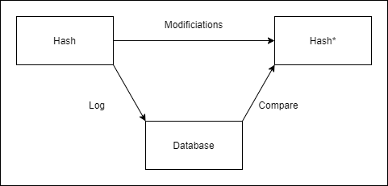
What does it do?
It is a software that logs and maintains a database of file hashes. The tool can be used for the purpose of monitoring file integrity.
Every time a file is modified its hash value is changed. If the hash value has changed, we can assume that the file has been modified in some way.
When a file is modified, we can compare its new hash to the previously logged hash value, to verify that it has been modified.
Basic operations

Slide 4
Where could it potentially be used?
Here are few ideas, where this software or the idea behind it could be used for:
It could be used to verify the integrity of the files downloaded from the internet. Malicious parties could try to modify downloaded files using man-in-the-middle attack.
It could be used by server databases to log the changes of the files stored in them. Can be used to expose unintended changes and malicious activity.
It could be used for the purpose of verification of file versions.

Slide 5
How is it implemented?
It is written using Python and JavaScript languages.
It uses Python eel architecture, which can be used to build user-interfaces using HTML.
The program is tested using Python’s unittest and JavaScript’s Mocha/Chai frameworks.
Currently calculates the hashes using SHA-1, however, this is just a placeholder solution.
Hashes are stored into a JSON a file.

Slide 6
Current Progress
Still a work in progress. Approximately 60 % away from the final version, with most of the backend features implemented and tested.
Can almost be considered the minimum viable product.
The frontend features are currently in progress.

Slide 7
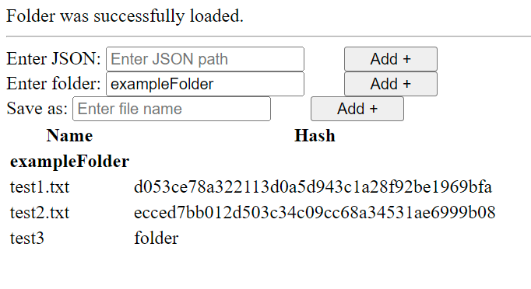
Screenshots
Current UI

Slide 8
Personal Criticisms of the Software
An attacker can currently modify the file hash and directly write the new hash to the JSON database, fooling the system. Can be avoided using encryption.
An attacker could modify the files and fool the software by calculating a colliding hash to the file. Can be achieved by adding malicious modifications to the file and modifying the file in some invisible area until the hash function calculates a matching hash. Can be avoided by using salting and stronger hashing methods.
These will be mitigated later.

Slide 9
Thank You!

Slide 10
Sources
https://www.logsign.com/blog/how-to-check-the-integrity-of-a-file/
https://www.imperva.com/learn/application-security/man-in-the-middle-attack-mitm/
https://www.beyondtrust.com/resources/glossary/file-integrity-monitoring
https://www.comparitech.com/blog/information-security/what-is-a-collision-attack/

