Slide 1

An Instruction Offloading PIM Architecture for Deep Learning Application
Group: Yi Ling, Siyu Mou, Jiayou Jin, Hao Peng, Kunyu Wu

Slide 2
Presentation Overview
• Today’s Content:
Background Introduction
Architecture Proposal
Implementation
Benchmark Comparison
Future Direction
2

Slide 3
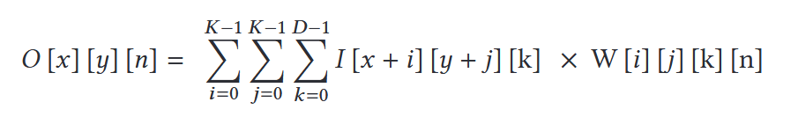
Background Introduction
Convolutional Neural Network (CNN) Basics
A CNN consists of multiple convolutional layers to learn the salient features and a few fully connected layers for classification
In a convolution layer, a large mount of multiply-and-accumulation (MAC) operations are taken during the computation process
Plus data needed to calculate often exceed the capacity of cache resulting in large amounts of data being read from the main memory (DRAM)
2

Slide 4
Background Introduction
Breaking the von Neumann bottleneck
Memory bandwidth limitation: CNNs need to handle large-scale matrix operations and data transfers, which often make memory bandwidth a system bottleneck.
High latency: The latency of retrieving data from main memory (typically at the nanosecond level) can significantly impact the inference and training speed of CNNs.
2

Slide 5
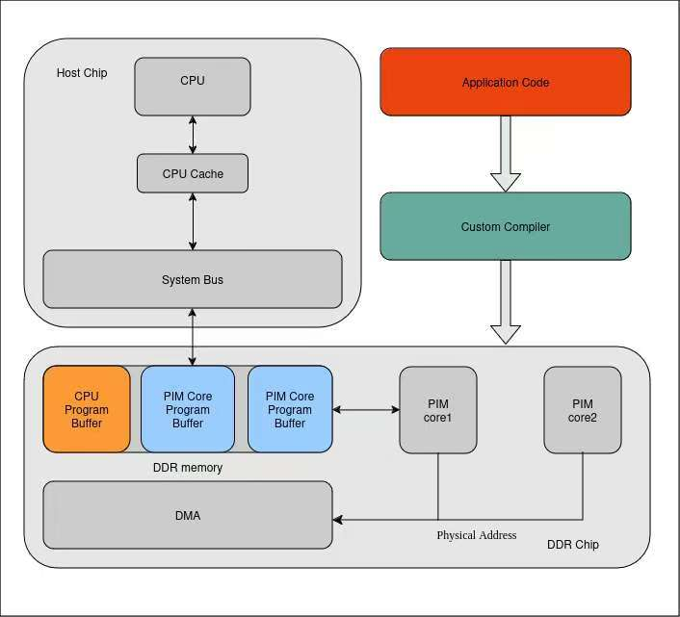
Architecture Proposal
Feature:
Instruction Offloading: Moving data intensive program to PIM cores through a custom compiler
Processing In Memory: By running program in DDRM chip, it will reduce the amount of loading and storing time of program
2

Slide 6
Implementation
ISA Design
Custom Compiler
Architecture Simulation
2

Slide 7
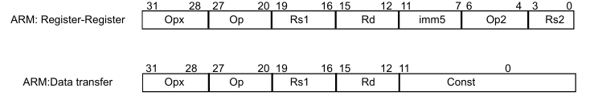
Implementation-ISA Design
Our basis: ARMv7 ISA
Register-Register: Its purpose is to perform operations on the data in the registers, usually without involving memory operations. Like: Add, Subtraction, Multiply, Division
Data Transfer: These instructions are used to load data from memory into registers, or to store data from registers into memory. Like: Load, Store.
2

Slide 8
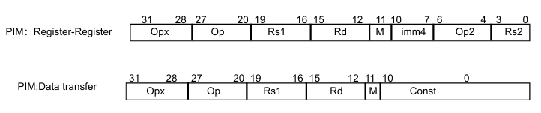
Implementation-ISA Design
Our PIM ISA:
For register-register operation
Opx (31-24): Operation extension field, specifies instruction categories or special operations.
Op (23-20): Opcode field, defines basic operations like addition, subtraction, or data movement.
Rs1 (19-16): Source register 1, the first input register.
Rd (15-12): Destination register, stores the operation result.
M (11): Mode selector, determines execution on CPU (0) or PIM-Core (1).
imm4 (10-7): 4-bit immediate value
Op2 (6-5): Auxiliary opcode, extends operation definitions.
0 (4): Reserved bit, ensures format alignment.
Rs2 (3-0): Source register 2, the second input register.
Const (10-0): Immediate constant.

Slide 9
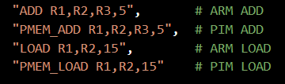
Implementation-ISA Design
Example：
ADD instruction decoding
LOAD instruction decoding
2

Slide 10
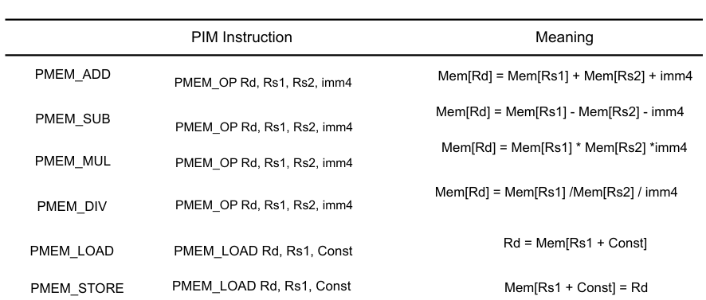
Implementation-ISA Design
Instruction and Meaning:
2

Slide 11
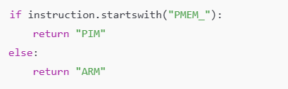
Implementation-Architecture Simulation
1. Architecture Detection:
The architecture that distinguishes instructions based on the prefix of opcodes (such as PMEM_) or specific values of fields:
If the opcode starts with PMEM_, it is a PIM instruction. Otherwise, it is an ARM instruction
2

Slide 12

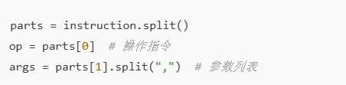
Implementation-Architecture Simulation
2. Parsing:
Input format: Assembly instructions consist of opcodes and parameters, for example:.
Parsing method:
Opcodes (such as ADD, PMEM_ADD).
The parameter list (such as R1, R2, R3,5) is further divided into individual registers or immediate numbers (R1, R2, R3, 5).
2

Slide 13
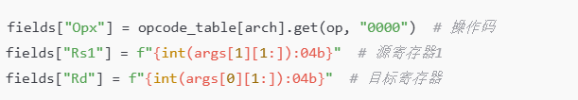
Implementation-Architecture Simulation
3. Field Generation:
Generate corresponding fields based on the parsed instructions and architecture (ARM or PIM):
Each field has a clear position and length. Convert register numbers, immediate numbers, etc. into binary using fixed rules..
Field example (using ARM as an example):
Opx (31-28 bits): Retrieve the corresponding value from the operation code table.
Op (27-20 bits): The opcode corresponding to a specific instruction.
Rs1 (19-16 bits): Source register, converted to 4-bit binary.
2

Slide 14
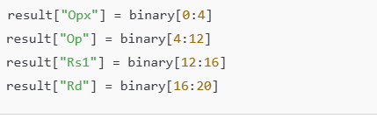
Implementation-Architecture Simulation
4. Decoding:
Decoding rule: Parse the complete instruction in binary field order, extract the value of each field, and print out the field name, binary value, and corresponding decimal value.
Field parsing method: Use binary slicing operation to extract each field:
Opx: binary[0:4]
Op: binary[4:12]
Rs1: binary[12:16]
2

Slide 15
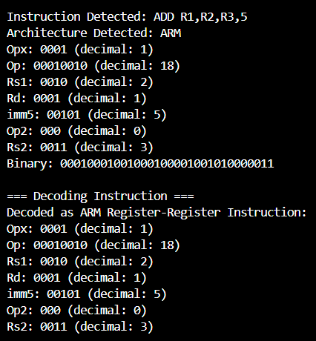
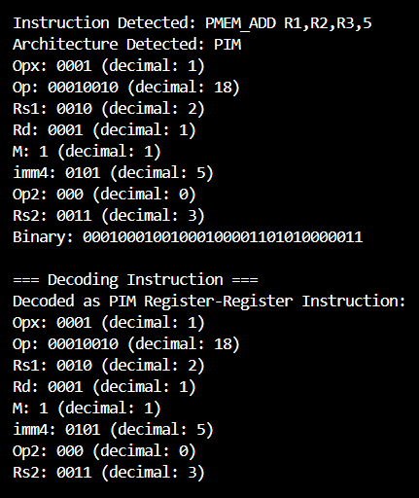
OUTPUT
2

Slide 16
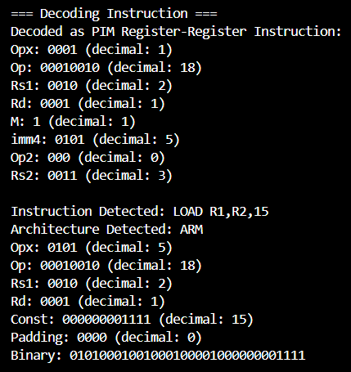
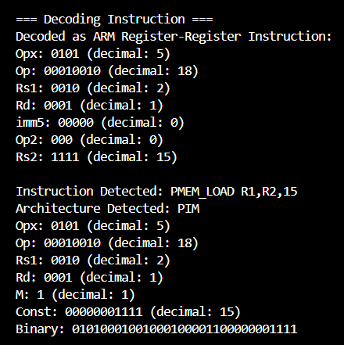
OUTPUT
2

Slide 17
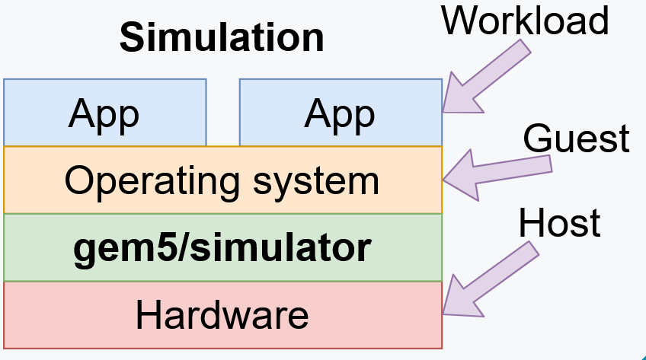

Implementation-Architecture Simulation
Introduction - gem5:
Host: the actual hardware you're using
Simulator: Runs on the host
Exposes hardware to the guest
Guest: Code running on simulated hardware
OS running on gem5 is guest OS
gem5 is simulating hardware
Simulator's code: Runs natively
executes/emulates the guest code
Guest's code: (or benchmark, workload, etc.)
Runs on gem5, not on the host.
2

Slide 18
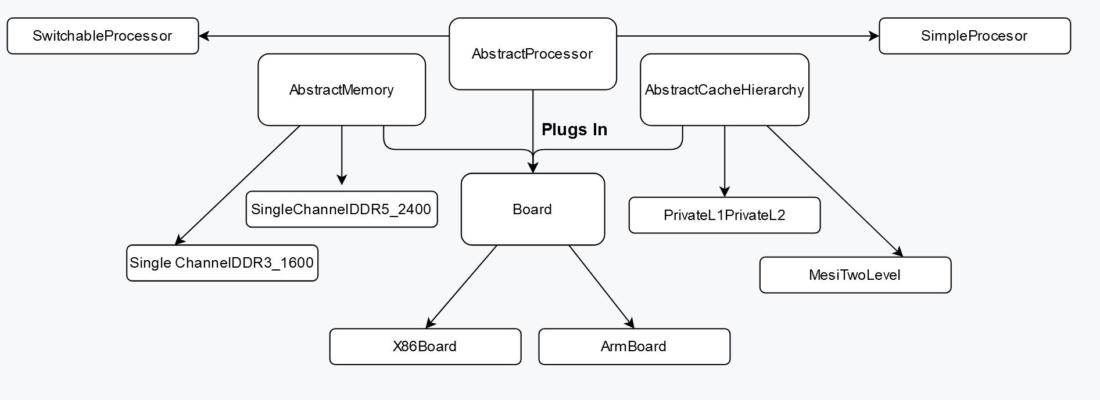
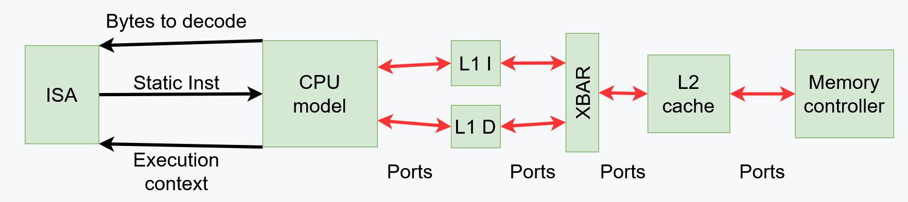
Implementation-Architecture Simulation
Component - gem5:
- CPU
- Cache Hierarchy
Memory System
Board: The “backbone” of the system
2

Slide 19
Implementation-Architecture Simulation
Steps of simulation:
https://www.gem5.org/
Installing gem5
Configure the environment & install dependency packages
Configure the components from the official repository
Configuring simulator & Implementation
Modify the component parameters in the config script to implementthe PIM system
Running Benchmark
Obtain benchmark resources from gem5
2

Slide 20
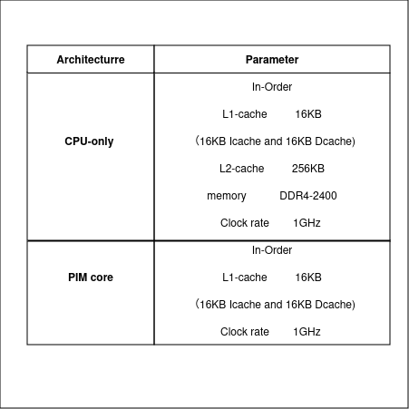
Implementation-Architecture Simulation
Configuration
2

Slide 21
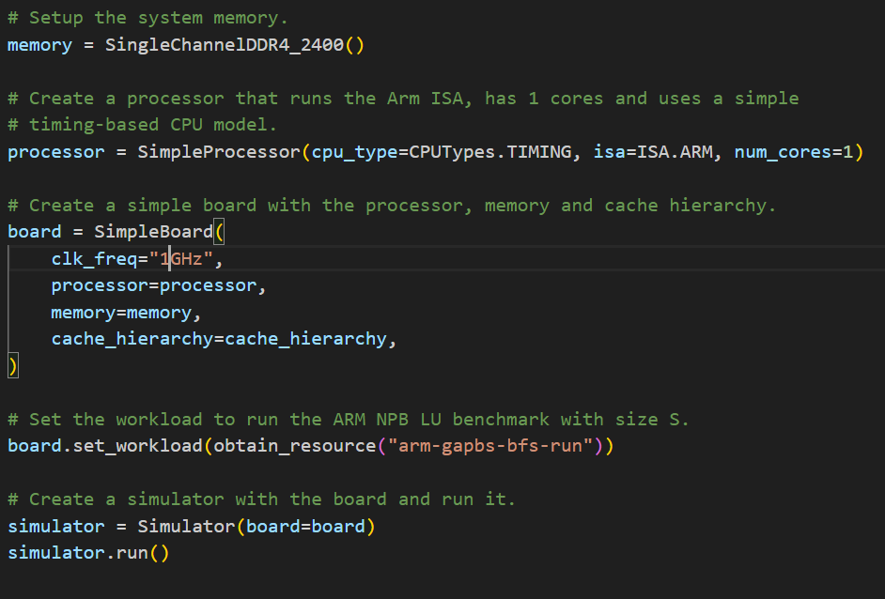
Implementation-Architecture Simulation
CPU-Only Model
CPU Model: Timing CPU
2

Slide 22
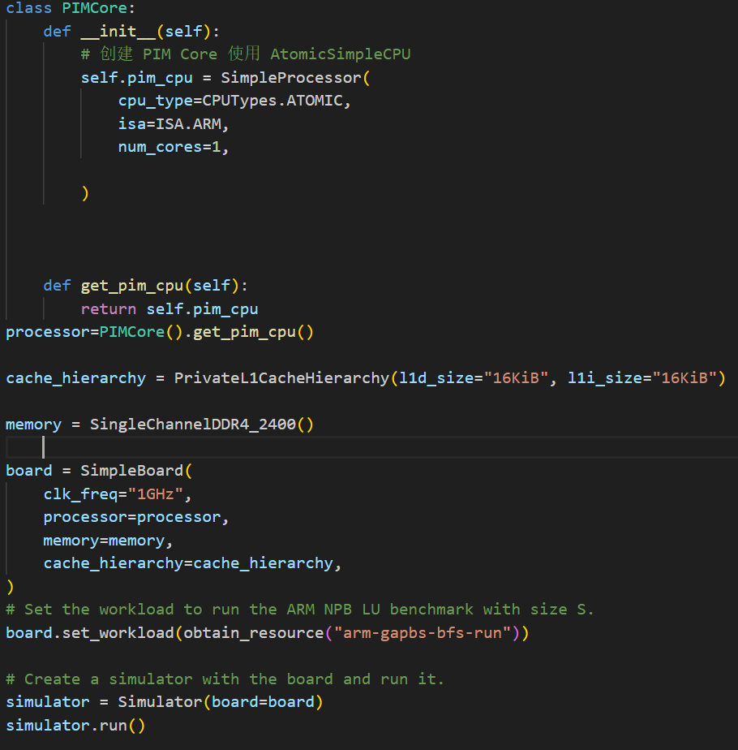
Implementation-Architecture Simulation
PIM Core Model
CPU Model: Atomic CPU
Atomic Memory Access: It is used for fast forwarding and warming up caches and return an approximate time to complete the request without any resource contention or queuing delay which is suitable to simulate DMA
2

Slide 23

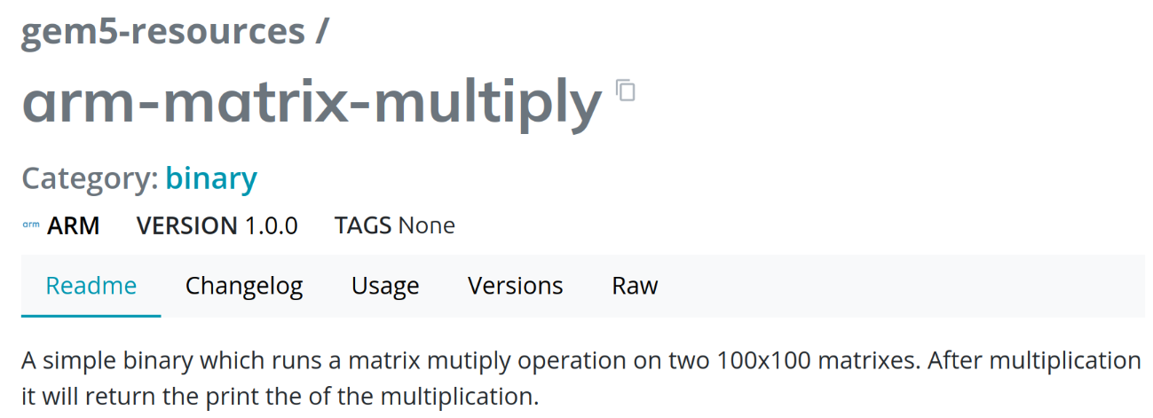
Benchmark Comparison
From gem5 resource, we choose 5 benchmark
(Graph Analysis Performance Benchmark Suite)
arm-gapbs-bfs-run:
Breadth-First Search (BFS): A search algorithm used to find the shortest path from a source node to a target node.arm-gapbs-tc-run:
Triangle Counting: Calculates the number of triangles in a graph, often used in social network analysis, etc.
NPB (NAS Parallel Benchmarks)
arm-npb-bt-size-s-run:
BT (Block Tridiagonal): Often used to solve spatiotemporal discretization problems in physics.
arm-npb-cg-size-s-run:
CG (Conjugate Gradient): A method used to solve linear systems using the conjugate gradient method.
2

Slide 24
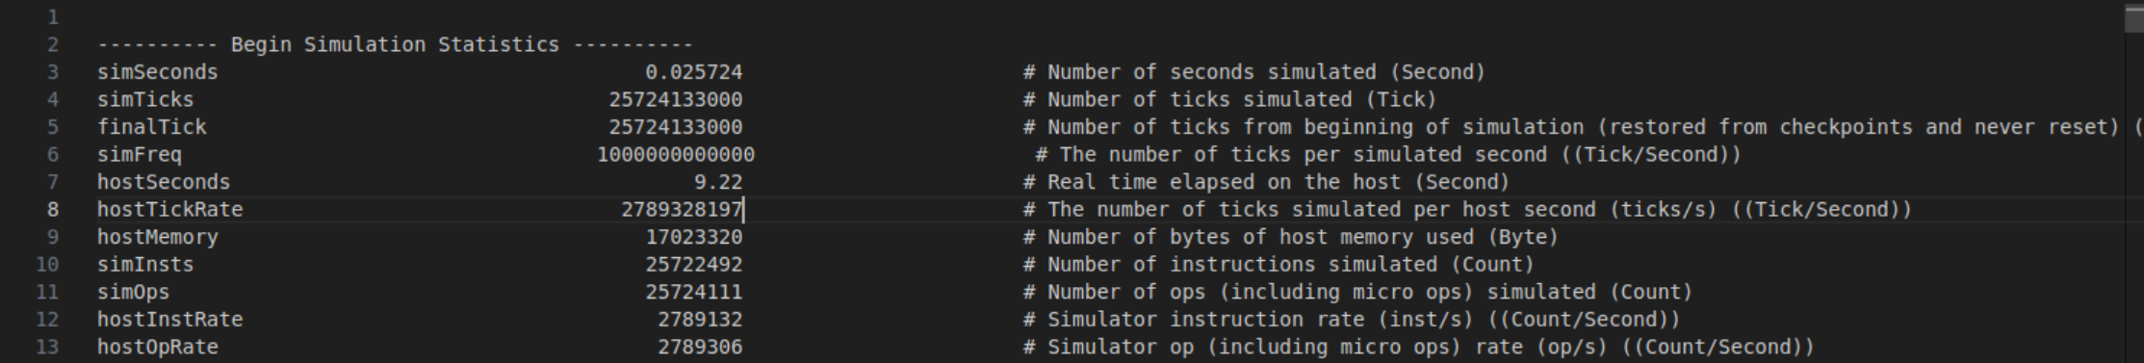
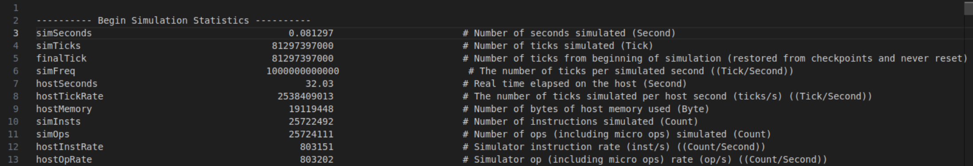
Benchmark Comparison-Matrix Multiply
PIM Core
CPU Only
2

Slide 25
Benchmark Comparison
Speedup(exTimePC / exTime CPU):
1. Gapbs-bfs: X2.53
2. Gapbs-tc: X2.43
3. Matrix-multiply: X3.16
4. Npb-bt: X2.98
5. Npb-cg: X4.22
Average Speedup: X3.06!!!
2

Slide 26
Performance Modeling
Not always does the PIM core encounter a resource contention state
Not always can the PIM core offload all the task
2

Slide 27
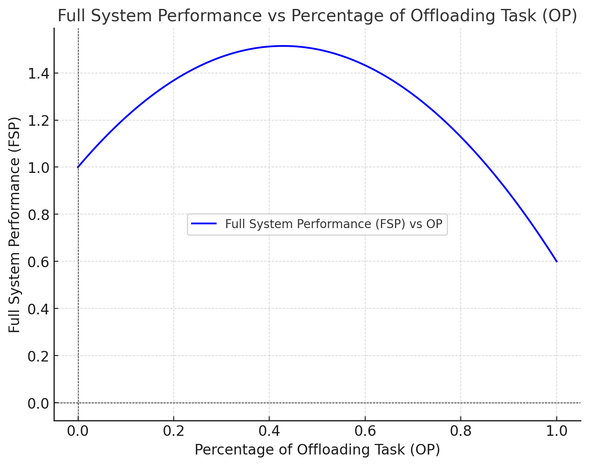
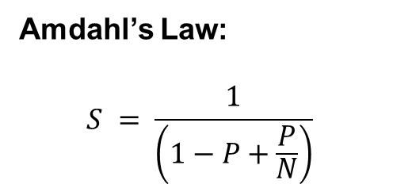

Performance Modeling
Amdahl’s Law:
$$S = \frac{1}{\left(1−P+\frac{P}{N}\right)}$$
Queuing theory:
$$W=\frac{λ}{μ\left(μ−λ\right)}$$
$$λ:average arrival rate$$
$$μ:average service time$$
$$W:expected waiting time$$
Increasing by Amdahl’s law
Decreasing by Queuing theory
2

Slide 28
Future Direction
Smarter compiler:
Achieving most out of PIM core through smart task offloading
Domain specific architecture for PIM Core:
Targeted acceleration by modifying the PIM core architecture to make it better suited for accelerating deep learning tasks.
2

Slide 29
Contribution
Thanks for all group member’s commitment!
Yi Ling: Architecture Proposal, Simulation & Analysis(50%), PPT(30%)
Jiayou Jin: Architecture Proposal, Simulation & Analysis(50%), PPT(20%)
Siyu Mou: Architecture Proposal, ISA design & Compiler(50%), PPT(20%)
Hao Peng: Architecture Proposal, ISA design & Compiler(50%), PPT(20%)
Kunyu Wu: PPT(10%)
2

