Slide 1
BIBDA: Semester Project Athens University of Economics and Business
Course: Business Intelligence and Big Data Analysis
Professor: Chatziantoniou Damianos
Academic year: Winter Semester 2023-2024
Students:
Alexios Mandelias (ID: 3190106)
Anna-Lefkothea Papavasileiou (ID: 6190101)

Slide 2
Warehouse

Slide 3
The Dataset
Source: Dataset used in another university course and provided by the course’s professor
Data: Card Transactions
Time period: 2015-2020
Aim: Transaction analysis based on several characteristics

Slide 4
Data Preprocessing
No missing or malformed data
Split into Fact Table & 5 Dimension Tables
Year 2020: Only January & February
=> attention with certain operations!
Add State data:
City "Franklin" present in 29 states
No city → state mapping possible!

Slide 5
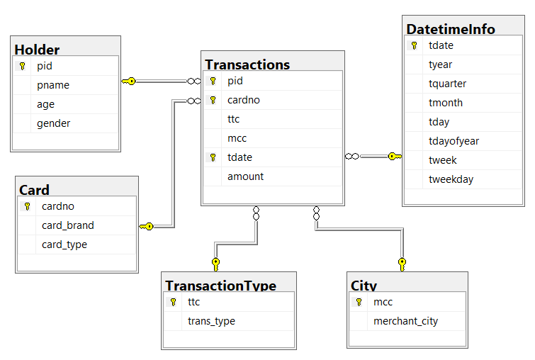
Star Schema
Metric: amount

Slide 6
Cube
SELECT gender, age, tmonth, SUM(amount) as transaction_amount
FROM Transactions
JOIN Holder ON Transactions.pid = Holder.pid
JOIN DatetimeInfo ON Transactions.tdate = DatetimeInfo.tdate
GROUP BY CUBE (gender, age, tmonth);

Slide 7
Visualizations

Slide 8
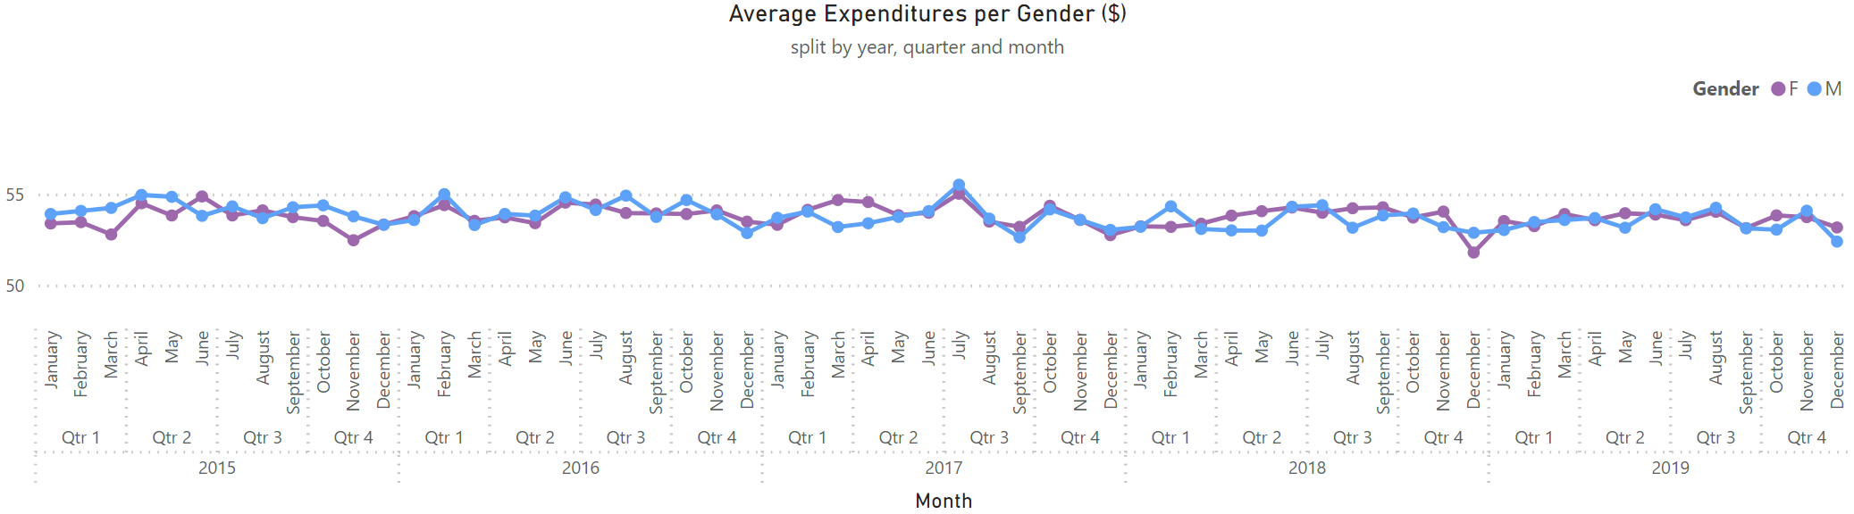
Expenditures per Gender
Key observations: Both genders spend, on average, the same amount of money in the span of many months. Any discrepancies are not consistent across different years.

Slide 9
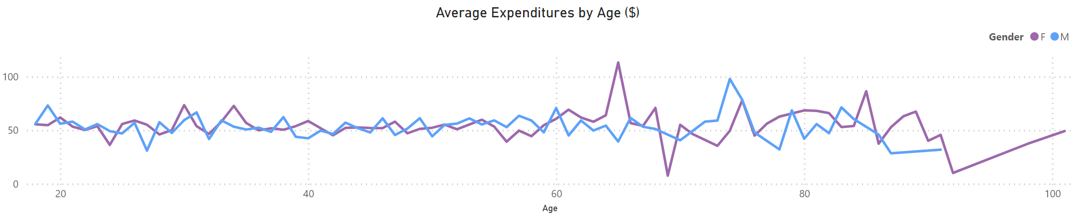
Expenditures by Age
Key observations: Both genders spend, on average, the same amount of money at the ages 18-65. After that, the amount they spend inexplicably diverges and changes rapidly in the following years.

Slide 10
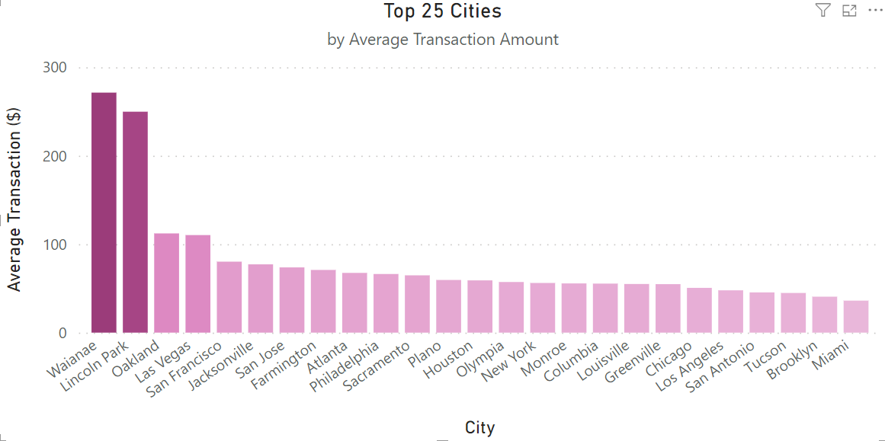
Top 25 Cities by Transaction Amount
Key observations: Two cities spend, on average, considerably more per transaction than the rest.

Slide 11
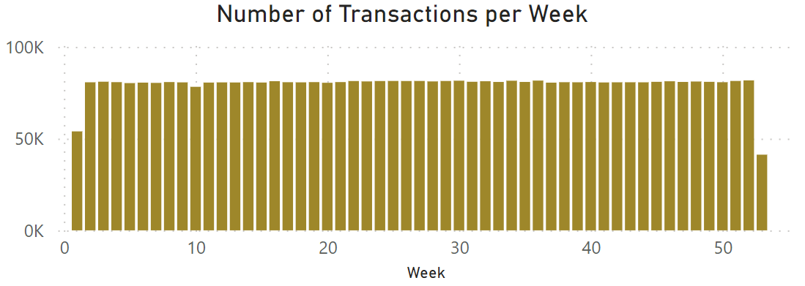
Number of Transactions by Week
Key observations: There is a significant drop in the number of transactions per week on the weeks leading to and following New Year’s Eve. During the rest of the year, the number doesn't fluctuate.

Slide 12
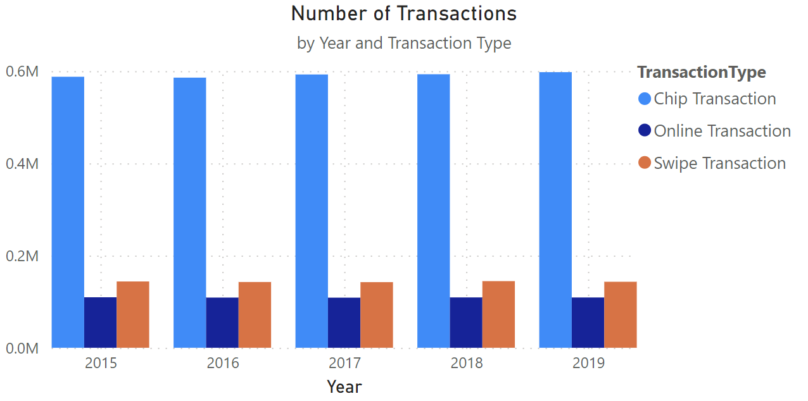
Number of Transactions by Type
Key observations: Throughout the years, chip transactions remain the most common transaction type.

Slide 13
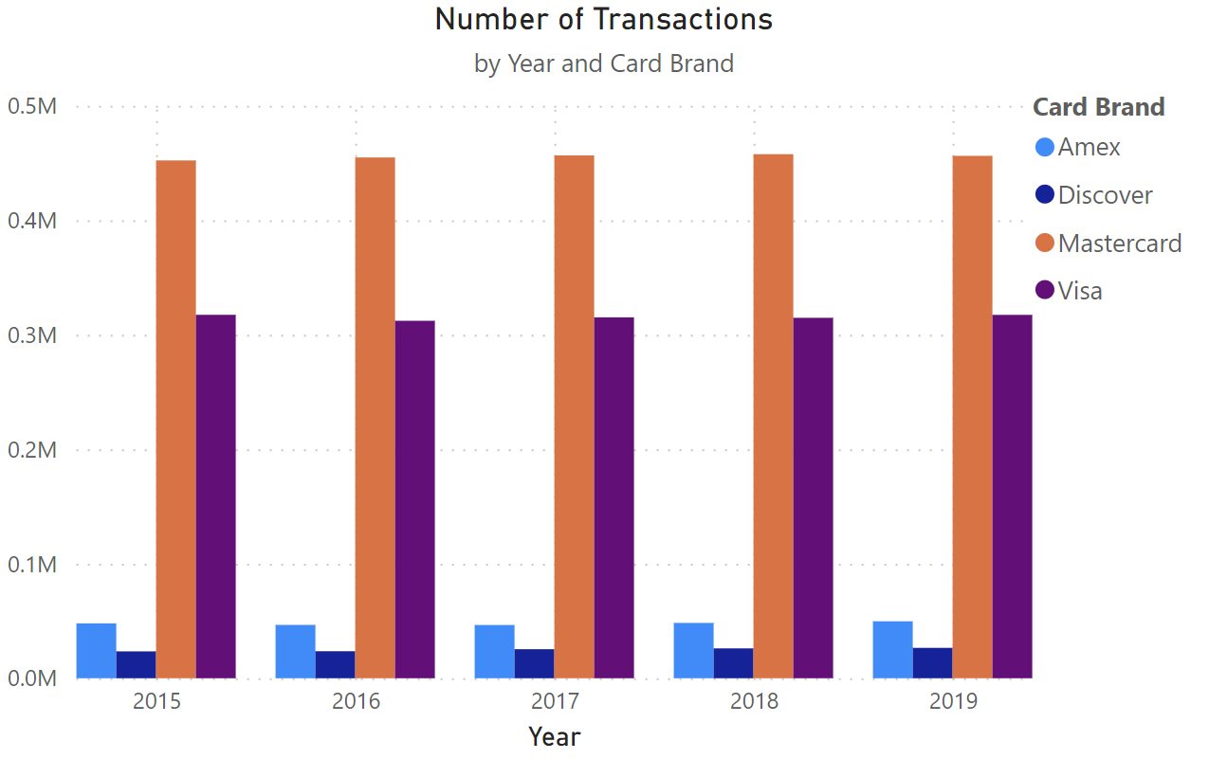
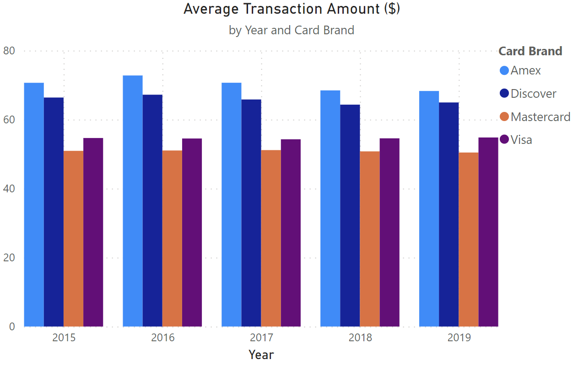
Card Brand Comparison
Key observations: Mastercard & Visa are the most popular card types.
However, Amex & Discover are generally used for the most expensive transactions.

Slide 14
Data Mining

Slide 15
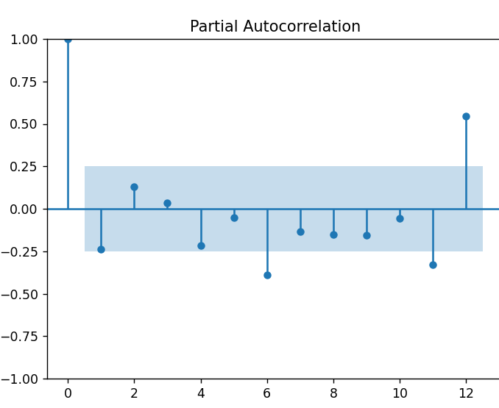
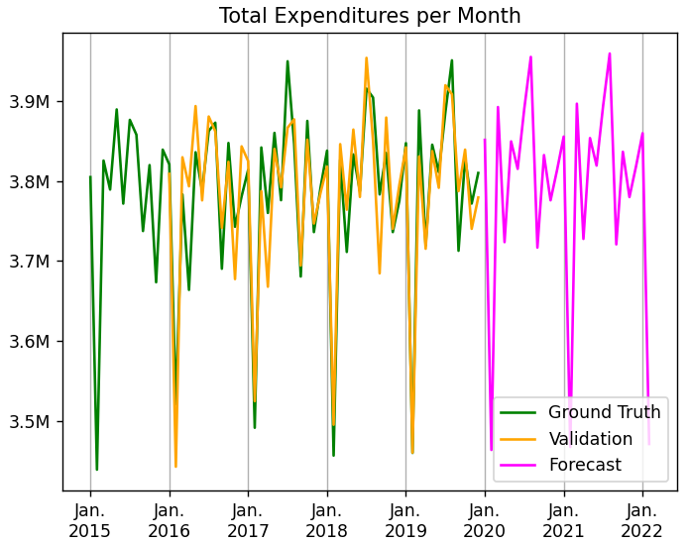
Prediction of Expenditures

Slide 16
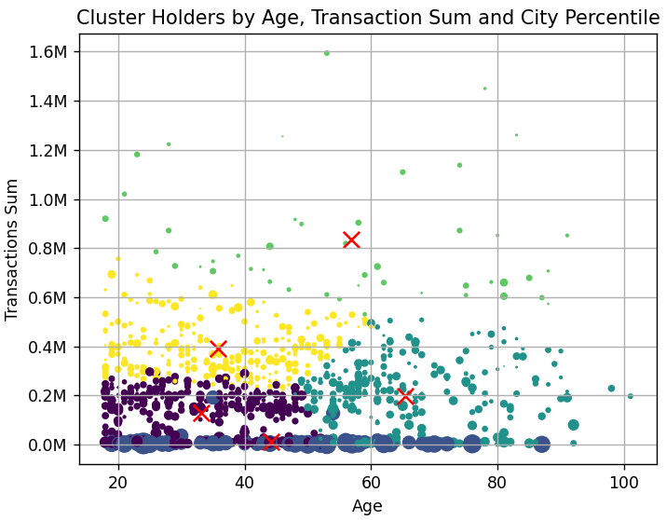
Grouping People by Spending Characteristics

Slide 17
Thank you for your Attention! Any Questions?

