Slide 1

Meta analysis of DTA studies using Bayesian latent class models
Xanthoula Rousou: Ph.D. student
Supervisor: P. Kostoulas

Slide 2
Outline
What is a meta-analysis of diagnostic accuracy studies
Current methods-OVERVIEW
Bayesian LATENT: BIVARIATE and HSORC
Model definition of HSROC
Example-Campylobacter
-problem definition
-Model
-Results/discussion
Conclusions-recommendations

Slide 3
What is a meta-analysis of DTA studies
Studies that evaluate the accuracy of a diagnostic test
Results of a diagnostic test study as a 2X2 table
Sensitivity SE
Specificity SP
statistical pooling of the results of primary studies to derive summary estimates of sensitivity and specificity from several separately performed test studies.
summary points->summary SE, SP, DOR, or summary ROC curve
SE and SP are often negatively correlated, so problematic pooling pairs
 | Disease + | Disease -
Test + | TP (SE) | FP (1-SP)
Test - | FN (1-SE) | TN (SP)

Slide 4
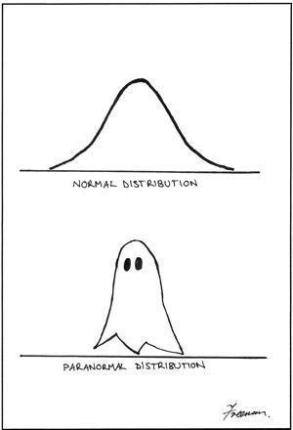
Methods-Overview
Bivariate analysis of sensitivity and specificity (Reitsma et al.2005)
pairs of sensitivity and specificity are jointly analysed
correlation btw Se and Sp -> random effects
Upgrades of the bivariate: binomial exact (Chu and Cole 2006 ),
beta-binomial (Chen et al. 2011 and Kuss et al. 2014)
Split component synthesis(SCS)(Doi et al. 2015, Furuya-Kanamori et al. 2020)
Distribution free model
Estimation of the DOR and then split into its components
Threshold resistant

Slide 5
Bayesian latent class
Bivariate latent class with or without a reference standard:
Correlation matrix
Shiny app
Hierarchical summary ROC (HSROC) latent class with or without a reference standard:
Hierarchical Summary ROC (Rutter and Gatsonis 2001)
Dendukuri N. et al 2012
Accounts for threshold differences

Slide 6
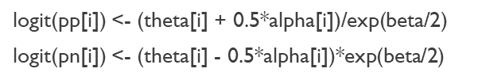

Hsroc-model definition
level I (within study)
level II (between studies)
Level III (prior specifications)
$θ_{i}$are cutpoint parameters (or positivity criteria)
$α_{i}$ are accuracy parameters
$β$ is a shape parameter, allowing true-positive and false-positive fractions to increase at different rates as i increases

Slide 7
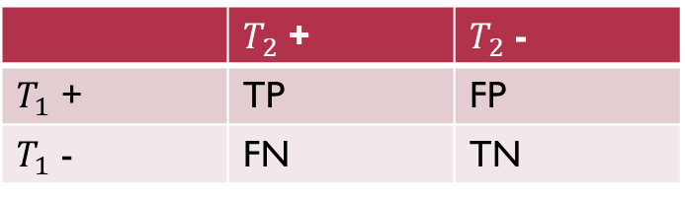
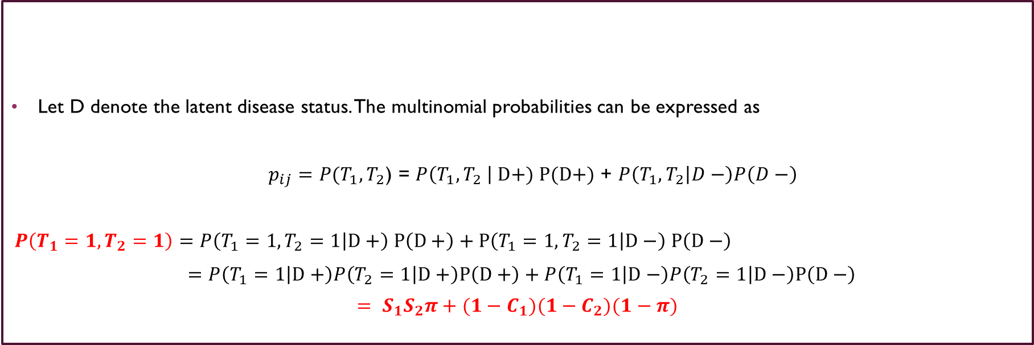
Model definition
 | $T_{2}$ + | $T_{2}$ -
$T_{1}$ + | TP | FP
$T_{1}$ - | FN | TN
Let D denote the latent disease status. The multinomial probabilities can be expressed as
$p_{ij}=P(T_{1},T_{2}$) = $P\left(T_{1},T_{2} \right| D+) P(D+)$ + $P\left(T_{1},T_{2} | D−\right)P\left(D−\right)$
$$P\left(T_{1}=1,T_{2}=1\right)=P\left(T_{1}=1,T_{2}=1 | D+\right) P\left(D+\right)+P\left(T_{1}=1,T_{2}=1 | D−\right) P\left(D−\right)$$
$=P\left(T_{1}=1 | D+\right)P\left(T_{2}=1 | D+\right)P\left(D+\right)+P\left(T_{1}=1 | D−\right)P\left(T_{2}=1 | D−\right)P\left(D−\right)$
$$= S_{1}S_{2}π+{(1−C}_{1})(1−C_{2})(1−π)$$

Slide 8
LATENT CLASS Model- WITHOUT A REFERENCE STANDARD
for(i in 1:l) {
cell[i,1:4] ~ dmulti(cell_prob[i,1:4],n[i])
# Positive_Index - Positive_reference
cell_prob[i,1] <- pi[i]*( pp[i] * s2 ) + (1-pi[i])*( pn[i] * (1-c2))
# Positive_Index - Negative_reference
cell_prob[i,2] <- pi[i]*( pp[i] * (1-s2) ) + (1-pi[i])*( pn[i] * c2)
# Negative - Positive_reference
cell_prob[i,3] <- pi[i]*( (1-pp[i]) * s2 ) + (1-pi[i])*( (1-pn[i]) * (1-c2))
# Negative_Index - Negative_reference
cell_prob[i,4] <- pi[i]*( (1-pp[i]) * (1-s2) ) + (1-pi[i])*( (1-pn[i]) * c2)
se[i] <- pp[i]
sp[i] <- 1-pn[i]

Slide 9
LATENT CLASS Model- WITHOUT A REFERENCE STANDARD
HSROC
Bivariate
Level I:
logit(pp[i]) <- (theta[i] + 0.5*alpha[i])/exp(beta/2)
logit(pn[i]) <- (theta[i] - 0.5*alpha[i])*exp(beta/2)
pp = True positive rate
pn = False positive rate= 1-SP
- Study level SE and Sp of index test:
se[i] <- pp[i]
sp[i] <- 1-pn[i]
Level II-Hierarchical prior distributions
theta[i] ~ dnorm(THETA,tau[1])
alpha[i] ~ dnorm(LAMBDA,tau[2])
Level I:
logit(se[i]) <- l1[i,1]
logit(sp[i]) <- l1[i,2]
l1[i,1:2] ~ dmnorm(mu[,], T[,])
Level II- Hierarchical prior distributions
mu[1] ~ dnorm(0,0.25)
mu[2] ~ dnorm(0,0.25)
BETWEEN-STUDY VARIANCE-COVARIANCE MATRIX
TAU[1,1] <- tau[1]*tau[1]
TAU[2,2] <- tau[2]*tau[2]
TAU[1,2] <- rho*tau[1]*tau[2]
TAU[2,1] <- rho*tau[1]*tau[2]
Pooled sensitivity and specificity
Pooled_S<-1/(1+exp((-THETA-0.5*LAMBDA)/exp(beta/2)))
Pooled_C<-1/(1+exp((THETA-0.5*LAMBDA)*exp(beta/2)))
Pooled sensitivity and specificity
Pooled_S<-1/(1+exp(-mu[1]))
Pooled_C<-1/(1+exp(mu[2]))

Slide 10
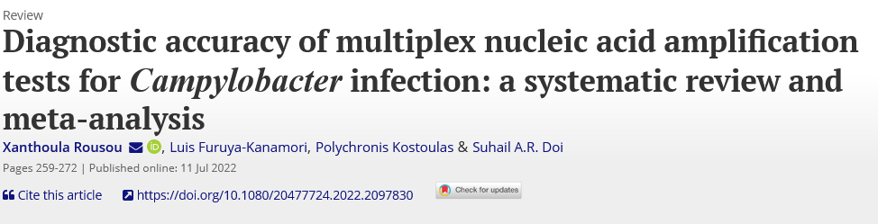
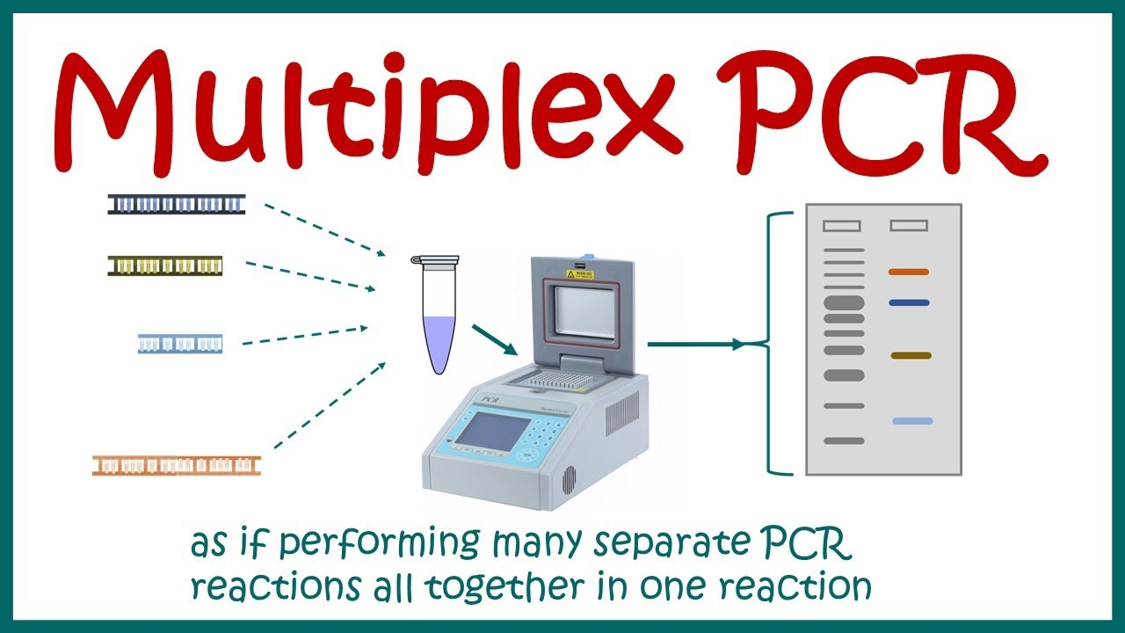

Campylobacter-Meta analysis
34 studies
Diagnostic test->multiplex PCR
Reference test-> culture
SCS method
The overall Se and Sp of multiplex PCR were 95.3% (92.3; 97.1) and 97.1% (95.1; 98.3) respectively
Multiplex NAT/PCR test | Se (95%CI) | Sp (95%CI) | Studies
BD Max EBP | 0.981 (0.961,0.99) | 0.985 (0.97,0.993) | (13, 38, 39)
EntericBio | 0.977 (0.906,0.995) | 0.986 (0.941, 0.997) | (40, 41)
FilmArray | 0.97 (0.924,0.989) | 0.983 (0.954,0.994) | (8, 14, 19, 43)
Luminex | 0.938 (0.892,0.966) | 0.982 (0.965, 0.99) | (11, 16, 18, 20, 22, 24, 48–52)
Seeplex | 0.852 (0.631, 0.951) | 0.957 (0.84, 0.99) | (21, 23, 55)

Slide 11
Problem definition
Problem:
->excess positives->FALSE or TRUE?
LOW SP of multiplex PCR or LOW SE of culture?
->Composite reference standard->singleplex or other multiplex PCR (results favoring index) or/and Antigen-based tests (low sensitivity)
->Many manufacturers->different cut-off values, different Camp.spp
Bayesian approach latent class model without a reference standard
HSROC or Bivariate?

Slide 12
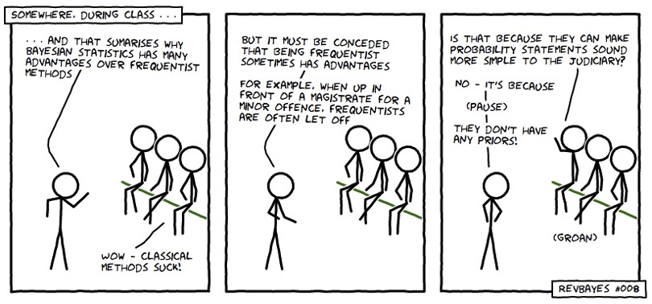
LATENT CLASS MODEL - level iii - priors
HYPER PRIOR DISTRIBUTIONS FOR INDEX TEST
PRIORS FOR REFERENCE STANDARD
HSROC
THETA ~ dunif(-10,10)
LAMBDA ~ dunif(-6,6)
beta ~ dunif(-2,2)
for(j in 1:2) {
tau[j] <- pow(sigma[j],-2)
sigma[j] ~ dgamma(4,2)
Bivariate
mu[1] ~ dnorm(0,0.25)
mu[2] ~ dnorm(0,0.25)
rho ~ dunif(-1,1)
prec[1] ~ dgamma(2,0.5)
prec[2] ~ dgamma(2,0.5)
tau[1]<-pow(prec[1],-0.5)
tau[2]<-pow(prec[2],-0.5)
Informative priors
Non-informative priors
#s2 ~ dbeta(1,1)
#c2 ~ dbeta(1,1)
Restrictive priors
#s2 ~ dbeta(1,1)I(0.3,)
#c2 ~ dbeta(1,1)I(0.7,)
Parameter | Mean | Range (min-max) | Be (a, b)
Se | 0.8 | 0.66-0.9 | beta (126.13, 31.53)
Se | 0.75 | 0.62-0.86 | beta (142.57, 47.52)
Sp | 0.95 | 0.8-0.999 | beta (63.2, 3.33)

Slide 13
Results
Updated additional 5 studies -> total 39 studies
Similar SE and SP btw the different methods
Higher SP and SE for culture
Model | Index test |  | Culture test
 | Sensitivity % (95%CI) | Specificity % (95%CI) | Sensitivity % (95%CI) | Specificity % (95%CI)
SCS method | 95.5 (9.,2,97.1) | 96.9 (95.2,98)
Bayesian HSROC without gold standard | 94.1 (92.32,95.83) | 95.78 (94.35,97.09) | 97.09 (95.19,98.92) | 99.98 (99.99,1)
Bayesian HSROC | 94.54 (92.98,96.09) | 95.47 (94.09,96.77)
Bivariate method (mada package) | 94.8 (93,96.2) | 97.2 (96.3,97.9)

Slide 14
Bivariate latent class analysis-SHINNY APP
https://nandinidendukuri.com/bdtama#shiny-app
https://bayesdta.shinyapps.io/meta-analysis/

Slide 15
Conclusions-Recommendations
Bayesian approach to be preferred if the accuracy of the reference test is questioned
When high heterogeneity is expected -> Bayesian or SCS method
Meta-regression-> Bayesian or bivariate meta-analysis model
It is easier nowadays to implement Bayesian due to shinny apps and R packages
Decision-making trees and cost-benefit analyses
Prediction models

Slide 16
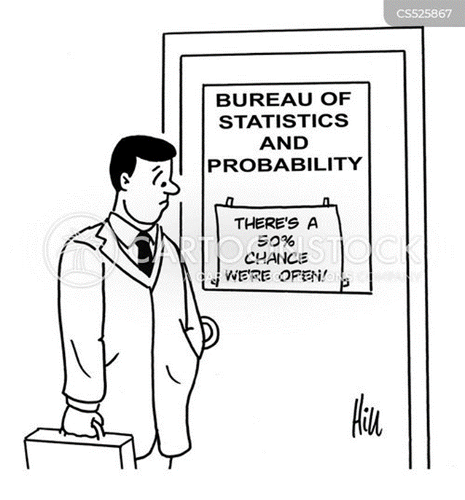
Thank you, any questions?

