Slide 1

Meta analysis of DTA studies using Bayesian latent class models
Xanthoula (Ksanthi) Rousou: Ph.D. student
Supervisor: P. Kostoulas
Notes:
GOOD day everyone my name is X.Rousou I am a PHD student at the department of public nd one health of the university of Thessaly in Karditsa. My supervisor is Mr Kostoulas.
I will present for you today an interestic topic entitled meta analysis of diagnostic test accuracy studies using Bayesian latent class models.

Slide 2
Outline
What is a meta-analysis of diagnostic accuracy studies
Current methods-OVERVIEW
Bayesian LATENT: BIVARIATE and HSROC
Model definition of HSROC
Example-Campylobacter
-problem definition
-Model
-Results/discussion
Conclusions-recommendations
Notes:
First lets see the outline.
I will begin with what do we mean by DTA studies and what is meta analysis and proceed with an overview of the methods used and then discuss the Bayesian models available.
The focus of this presentation is the HSROC model, therefore we will define and illustrate this approach but also keep in comparison the bivariate latent model.
A previous metaanalysis about Camp.spp and the accuracy of multiplex PCR will be used as an example for illustrating the model and discuss the results. We will close this topic this presentation with some final comments.

Slide 3
What is a meta-analysis of DTA studies
Studies that evaluate the accuracy of a diagnostic test
Results of a diagnostic test study as a 2X2 table
Sensitivity SE
Specificity SP
statistical pooling of the results of primary studies to derive summary estimates of sensitivity and specificity from several separately performed test studies.
summary points->summary SE, SP, DOR, or summary ROC curve
SE and SP are often negatively correlated, so problematic pooling separate estimates
 | Disease + | Disease -
Test + | TP (SE=ℙ(T = 1 ∣ D = 1)) | FP (1-SP)
Test - | FN (1-SE) | TN (SP=ℙ(T=0 ∣D = 0)
Notes:
What do we mean when we say diagnostic test accuracy study?
Studies that evaluate the accuracy of a diagnostic test in comparison with the current method, the reference standard or gold standard. Hence compare it with a method that perfectly recognizes if a person is diseased or not.
Usually the results form a 2x2 table. Where you have 4 categories, tp,fp,fn,tn.
The accuracy of the test is summarized by two measures. SE and SP.
SE is the TPR, therefore sensitivity is the probability of a positive test
given disease is present, therefore the ability of the test to recognize a diseased individual among the diseased.
SP is the probability of a negative test given the absence of a disease, so the ability of the test to recognize a healthy individual among the healthy
So what is the meta analysis of these studies?
It is the statistical pooling of the results of primary studies to derive summary estimates of sensitivity and specificity from several separately performed test studies.
Summary points besides SE and SP can be the DOR or a summary ROC curve
However, you cannot estimate SE and SP separately due to their often negative correlation

Slide 4
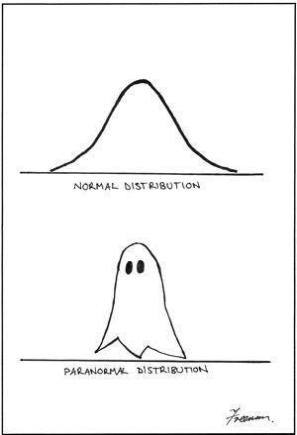
Methods-Overview
Bivariate analysis of sensitivity and specificity (Reitsma et al.2005)
pairs of sensitivity and specificity are jointly analysed
correlation btw Se and Sp -> random effects
Upgrades of the bivariate: binomial exact (Chu and Cole 2006 ), beta-binomial (Chen et al. 2011 and Kuss et al. 2014)
Split component synthesis(SCS)(Doi et al. 2015, Furuya-Kanamori et al. 2020)
Distribution free model
Estimation of the DOR and then split into its components
Threshold resistant
Notes:
The most widely used model is the bivariate model where pairs of SE and SP are jointly analysed as a vector incorporating their correlation as random effects, hence a variance-covariance matrix in a mixed model approach.
Because it uses a continuity correction, which has it faults in some situations where small number of studies are used for example, CHU and COLE provided a binomial exact mixed model for better performance.
A new approach developed by DOI et al is the SCS method developed in 2020 and is an extension of the inverse variance heterogeneity model for application in DTA STUDIES.
Scs method outperforms bivariate when high heterogeneity is present.
In the bivariate method SE and SP are assumed to follow a normal distribution, here the SCS method is a distribution free model therefore even a paranormal distribution would not be problem.
The model first estimates the DOR and then splits it into its components. Hence since DOR is robust against cutoff differences is a suitable model when different thresholds are present.

Slide 5
Bayesian latent class
Bivariate hierarchical latent class with or without a reference standard:
Correlation matrix
Shiny app
Hierarchical summary ROC (HSROC) latent class with or without a reference standard:
Hierarchical Summary ROC (Rutter and Gatsonis 2001)
Dendukuri N. et al 2012
Accounts for threshold differences
Notes:
What do we mean when we say latent?
These models assume that the true disease status is a latent variable hence unobserved that is not directly measured and can only be inferred from the results of imperfect tests
and covariates if included.
There are two latent class models: the bivariate and the HSROC.
Bivariate is equivalent to reistma because it incorporates the variance covariance matrix. It is most widely used due to the development of two shinny apps that make the implementation of this model easier.
The HSROC was first developed by Rutter and Gatsonis in 2001 and Dendukuri in 2012 provided an extension of this model for the case where more than one reference standards exist and to account for conditional dependence.
This model accounts for threshold differences by including it as an unknown parameter in the model both within and between studies

Slide 6

Hsroc-model definition
level I (within study)
level II (between studies)
Level III (prior specifications)
$θ_{i}$are cutpoint parameters (or positivity criteria)
$α_{i}$ are accuracy parameters
$β$ is a shape parameter, allowing true-positive and false-positive fractions to increase at different rates as θi increases
Notes:
In level one the logit of the probability of a positive test is equal to theta plus the product of a and D which is the Disease status all multiplied by the exponential of minus beta times D.
In level two the between study level, these thetas and alphas from all the studies come from a normal distribution with mean THETA and LAMDA respectively and variance sigma square theta and alpha respectively.
Now what is this theta and alpha and beta?
Theta is the cutpoint parameter the threshold parameter, alpha are the accuracy parameters and beta is a shape parameter that influences how curvy SROC will be.
The probability of a positive test is either the TPR hence the SE or the FPR hence 1-SP.
Therefore if we code the D as 0,5 when disease is present and minus 0,5 when disease is absent, the true positive rate is the inverse logit of THETA plus 0,5LAMDA all divided by the exponential of 0,5BETA and the FPR the inverse logit of theta minus 0,5lamda and all multiplied by 0,5beta.
THE THIRD LEVEL OF THE MODEL IS THE SPECIFICATION OF THE PRIOR INFORMATION AND CHOOSE A DISTRIBUTION FOR THESE PRIORS

Slide 7
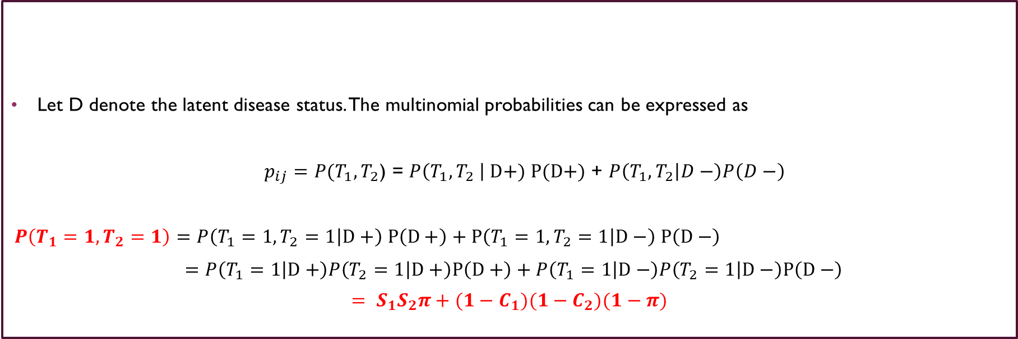
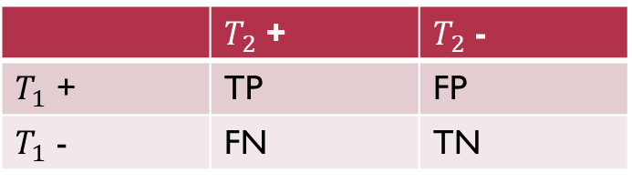
Model definition
 | $T_{2}$ + | $T_{2}$ -
$T_{1}$ + | TP | FP
$T_{1}$ - | FN | TN
Let D denote the latent disease status. The multinomial probabilities can be expressed as
$p_{ij}=P(T_{1},T_{2}$) = $P\left(T_{1},T_{2} \right| D+) P(D+)$ + $P\left(T_{1},T_{2} | D−\right)P\left(D−\right)$
$$P\left(T_{1}=1,T_{2}=1\right)=P\left(T_{1}=1,T_{2}=1 | D+\right) P\left(D+\right)+P\left(T_{1}=1,T_{2}=1 | D−\right) P\left(D−\right)$$
$=P\left(T_{1}=1 | D+\right)P\left(T_{2}=1 | D+\right)P\left(D+\right)+P\left(T_{1}=1 | D−\right)P\left(T_{2}=1 | D−\right)P\left(D−\right)$
$$= S_{1}S_{2}π+{(1−C}_{1})(1−C_{2})(1−π)$$
Notes:
As we know in a Bayesian inference to estimate the posterior distribution of our parameters we need to define THE LIKELIHOOD OF THE DATA AND make assumptions about the underlying distribution that the observed data follow and then specify the priors.
Let D denote the disease status. The disease status is assumed latent meaning unobserved, that its presence is not directly measured and can only be inferred from the results of the tests
The probability of getting any result from test 1 and test 2 is equal to the probability of getting a result given the disease is present multiplied by the probability of the disease being present plus the probability of getting any result given the disease is absent multiplied by the probability the disease is absent.
So if we take the probability of both tests to give a positive result this translates to the probability of test1 to give a positive result given the disease is present which is the SE. Therefore the product of the Ses of the two tests times the probability of being diseased which is the prevalence.
That provides us the first part of the final line in the equation.
Now the probability to get a positive result given disease is absent translates to the false positive rate hence 1-SP. That’s why the second part of the equation transforms into 1-sp1 times 1-sp2 times 1-p.

Slide 8
LATENT CLASS Model- WITHOUT A REFERENCE STANDARD
for(i in 1:l) {
cell[i,1:4] ~ dmulti(cell_prob[i,1:4],n[i])
# Positive_Index - Positive_reference
cell_prob[i,1] <- pi[i]*( pp[i] * s2 ) + (1-pi[i])*( pn[i] * (1-c2))
# Positive_Index - Negative_reference
cell_prob[i,2] <- pi[i]*( pp[i] * (1-s2) ) + (1-pi[i])*( pn[i] * c2)
# Negative - Positive_reference
cell_prob[i,3] <- pi[i]*( (1-pp[i]) * s2 ) + (1-pi[i])*( (1-pn[i]) * (1-c2))
# Negative_Index - Negative_reference
cell_prob[i,4] <- pi[i]*( (1-pp[i]) * (1-s2) ) + (1-pi[i])*( (1-pn[i]) * c2)
se[i] <- pp[i]
sp[i] <- 1-pn[i]
Notes:
Well in this slide we see how the likelihood that we discussed in the previous slide can be passed in R. PP is the SE and PN is the FPR since in the model definition we expressed the probability of a positive test.
The first probability is the one we showed previously.
and with the same reasoning we construct the other 3 probabilities.
So when index test is positive and reference is negative we have the FP category.
Therefore the probability of a positive result given disease is present is given by SE and the probability of a negative result of the reference test given disease is present becomes 1-S2.
Now for the second part. The probability of a positive given disease is not present is 1-C1 therefore FPR and negative when disease is absent is C2.
And so on for the next two.

Slide 9
LATENT CLASS Model- WITHOUT A REFERENCE STANDARD
HSROC
Bivariate
Level I:
logit(pp[i]) <- (theta[i] + 0.5*alpha[i])/exp(beta/2)
logit(pn[i]) <- (theta[i] - 0.5*alpha[i])*exp(beta/2)
pp = True positive rate
pn = False positive rate= 1-SP
- Study level SE and Sp of index test:
se[i] <- pp[i]
sp[i] <- 1-pn[i]
Level II-Hierarchical prior distributions
theta[i] ~ dnorm(THETA,tau[1])
alpha[i] ~ dnorm(LAMBDA,tau[2])
Level I:
logit(se[i]) <- l1[i,1]
logit(sp[i]) <- l1[i,2]
l1[i,1:2] ~ dmnorm(mu[,], T[,])
Level II- Hierarchical prior distributions
mu[1] ~ dnorm(0,0.25)
mu[2] ~ dnorm(0,0.25)
BETWEEN-STUDY VARIANCE-COVARIANCE MATRIX
TAU[1,1] <- tau[1]*tau[1]
TAU[2,2] <- tau[2]*tau[2]
TAU[1,2] <- rho*tau[1]*tau[2]
TAU[2,1] <- rho*tau[1]*tau[2]
Pooled sensitivity and specificity
Pooled_S<-1/(1+exp((-THETA-0.5*LAMBDA)/exp(beta/2)))
Pooled_C<-1/(1+exp((THETA-0.5*LAMBDA)*exp(beta/2)))
Pooled sensitivity and specificity
Pooled_S<-1/(1+exp(-mu[1]))
Pooled_C<-1/(1+exp(mu[2]))
Notes:
Here you can see the code for both models for the model definition.
We see that both models let se and sp vary within studies and come from a normal distribution with an overall mean and variance but the HSROC model incorporates more of the factors that influence the accuracy of a test.
So in level 1 the equation defining se and sp and in level two the hierarchical prior distributions.
Now for the pooled estimates of SE and SP we see that they are similar in both models. One divided by one plus exponential of minus or not of miou respectively. The difference btw them is that miou is replaced by an equation that incorporates three important parameters that influence accuracy theta lamda and beta.

Slide 10
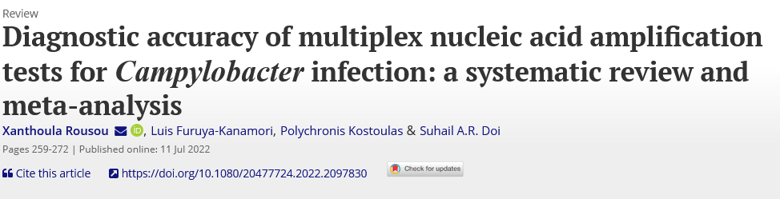
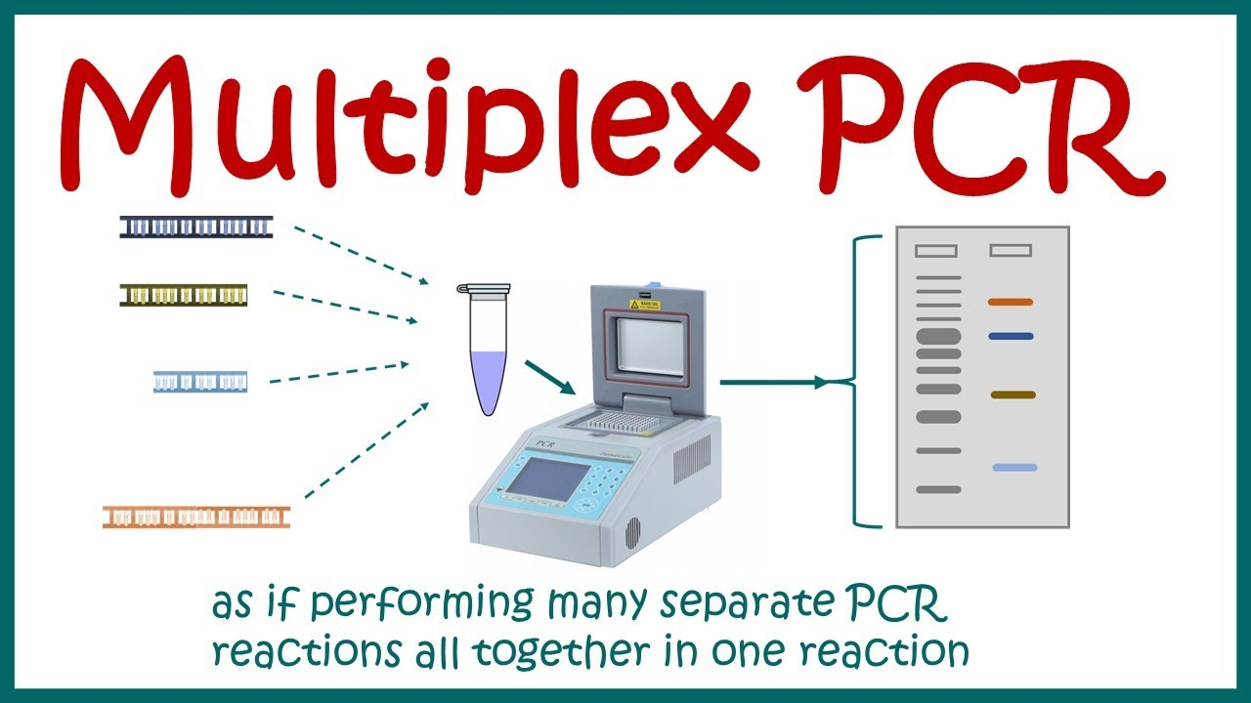

Campylobacter-Meta analysis
34 studies
Diagnostic test->multiplex PCR
Reference test-> culture
SCS method
The overall Se and Sp of multiplex PCR were 95.3% (92.3; 97.1) and 97.1% (95.1; 98.3) respectively
Multiplex NAT/PCR test | Se (95%CI) | Sp (95%CI) | Studies
BD Max EBP | 0.981 (0.961,0.99) | 0.985 (0.97,0.993) | (13, 38, 39)
EntericBio | 0.977 (0.906,0.995) | 0.986 (0.941, 0.997) | (40, 41)
FilmArray | 0.97 (0.924,0.989) | 0.983 (0.954,0.994) | (8, 14, 19, 43)
Luminex | 0.938 (0.892,0.966) | 0.982 (0.965, 0.99) | (11, 16, 18, 20, 22, 24, 48–52)
Seeplex | 0.852 (0.631, 0.951) | 0.957 (0.84, 0.99) | (21, 23, 55)
Notes:
Now lets implement this model with an example. Our laboratory conducted a meta-analysis concerning the diagnostic accuracy of multiplex PCR against Campylobacter spp. In total 34 studies were included.
Index test multiplex pcr and reference test culture.
The statistical method used was the scs method. The overall se and sp were 95 and 97 respectively. However a subgroup analysis revealed that there were differences in accuracy btw the different brands. For example Seeplex’s se was 85%.
But the confidence intervals overlap with the other brands. However this indicates that there are threshold differences which is reinforced by the fact that for example all include jejuni and coli but Luminex also tests for LARI while filmarray includes upsaliensis.

Slide 11
Problem definition
Problem:
->excess positives->FALSE or TRUE?
LOW SP of multiplex PCR or LOW SE of culture?
->Composite reference standard->singleplex or other multiplex PCR (results favoring index) or/and Antigen-based tests (low sensitivity)
->Many manufacturers->different cut-off values, different Camp.spp
Bayesian approach latent class model without a reference standard
HSROC or Bivariate?
Notes:
What we define as a problem besides the threshold differences ?
Multiplex pcr had an excess of positives in comparison with culture. Few studies showed that the sensitivity of culture could be around 60 to 80 %.
Therefore, is it false or true ,in other words is the spe of multiplex low or is it the sensitivity of culture?
One could say that another reference standard could solve the discrepancy btw the two tests.
Most of the studies used another pcr sigleplex or multiplex to solve this . Therefore the results would mostly favor pcr. Other used an antigen based test which have low sensitivity.
We already mentioned the problem with the many manufacturers.
Therefore a solution to this problem would be to go Bayesian but which model bivariate or HSROC? Well since the focus of this presentation is HSROC we went with HSROC but the reasoning is due to the incorporation of threshold differences as a parameter in the model.

Slide 12
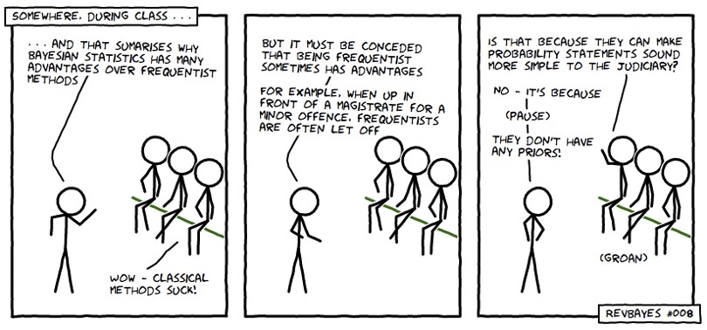
LATENT CLASS MODEL - level iii - priors
HYPER PRIOR DISTRIBUTIONS FOR INDEX TEST
PRIORS FOR REFERENCE STANDARD
HSROC
THETA ~ dunif(-10,10)
LAMBDA ~ dunif(-6,6)
beta ~ dunif(-2,2)
for(j in 1:2) {
tau[j] <- pow(sigma[j],-2)
sigma[j] ~ dgamma(4,2)
Bivariate
mu[1] ~ dnorm(0,0.25)
mu[2] ~ dnorm(0,0.25)
rho ~ dunif(-1,1)
prec[1] ~ dgamma(2,0.5)
prec[2] ~ dgamma(2,0.5)
tau[1]<-pow(prec[1],-0.5)
tau[2]<-pow(prec[2],-0.5)
Informative priors
Non-informative priors
#s2 ~ dbeta(1,1)
#c2 ~ dbeta(1,1)
Restrictive priors
#s2 ~ dbeta(1,1)I(0.3,)
#c2 ~ dbeta(1,1)I(0.7,)
Parameter | Mean | Range (min-max) | Be (a, b)
Se | 0.8 | 0.66-0.9 | beta (126.13, 31.53)
Se | 0.75 | 0.62-0.86 | beta (142.57, 47.52)
Sp | 0.95 | 0.8-0.999 | beta (63.2, 3.33)
Notes:
We defined our model we saw the code for level one and two which leads us to level three the specification of priors. The only problem with priors is that you might go to jail even for a minor offence as illustrated in the picture.
For HSROC we need to specify priors for THETA LAMDA BETA and the variances. We usually use uninformative priors that give all plausible values for these paramters.
For the bivariate we need to specify for the means and the variances as well the correlation coefficient. Means follow a normal distribution
The priors for the reference test can be non informative so all plausible values or restrictive for example we know that below 30% we donot expect the se to be or below 70 for the specificity. Of course for matters of sensitivity analysis we use informative priors. As already stated se was found 60 % in one study around 80 percent in an another so a beta distribution with mean around 80 % and range from 60 to 90% would include this prior information.

Slide 13
Results
Updated additional 5 studies -> total 39 studies
Similar SE and SP btw the different methods
Higher SP and SE for culture
Model | Index test |  | Culture test
 | Sensitivity % (95%CI) | Specificity % (95%CI) | Sensitivity % (95%CI) | Specificity % (95%CI)
SCS method | 95.5 (9.,2,97.1) | 96.9 (95.2,98)
Bayesian HSROC without gold standard | 94.1 (92.32,95.83) | 95.78 (94.35,97.09) | 97.09 (95.19,98.92) | 99.98 (99.99,1)
Bayesian HSROC | 94.54 (92.98,96.09) | 95.47 (94.09,96.77)
Bivariate method (mada package) | 94.8 (93,96.2) | 97.2 (96.3,97.9)
Notes:
We updated the meta analysis so five additional studies were included. We can see from the table that we also conducted the SCS method with the new data but also the bivariate model by reitsma using the mada package in R for comparison reasons.
We can observe that se and sp are similar with minor differences perhaps due to the high number of studies . We can observe that culture has almost perfect specificity and higher sensitivity than multiplex which could explain why all methods have similar results because culture has excellent accuracy.

Slide 14
Bivariate latent class analysis-SHINNY APP
https://bayesdta.shinyapps.io/meta-analysis/
https://crsu.shinyapps.io/MetaBayesDTA/
Notes:
Here I included the links of the two shinny apps for the bivariate model that we could have a look

Slide 15
Conclusions-Recommendations
Bayesian approach to be preferred if the accuracy of the reference test is questioned
When high heterogeneity is expected -> Bayesian or SCS method
Threshold differences->Bayesian HSROC or SCS method
Meta-regression-> Bayesian or bivariate meta-analysis model
It is easier nowadays to implement Bayesian due to shinny apps and R packages
Decision-making trees and cost-benefit analyses
Prediction models
Notes:
Some final comments
If the accuracy of the reference standard is questioned you should do a Bayesian analysis.
As we said the bivariate method might overestimate when heterogeneity is high or with a small mumber of studies so in that case you could do the scs method or follow a Bayesian approach
We saw that when threshold differences are present HSROC and SCS method could be of assistance.
However meta regression , the inclusion of covariates can be done with Bayesian models bt of course you must deal with matters of convergence of your model so perhaps provide informative priors for some parameters
The bivariate by Reitsma also extends for the inclusion of covariates. The SCS method cannot for now be used with covariates.
As said you can use the shinny apps for Bayesian analysis.
Another usefull implementation of a Bayesian analysis is prediction and the use in cost benefit analysis and decision making trees.

Slide 16
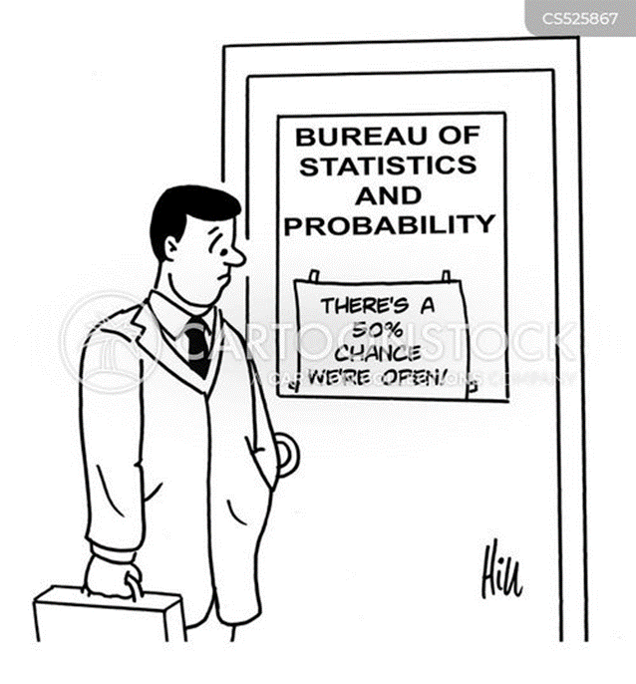
Thank you, any questions?
Notes:
And we reached the end of the presentation, thank you very much and of course there is 50% chance I will be answer your questions

