Slide 1

Airbnb Database Presentation
By Tom Schmaeling

Slide 2
Table of Contents
Introduction and Structure of Presentation
General Database Structure
Individual Table Examinations

Slide 3
introduction
This presentation is a part of the project of phase 2 and intends to provide an extensive overview of the database structure, it’s tables, relationships and constraints, as well as explain the reasoning behind them.
We will first explain the changes to the concept, the overall structure and elements of the database before examining each of the 27* tables that make up the database.
*One table has been removed; all changes are explained in the following 2 slides.

Slide 4
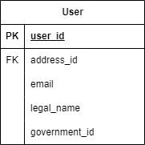
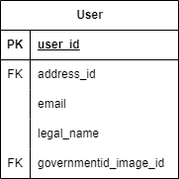
Changes
I have made some small adjustments compared to the conception phase that I would like to illustrate before introducing the individual tables.
The changes are visualized in the following slide as well for easier viewing
The ‘government_id’ attribute in the ‘User’ table has been changed to ‘governmentid_image_id’ as I noticed that the application requests users to submit a picture of their id.

Slide 5
Changes
I have decided to remove the optional triphistory table. The idea behind the table was to improve the access to the bookings of a guest for easier access. There is however not a significant enough improvement to justify the redundancy.
There have been some adjustments to the attribute distribution of the user, guest and host tables after reflecting the requirements/constraints of the individual attributes.
Small additional changes include:
Addresses now have an ‘address_type’ attribute
Messages now have an ‘owning_user_id’ attribute
Bookings no longer have the ‘transaction_id’ attribute

Slide 6
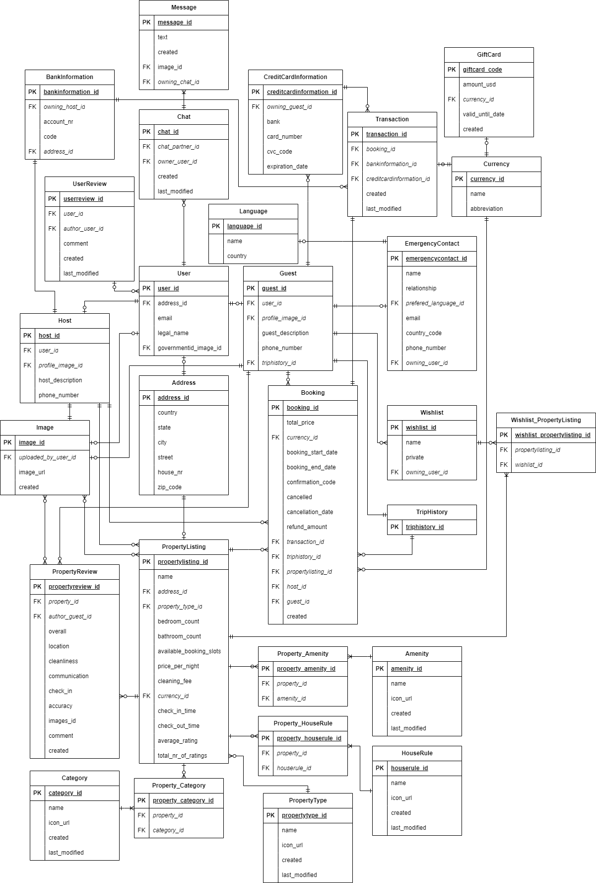
Structure
There are two major “blocks” of information the database needs to support: Users and Properties.
There are multiple tables facilitating each of these data sets, and their attributes.
The two categories of users, ‘guest’ and ‘host’ share a base ‘user’ class creating a joined subclass table strategy.
The ‘PropertyListing’ table includes relevant attributes for the properties offered on the page, multiple of which use N:M relations and therefore need to be normalized via additional tables.

Slide 7
Table - User
The User is the base class for all users and holds attributes any user will have
The ‘address_id’ is a foreign key that references the address table
The ‘governmentid_image_id’ is a foreign key that references the image table.

Slide 8
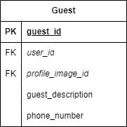
Table - Guest
The ‘user_id’ attribute refers back to the base class
‘profile_image_id’ references the id of an image that can be loaded to display the users profile image

Slide 9
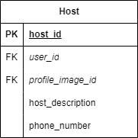
Table - Host
The ‘user_id’ attribute refers back to the base class
‘profile_image_id’ references the id of an image that can be loaded to display the users profile image
The reasoning for having this attribute in both subclasses is that it is only required for
The ‘triphistory_id’ is used to link together

Slide 10
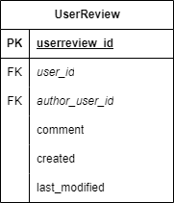
Table - UserReview
The ‘UserReview’ table holds all the reviews given on users.
These are comments left by hosts on the guest pages and are different from reviews left by guests on the property listing.
The comment attribute holds the user created written text
User and author_user ids and timestamps are also saved

Slide 11
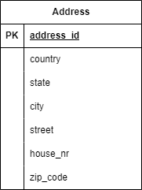
TABLE - Address
The address attributes themselves are self-explanatory in meaning.
The reasoning for the selection of attributes is the categorization or search user flow on the website.
An address can be used by either users, properties (listings) or banks.

Slide 12
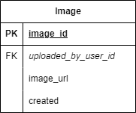
Table - Image
This table assumes that the images themselves are stored by a cloud storage provider for example.
This means that the attribute itself can be of type VARCHAR instead of having to save the image as a BLOB, which is inefficient.
The Table also stores the id of the user that uploaded the image.
The ‘created’ attribute is defaulted to the current timestamp, meaning it shows the time the image was uploaded.

Slide 13
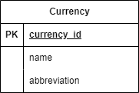
Table - Currency
The currency table represents all currencies available in the application.
Name represents the name of the currency while country represents the country it is used in.
Abbreviation is used for display purposes.
Currency is not a table that will see frequent changes and is rather used as a reference.

Slide 14
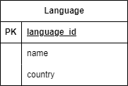
Table - Language
The language table represents all languages available in the application.
Name represents the name of the language while country represents the country it is used in.
The reason for this is that Airbnb differentiates between, for example, American and British English.
Language is not a table that will see frequent changes and is rather used as a reference.

Slide 15
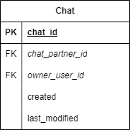
Table - Chat
A chat is a collection of messages, in the next slide we will inspect the ‘message’ table.
These messages are linked to a chat by sharing the same chat id.
Other than the ‘created’ and ‘last_modified’ timestamps, the chats table also holds both chat participants.

Slide 16
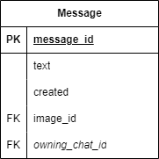
Table - Message
The message is linked to the chat via the chat id, represented here as ‘owning_chat_id’.
As Airbnb enables users to share images in chats, a message may contain an image instead of text. This necessitates the optional ‘image_id’ attribute.
The created timestamp is essentially the ‘sent’ timestamp of the message.

Slide 17
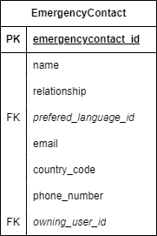
Table - EmergencyContact
The emergency contact different to a user as it is only a collection of information relevant to the contact without any of the functionality of an actual account.
All the information regarding the contact should be self-explanatory.
The ‘owning_user_id’ refers to the user that owns it.

Slide 18
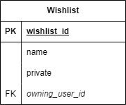
Table - Wishlist
Wishlists in the Airbnb application are a collection of property listings.
As this is a M:N relation it needs to be normalized, we achieve this by using this ‘wishlist’ and a ‘wishlist_propertylisting’ table (see next slide).
A user can have multiple Wishlists, hence the need for a name.
The ‘wishlist_id’ is used in the next table to normalize the M:N relation.

Slide 19
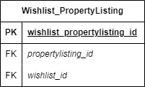
Table – Wishlist_PropertyListing
This table, as mentioned, is used to normalize the wishlist – propertylisting relation.
The table matches Propertylistings to Wishlists using the two foreign key ids.
The propertylisting table will be introduced in the following slides.

Slide 20
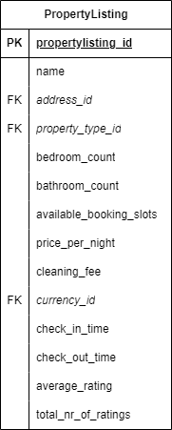
Table - propertyListing
The ‘PropertyListing’ table marks the second important ‘block’ of data mentioned in the introduction.
This table holds all relevant information for the listings and has multiple M:N relations that are not shown in the table itself.
These relations rely on the ‘propertylisting_id’ and are introduced in the following slides.

Slide 21
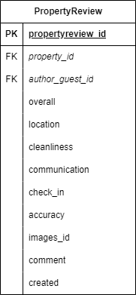
Table - PropertyReview
Similar to a User Review this table holds the reviews given by guests to properties.
It holds multiple ratings for overall, location, cleanliness, communication, check in and accuracy which are displayed on the listing page. These are represented as integers with values from 0 to 5. (Star rating)
Users can also add comments and images to the review.

Slide 22
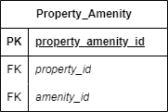
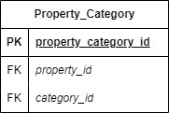
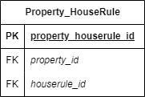
Table – Property_X
Each table is used to normalize a relation between the PropertyListing and their respective table.
The naming convention of these tables is meant to represent link between ‘PropertyListing’ and ‘Amenity’, ‘Category’ or ‘HouseRule’ table.
The individual tables they are related to will be introduced in the following slide.
These table are used to link other tables and hence do not necessarily need an id attribute. (I am considering removing these for the finalization phase and would appreciate feedback regarding this)

Slide 23
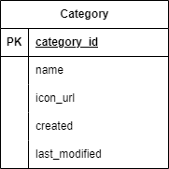
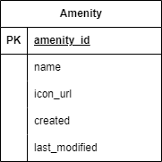
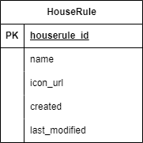
Table – Amenity/Category/HouseRule
These are the tables that are in a M:N relationship with the ‘PropertyListing’ table.
These table hold unexpectedly little information because they are only represented by their name and an icon in the application.

Slide 24
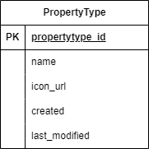
Table - PropertyType
Different to the previous three tables, the ‘PrototypeType’ is not in a M:N relation with the PropertyListing table.
In the Airbnb application, each property is listed based on its type.
These types are not frequently changed, and if they are, then they are changed by an admin.

Slide 25
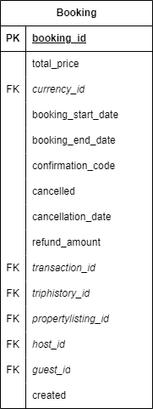
Table - Booking
Once a guest books a property, an entry in the ‘Booking’ table is made.
Most of the information listed is obvious and inferred by the attribute name.
The time frame is stated by the booking start and end dates.
The optional ‘cancelled’ Boolean and the relevant ‘refund_amount’ is only used in case the booking is cancelled.

Slide 26
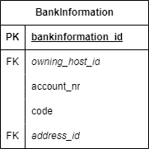
Table - BankInformation
As stated in the problem statement, Bank Information is only relevant for hosts.
The ‘BankInformation’ table references its address as well its owning host user via ids.
The rest of the information given in this table is example data relevant to Banks.

Slide 27
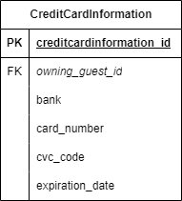
Table - CreditCardInformation
As stated in the problem statement, Credit Card Information is only relevant for guests.
The ‘CreditCardInformation’ table references its address as well its owning host user via ids.
The rest of the information given in this table is example data relevant to Banks.

Slide 28
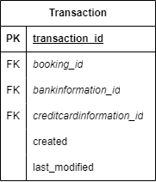
Table - Transaction
The transaction holds relevant payment information for each booking.
The table references ‘BankInformation’ and ‘CreditCardInformation’, as well as the booking it was made for.

Slide 29
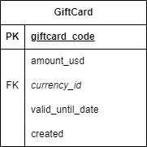
Table - GiftCard
The ‘GiftCard’ table contains information relevant to gift cards.
The ‘amound_usd’ attribute saves the value of gift card in us dollars.
The ‘currency_id’ attribute can then be used to convert it, if necessary

Slide 30
Thanks for reading
Additional information is given is the Pebble Pad submission as well as in code via comments.

