Slide 1

Airbnb Database Presentation Phase 2 - Implementation
By Tom Schmäling
Schmaeling_Tom_32111919_DLBDSPBDM01_P2_S

Slide 2
Table of Contents
Introduction
Changes compared to Phase 1
General Database Structure
Examining Individual Table

Slide 3
introduction
This presentation is a part of phase 2 and intends to provide extensive documentation of the database structure, it’s tables, relationships and constraints, as well as explain the provided test cases, and their results.
We will first explain the changes to the concept, the overall structure and elements of the database before examining each of the 27* tables that make up the database.
*One table has been removed; all changes can be found on the following slide.
I encourage the reader to run the test commands in their own environment for better readability, source code will be provided in phase 3.. any of the statements that are referred to but are not part of this presentation are very simple and are omitted without losing context. (usually simple select all test statements)

Slide 4
Changes
I have decided to remove the triphistory table. The idea behind the table was to improve the access to the bookings of a guest for easier access. There is however not a significant enough improvement to justify the redundancy.
There have been some adjustments to the attribute distribution of the user, guest and host tables after reflecting the requirements/constraints of the individual attributes.
Small additional changes include:
The primary key’s now have more descriptive names.
Addresses now have an ‘address_type’ attribute
User attribute ‘‘government_id’ was changed to ‘governmentid_image_id’
Messages now have an ‘author_user_id’ attribute
Bookings no longer have the ‘transaction_id’ attribute
PropertyListing now has the ‘owning_host_id’ attribute
PropertyReview attributes have changed to better align with the AirBnB app.
Currency attribute ‘amount_usd’ was changed to ‘amount’
BankInformation now has a ‘name’ attribute for the bank’s name

Slide 5
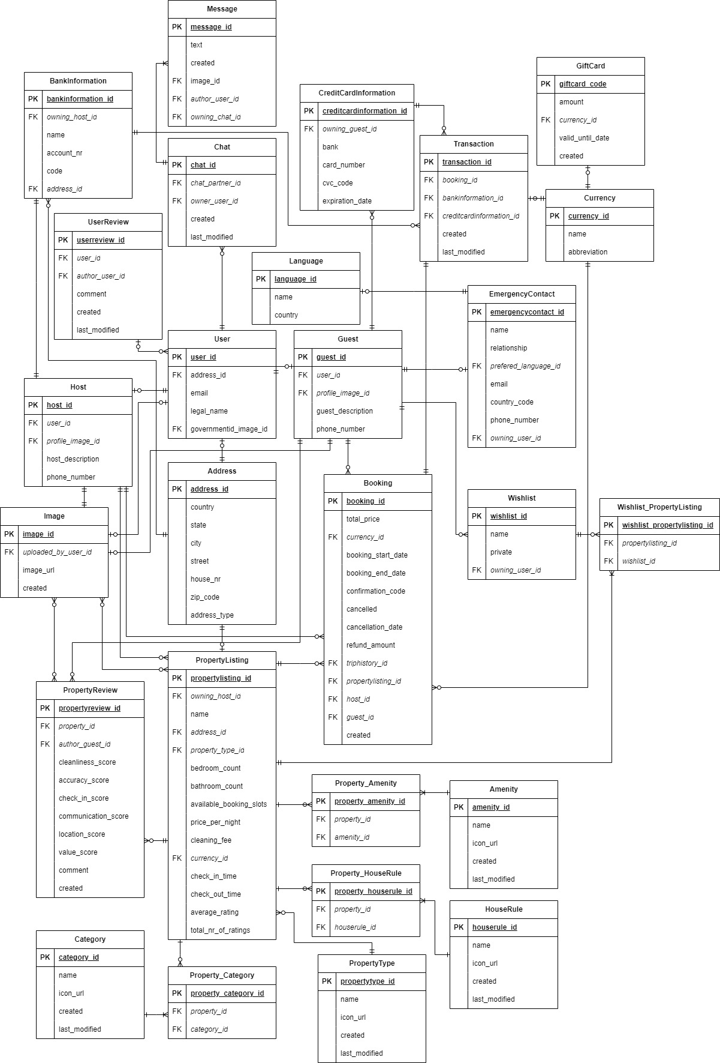
Structure
There are two main “blocks” of information the database needs to support: Users and Properties.
There are multiple tables facilitating each of these data sets, and their attributes.
The two categories of users, ‘guest’ and ‘host’ share a base ‘user’ class, creating a joined subclass table strategy.
The ‘PropertyListing’ table includes relevant attributes for the properties offered on the page, multiple of which use N:M relations and therefore need to be normalized via additional tables.

Slide 6
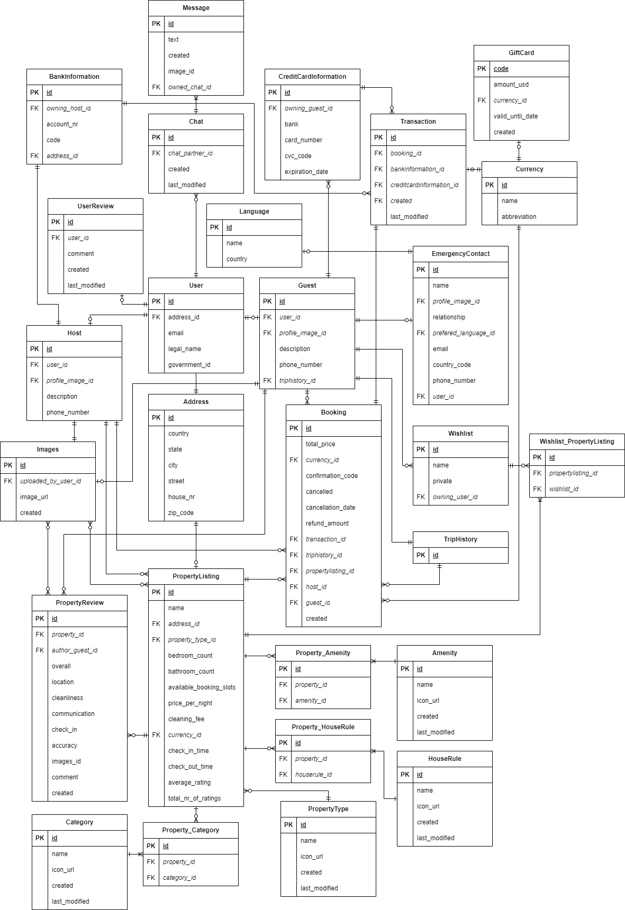
Structure Changes Overview
OLD
NEW

Slide 7

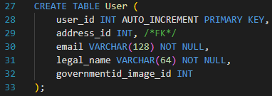
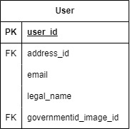
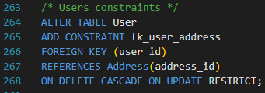
Table - User
COUNT
The User is the base/super class for all users and holds attributes any user will have.
The ‘address_id’ is a foreign key that references the address table.
The ‘governmentid_image_id’ is a foreign key that references the image table.
This table is tested via the host and guest tables which can be seen in the following two slides.
*code line indicator in screenshots may differ slightly compared to the source file.
Tested via ‘Guest’ and ‘Host’ test cases
Insert statements are part of ‘Guest’/’Host’ transaction.

Slide 8

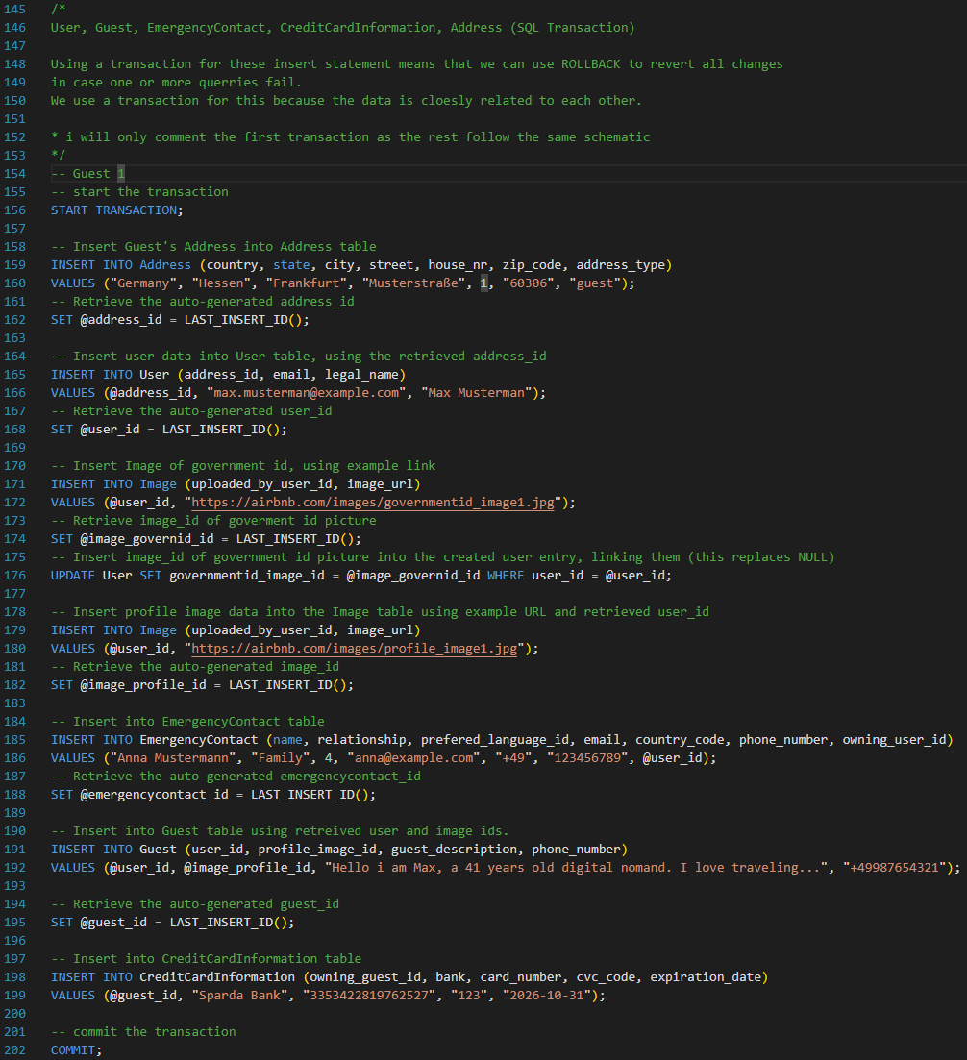
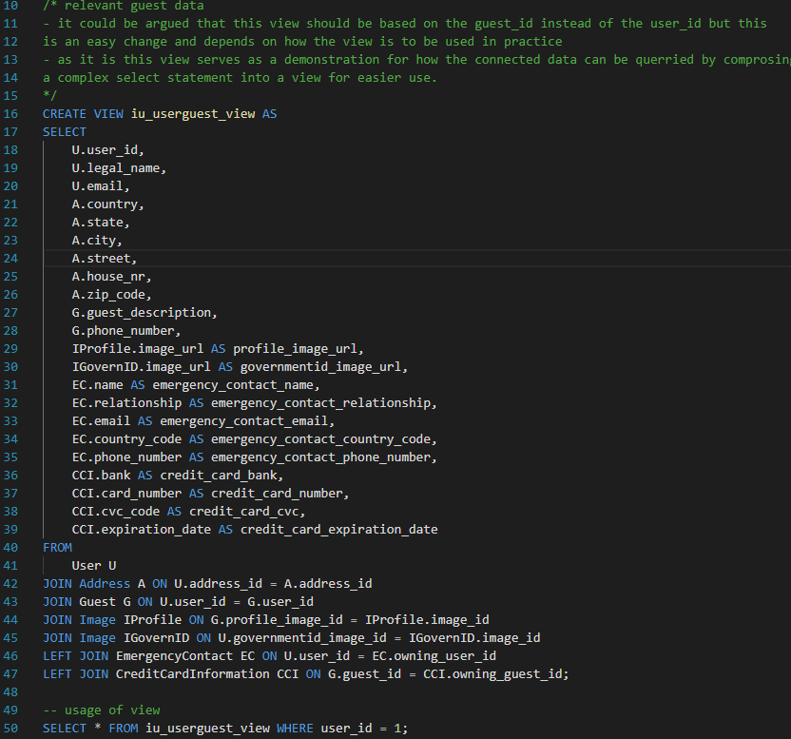
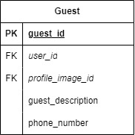
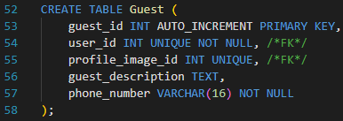
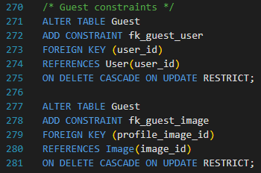
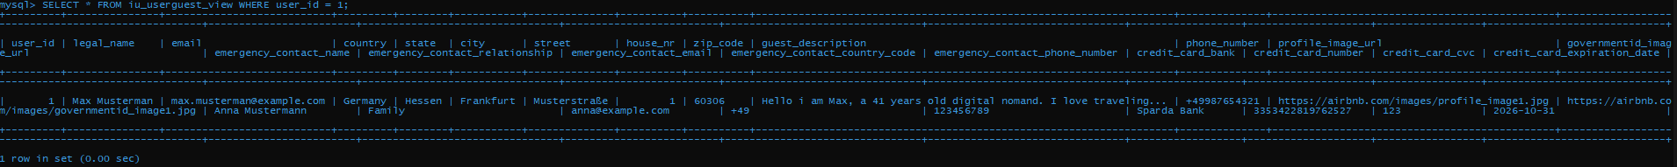
Table - Guest
COUNT
The ‘user_id’ attribute refers to the base class.
‘profile_image_id’ references the id of an image that can be loaded to display the users profile image. It refers to the image table.
The test case is meant to test the relationship between the ‘Guest’ table/class and its super class ‘User’. As well as testing other relevant relationships via all the foreign keys.
INSERT
Test Case
CREATE
Notes:
- The ‘user_id’ attribute refers back to the base class
- ‘profile_image_id’ references the id of an image that can be loaded to display the users profile image
- The test case is meant to test the relationship between the ‘Guest’ table/class and its super class ‘User’. As well as testing other relevant relationships.

Slide 9

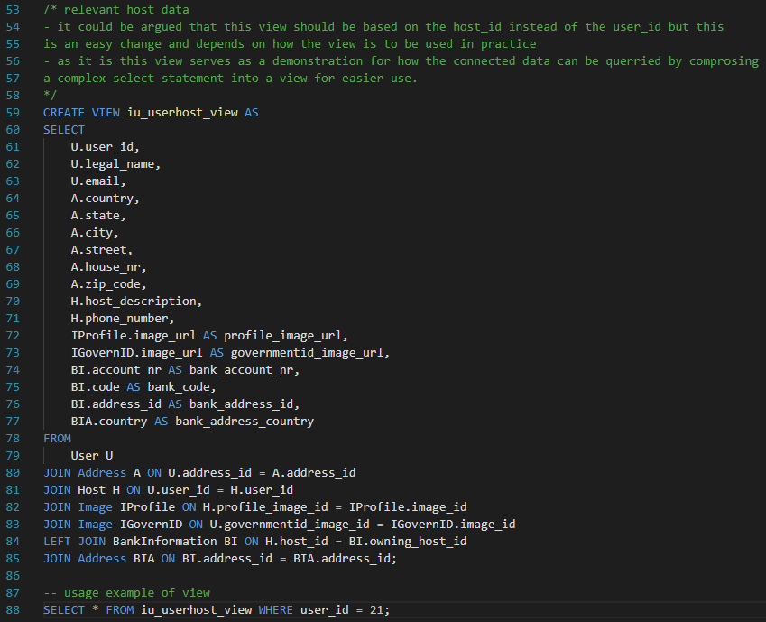
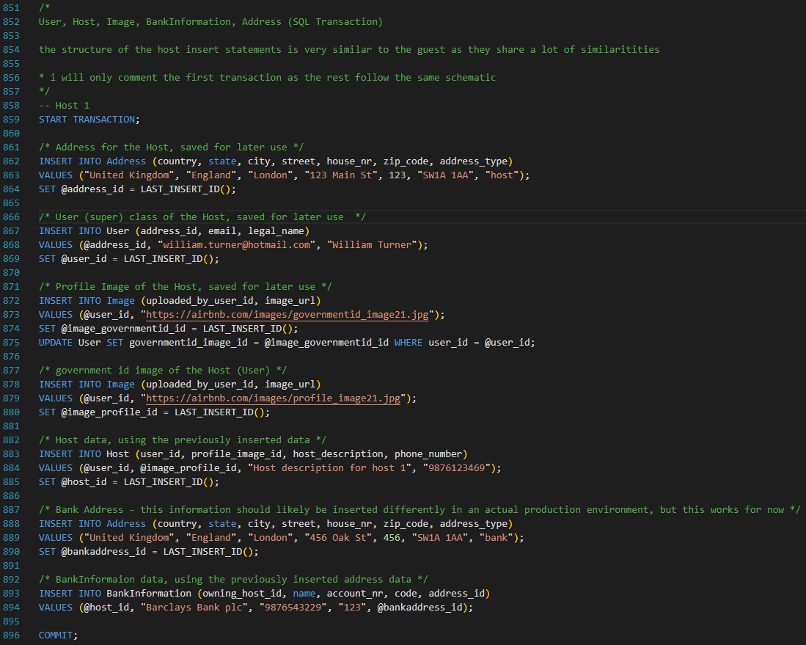
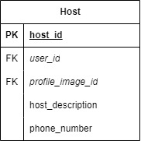
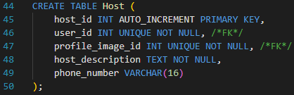
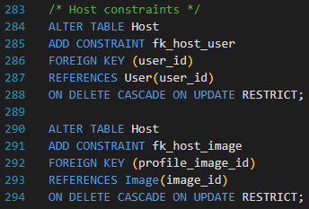
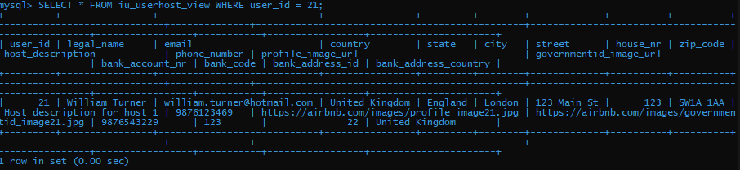
Table - Host
COUNT
The ‘user_id’ attribute refers back to the base class.
‘profile_image_id’ references the id of an image that can be loaded to display the users profile image.
The reasoning for having this attribute in both subclasses is that it is only required, or ‘NOT NULL’ for Hosts.
The test case is very similar to that of the previous guest class, adjusting where relevant relationships change compared to the previous slide. This should ensure that all the data for single user that is stored in multiple tables is properly connected.
Test Case
INSERT
CREATE

Slide 10

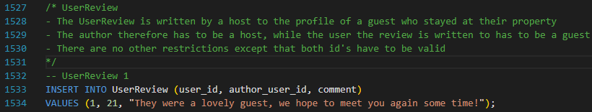
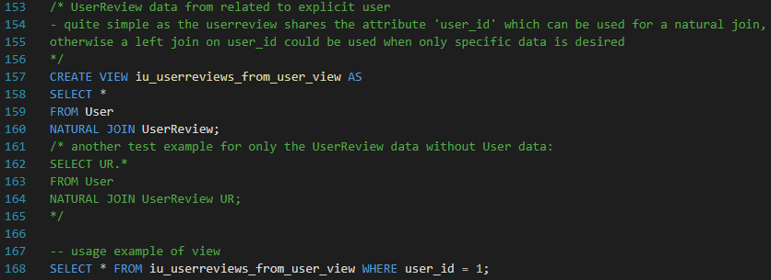
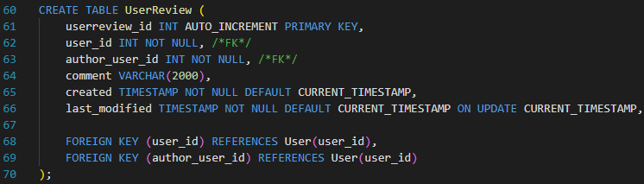
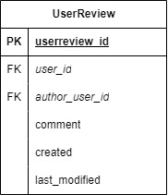
Table - UserReview
COUNT
INSERT
The ‘UserReview’ table holds all the reviews given on users.
These are comments left by hosts on the guest pages and are different from reviews left by guests on the property listing.
The comment attribute holds the user created written text.
User and author_user ids and timestamps are also saved.
The test case tests the content and relationship of user reviews and users by returning all data entries of user reviews for a given user.
CREATE
Test Case

Slide 11

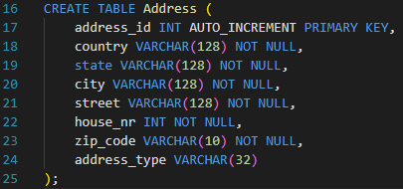
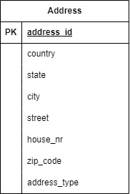
TABLE - Address
COUNT
CREATE
The address attributes themselves are self-explanatory in meaning.
The reasoning for the selection of attributes is the categorization or search user flow on the AirBnB website.
An address can be used by either users, properties (listings) or banks.
This table is tested is a part of many other tables and is therefore already tested more than enough. There is still a simple select all test to check for completeness of content in the test.sql file.
Tested and inserted via multiple other test cases.
Please refer to one of the user classes for an example

Slide 12

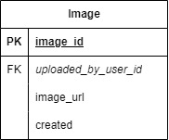
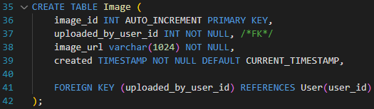
Table - Image
COUNT
This table assumes that the images themselves are stored by a cloud storage provider for example.
This means that the attribute itself can be of type VARCHAR instead of having to save the image as a BLOB, which is inefficient.
The Table also stores the id of the user that uploaded the image.
The ‘created’ attribute is defaulted to the current timestamp, meaning it shows the time the image was uploaded.
Like the ‘Address’ table, the ‘Image’ table is also part of many other tables, meaning that the relationships of this table are already thoroughly tested. There is, again, still a select all test to check for completeness of content.
CREATE
Tested and inserted via multiple other test cases.
Please refer to one of the user classes for an example

Slide 13


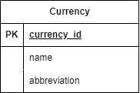
Table - Currency
COUNT
CREATE
The currency table represents all currencies available in the application.
Name represents the name of the currency while country represents the country it is used in.
Abbreviation is used for display purposes.
Currency is not a table that will see frequent changes and is rather used as a reference or lookup table.
This table is very simple and does not require complicated testing, a simple select all test can be found in the test.sql file.
INSERT
‘Currency’ is a simple table, see test case in test.sql

Slide 14


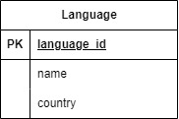
Table - Language
COUNT
CREATE
The language table represents all languages available in the application.
Name represents the name of the language while country represents the country it is used in.
The reason for this is that Airbnb differentiates between, for example, American and British English.
Language is not a table that will see frequent changes and is rather used as a reference or look up table.
Like the ‘Currency’, this table is also very simple, a test for content should suffice for this table, which can be found in the test.sql file.
INSERT
‘Language’ is a simple table, see test case in test.sql

Slide 15

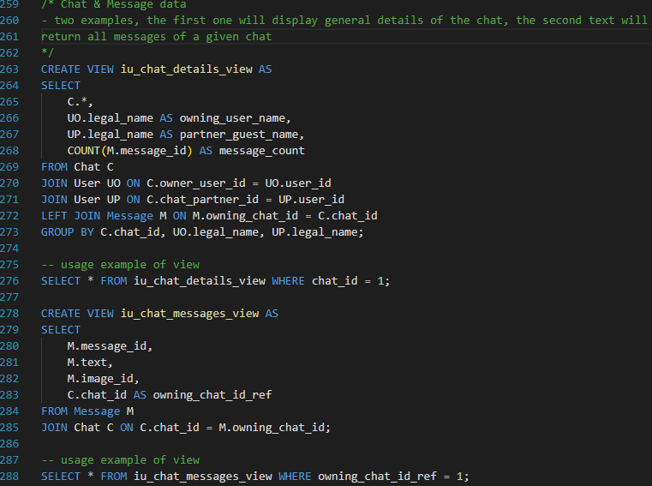
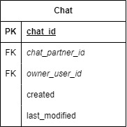
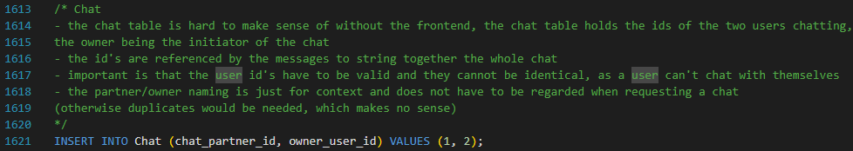
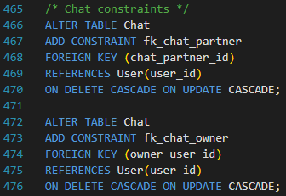
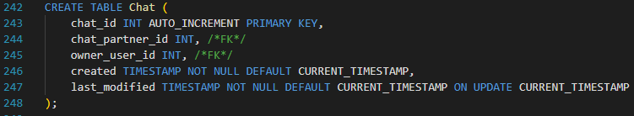
Table - Chat
COUNT
Test Case
A chat is a collection of messages, in the next slide we will inspect the ‘message’ table.
These messages are linked to a chat by sharing the same chat id.
Other than the ‘created’ and ‘last_modified’ timestamps, the chats table also saves both chat participants.
The test case for this table works in combination with the message table (next slide). The first test case checks the general content of the chat table.
INSERT
CREATE

Slide 16

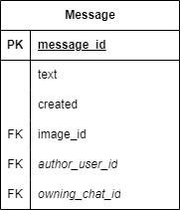


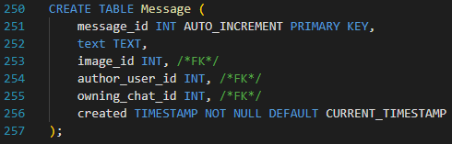
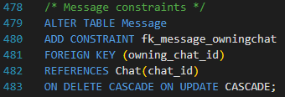

Table - Message
COUNT
Test Case
The message is linked to the chat via the chat id, represented here as ‘owning_chat_id’. The ‘author_user_id’ attribute holds the author; Both id’s can be used to reconstruct a chat.
As Airbnb enables users to share images in chats, a message may contain an image instead of text. This necessitates the optional ‘image_id’ attribute.
The created timestamp is essentially the ‘sent’ timestamp of the message.
The second test case in the screenshot tests the relationship of ‘Chat’ and ‘Message’ tables by returning all data entries of messages for a given Chat.
INSERT
CREATE

Slide 17

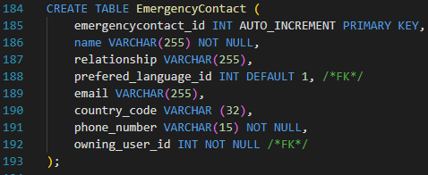
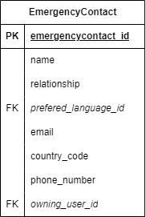
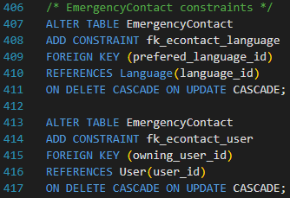
Table - EmergencyContact
COUNT
The emergency contact is different to a user as it is only a collection of information relevant to the contact without any of the functionality of an actual account in the application.
All the information regarding the contact should be self-explanatory.
The ‘owning_user_id’ refers to the user that “owns” the entry.
This table is covered in the Guest user test cases, another simple select all statement is provided in the test.sql file to check for completeness of content.
CREATE
INSERT
‘Language’ is a simple table that gets added to during the guest transaction.

Slide 18

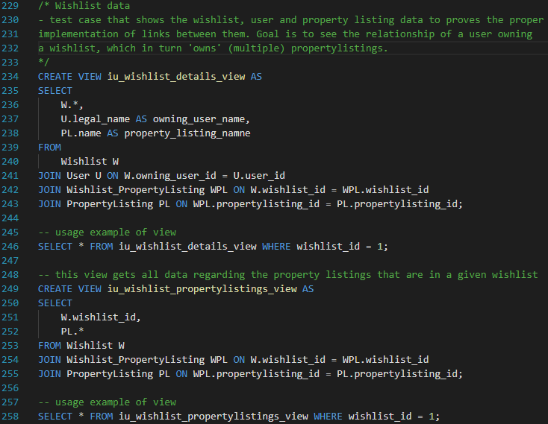
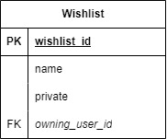
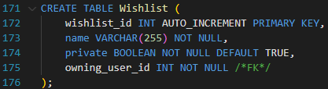
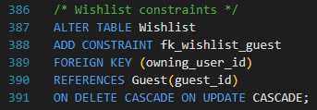
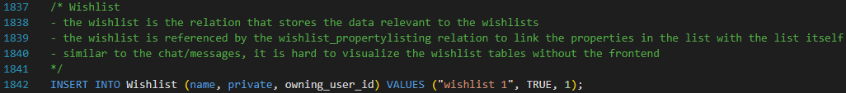
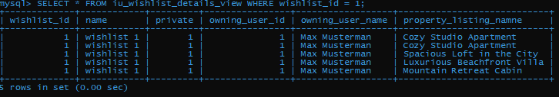
Table - Wishlist
COUNT
Test Case
Wishlists in the Airbnb application are a collection of property listings.
As this is a M:N relation it needs to be normalized. We achieve this by using this ‘wishlist’ and a ‘wishlist_propertylisting’ table (see next slide).
A user can have multiple Wishlists, hence the need for a name.
CREATE
The ‘wishlist_id’ is used in the next table to normalize the M:N relation.
The table works in close relation to the ‘wishlist_propertylisting’ table (next slide). This first test case checks for general data of the wishlist table and other related tables in conjunction. The second test checks the relation of a wishlist and its propertylistings.
INSERT

Slide 19

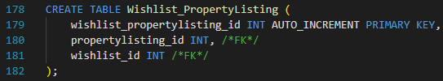
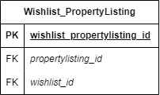
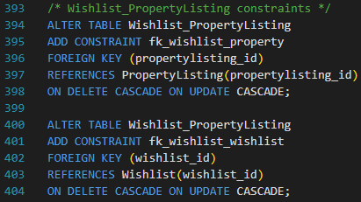

Table – Wishlist_PropertyListing
COUNT
Test Case
This table, as mentioned, is used to normalize the wishlist – propertylisting relation.
The table matches Propertylistings to Wishlists using the two foreign key ids.
The propertylisting table will be introduced in the following slides.
As explained in the previous slide, this table stands in close relation to the wishlist table. The second test case demonstrates the relationship of a wishlist with the propertylisting table via the link of this table very well.
CREATE
INSERT

Slide 20

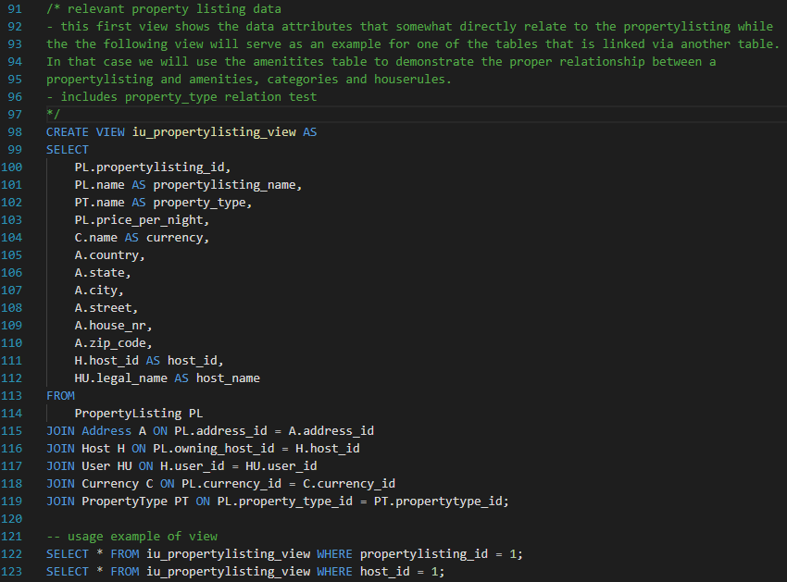
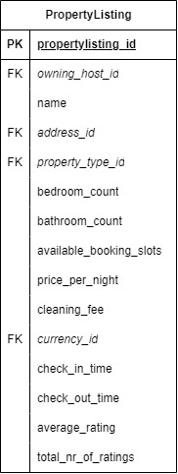
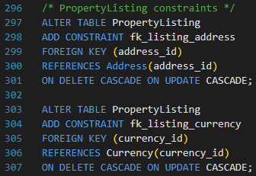


Table - propertyListing
COUNT
Test Case
The ‘PropertyListing’ table marks the second important ‘block’ of data mentioned in the introduction.
This table holds all relevant information for the listings and has multiple M:N relations that are not shown in the table itself.
These relations rely on the ‘propertylisting_id’ and are introduced in the following slides.
Although many of the relations of this table have already been tested, this table is of great importance to the overall system. It is therefore reasonable to create a test case that generally tests all relationships of this table. Said test case can be seen here, it focuses on returning relevant data from all tables that have a relationship with the propertylisting table. (Either via property or host id)
CREATE
INSERT

Slide 21






Table - PropertyReview
COUNT
Similar to a User Review this table holds the reviews given by guests to properties.
It holds multiple ratings/scores which are displayed on the listing page. These are represented as integers with values from 0 to 5. (Star rating). The application should make sure that the input is an integer within the given range before sending it to the DBMS.
Users can also add comments to the review.
The test case simple checks the relationship between propertylistings and reviews, as well as the review content.
CREATE
Test Case
INSERT

Slide 22









Table – Property_X
COUNT
*X = Category/Amenity/HouseRule
Each table is used to normalize a relation between the PropertyListing and their respective table. I see these tables as one equivalence class.
The naming convention of these tables is meant to represent the link between ‘PropertyListing’ and ‘Amenity’, ‘Category’ or ‘HouseRule’ table.
The individual tables they are related to will be introduced in the following slide.
These table are used to link other tables and hence do not necessarily need an id attribute. (I am considering removing these ids for the finalization phase and would appreciate feedback regarding this)
The test case checks the link of the propertylisting to the respective table via the link of these tables by returning data of each data entry.
Test Case
CREATE
INSERT

Slide 23







Table – Amenity/Category/HouseRule
COUNT
These are the tables that are in a M:N relationship with the ‘PropertyListing’ table.
Like the tables in the last slide, I also consider these tables one equivalence class.
These table hold unexpectedly little information because they are only represented by their name and an icon in the application.
Relevant for test cases are the relationships of these tables; these are already tested via other test cases, resulting in these simple queries, which check for content.
CREATE
INSERT
Simple tables, which are tested in test case on previous slide.

Slide 24



Table - PropertyType
COUNT
*explained in the comment of the insert statement (2nd bullet point)
CREATE
Different to the previous three tables, the ‘PrototypeType’ is not in a M:N relation with the PropertyListing table.
In the Airbnb application, each property is listed based on its type.
These types are not frequently changed, and if they are, then they are changed by an admin.
The relevant relationship of this table is already tested in the propertylisting test case, the content itself is once again tested via a simple select all statement at the end of the test.sql file.
INSERT
‘PropertyType’ is tested via the ‘PropertyListing’ table test case.

Slide 25





Table - Booking
COUNT
CREATE
Once a guest books a property, an entry in the ‘Booking’ table is made.
Most of the information listed is obvious and inferred by the attribute name.
The time frame is stated by the booking start and end dates.
The optional ‘cancelled’ Boolean and the relevant ‘refund_amount’ is only used in case the booking is cancelled.
The test case displays that the relationships work as intended, and the related data is properly drawn into one coherent data entry.
Test Case
INSERT

Slide 26




Table - BankInformation
COUNT
CREATE
As mentioned in the problem statement, Bank Information is only relevant for hosts.
The ‘BankInformation’ table references the bank address as well its owning host user via the respective foreign keys.
The rest of the information given in this table is example data relevant to Banks.
This tables relationships are tested via other test cases (such as Host), the content itself is tested once again via a select all query at the end of the test.sql file.
Tested via multiple other test cases, insert statement happens in the ‘Host’ transaction.

Slide 27




Table - CreditCardInformation
COUNT
CREATE
As stated in the problem statement, Credit Card Information is only relevant for guests.
The ‘CreditCardInformation’ table references its owning host user via the foreign key.
The rest of the information given in this table is example data relevant to credit cards.
Counterpart to the previous table, it is likewise tested in the relevant user table, in this case ‘Guest’.
Both tables are also tested in the test cases of the ‘Transaction’ table in the following slide.
Tested via multiple other test cases, insert statement happens in the ‘Guest’ transaction.

Slide 28






Table - Transaction
COUNT
The transaction holds relevant payment information for each booking.
The table references ‘BankInformation’ and ‘CreditCardInformation’, as well as the booking it was made for.
The test case can be used to check if the relationships of the transaction table and the respective payment information and ‘booking_id’ are plausible.
Test Case
CREATE
INSERT

Slide 29



Table - GiftCard
COUNT
CREATE
The ‘GiftCard’ table contains information relevant to gift cards.
The ‘amount’ attribute in combination with the ‘currency_id’ attribute are used to store the value of the gift card.
The GiftCard table is quite simple and not as important as other tables to the functionality of the system and therefore does not warrant a complicated test case, content is checked again at the end of the test.sql file.
INSERT
‘GiftCard’ is a simple table, see content test in test.sql

Slide 30
Thanks for reading
I am looking forward to your feedback!

