Slide 1
Habit Tracking App
Python Application with DB back-end.
Made by Tom S.
https://github.com/LeftEmpty/habit_tracker/

Slide 2
Table of Contents
Overview
Features
Structure
Data Flow
Usage
Usage instructions mirrored from GitHub repository
Database
Table Structure - ER Diagram
Request to Controller - Example
Back-end
Object Classes & Request Handler
Front-end
GUI Class Setup
Usage
Chapters 3 through 6 explain how the project / code works. They don’t touch the project’s content or usage and could therefore be ignored. I strongly recommend reading the database chapter.

Slide 3
Overview
Features
Structure
Data Flow

Slide 4
Features
App features include:
Graphical User Interface (GUI)
User login / register
Habit creation, editing, and deletion
Public & Private Habits (explained further on following slides)
User & Habit statistics
SQLite3 Database controller (incl. Logger & Test Data)
Test unit
Usage is clearly explained in the GitHub repository’s *Readme!
*https://github.com/LeftEmpty/habit_tracker/?tab=readme-ov-file#usage-instructions

Slide 5
Structure
The following showcases and explains the overall (folder) structure of the project.
GUI
Consists of the main class, screens & widgets which include popup windows.
Obj (Objects)
User based system.
Users own Subscriptions, actions/requests use the users id.
The user is also set as cur_user in the GUI on successful login)
Separated Habits and Subscriptions to support private and public habits.
A Habit Subscription is based on a Habit Data and contains additional information about periodicity and streaks.
The end-user only sees habits, the name ‘subscription’ is only used in-code.
Request handler acts as a sort of API that interfaces object classes and the database controller.
This should enable quick and easy adjustment or replacement of the database to support servers, different systems, etc.
DB
Database controller containing SQL queries.
Also contains the script that populates the database with test data (adjusts to date) and a logger.

Slide 6
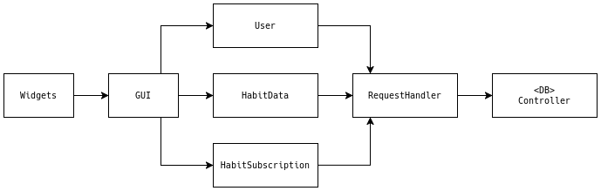
Data Flow Overview
The GUI takes in user input. The GUI itself may also use the currently logged in user to request a list of active habit subscriptions for example.
These actions/requests reach the request handler via the appropriate object class. The request handler acts as some sort of API for the classes to make requests to the database controller. The request handler finally formats the query result and returns it.

Slide 7
Usage
Features
Structure
Data Flow

Slide 8
Usage
I recommend reading the usage instructions via the GitHub’s Readme, mirrored here for content completion.
The following 4 slides will explain the usage instructions.
The chapters after this one include more detailed information about how the project works.

Slide 9
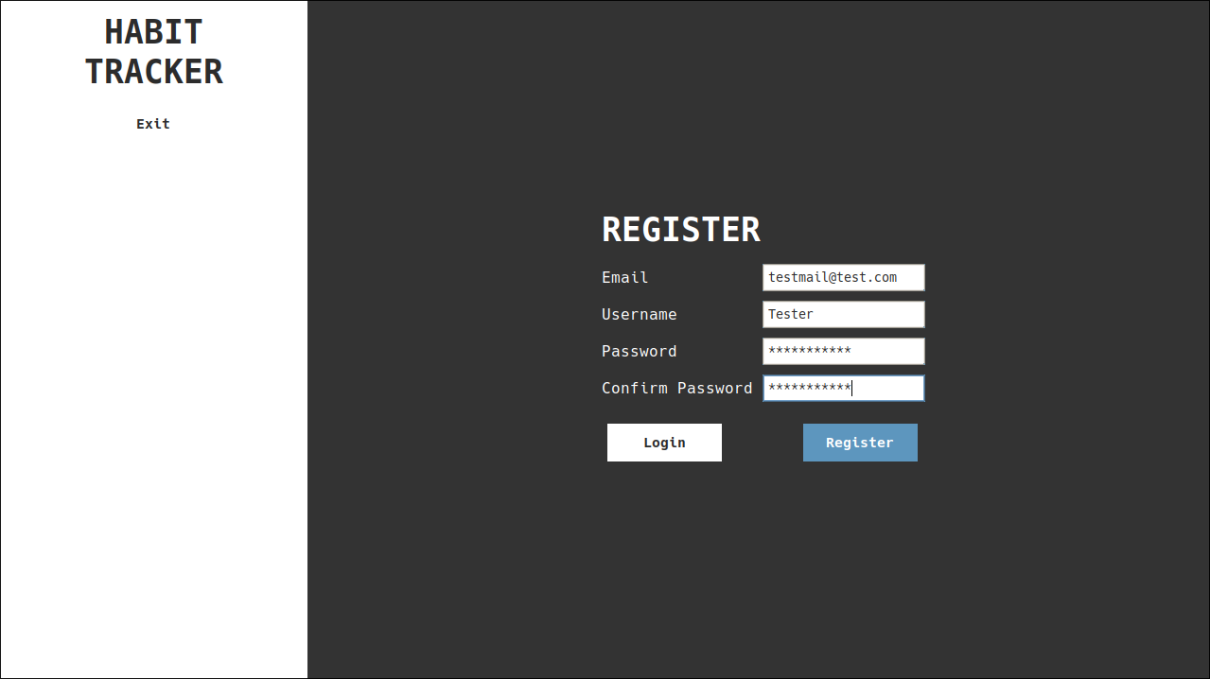
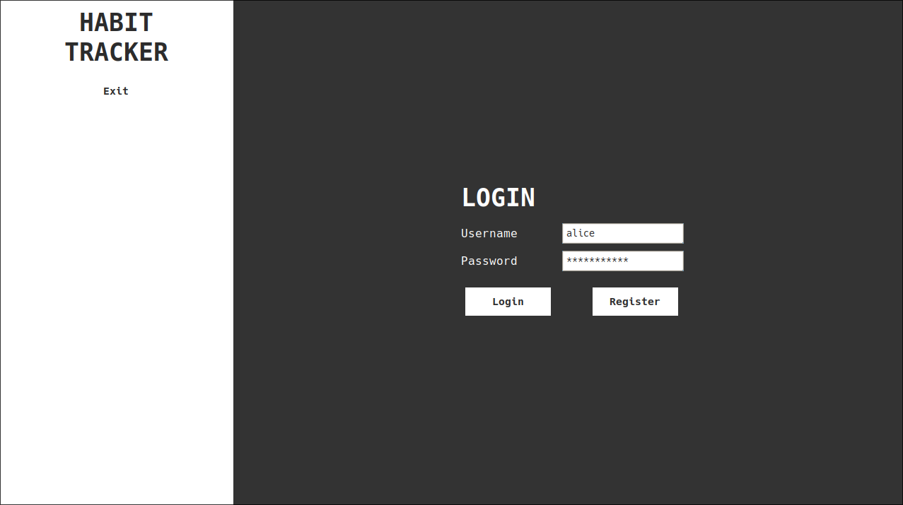
Launch the App & Register or Login
Launch the application
Installation guide in repository’s Readme.
Use the --debug argument to utilize test data.
Log in or register a user
Users alice & bob are provided when using the test data.
Password for both is simply 'password123'.
The login information is also shown in the Terminal log when using the --debug argument.
The Login/Register buttons swap the screen when on the 'wrong' screen or fulfill the action when already on the 'correct' screen.
Image: Register Screen Image: Login Screen

Slide 10
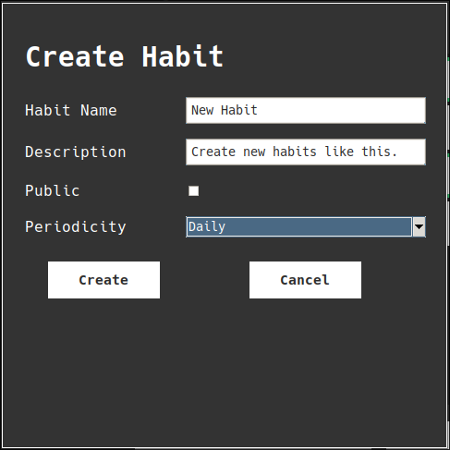
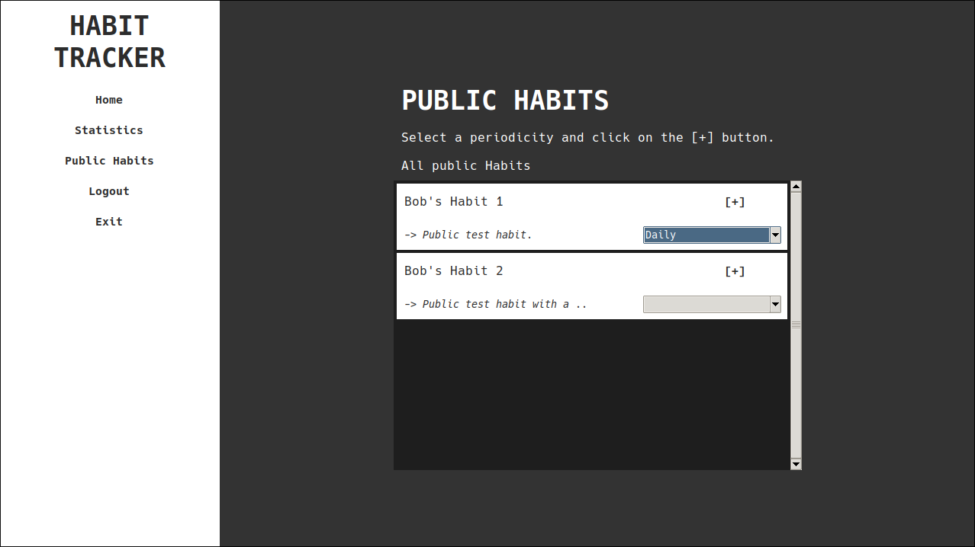
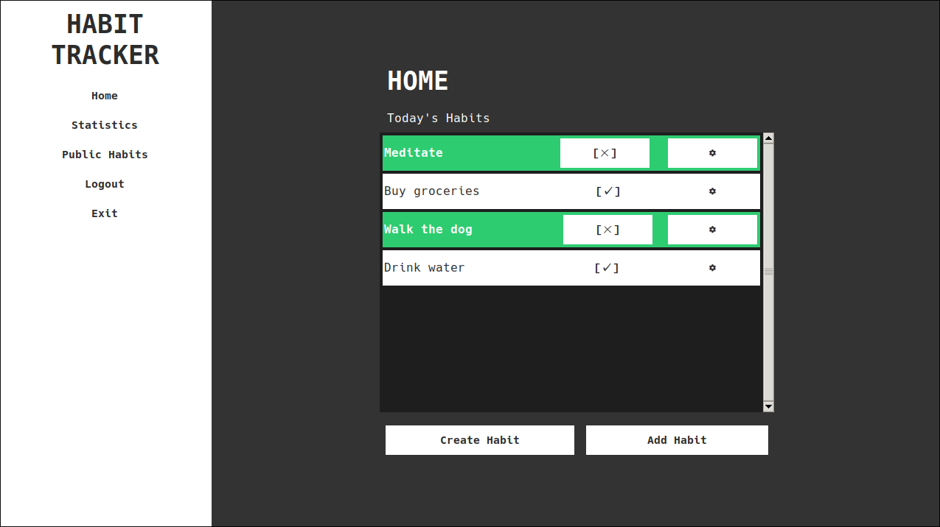
Create or Add Habits
Image: Create Habit Popup
On the Home screen you can view habits that are due today.
Here you can also 'Create' or 'Add' new habits by clicking one of the buttons.
Creating a new Habit will open a popup, selecting a periodicity and providing the required input will let you click the 'Create' button in the popup and the habit will be created and automatically subscribed to.
Adding a new habit will lead you to the public habits screen from which you can subscribe to a habit by selecting a periodicity and clicking the [+] button on the listed habit widget.
Image: Home Screen
Image: Public Habits Screen

Slide 11
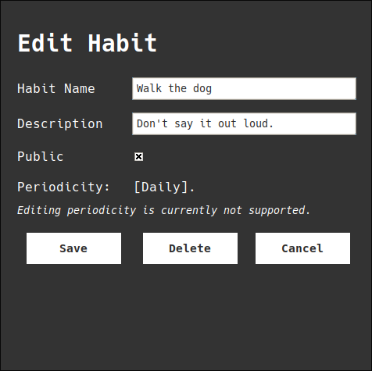
Complete Habits & Edit Habits
Mark habits as completed
On the Home screen (see above for image) you can mark your habits as done, by clicking the [✓] button on one of your listed subscribed habits.
Can be undone via the [✗] button that's shown on completed habits.
This will create/destroy a completion for the Habit Subscription.
Edit habits as necessary
Clicking the  button on a subscribed habit enables the user to edit the habit.
The habit data entry is then modified with the newly input data.
This propagates to all other users as well.
As of now, only the author user can edit the habit, and the habit data database entry is then modified accordingly.
There is currently no support for the periodicity setting.
Image: Edit Habit

Slide 12
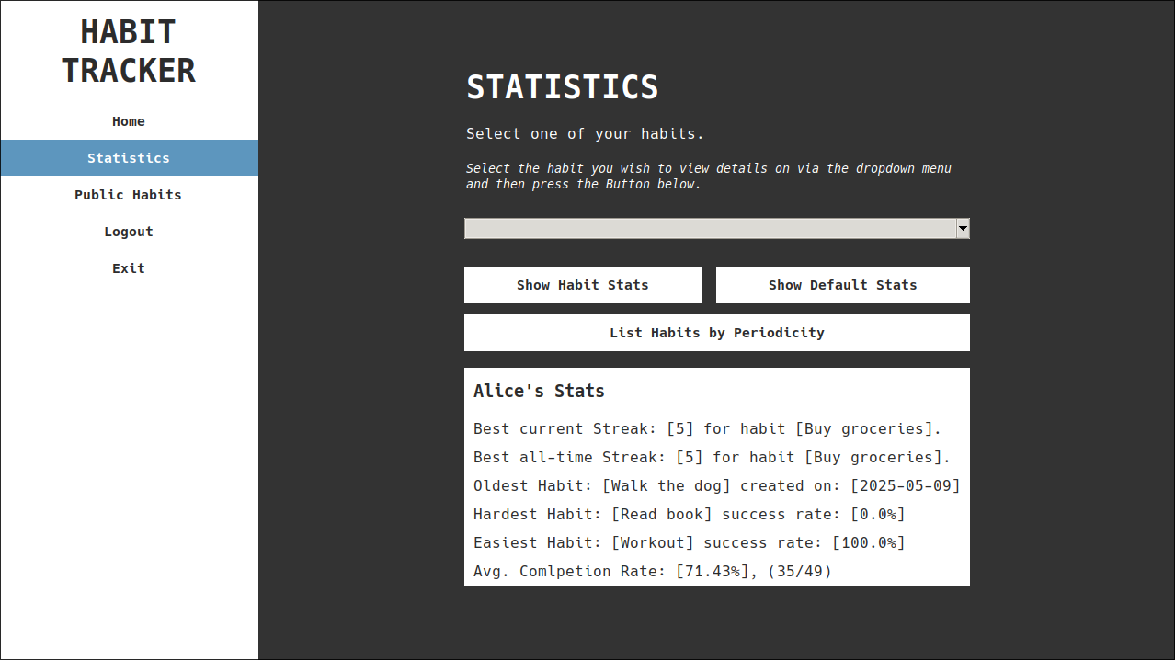
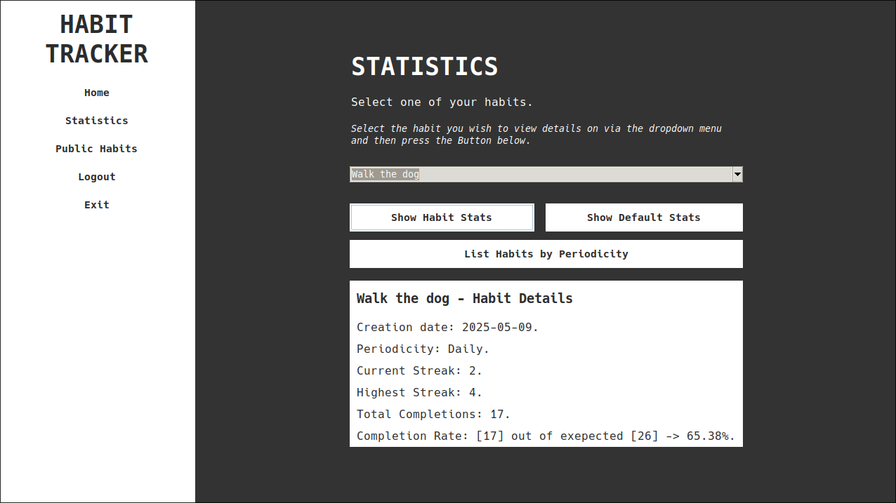
View statistics and track streaks & progress over time
On the Statistics screen, the user can view their overall Statistics, as well as view a list of all their subscribed habits ordered by periodicity via the List Habits by Periodicity button (Opens popup window).
Habit specific stats can be viewed by selecting a habit in the drop-down and clicking the Show Habit Stats button. This will update the screen to reflect the selected habits stats.
The Show Default Stats button can be used to view the general user stats again, this will also be shown when re-opening the screen.
Image: Default Statistics Image: Habit Statistics

Slide 13
Database
Table Structure – ER Diagram
SQL Query Example
Request to Controller Example

Slide 14
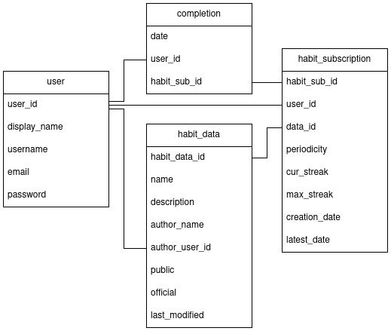
Table Structure - ER diagram
Subscriptions serve to ‘connect’ habit data with users
When a user ‘checks off’, i.e. completes a habit (via GUI), a new completion entry will be created.
Completions entries can be used to calculate stats for a given subscription and user.
There are no ‘failed completions’ the success rate is derived by calculating expected completions and the actual completions retrieved via a query.

Slide 15
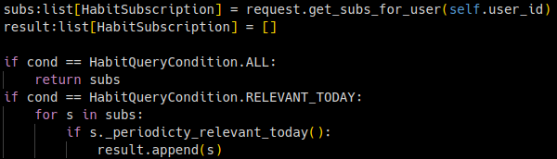
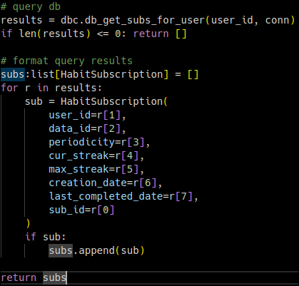
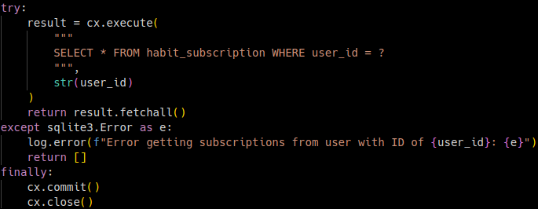
Request to Controller - Example
Example of a request chain, user —> request_handler —> db_controller.
User
Request Handler (request)
Database Controller (dbc)
Queries use try blocks and include error logging.
Input is not inserted directly to avoid injection attacks.
DB Controller only does it’s job, does not format anything.

Slide 16
Back-end
Object Classes & Request Handler

Slide 17
Object Classes
Object classes, as mentioned, consist of Users, HabitData, HabitSubscription (also contains Completion and Periodicity Enum)
The “request_handler.py” file is also in the obj folder but follows a functional programming paradigm allowing the aforementioned classes to use it’s functions as necessary.

Slide 18
Front-end
GUI Class Setup

Slide 19
GUI Class Setup
The main GUI class stores the current user and theme (Tkinter style). It is mainly responsible for displaying the base layout and populating the sidebar.
Screen classes (base-class & individual classes) are instantiated on app launch and receive data in the on_screen_opened class. Opening a screen via the sidebar ‘opens’ it in the content_area of the base layout in the GUI class.
Widgets.py contains a lot of useful widgets and popup windows used by the screens.

