Slide 1
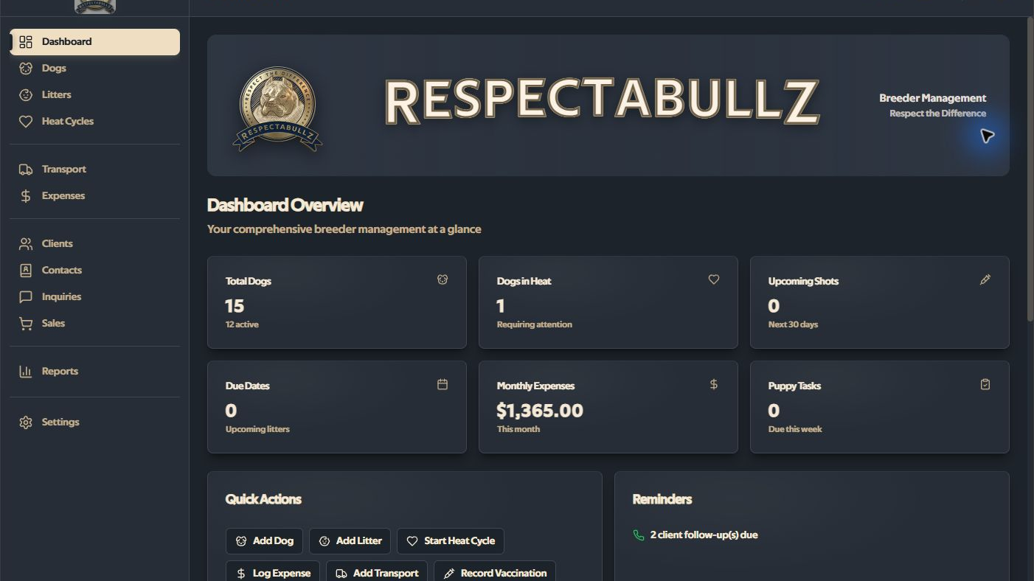
Respectabullz under constraint
Supporting product and reliability evidence
Containment, recoverable state, and reproducible local evidence—without an adoption, recovery, audit, or release-readiness claim.
Live synthetic capture • com.respectabullz.demo • no real records
v1.10.3 • live synthetic capture: docs/case-study/screenshots/hero-dashboard.jpg
1

Slide 2
Local-first raises the cost of silent failure
One user, one Windows machine, two durable systems.
React and Tauri cross into SQLite and managed files. A database transaction cannot undo a filesystem change.
The reliability question is what durable state remains after interruption or ambiguity.
SQLite state
Managed-file state
Transactional within one connection
Schema + foreign-key invariants
No cloud recovery layer
Documents, photos, and logs
User-selected export paths
Interruption can leave residue
Source: README.md; docs/ARCHITECTURE.md; docs/RELIABILITY.md
2

Slide 3
Containment came before feature work
REMOVE
WITHDRAW
RENAME
Renderer credential path
No bundled PAT and no direct issue API from the renderer.
Unsafe destructive paths
Restore and unverified reset controls removed from the product surface.
Overstated outputs
Incomplete JSON and ZIP outputs relabeled partial exports.
Source: SECURITY.md; PRIVACY.md; docs/case-study/CASE_STUDY.md
3

Slide 4
The desktop bridge is the trust boundary
React renderer
Routes and forms
User-selected input
No direct DB access
No credential handling
Tauri bridge
Fixed SQL connection
Command allowlist
Path and size checks
Transactional writes
Durable local state
SQLite application DB
Managed documents
Quarantine + staging
Startup reconciliation
RENDERER
TRUST BOUNDARY
LOCAL STATE
Scoped claim: fixed SQL preload + narrowed Tauri capabilities • not an OS sandbox
4

Slide 5
Restore withdrawn / remediation in progress
What is true today
The historical flow could mutate files before database import completed. Restore is disabled. Current JSON and ZIP outputs are partial exports; the ZIP target is non-atomic and can be interrupted.
Enablement gate
A future recovery claim requires a versioned complete format, inventory and hashes, staging, a pre-restore snapshot, rollback and interruption tests, supported compatibility, and ephemeral Windows evidence.
Source: docs/BACKUP_FORMAT.md • proposal only; not implemented
5

Slide 6
Local exact-tree gates passed; release gates remain
v1.10.3 final local checkpoint
Tests, lint, type checks, builds, packaging, scans, and SBOM generation passed locally. The NSIS artifact is unsigned; public final-SHA CI remains pending.
354/354
39/39
22.21%
frontend tests
39 files
Rust tests
real SQLite paths
statements / lines
62.73% branches
27.85% functions
NSIS 29,413,927 bytes • SHA-256 3167be8a9a0b774a72bcc4b1af30fd00ac95e03215c4bc6dd4d79d74b020bd11 • NotSigned
App EXE 32,942,080 bytes • SHA-256 4b23378378504c47f205520bec77b7971accb3a67e583a06b2949d76d520cf44 • NotSigned
6

Slide 7
Residual risk stays visible
External containment
Historical credential revocation or rotation is outside repository proof.
Release evidence
Local exact-tree gates passed. NSIS is unsigned; public final-SHA Windows smoke/CI remains pending.
Recovery
No supported restore, complete backup format, or verified factory reset.
Assurance scope
Cargo audit: 5 vulnerability entries. Filesystem scope remains path-specific; no independent audit or adoption study.
Source: docs/THREAT_MODEL.md; docs/case-study/DEPENDENCY_RISK.md
7

Slide 8
PRODUCT + RELIABILITY ENGINEERING
Contain. Model failure.
Prove the boundary.
Narrow the promise
Preserve durable state
Make evidence traceable
Respectabullz employer case study • supporting evidence, not assurance

