Slide 1
Contents
RDB latency
RDB to AOF, AOF to RDB
Partial Sync
Cluster Communication and Reshard

Slide 2
RDB + AOF
RDB File
All keys & values dump
Using AOF file,
Not full dump, but partial dump by using file
AOF file

Slide 3
RDB 1.version(main server)
Client
AOF FILE
RDB FILE
Main Server
DISK

Slide 4
RDB 2.version(Child Process)
Client
AOF FILE
RDB FILE
Main Server
- Query exec
Child process
- RDB process
DISK

Slide 5
RDB
Child Process
Redis only copy page table which point the instance
Later Redis switch the pointer to point the new Value (robj)
In this think, rdb-latency is regardless of data size
Old Value
Hash table(Key)
New Value

Slide 6
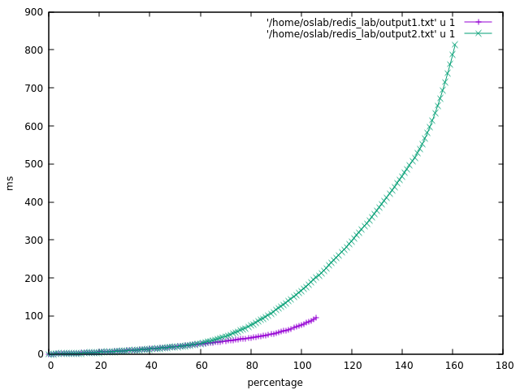
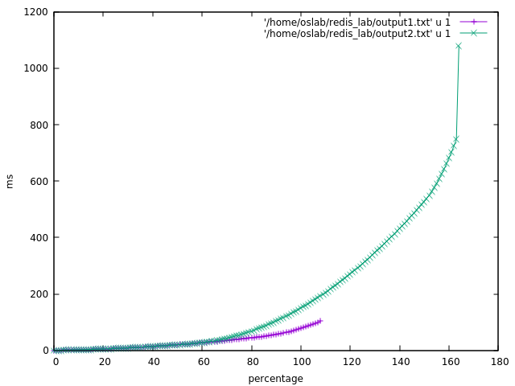
Memtier_Benchmark (1)
Configuration ( T 1 / C 1 / D 100KB / N 210000)
NO_RDB
WITH_RDB

Slide 7
RDB to AOF && AOF to RDB
RDB
Binary file of Key Value Pair
Magic
Compressed
AOF is slower recovery than RDB
RDB is faster and lighter than AOF
Redis prioritizes the RDB over the AOF
Why AOF cannot change to RDB?
Because while replaying the AOF file, Server cannot execute the commands
Because Redis must keep the latest version
Why RDB cannot change to AOF?
RDB files are compressed and stored as key value
They need to be uncompressed and again compressed in AOF way
To save as an AOF file, it must be blown in the form of command (must stop the server with same reason above)
AOF
Example:
Set key value
Lpop key value
Rpush key value
Ziplist key value

