Slide 1
Contents
RDB latency
RDB to AOF, AOF to RDB
Partial Sync
Cluster Communication and Reshard

Slide 2
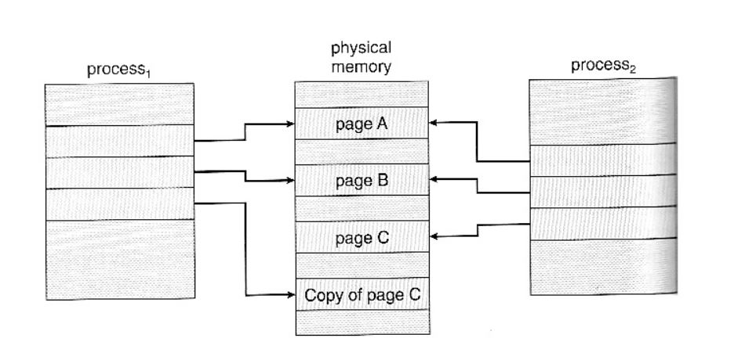
RDB latency
There is no data copy in redis (only copy page table)
Redis make object in memory before storing the data
Finally the object is linked to the key with hash table

Slide 3
RDB
Old Value
Redis only copy page table which point the instance
Later Redis switch the pointer to point the new Value (robj)
In this think, rdb-latency is regardless of data size
Hash table(Key)
New Value

Slide 4
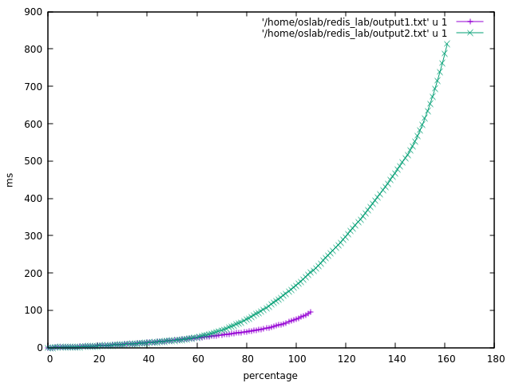
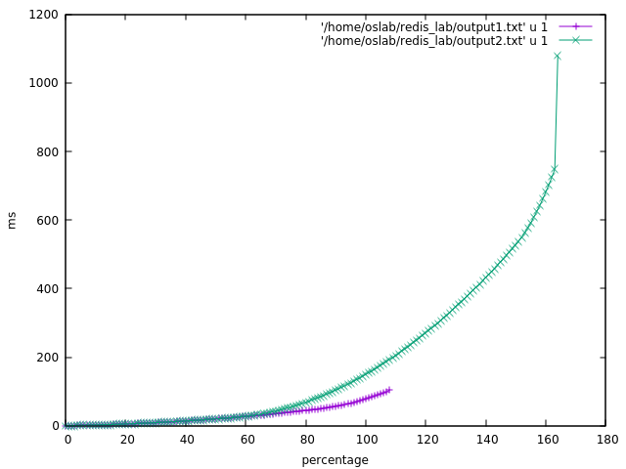
Memtier_Benchmark (1)
Configuration ( T 1 / C 1 / D 100KB / N 210000)
NO_RDB
WITH_RDB

Slide 5
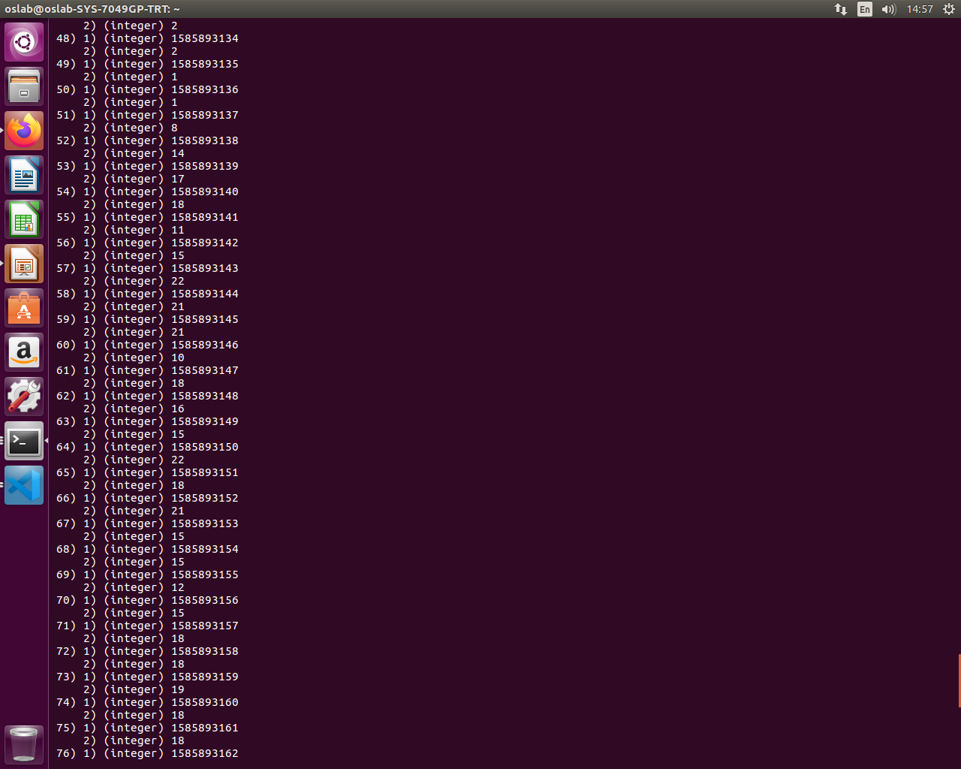
Make Object
Storage traffic && network traffic
Transfer the data
RDB
Memory
Storage
Kernel
Network packet

Slide 6
RDB to AOF && AOF to RDB
RDB
Binary file of Key Value Pair
Magic
Compressed
AOF is slower recovery than RDB
RDB is faster and lighter than AOF
Redis prioritizes the RDB over the AOF
Why AOF cannot change to RDB?
Because while replaying the AOF file, Server cannot execute the commands
Because Redis must keep the latest version
Why RDB cannot change to AOF?
RDB files are compressed and stored as key value
They need to be uncompressed and again compressed in AOF way
To save as an AOF file, it must be blown in the form of command (must stop the server with same reason above)
AOF
Example:
Set key value
Lpop key value
Rpush key value
Ziplist key value

Slide 7
PartialSync
Server
structure
Repl_backlog_off
Partial Sync
ProcessInputBuffer
Compute the read_len
client
structure
If Client is Master,
Reploff(applied)

Slide 8
PartialSync
Slave offset
Compute offset
Backlog Buffer
slaveTryPartialSync
MasterTryPartialSync
Master Only has One backlog_buffer & global offset
Cached_Master Needed
Slave offset
Compute offset

Slide 9
PartialSync
Master
Should a sub-slave wait for the slave to survive? (Because of consistency)
How long delay is needed?
In the changing situation, we should make the most of partial synchronization (In other words, offset)
If Master is dead, instead of transferring the rdb file(full sync), we see the offset, and all of slaves are synchronized with latest version.
Slave
dram
Sub-Slave
nvm
Chained Full-Sync to Final sub-slave

Slide 10
Question. What happens if the incoming command size exceeds the buffer size while syncing?
PartialSync
DISCONNECT
ALL FULL SYNC
Master
Slave 1
Slave 2
Slave 3
Offset 2
Offset 1, 3
Client Output Buffer

Slide 11
PartialSync
Make the Slave writeable
(use the switch configuration)
Master
Slave
Slave
2. Slave write the commands in buffer

Slide 12
Cluster communication and Reshard
slots
ClusterNode
Slots
ClusterState
ClusterNode
Slots
ClusterNode
Slots

Slide 13
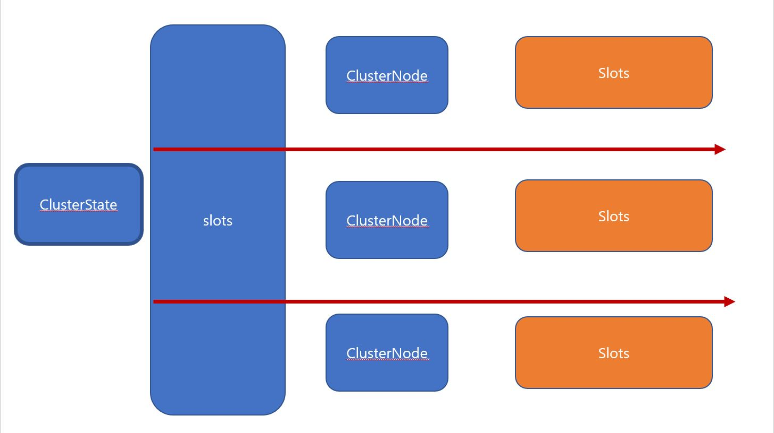
Cluster communication and Reshard
When reshard is needed, slots of clusterNodes in each server are fetched through bit operation
For a simple example, if 1, the slot is allocated in this Node. If 0, the slot is allocated to another node
This means that each node must hold an array corresponding to that slot
When node is master (have not slave), and node is down, is the existing data not preserved?
In the event of failure, will the other node store the command in the buffer and send it to new Node?

Slide 14
Cluster communication and Reshard
Master
Master
Master
Socket
PING & PONG
REDIRECT
getNodeByQuery -> obtain slot and clusterNode
ClusterWriteHandler -> Commands Node (using Socket)

Slide 15
Cluster communication and Reshard
Master
Master
Master
RDB
AOF
Socket

Slide 16
Cluster communication and Reshard
Thread
Thread
Thread
Thread
BIO_CLOSE_FILE Thread
BIO_AOF_SYNC Thread
BIO_LAZY_FREE Thread
JEMALLOC Thread
BIO jobs
Malloc

Slide 17
Cluster communication and Reshard
In the event of failure, will the other node store the command in the buffer and send it to new Node?
Master
Master
Master
FailOver Master dataset is overwritted by the other master
Socket
How to minimize data loss?
Why there is no automatic reshard?

Slide 18
Cluster communication and Reshard
Thread is dangerous because they are in one process
Thread
Thread
Thread
- In this case, we need to store AOF and RDB only once
- In this case, There is much less I/O traffic
CRC14 in 14bit
Area
Area
Area

Slide 19
Cluster communication and Reshard
Process
Process
Process
Much Faster than using Socket
CRC14 in 14bit
Shared Memory
Area
Area
Area

